Slide 1
Using Spotify Charts to Predict Song Popularity
Adrija Barvadheesh, Kayvon Coffey, Erica Lee, Jack Santaniello

Slide 2
Business Understanding
Notes:
Erika

Slide 3
Why do we care?
Spotify is the largest audio streaming platform in the world.
Question: Can we use audio features to predict how a song will chart?
Producers can leverage this information to analyze hit songs and determine whether artists will be profitable or not. This may aid in deciding which songs to advertise for.

Slide 4
The Data
Notes:
Erika

Slide 5
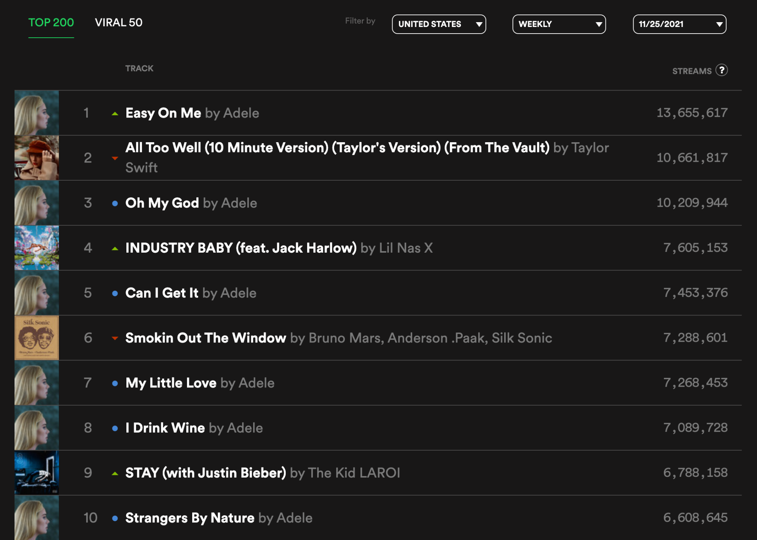

Slide 6
How will we do it?
Analyze a total of 57 weeks of Top 200 Songs for the USA region
Collect the audio features and popularity metric pulled from Spotify API
1,576 unique songs
600 unique songs in the Top 50 for at least one week

Slide 7
The Models
Notes:
Kayvon & Jack

Slide 8
What methods did we use?
Regression
Classification
Logistic Regression
Discriminant Analysis
Linear
Quadratic
KNN
Support Vector Machines
Linear
Degree 15 Polynomial
Radial
Trees
Classification
With pruning
With bagging
Random Forest
Linear
Regularization
Lasso
Ridge
Elastic Net
KNN

Slide 9
Results & Evaluation

Slide 10
Regression Results
 | RMSE
 | Popularity | Weeks in Top 50 | Weeks in Top 200
Linear | 18.90 | 4.89 | 10.40
Logistic | 18.90 | 4.90 | 10.40
Regularized | 16.69 | 4.76 | 11.86
KNN | 18.95 | 5.13 | 10.52
Random Guessing | 18.63 | 4.8 | 10.28

Slide 11
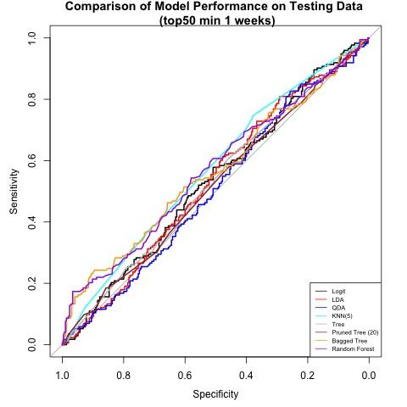
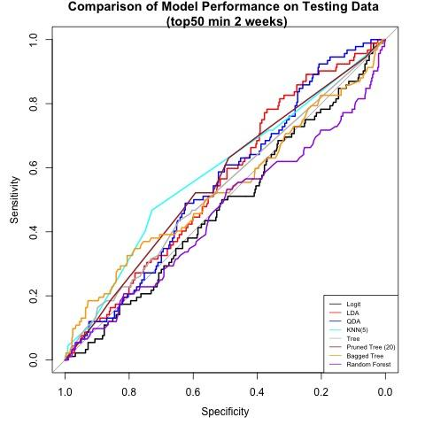
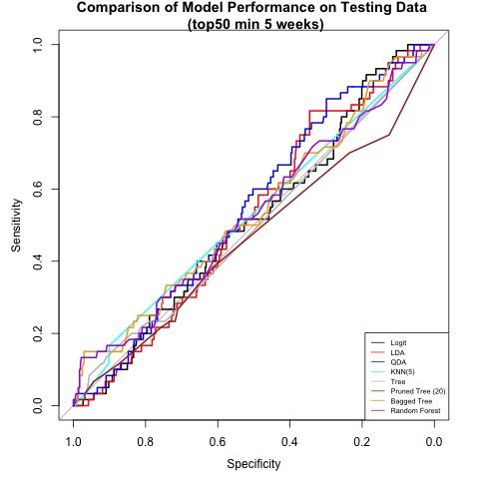
Classification Results - ROC
Overall, low predictive power available in this dataset.
Best performance on minimum 2 weeks in top 50
Not enough data for minimum 5 weeks in top 50
Trees and KNN perform best, followed by Logit and Discriminant Analysis

Slide 12
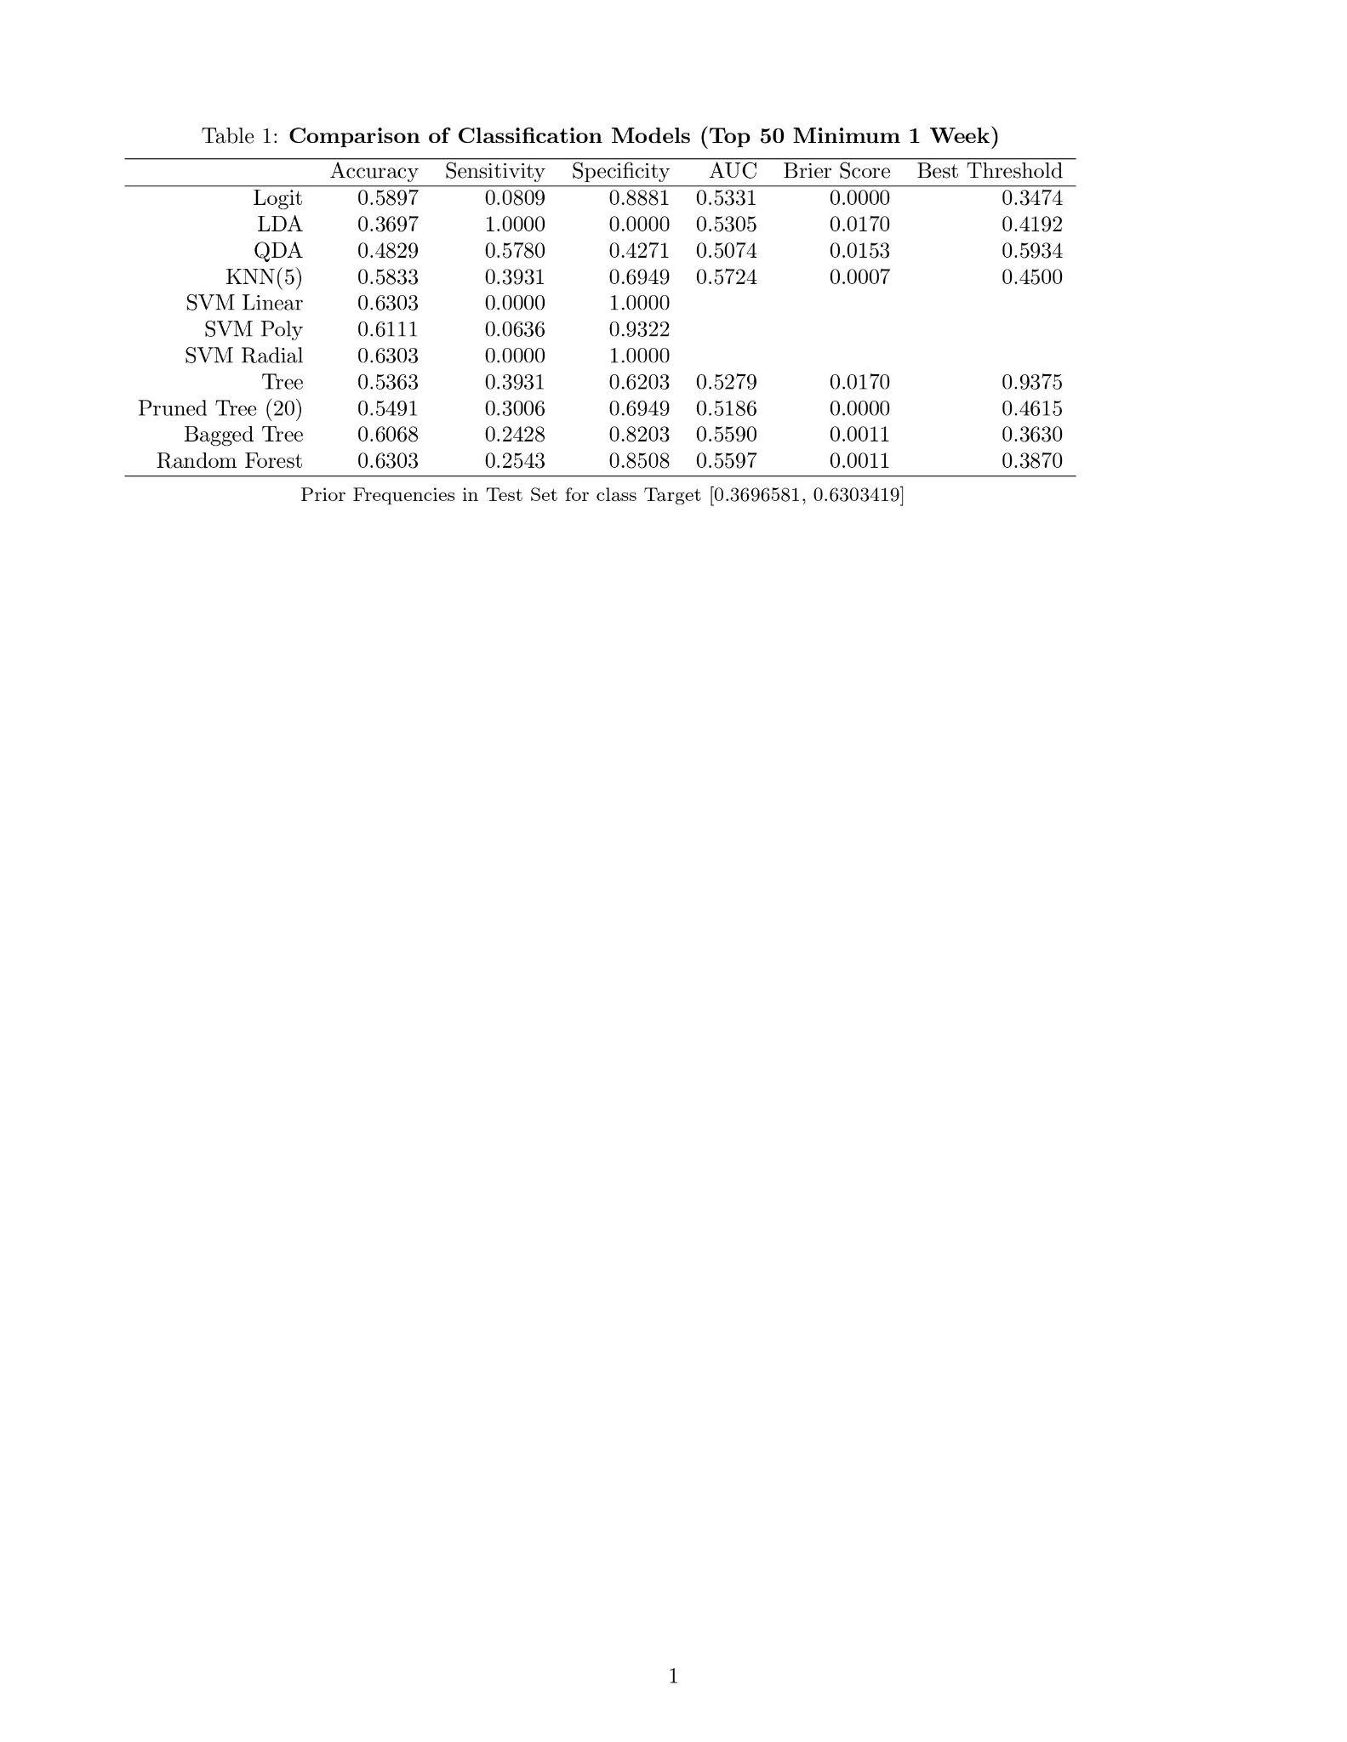

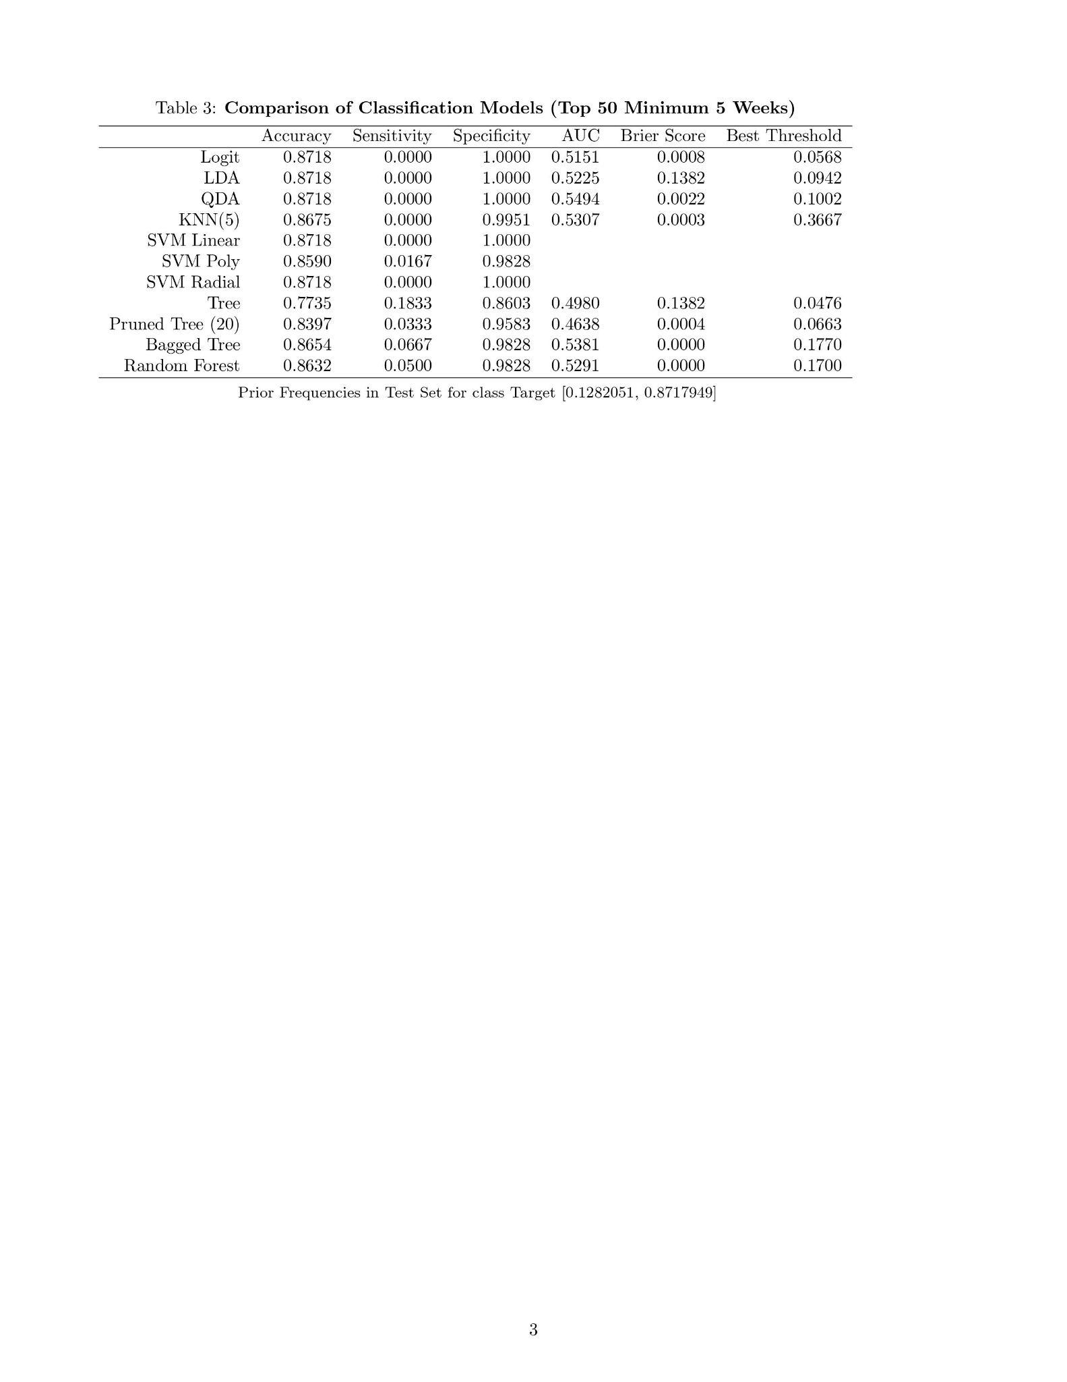
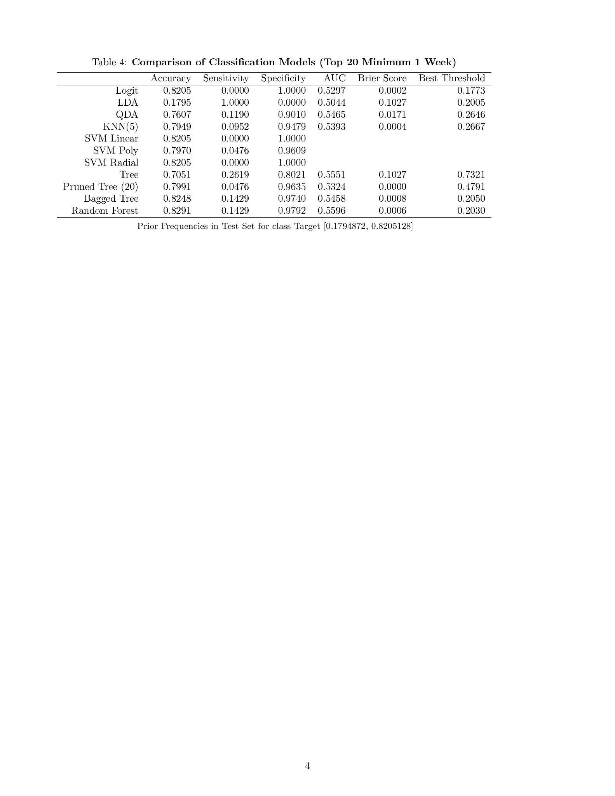
Classification Results - Fits
KNN(5) performed best in the main classification task
Tree next best, then pruned, bagged, and RF
Best performance on top 50 min 1, much worse on other outcomes
RF and Bagged trees better overall but regular Tree best at optimal threshold

Slide 13
Deployment
Notes:
Adrija

Slide 14
What’s next?
We suggest straying away from the model and trusting a “gut feelings” for choosing songs and valuing artists
Important ethical considerations and biases:
Genre bias
Artist bias
Music industry is always changing
Potential Risks:
Chance of missing out on a hit artist or song: instead, trust the producer’s industry knowledge

