Slide 1

INDUSTRIAL INSTRUMENTATION (EEE-4033) PROJECT TITLE : SMART CONTACTLESS DIGITAL TACHOMETER PRESENTED BY : ADRIJA CHAKRABORTY-18BEI0012

Slide 2
OBJECTIVES
To measure the speed of rotation of a motor in terms of revolutions per minute (RPM).
To remotely monitor various working conditions of the motor like its temperature, the surrounding humidity etc, besides the speed, in smart phone using Internet Of Things.
To automatically stop the motor in case its speed limit exceeds a pre-defined limit or if the motor gets too much heated and the humidity becomes high.

Slide 3
METHODOLOGY
A DC motor and an L298N motor driver are connected to an Arduino board. A 9V battery is used for power supply.
The speed of the motor is manually varied with the help of a potentiometer connected to Arduino. The Arduino board reads this analog input from potentiometer and sends the corresponding signal to the motor driver to change speed of the motor.
As the speed of the motor is varied, a Hall-effect sensor (A3144) is used to detect the presence of a magnet which is stuck to the rotating wheel attached to shaft of the motor. It gives a digital High output to Node MCU when a change in magnetic flux is detected. The Node MCU board computes the rpm of the motor based on the number of pulses detected by the Hall-effect sensor in one second.
The temperature and humidity are detected by DHT11 sensor. The Node MCU sends these values together with the rpm of the motor to Blynk’s database.

Slide 4
METHODOLOGY
An upper limit is set for the rpm, temperature and humidity of the motor. If these limits are exceeded, the Node MCU sends a message to Arduino, so that rotation of the motor is stopped.
If the motor stops working due to low voltage or current, besides exceeding those upper limits, Node MCU allows Blynk app to send a warning notification to the smart phone and a red led connected to Arduino glows.

Slide 5
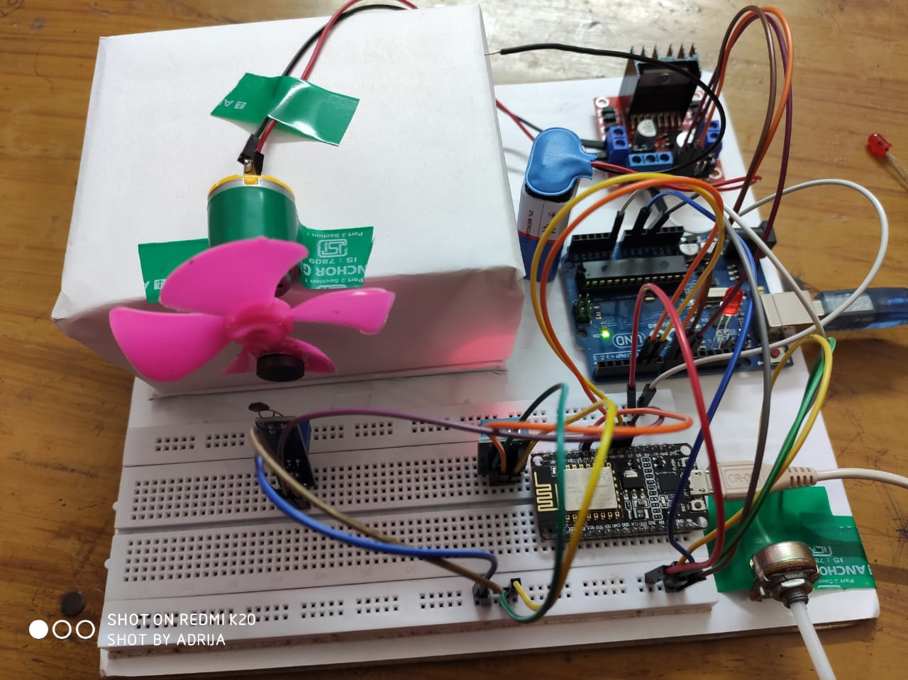
Experimental Setup Photograph

Slide 6
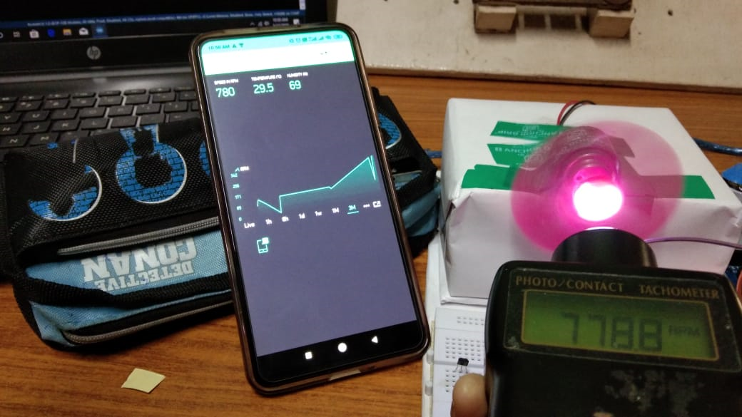
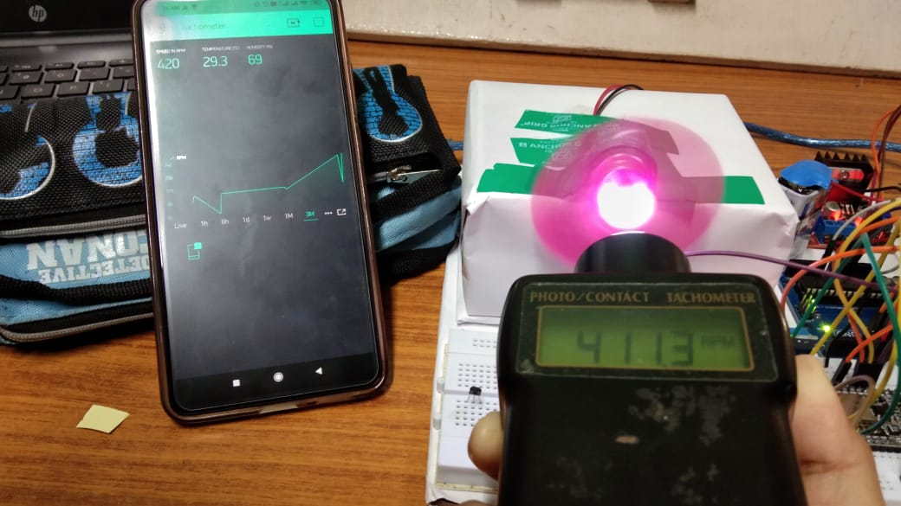
RESULTS

Slide 7
RESULTS
The speed in rpm shown by the module was verified with that shown by an optical tachometer and almost similar results were obtained.
The speed along with temperature and humidity was monitored wirelessly using smart phone.
The upper limit of speed, temperature and humidity was set in the Arduino code and when these limits got exceeded the motor stopped on its own and a notification was received in smart phone through Blynk app.
When the speed was lower than a set value a similar warning notification was received that the motor is about to stop working.

