Slide 1

RNAseq counts
Center for Health Data Science

Slide 2
Agenda
Count matrix and normalization
RPKM/FPKM-TPM-DESeq2
Exploratory Analysis
PCA, Pearson correlation,
distance heatmaps
Workflow
Differential Expression Analysis
Comparison between conditions
Functional Analysis
GO term and pathway annotations

Slide 3
Workflow
Experimental design
Isolate RNA
Prepare library
Count matrix and normalization
Untreated
Treated
Exploratory Analysis
Sequence
Filter and clean reads
FastQ files
Workflow
Differential Expression Analysis
Paired end reads
Single reads
Gene-gene correlation Networks
GO term
Paired end reads
Single reads
Align to reference
Create gene count matrix
 | Untreated 1 | Untreated 2 | Treated 1 | Treated 2
Gene A | 123 | 150 | 143 | 130
Gene B | 18 | 10 | 233 | 209
100 b
150 b
200 b
250 b
Bam files

Slide 4
Count matrix. Raw count matrix
Gene Name | Rep1 Counts | Rep2 Counts | Rep3 Counts
A (2 Kb) | 10 | 12 | 30
B (4 Kb) | 20 | 25 | 60
C (1 Kb) | 5 | 8 | 15
D (10 Kb) | 0 | 0 | 1
Total counts | 35 | 45 | 106
Is the expression of gene A higher in Rep3 than Rep1?
Is the expression of gene A higher than gene B in Rep1?
Do you think it is ok to compare genes and reps using this table?

Slide 5
Count matrix. Raw count matrix
Gene Name | Rep1 Counts | Rep2 Counts | Rep3 Counts
A (2 Kb) | 10 | 12 | 30
B (4 Kb) | 20 | 25 | 60
C (1 Kb) | 5 | 8 | 15
D (10 Kb) | 0 | 0 | 1
Total counts | 35 | 45 | 106
The raw count matrix cannot be used for anything!
There are several biases that affect the count matrix
Before our analysis, we need to correct for…

Slide 6
Count matrix. Biases
Gene Name | Rep1 Counts | Rep2 Counts | Rep3 Counts
A (2 Kb) | 10 | 12 | 30
B (4 Kb) | 20 | 25 | 60
C (1 Kb) | 5 | 8 | 15
D (10 Kb) | 0 | 0 | 1
Total counts | 35 | 45 | 106
Gene length bias (Kb)
Longer genes will have more reads mapping to them
Library size bias (total counts)
Deeper runs will have more reads mapping to each gene

Slide 7
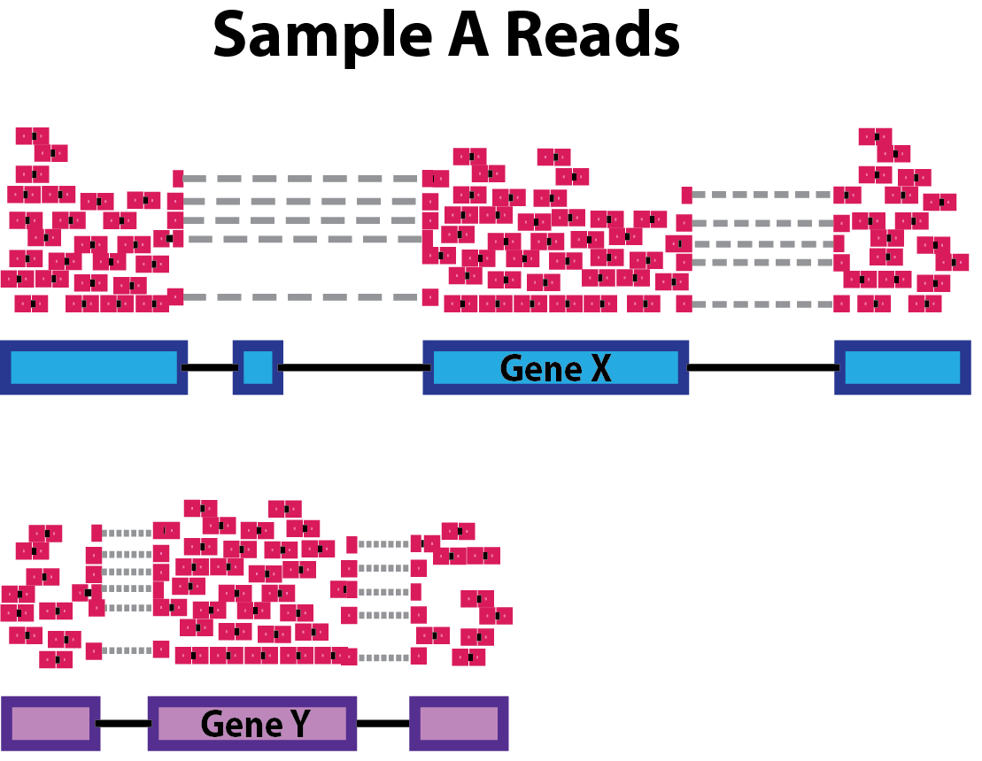
Count matrix. Biases
Gene length bias (Kb)
Longer genes will likely have more reads mapped to them
Notes:
In the example, Gene X and Gene Y have similar levels of expression, but the number of reads mapped to Gene X would be many more than the number mapped to Gene Y because Gene X is longer.

Slide 8
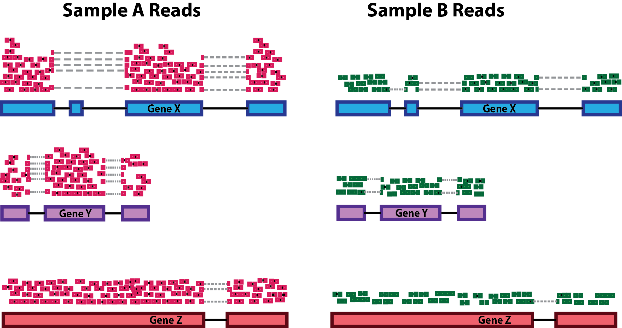
Count matrix. Biases
Library size bias
Deeper runs will have more reads mapping to each gene
Notes:
In the example below, each gene appears to have doubled in expression in Sample A relative to Sample B, however this is a consequence of Sample A having double the sequencing depth.

Slide 9
Count matrix. Biases
GC-content
GC-rich and GC-poor fragments are under-represented
These fragments are difficult to amplify = difficult to align
RNA composition
Few highly expressed genes can skew normalization
Especially important to consider for differential expression

Slide 10
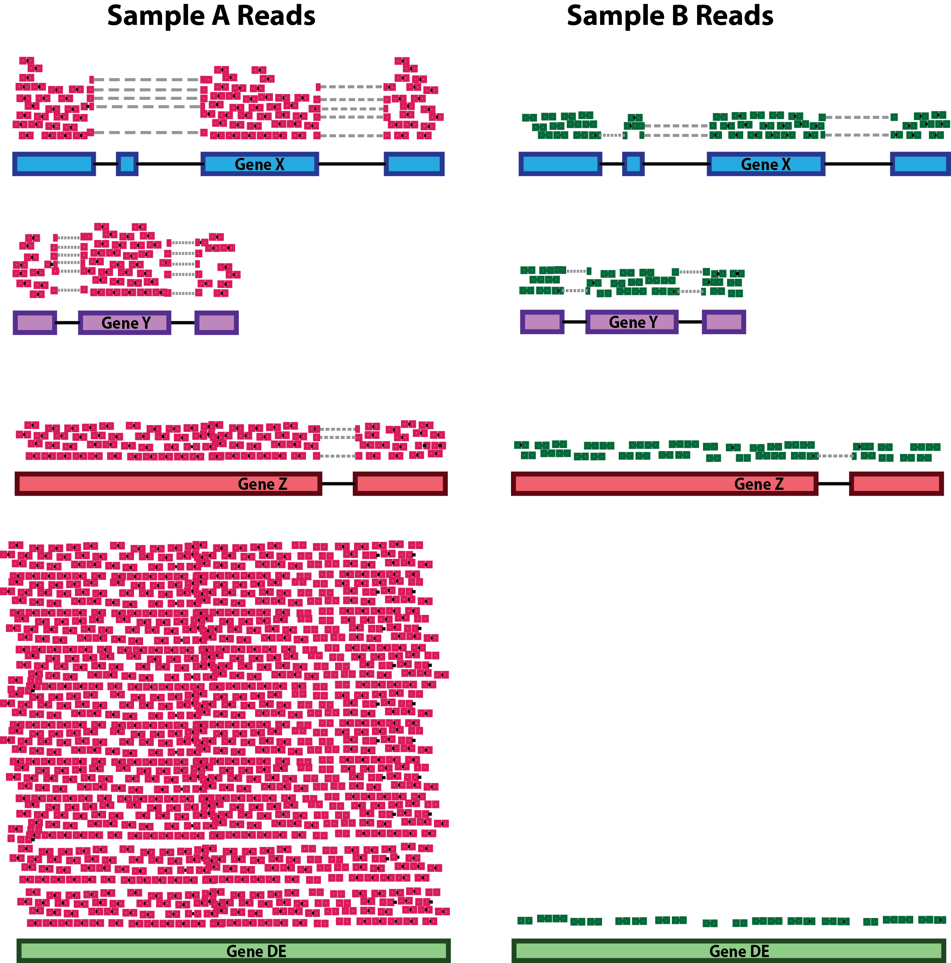
Count matrix. Biases
RNA composition
Few highly expressed genes can skew normalization
Especially important to consider for differential expression
Notes:
In the example, if we were to divide each sample by the total number of counts to normalize, the counts would be greatly skewed by the DE gene, which takes up most of the counts for Sample A, but not Sample B. Most other genes for Sample A would be divided by the larger number of total counts and appear to be less expressed than those same genes in Sample B.

Slide 11
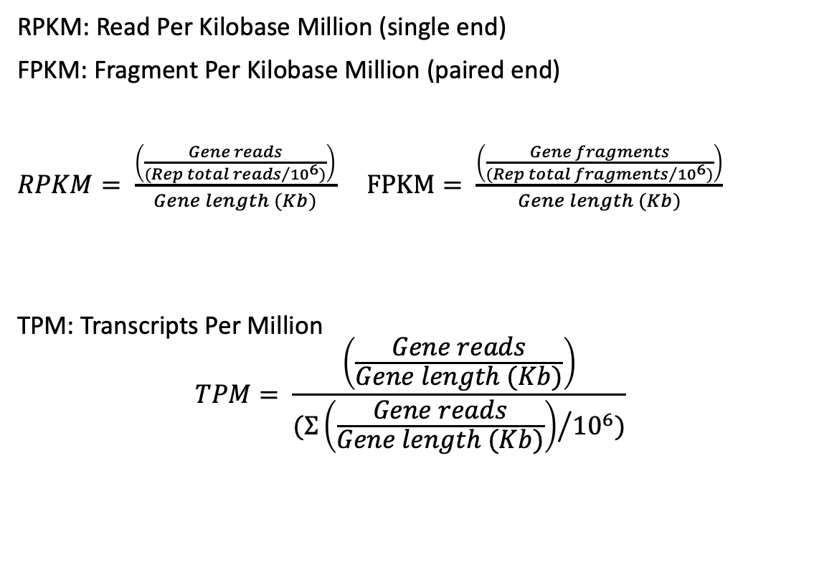
Data correction. Formulas
Gene Name | Rep1 counts | Rep2 counts | Rep3 counts
A (2 Kb) | 10 | 12 | 30
B (4 Kb) | 20 | 25 | 60
C (1 Kb) | 5 | 8 | 15
D (10 Kb) | 0 | 0 | 1
Total counts | 35 | 45 | 106
Original
RPKM: Read Per Kilobase Million (single end)
FPKM: Fragment Per Kilobase Million (paired end)
$RPKM= \frac{\left(\frac{Gene reads}{{(Rep total reads}/{{10}^{6})}}\right)}{Gene length (Kb)}$ $FPKM= \frac{\left(\frac{Gene fragments}{{(Rep total fragments}/{{10}^{6})}}\right)}{Gene length (Kb)}$
TPM: Transcripts Per Million
$$TPM= \frac{\left(\frac{Gene reads}{Gene length (Kb)}\right)}{{(Σ\left(\frac{Gene reads}{Gene length (Kb)}\right)}/{{10}^{6})}}$$
Gene Name | Rep1 RPKM | Rep2 RPKM | Rep3 RPKM
A (2 Kb) | 1.43 | 1.33 | 1.42
B (4 Kb) | 1.43 | 1.39 | 1.42
C (1 Kb) | 1.43 | 1.78 | 1.42
D (10 Kb) | 0 | 0 | 0.009
Total | 4.29 | 4.5 | 4.269
RPKM
*Divided by 10, not 10⁶
Gene Name | Rep1 TPM | Rep2 TPM | Rep3 TPM
A (2 Kb) | 3.33 | 2.96 | 3.326
B (4 Kb) | 3.33 | 3.09 | 3.326
C (1 Kb) | 3.33 | 3.95 | 3.326
D (10 Kb) | 0 | 0 | 0.02
Total | ~10 | ~10 | ~10
TPM

Slide 12
Data correction. RPKM/FPKM
RPKM/FPKM
Sizes of pie charts are not the same!

Slide 13
Data correction. TPM
TPM
Sizes of pie charts are the same and it is easier to compare now
It is not recommend to use TPM/RPKM to compare gene expression between samples!!

Slide 14
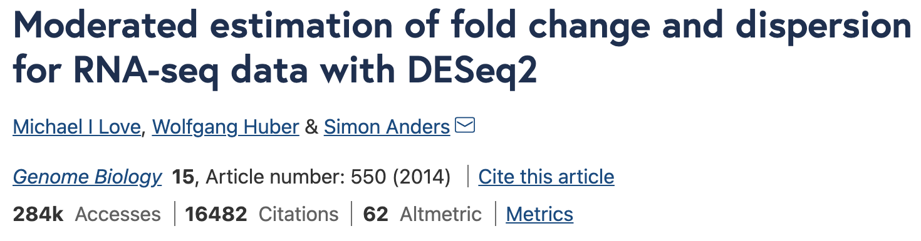
Data correction. DESeq2 package
One of the most (if not most) used packages for RNAseq analysis
Normalize your data
Very different than RPKM
Uses median of ratios and size factor calculation
One of most popular normalization methods for DEA
Compare your samples
Find Differentially Expressed Genes between conditions
Notes:
DESeq: https://doi.org/10.1186/gb-2010-11-10-r106
DESEQ2 original paper: https://genomebiology.biomedcentral.com/articles/10.1186/s13059-014-0550-8
Usage tutorial: https://www.bioconductor.org/packages/devel/bioc/vignettes/DESeq2/inst/doc/DESeq2.html

Slide 15
DESeq2 normalized counts
Median of ratios
Accounts for sequencing depth and RNA composition
We do not compare different genes, we compare samples
4 step process:
Create pseudo-reference sample
Calculate ratio of each sample to the reference
Calculate normalization factor for each sample
Calculate normalized count values using normalization factor
Notes:
DESEQ2 original paper: https://genomebiology.biomedcentral.com/articles/10.1186/s13059-014-0550-8
Usage tutorial: https://www.bioconductor.org/packages/devel/bioc/vignettes/DESeq2/inst/doc/DESeq2.html

Slide 16
DESeq2 normalized counts
1. Create pseudo-reference sample
Geometric mean across all samples
gene | sampleA | sampleB | Pseudo-reference sample
EF2A | 1489 | 906 | sqrt(1489 * 906) = 1161.5
ACBD1 | 22 | 13 | sqrt(22 * 13) = 17.7
… | … | … | …
Notes:
DESEQ2 original paper: https://genomebiology.biomedcentral.com/articles/10.1186/s13059-014-0550-8
Usage tutorial: https://www.bioconductor.org/packages/devel/bioc/vignettes/DESeq2/inst/doc/DESeq2.html

Slide 17
DESeq2 normalized counts
2. Calculate ratio of each sample to the reference
Ratios of every gene in each sample compared to the reference
gene | sampleA | sampleB | Pseudo-reference sample | Ratio of sampleA/ref | Ratio of sampleB/ref
EF2A | 1489 | 906 | sqrt(1489 * 906) = 1161.5 | 1489/1161.5 = 1.28 | 906/1161.5 = 0.78
ACBD1 | 22 | 13 | sqrt(22 * 13) = 16.9 | 22/16.9 = 1.30 | 13/16.9 = 0.77
… | … | … | … | … | …
Notes:
DESEQ2 original paper: https://genomebiology.biomedcentral.com/articles/10.1186/s13059-014-0550-8
Usage tutorial: https://www.bioconductor.org/packages/devel/bioc/vignettes/DESeq2/inst/doc/DESeq2.html

Slide 18
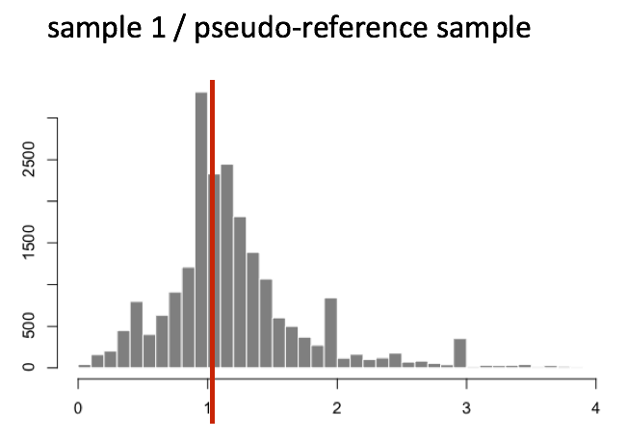
DESeq2 normalized counts
3. Calculate normalization factor for each sample
Median value of the ratios for each sample is used as normalization factor
Assumes that not ALL genes are differentially expressed
Robust to imbalance in up/down regulation
Robust to large number of DE genes
If size factor >> or << 1 = extreme outlier!
median
Distribution of ratios for a sample
Notes:
DESEQ2 original paper: https://genomebiology.biomedcentral.com/articles/10.1186/s13059-014-0550-8
Usage tutorial: https://www.bioconductor.org/packages/devel/bioc/vignettes/DESeq2/inst/doc/DESeq2.html

Slide 19
DESeq2 normalized counts
Calculate normalized count values
Divide raw count value in a sample by sample’s normalization factor
Sample A median ratio = 1.3
Sample B median ratio = 0.77
gene | sampleA | sampleB
EF2A | 1489 / 1.3 = 1145.39 | 906 / 0.77 = 1176.62
ACBD1 | 22 / 1.3 = 16.92 | 13 / 0.77 = 16.88
… | … | …
Notes:
DESEQ2 original paper: https://genomebiology.biomedcentral.com/articles/10.1186/s13059-014-0550-8
Usage tutorial: https://www.bioconductor.org/packages/devel/bioc/vignettes/DESeq2/inst/doc/DESeq2.html

Slide 20
DESeq2 normalized counts
Let’s calculate our normalize counts for our dataset

