Slide 1

Healthcare Analytics for Doctor Visits_TIRTC
Student Name – ADRIKA CHATTOPADHYAY
College Name – UNIVERSITY INSTITUTE OF TECHNOLOGY, THE UNIVERSITY OF BURDWAN
AICTE STU ID : STU6a6ca87b25a2b1785505915

Slide 2

PROBLEM STATEMENT
Healthcare providers and policy-makers lack clear, data-driven insights into the specific drivers of patient doctor visits. Specifically, it is unclear how individual demographics (age, gender), health indicators (number of illnesses, self-reported health scores, presence of chronic or long-term chronic conditions), and socioeconomic factors (income level, insurance status) interact to influence healthcare-seeking behavior.
Without understanding these relationships, healthcare facilities cannot optimize resource allocation, design targeted preventive health programs, or effectively mitigate health disparities among vulnerable groups.
The problem is to analyze the given healthcare dataset and investigate the primary factors that significantly influence the frequency of doctor visits by identifying meaningful patterns, trends, relationships and variations within the available data.

Slide 3
Project Description
This project uses Python, Pandas, and data visualisation to analyze doctor visit patterns. It explores how illness, health status, age groups, and chronic conditions are associated with healthcare utilization. The insights help hospital management understand patient needs and identify opportunities to improve healthcare services.

Slide 4

WHO ARE THE END USERS?
Hospital management and administrators.
Doctors and healthcare professionals.
Healthcare planners and data analysts.
Public health organizations

Slide 5

Technology Used
  Python
  Pandas
  Matplotlib
  Seaborn
  Num Py

Slide 6
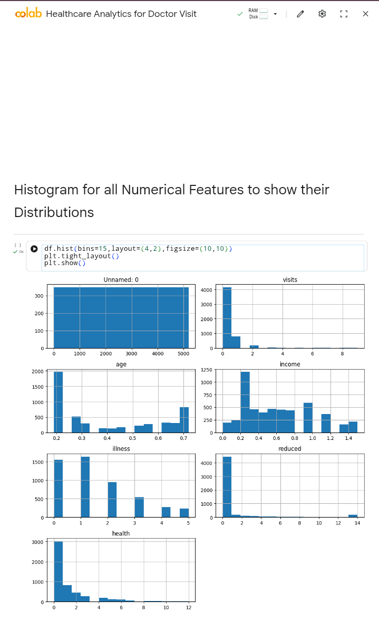
RESULTS

Slide 7

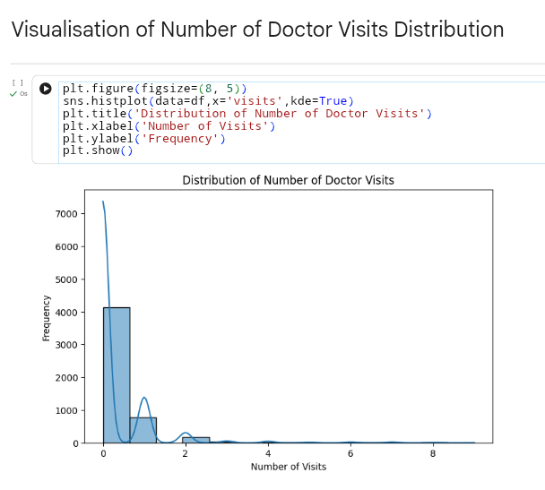
RESULTS

Slide 8
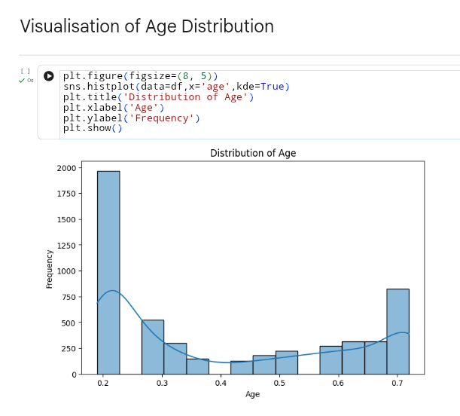
RESULTS

Slide 9
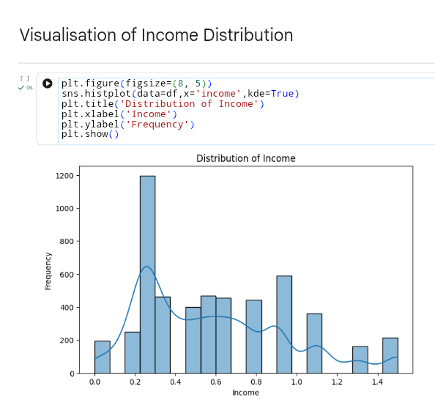
RESULTS

Slide 10
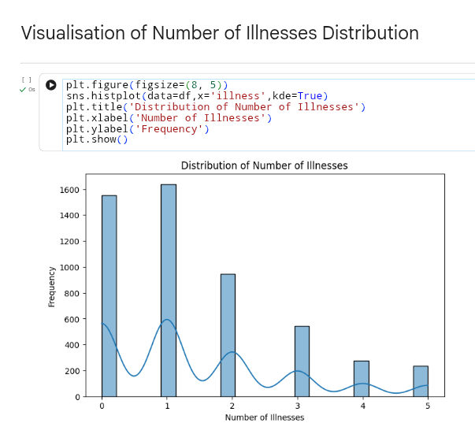
RESULTS

Slide 11
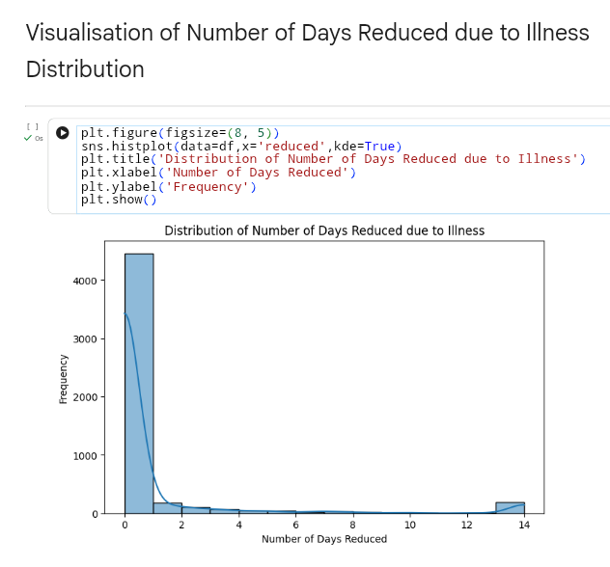
RESULTS

Slide 12
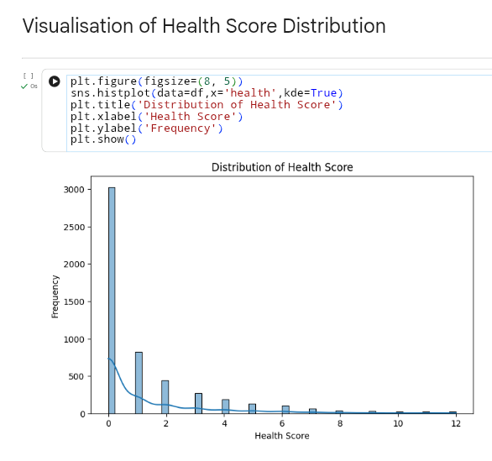
RESULTS

Slide 13
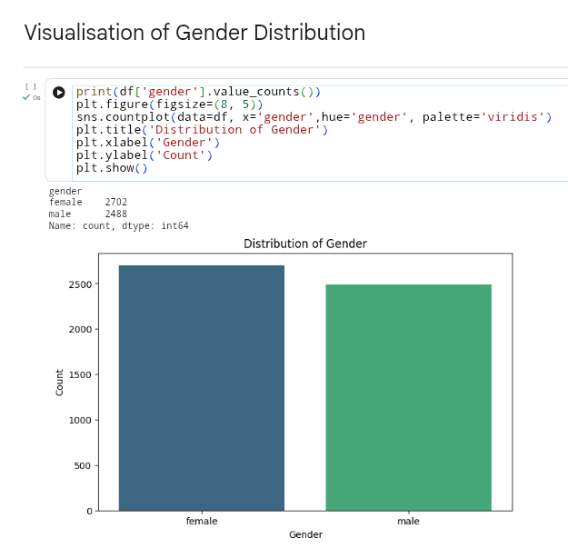
RESULTS

Slide 14
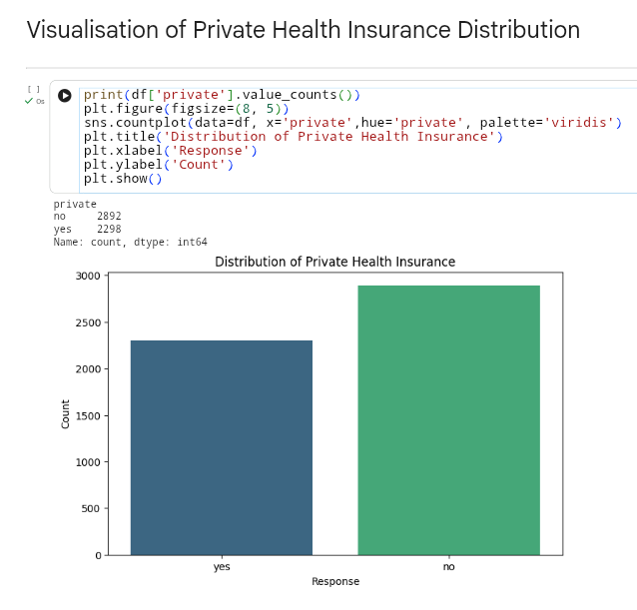
RESULTS

Slide 15
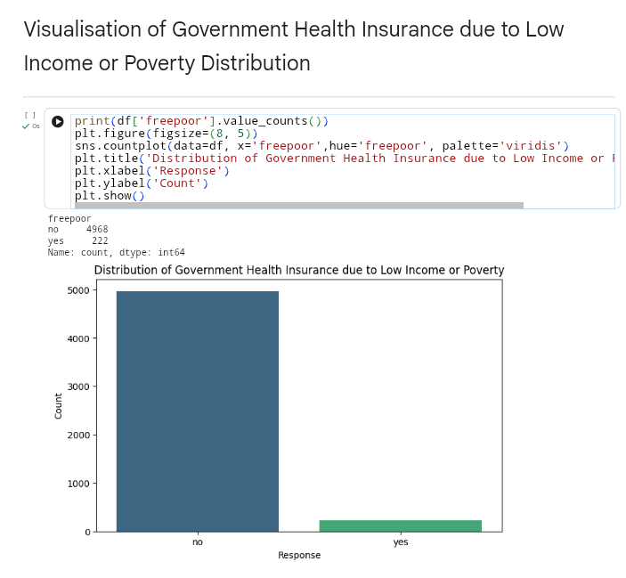
RESULTS

Slide 16
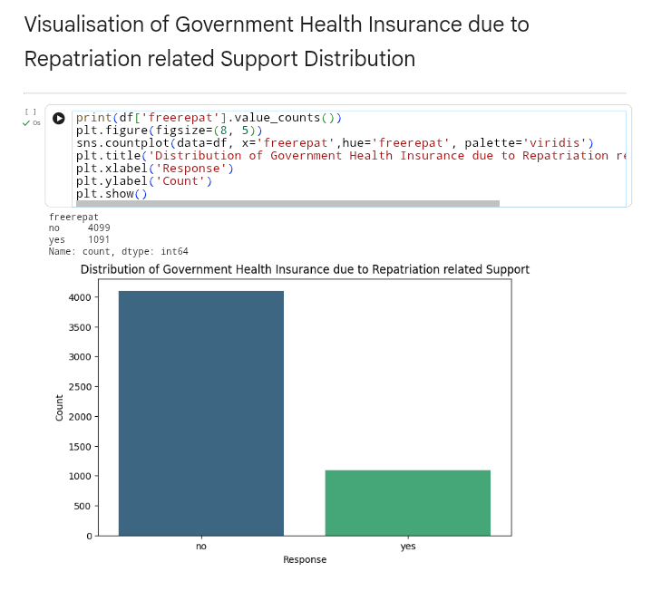
RESULTS

Slide 17
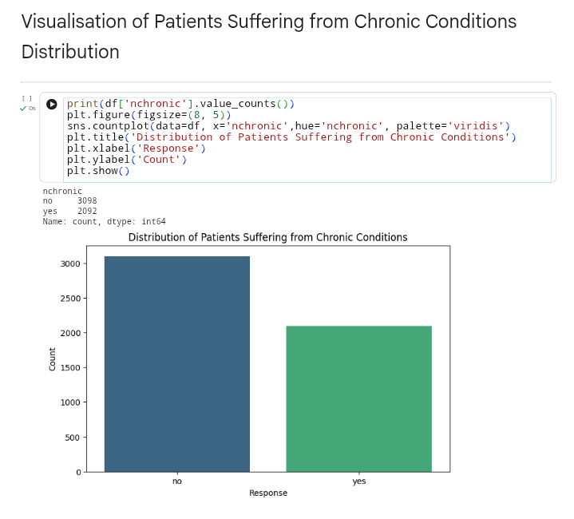
RESULTS

Slide 18
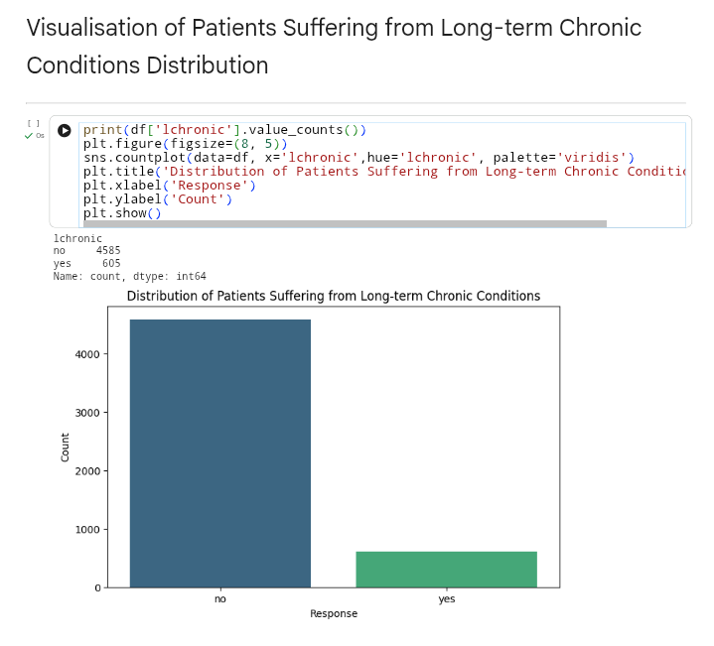
RESULTS

Slide 19

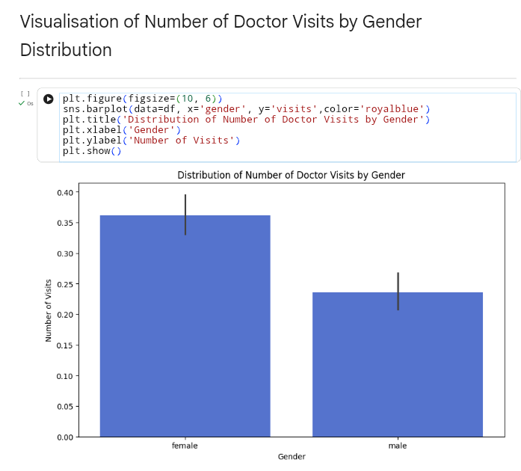
RESULTS

Slide 20
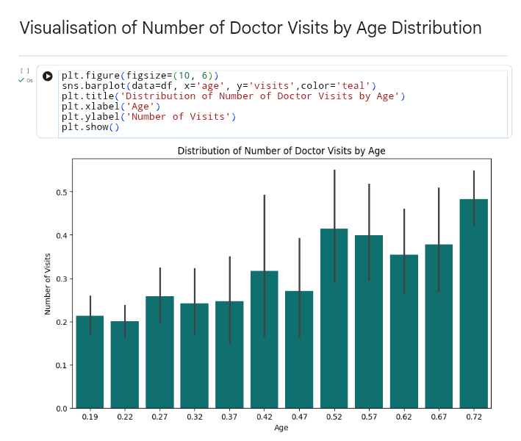
RESULTS

Slide 21
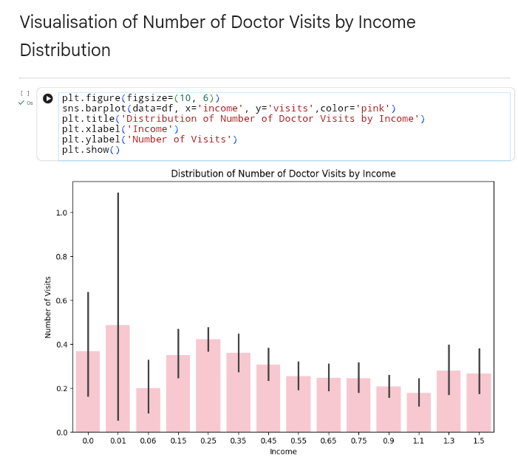
RESULTS

Slide 22
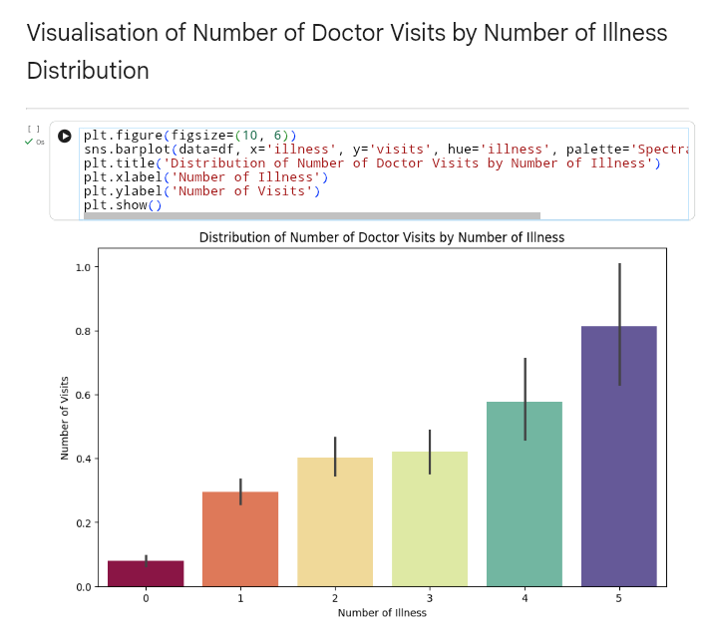
RESULTS

Slide 23
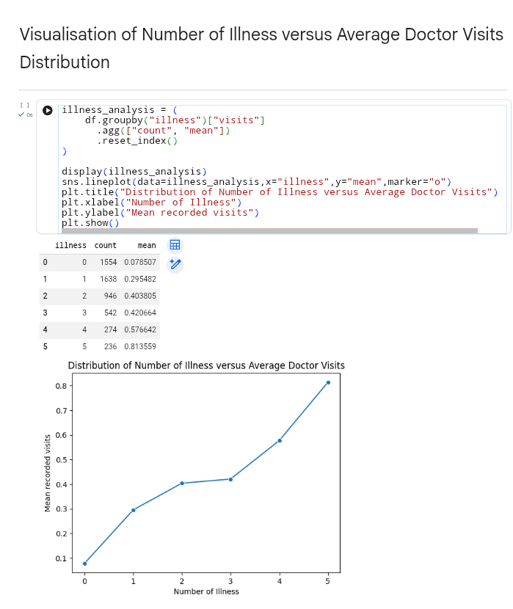
RESULTS

Slide 24
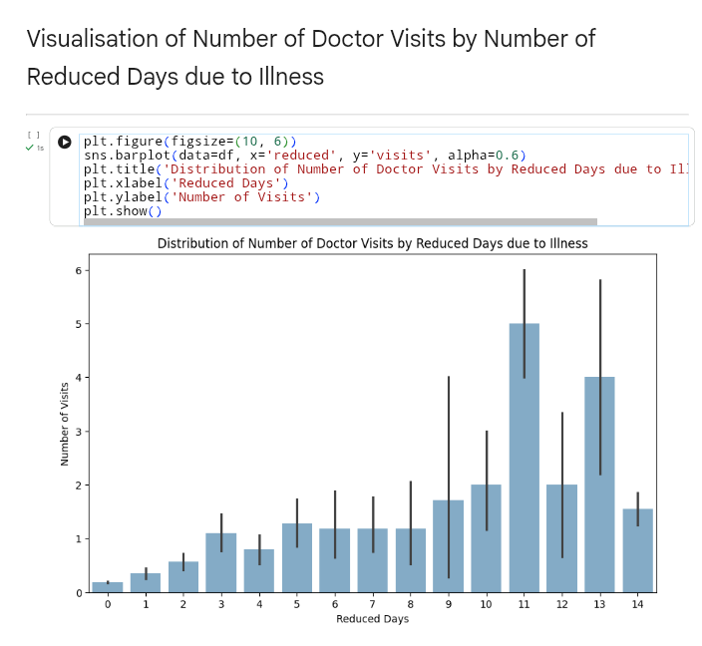
RESULTS

Slide 25
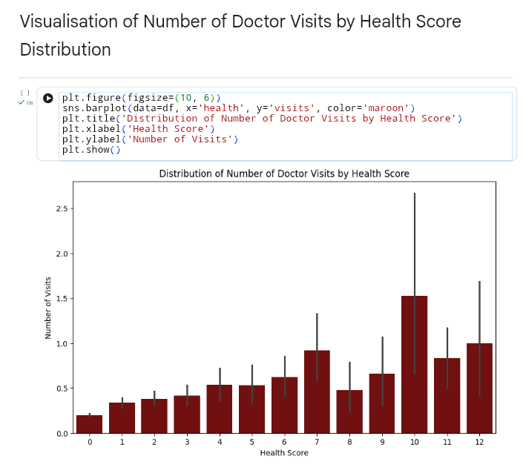
RESULTS

Slide 26
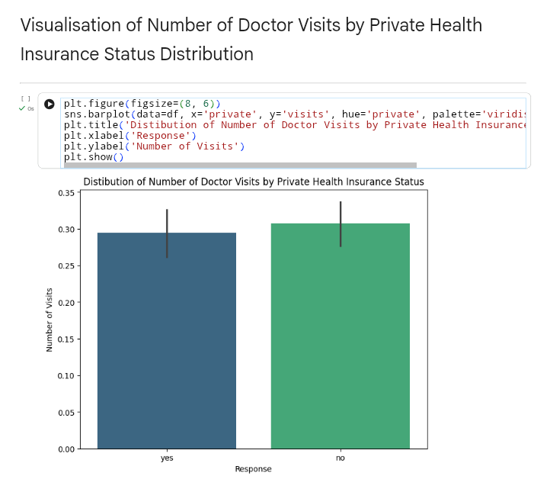
RESULTS

Slide 27
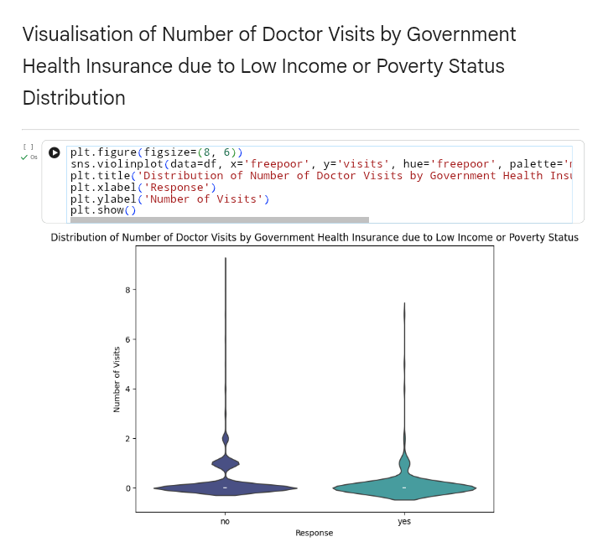
RESULTS

Slide 28
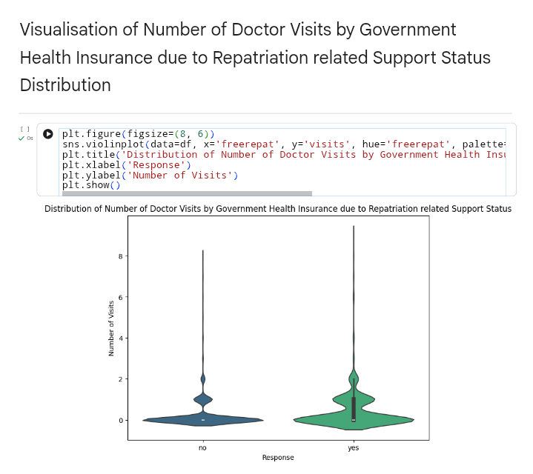
RESULTS

Slide 29
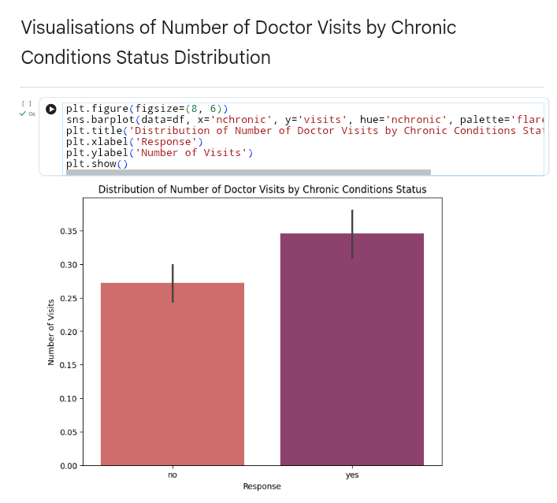
RESULTS

Slide 30
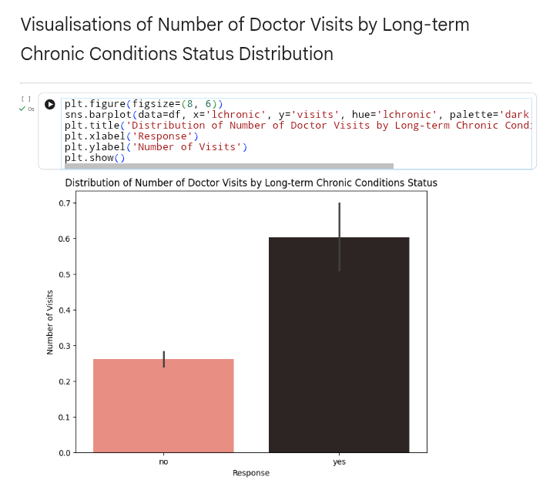
RESULTS

Slide 31
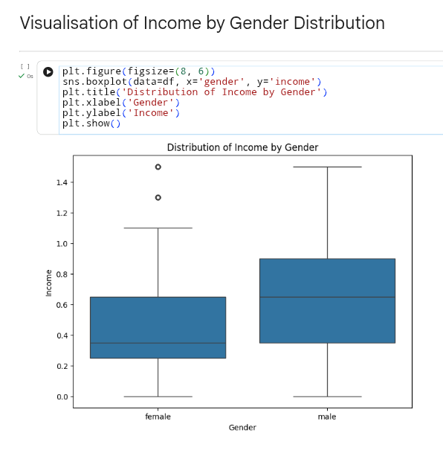
RESULTS

Slide 32
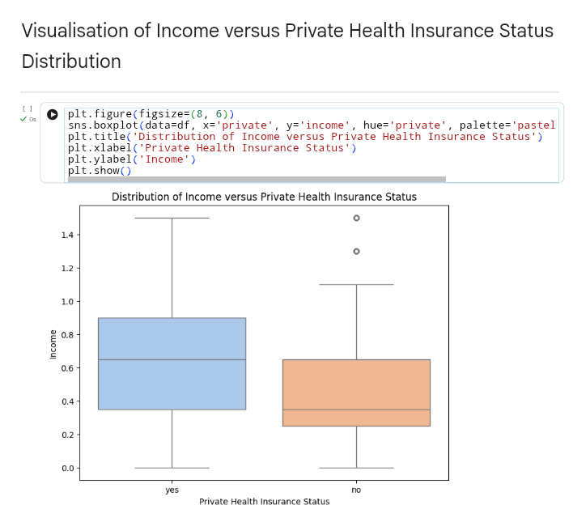
RESULTS

Slide 33
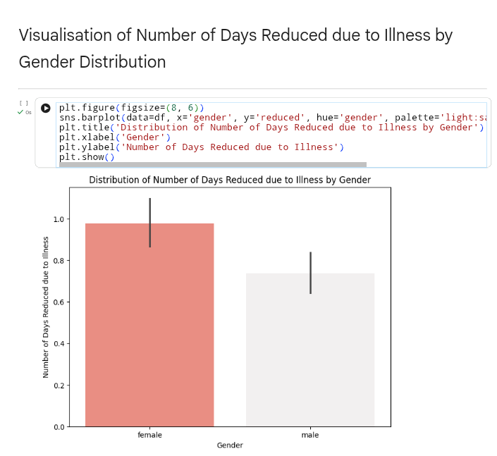
RESULTS

Slide 34
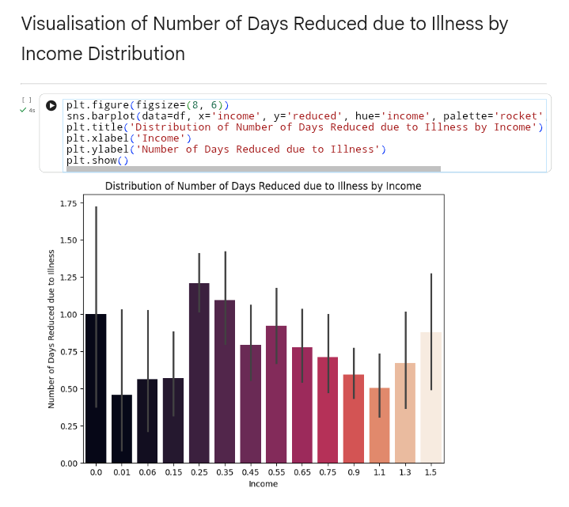
RESULTS

Slide 35

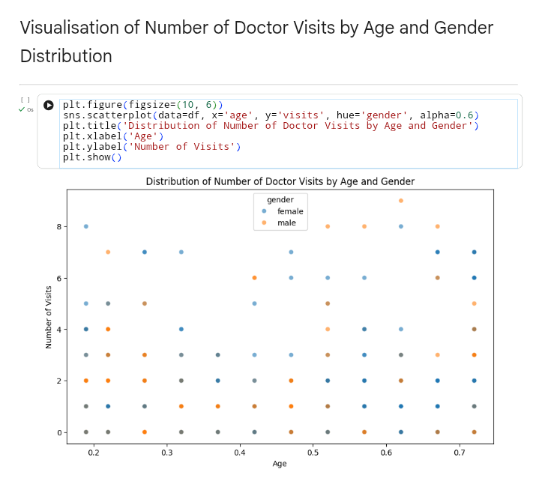
RESULTS

Slide 36
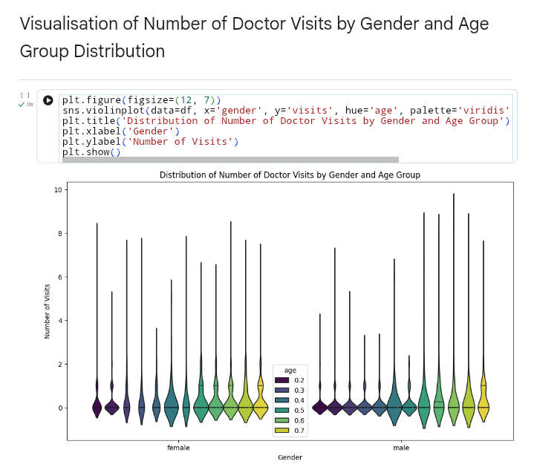
RESULTS

Slide 37
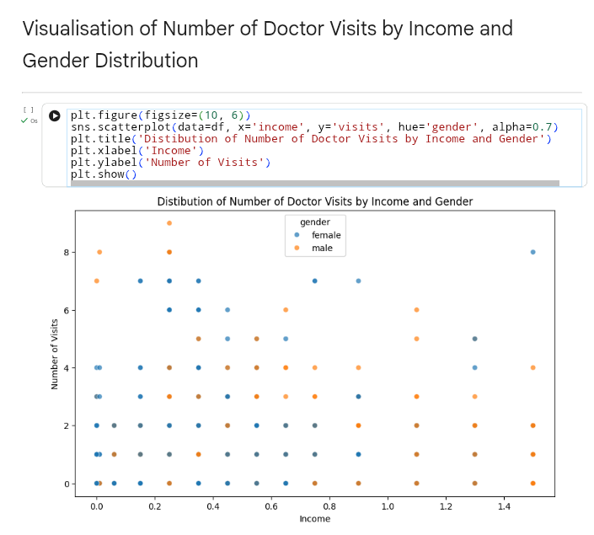
RESULTS

Slide 38
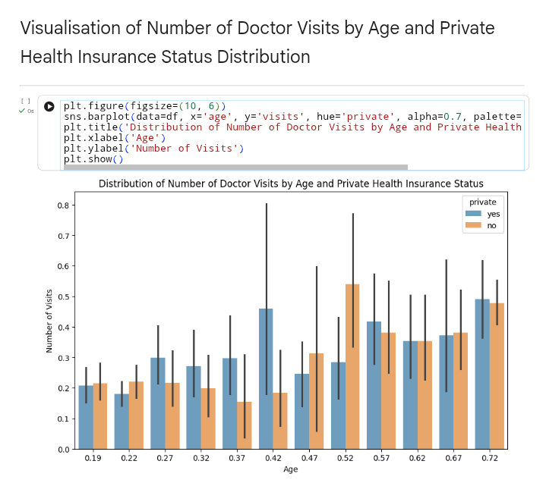
RESULTS

Slide 39
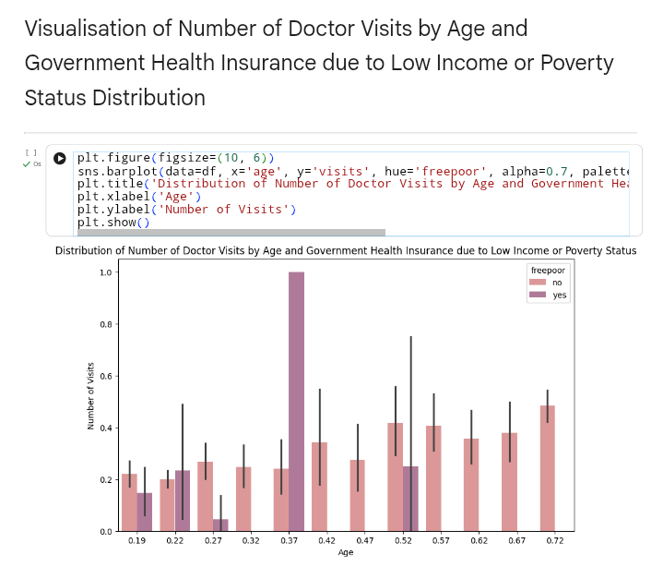
RESULTS

Slide 40
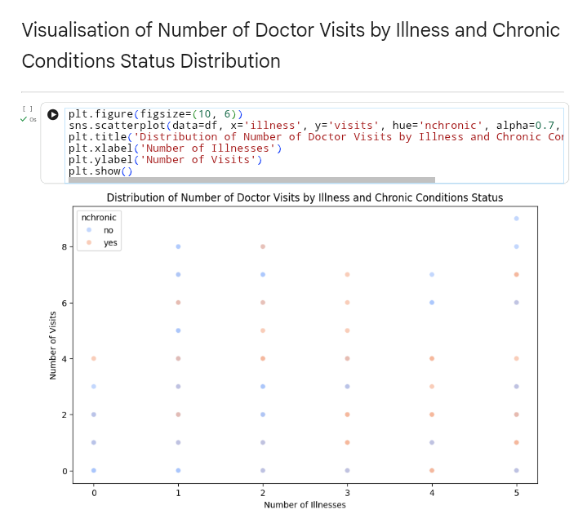
RESULTS

Slide 41
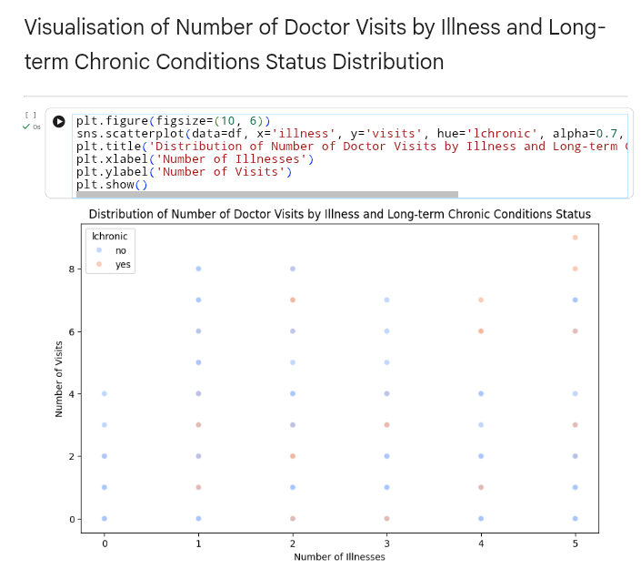
RESULTS

Slide 42
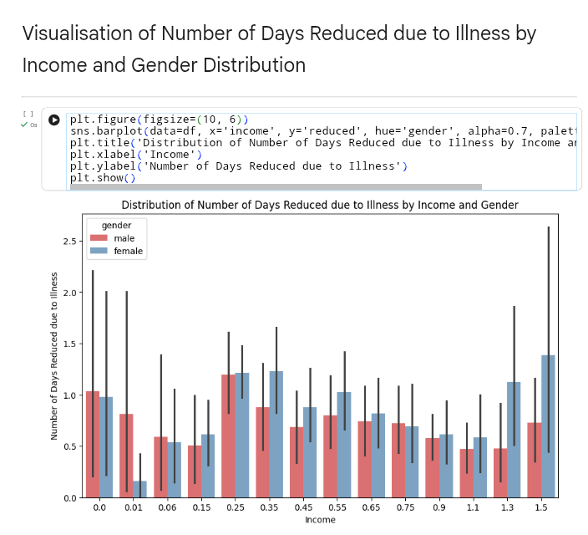
RESULTS

Slide 43
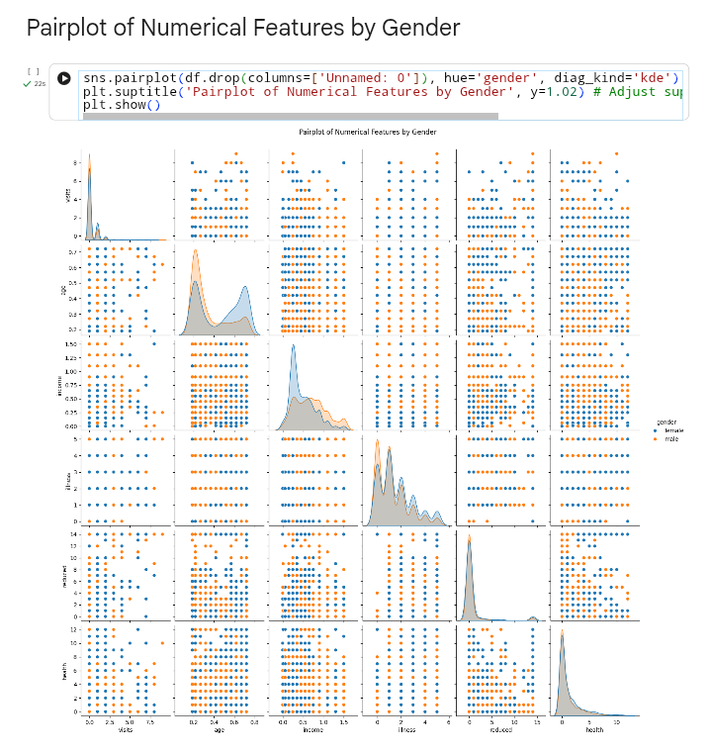
RESULTS

Slide 44
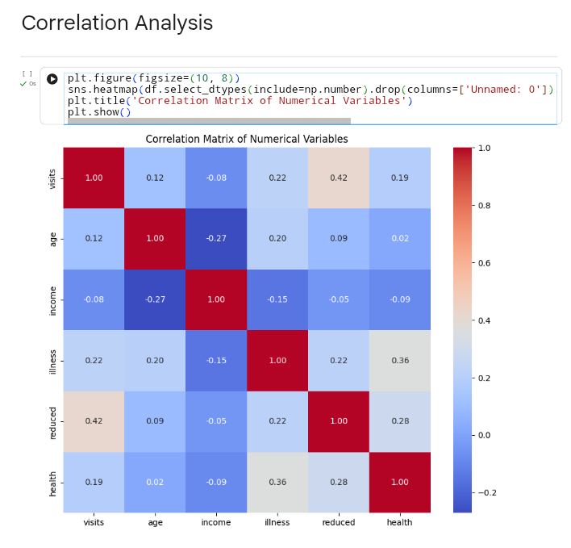
RESULTS

Slide 45


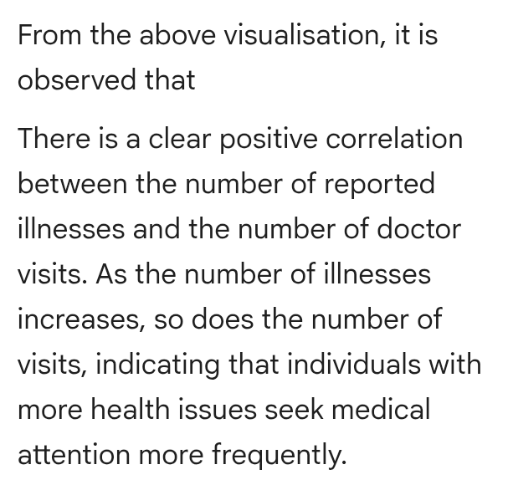
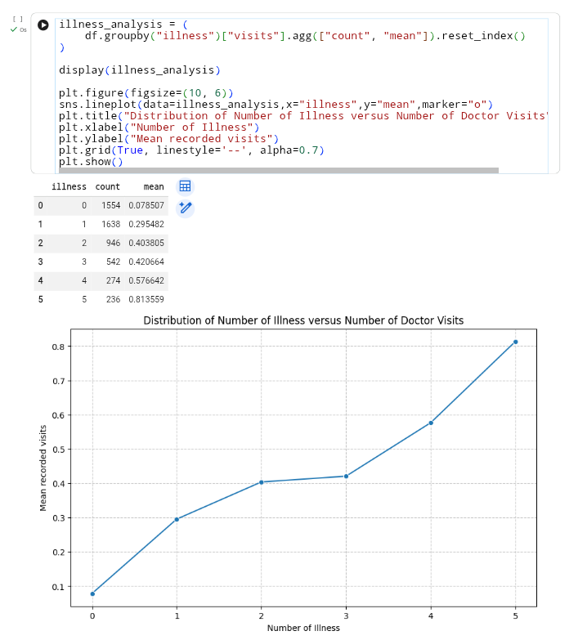
RESULTS

Slide 46

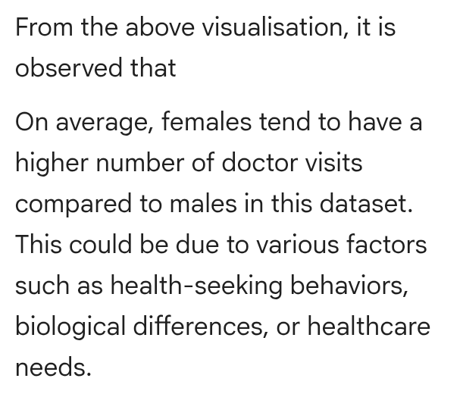
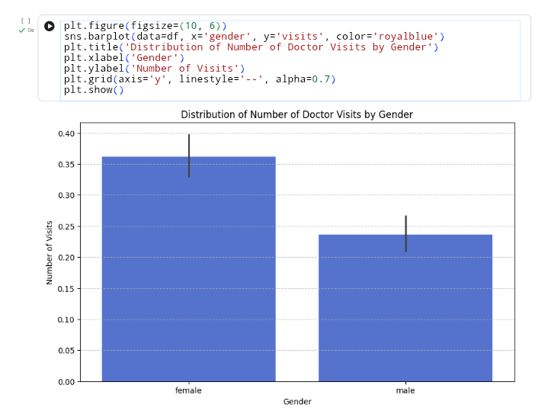
RESULTS

Slide 47

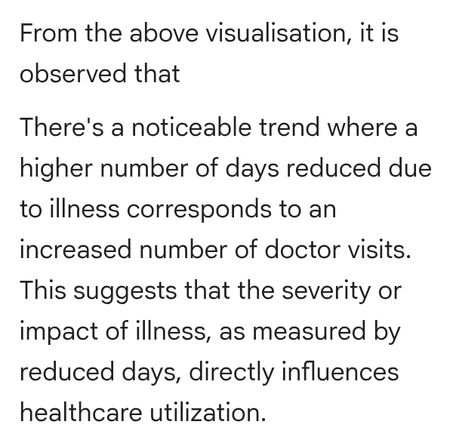
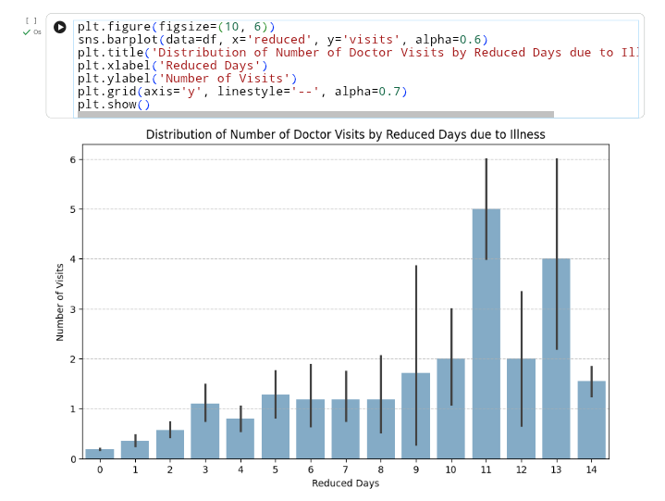
RESULTS

Slide 48

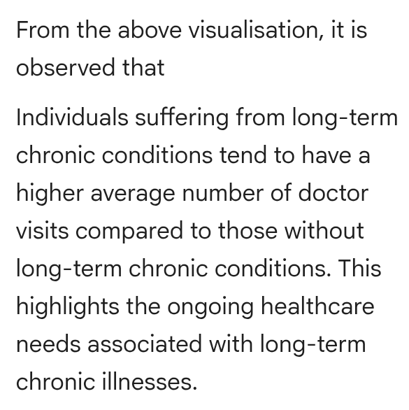
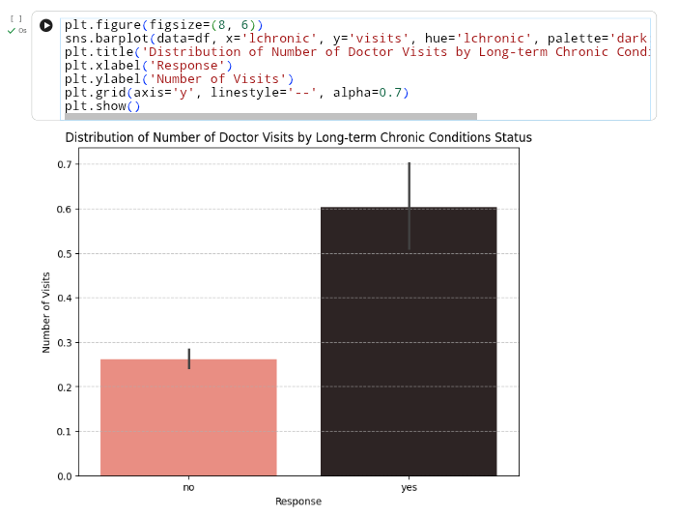
RESULTS

Slide 49
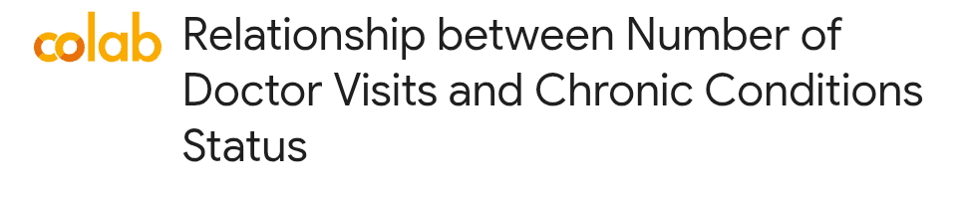
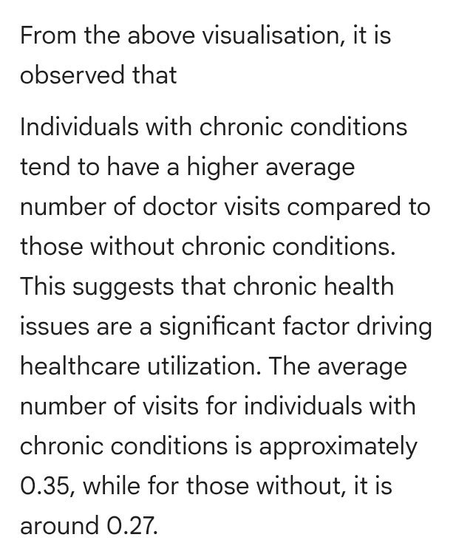
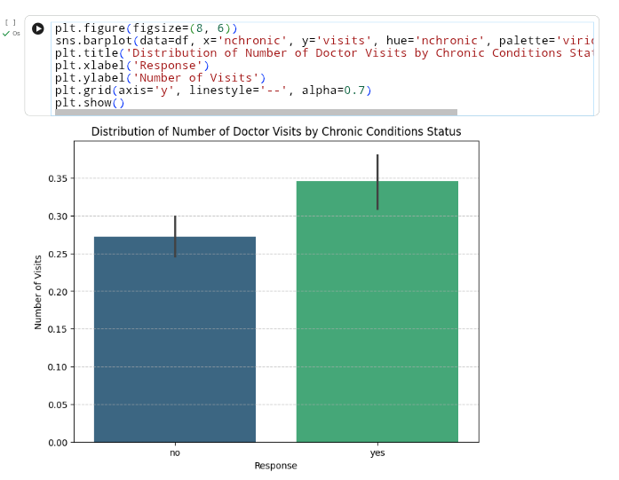
RESULTS

Slide 50



RESULTS

Slide 51



RESULTS

Slide 52



RESULTS

Slide 53



RESULTS

Slide 54



RESULTS

Slide 55



RESULTS

Slide 56



RESULTS

Slide 57



RESULTS

Slide 58



RESULTS

Slide 59



RESULTS

Slide 60


RESULTS

Slide 61


RESULTS

Slide 62


RESULTS

Slide 63


RESULTS

Slide 64


RESULTS

Slide 65


RESULTS

Slide 66


RESULTS

Slide 67

RESULTS

Slide 68

RESULTS

Slide 69

RESULTS

Slide 70
GitHub Link
https://github.com/Adrika-Chattopadhyay/Healthcare-Analytics-for-Doctor-Visits.git

Slide 71
Thank you
I sincerely thank my mentors for their guidance and support throughout this data analytics internship. I am grateful to the organisation for providing me with the opportunity to apply my skills in a practical setting, which has greatly enhanced my learning and professional growth.
.
.

