Slide 1
PROJECT TITLE – Seasonal Agriculture Performance Analysis
Student Name – ADRIKA CHATTOPADHYAY
College Name – UNIVERSITY INSTITUTE OF TECHNOLOGY, THE UNIVERSITY OF BURDWAN
AICTE STU ID : STU6a6ca87b25a2b1785505915

Slide 2

PROBLEM STATEMENT
Agricultural activities are influenced by seasonal variations in environmental conditions, farming practices, resource availability and market conditions. As a result, agricultural performance may differ from one season to another.
However, raw agricultural data does not clearly explain how agricultural performance changes across seasons or what patterns can be observed in different seasonal conditions.
The problem is to analyze the given agricultural dataset and investigate seasonal differences in agricultural performance by identifying meaningful patterns, trends, relationships and variations within the available data.

Slide 3
Project Description
This project focuses on analyzing Seasonal Agriculture Performance data using data analysis and visualisation techniques. The dataset contains information such as Farm ID, State, District, Crop Types, Seasons, Farm area in hectares, Rainfall in millimetres, average temperature in Celcius, humidity percentage, sunlight hours per day, soil pH, soil moisture percentage, kilograms of Nitrogen per hectare, kilograms of Phosphorus per hectare, kilograms of Potassium per hectare, kilograms of fertilizer per hectare, irrigation methods, litres of pesticide per hectare, seed quality score, agricultural yield in tonnes per hectare, production in tonnes, market price in INR per tonne, total cost in INR, revenue in INR, profit in INR, water used per cubic metre, water efficiency in tonnes per 1000 cubic metre, disease / pest risk percentage. The analysis explores intricate relationships between seasonal variations and agricultural performance, utilizing the comprehensive dataset spanning diverse farming conditions across different seasons, geographical areas, and agricultural practices. The project can help stakeholders to identify meaningful patterns, trends, relationships to enhance agricultural planning and optimize resource utilization and make informed decisions.

Slide 4

WHO ARE THE END USERS?
Farmers: To make informed decisions about crop selection, resource allocation (like water and fertilizers), and pest/disease management strategies for each season to maximize yield and profitability.
Policymakers/Government Agencies: To formulate effective agricultural policies, provide targeted subsidies, develop risk mitigation strategies, and support regionalized agricultural development programs.
Agricultural Researchers and Scientists: To gain deeper insights into seasonal patterns, environmental impacts on crops, and the effectiveness of different farming practices, which can lead to further research and development of resilient agricultural systems.
Agri-businesses/Suppliers: To optimize the supply chain, forecast demand for inputs (seeds, fertilizers, pesticides) based on seasonal trends, and manage logistics for crop procurement.
Students/Data Analysts: To derive insights from real-world case study for learning data analytics, agricultural science, and environmental studies.

Slide 5

Technology Used
Python
Pandas
Matplotlib
Seaborn
Num Py

Slide 6
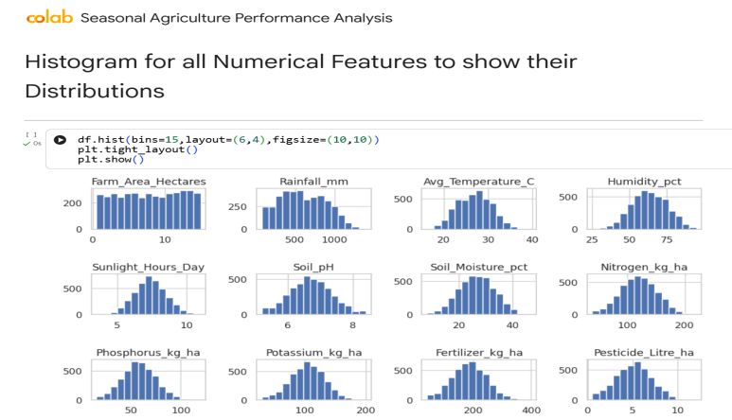
RESULTS

Slide 7
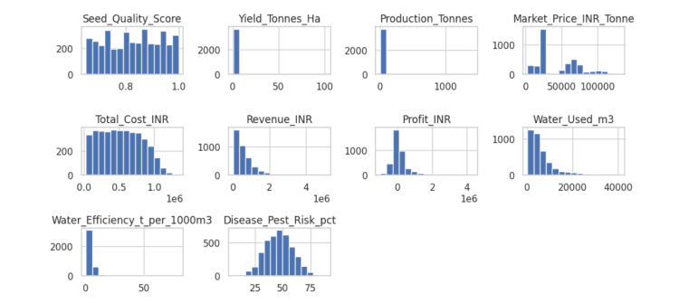
RESULTS

Slide 8
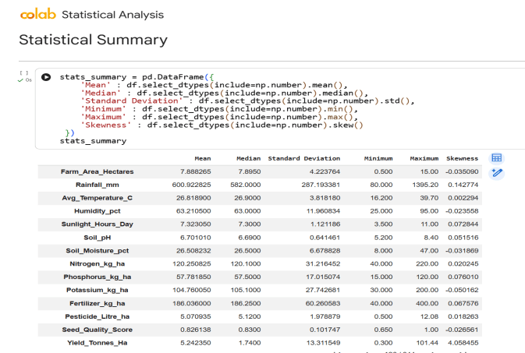
RESULTS

Slide 9
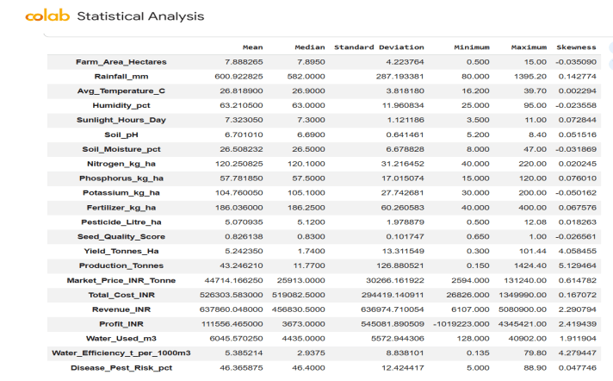
RESULTS

Slide 10
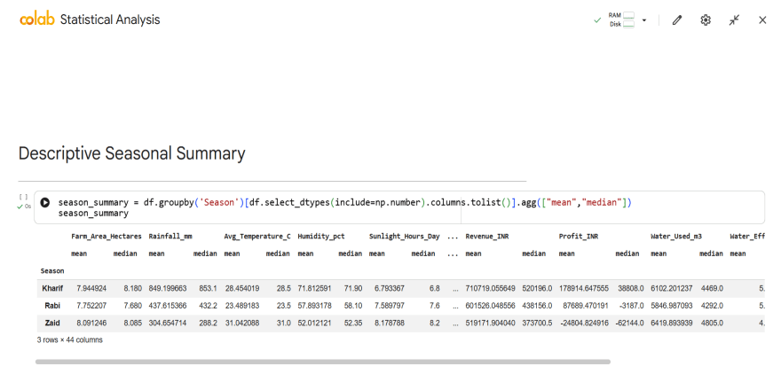
RESULTS

Slide 11

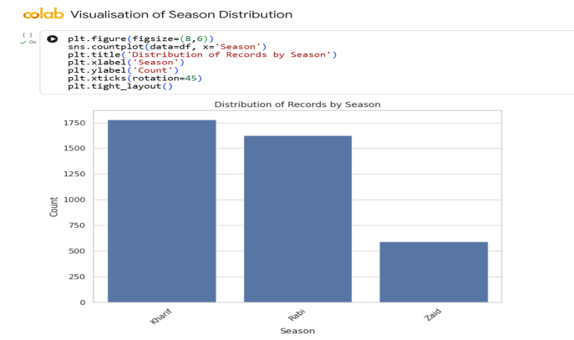
RESULTS

Slide 12
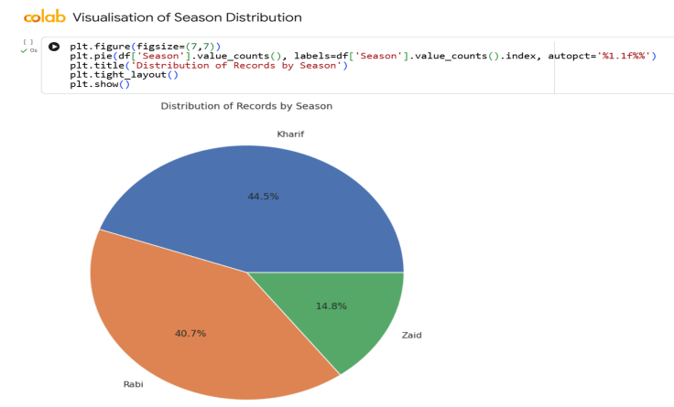
RESULTS

Slide 13
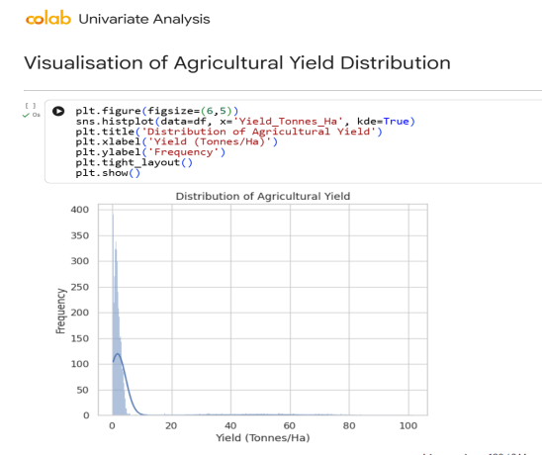
RESULTS

Slide 14
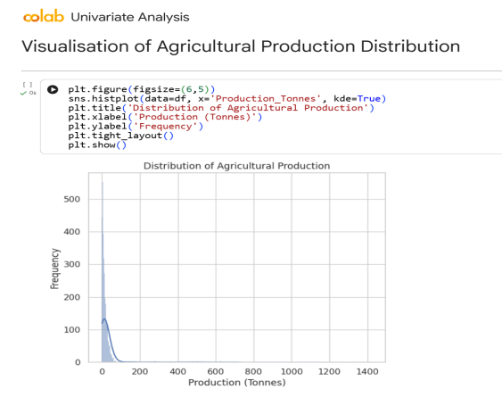
RESULTS

Slide 15
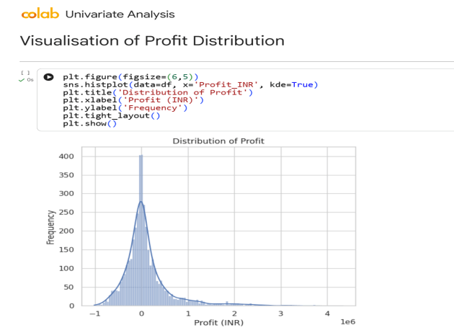
RESULTS

Slide 16
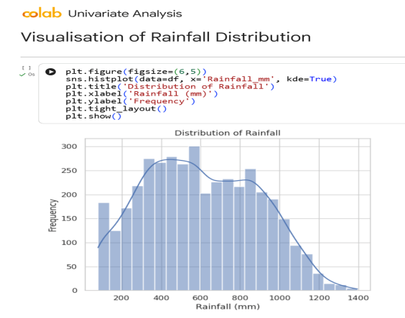
RESULTS

Slide 17
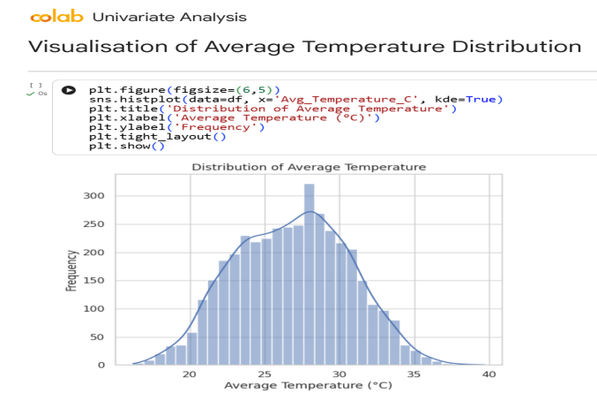
RESULTS

Slide 18
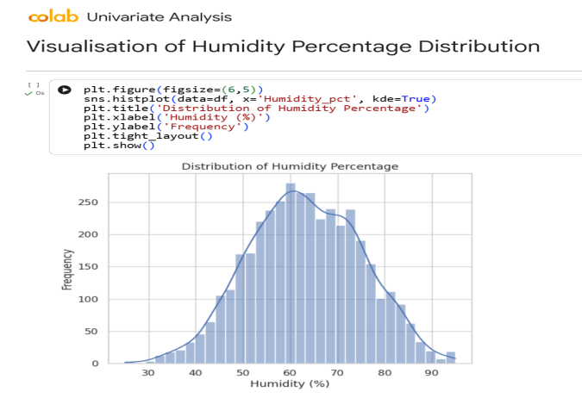
RESULTS

Slide 19
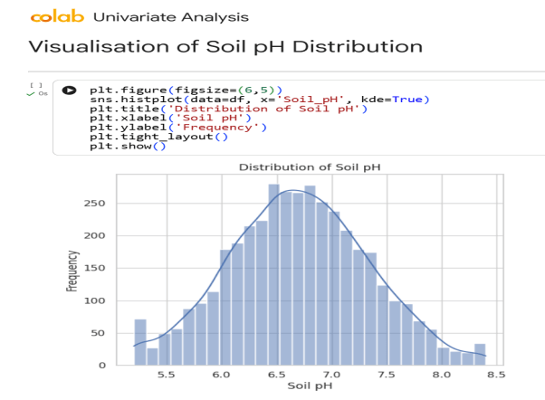
RESULTS

Slide 20
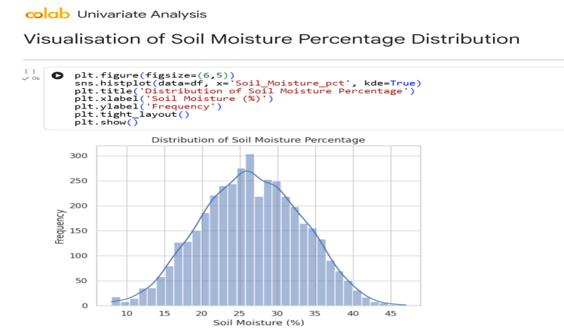
RESULTS

Slide 21
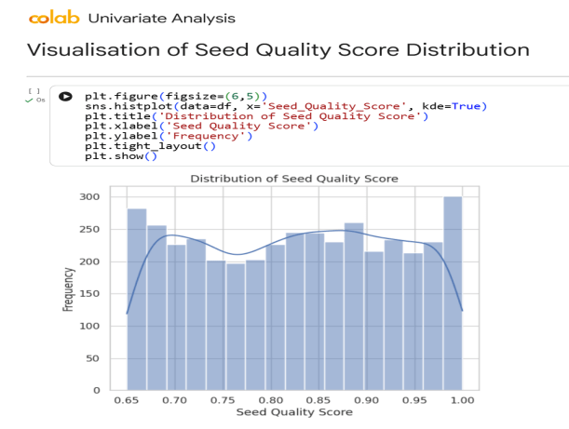
RESULTS

Slide 22

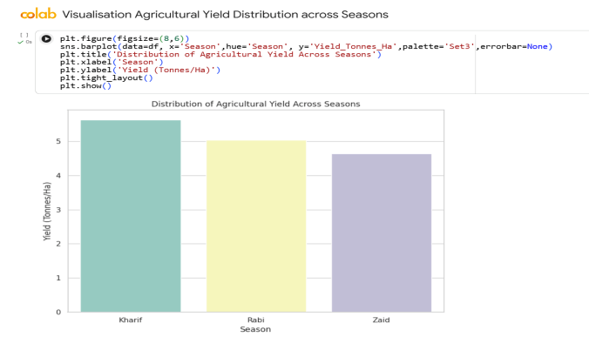
RESULTS

Slide 23
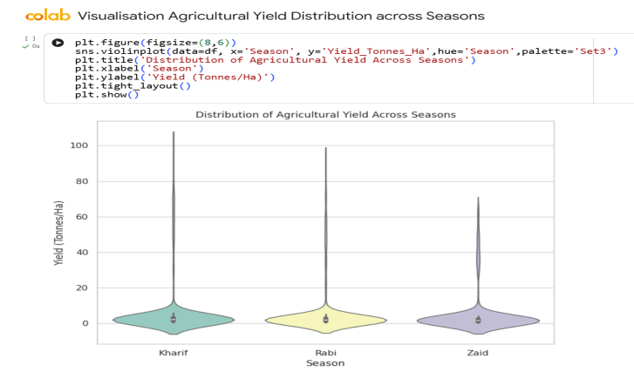
RESULTS

Slide 24
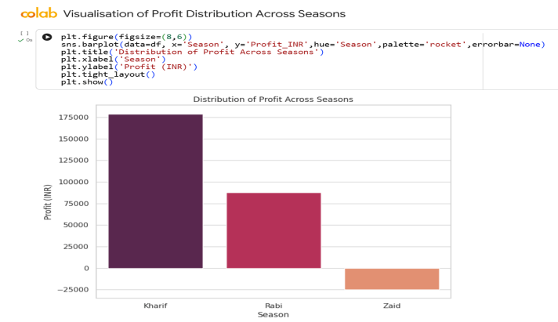
RESULTS

Slide 25
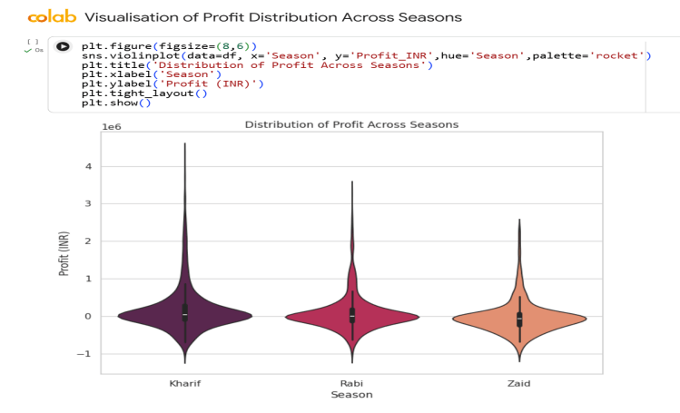
RESULTS

Slide 26
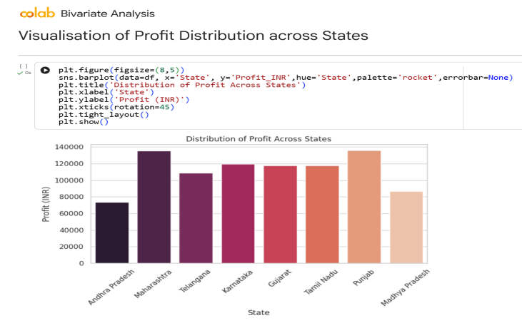
RESULTS

Slide 27
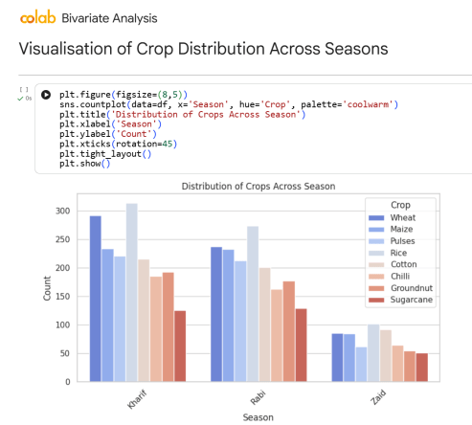
RESULTS

Slide 28
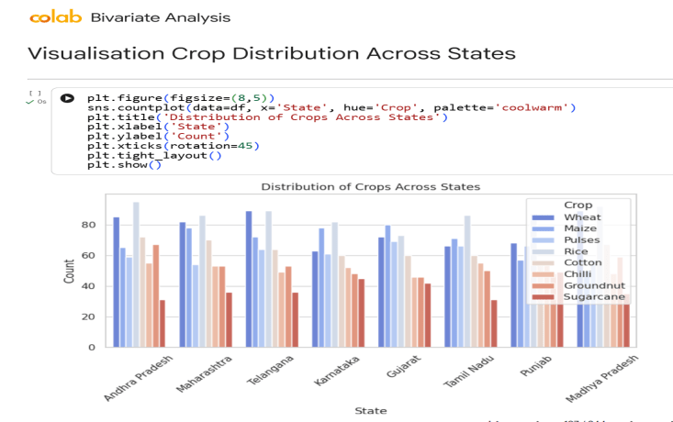
RESULTS

Slide 29
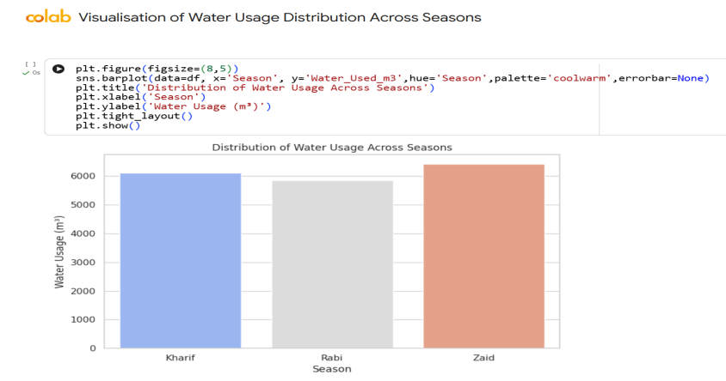
RESULTS

Slide 30
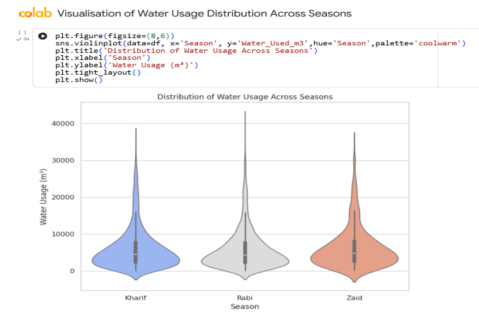
RESULTS

Slide 31
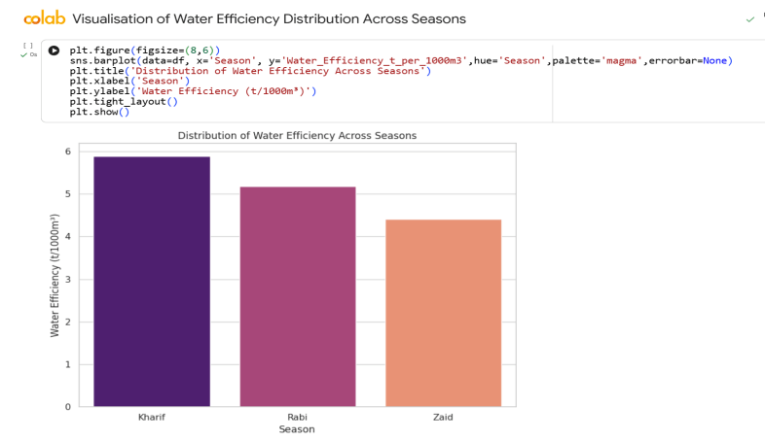
RESULTS

Slide 32
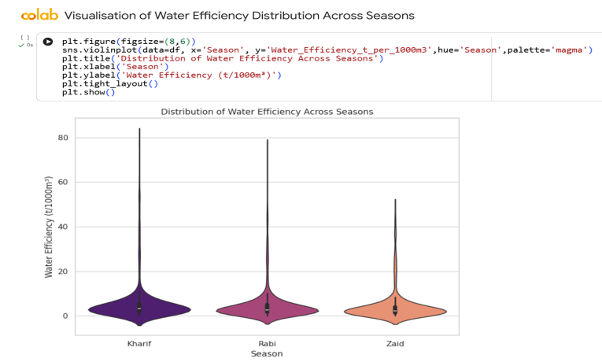
RESULTS

Slide 33
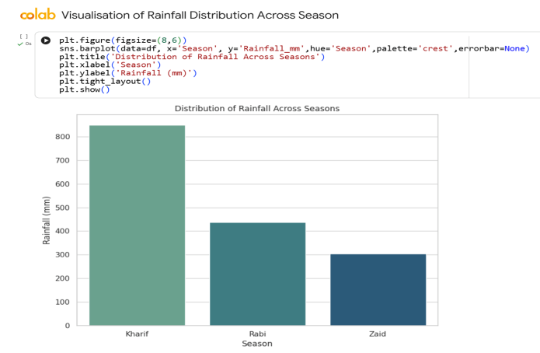
RESULTS

Slide 34
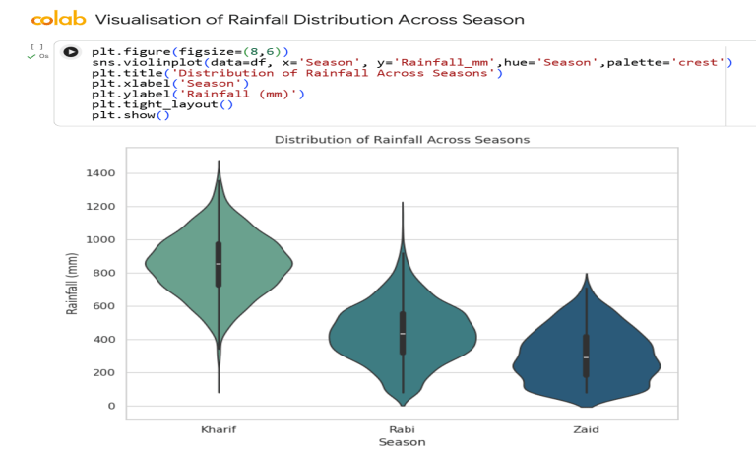
RESULTS

Slide 35
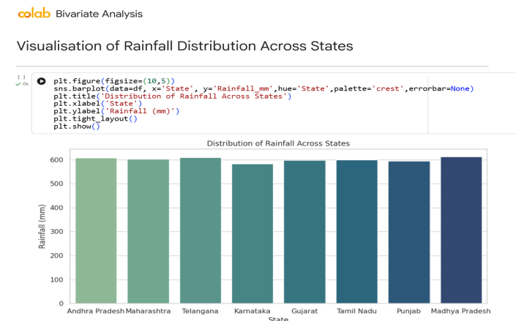
RESULTS

Slide 36
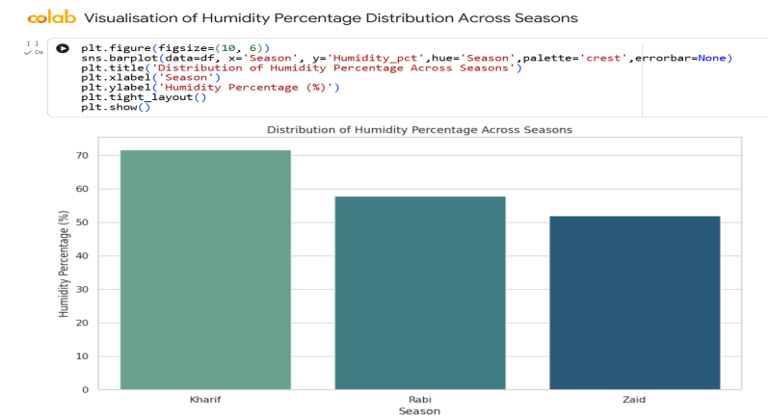
RESULTS

Slide 37
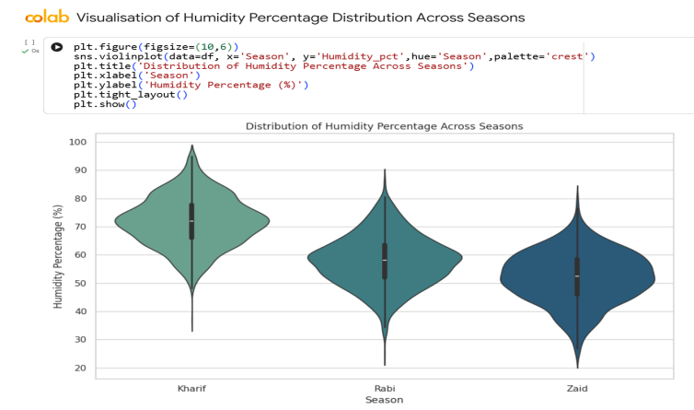
RESULTS

Slide 38
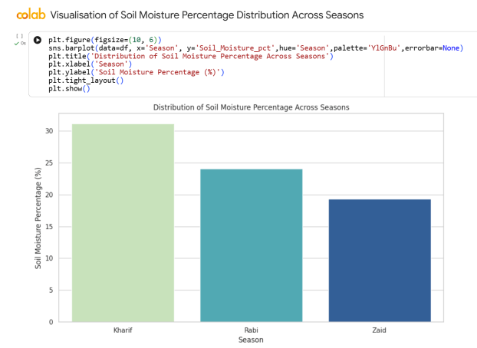
RESULTS

Slide 39
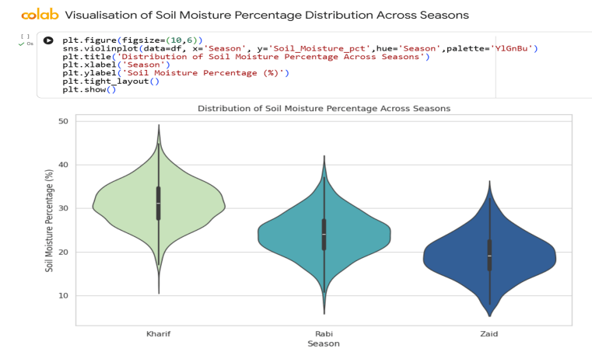
RESULTS

Slide 40
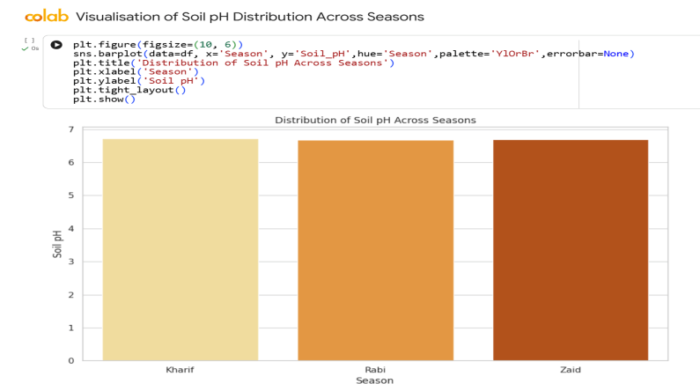
RESULTS

Slide 41
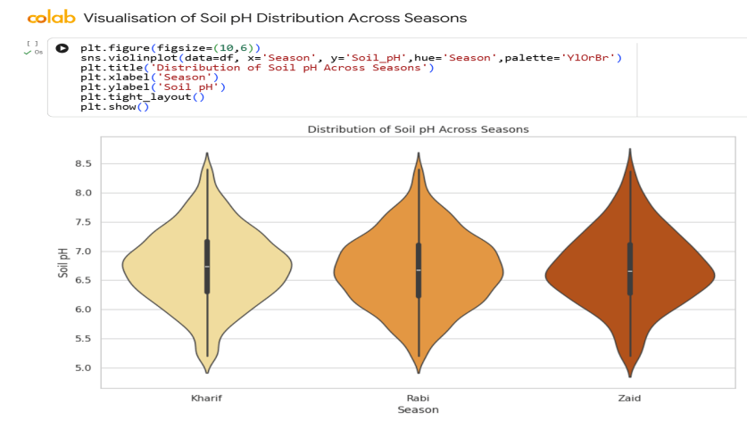
RESULTS

Slide 42
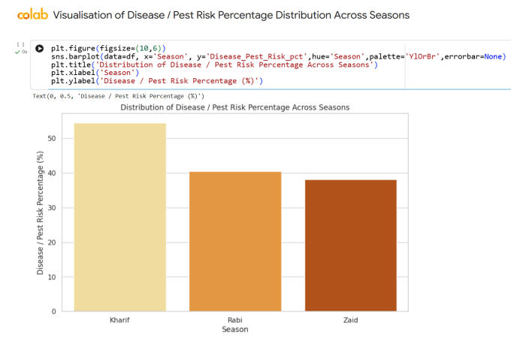
RESULTS

Slide 43
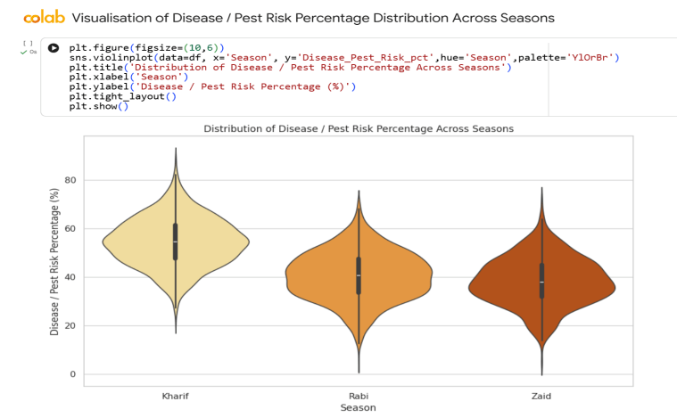
RESULTS

Slide 44
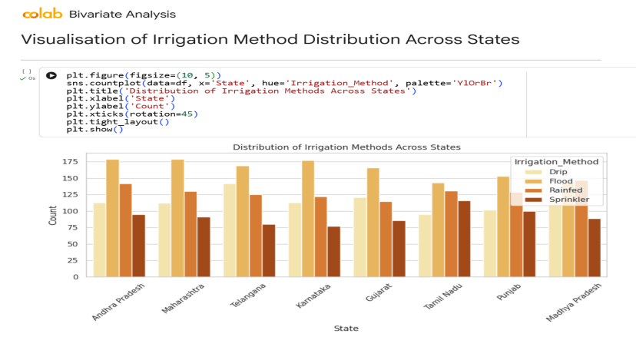
RESULTS

Slide 45
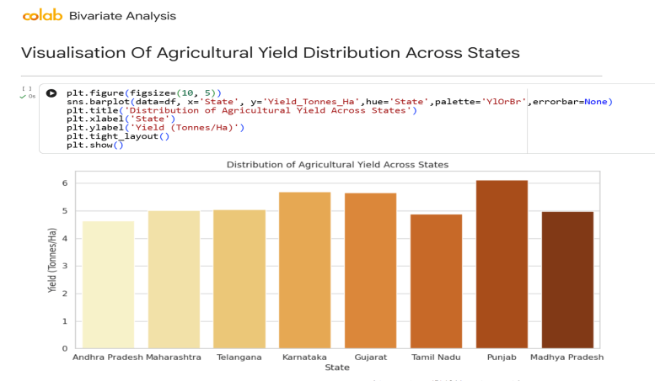
RESULTS

Slide 46
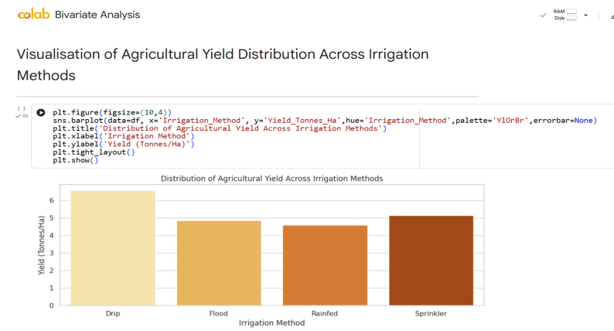
RESULTS

Slide 47
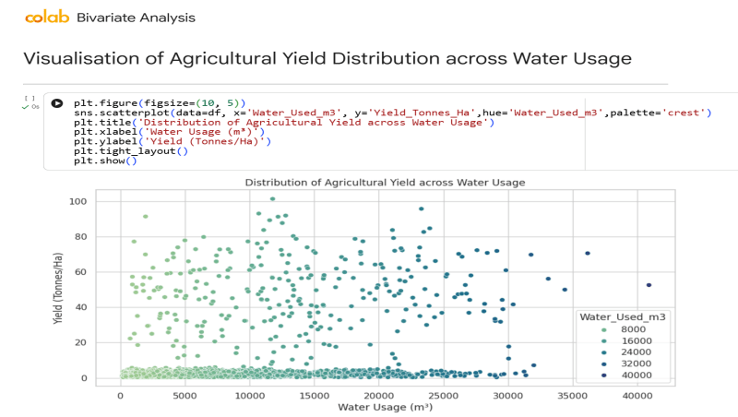
RESULTS

Slide 48
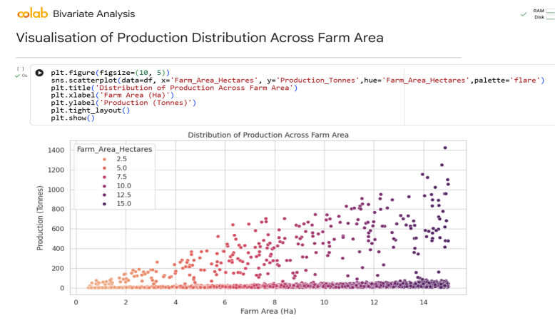
RESULTS

Slide 49
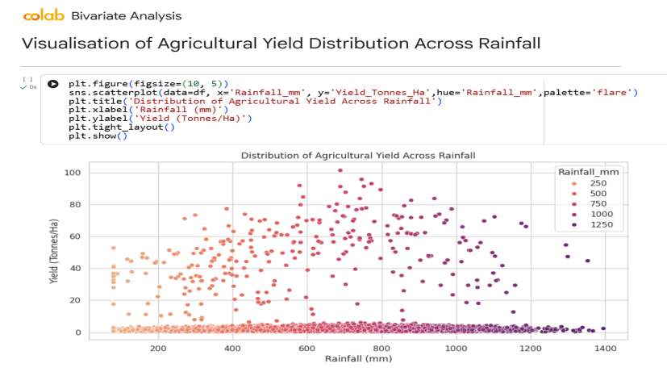
RESULTS

Slide 50
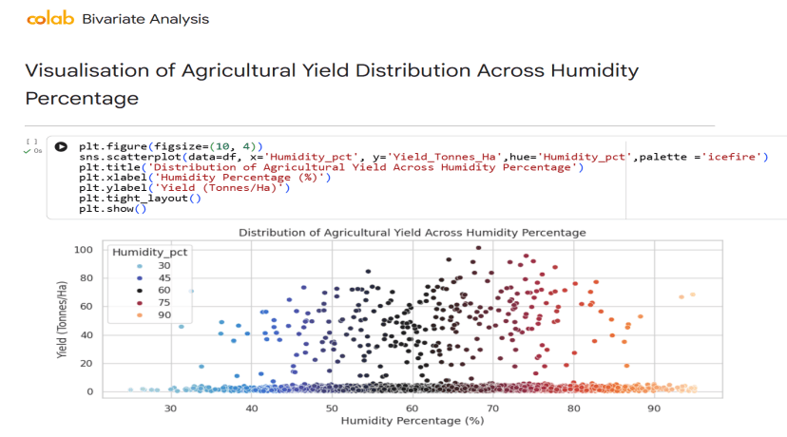
RESULTS

Slide 51
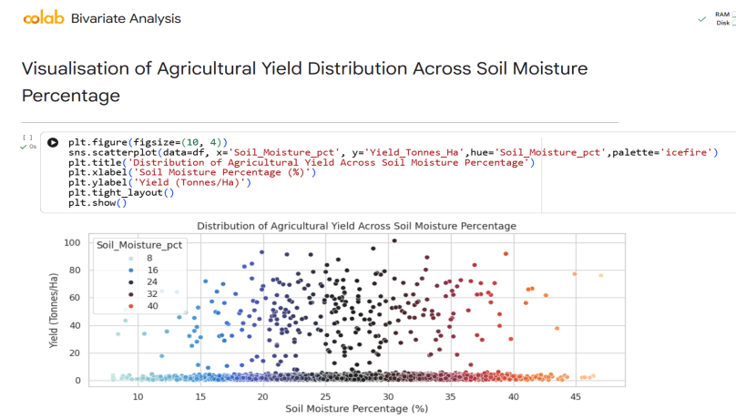
RESULTS

Slide 52
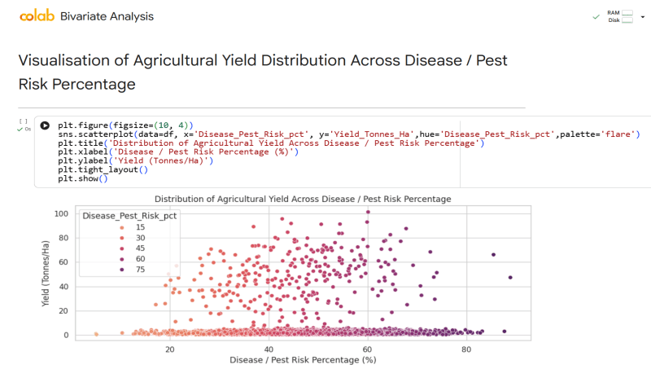
RESULTS

Slide 53
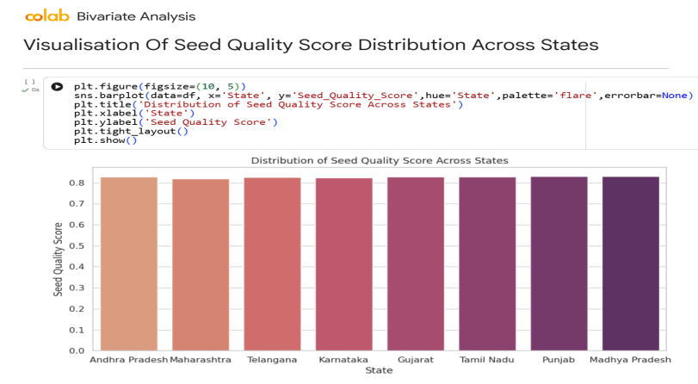
RESULTS

Slide 54

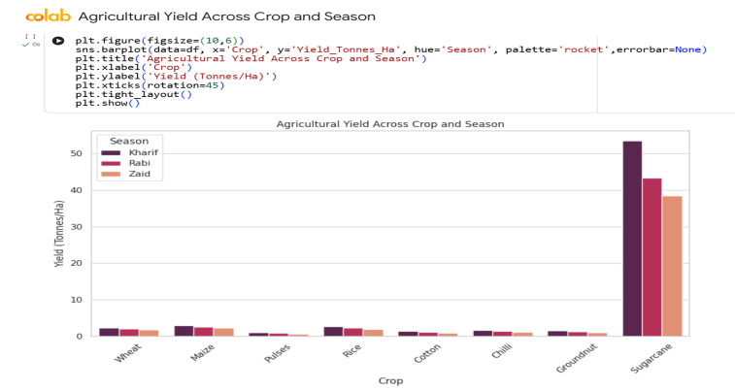
RESULTS

Slide 55
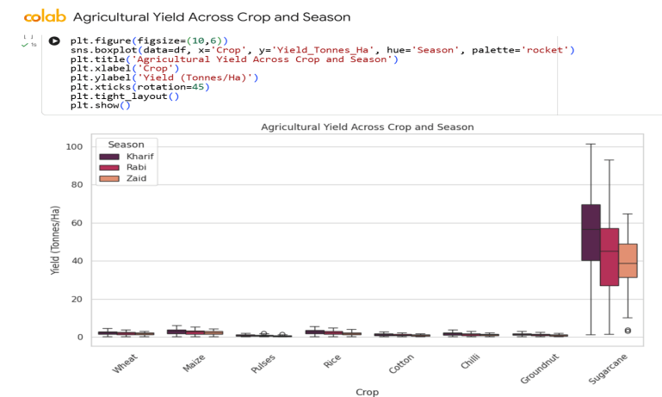
RESULTS

Slide 56

RESULTS

Slide 57

RESULTS

Slide 58

RESULTS

Slide 59

RESULTS

Slide 60

RESULTS

Slide 61

RESULTS

Slide 62

RESULTS

Slide 63

RESULTS

Slide 64

RESULTS

Slide 65

RESULTS

Slide 66


RESULTS

Slide 67

RESULTS

Slide 68

RESULTS

Slide 69

RESULTS

Slide 70

RESULTS

Slide 71

RESULTS

Slide 72

RESULTS

Slide 73

RESULTS

Slide 74

RESULTS

Slide 75

RESULTS

Slide 76

RESULTS

Slide 77

RESULTS

Slide 78

RESULTS

Slide 79

RESULTS

Slide 80

RESULTS

Slide 81

RESULTS

Slide 82

RESULTS

Slide 83

RESULTS

Slide 84

RESULTS

Slide 85

RESULTS

Slide 86

RESULTS

Slide 87

RESULTS

Slide 88

RESULTS

Slide 89

RESULTS

Slide 90

RESULTS

Slide 91

RESULTS

Slide 92

RESULTS

Slide 93

RESULTS

Slide 94

RESULTS

Slide 95


RESULTS

Slide 96

RESULTS

Slide 97

RESULTS

Slide 98

RESULTS

Slide 99

RESULTS

Slide 100

RESULTS

Slide 101

RESULTS

Slide 102

RESULTS

Slide 103

RESULTS

Slide 104

RESULTS

Slide 105

RESULTS

Slide 106

RESULTS

Slide 107

RESULTS

Slide 108

RESULTS

Slide 109

RESULTS

Slide 110

RESULTS

Slide 111

RESULTS

Slide 112

RESULTS

Slide 113

RESULTS

Slide 114

RESULTS

Slide 115

RESULTS

Slide 116

RESULTS

Slide 117

RESULTS

Slide 118

RESULTS

Slide 119

RESULTS

Slide 120

RESULTS

Slide 121

RESULTS

Slide 122

RESULTS

Slide 123

RESULTS

Slide 124

RESULTS

Slide 125

RESULTS

Slide 126

RESULTS

Slide 127

RESULTS

Slide 128

RESULTS

Slide 129

RESULTS

Slide 130

RESULTS

Slide 131

RESULTS

Slide 132

RESULTS

Slide 133

RESULTS

Slide 134

RESULTS

Slide 135

RESULTS

Slide 136

RESULTS

Slide 137

RESULTS

Slide 138

RESULTS

Slide 139

RESULTS

Slide 140

RESULTS

Slide 141

RESULTS

Slide 142

RESULTS

Slide 143

RESULTS

Slide 144

RESULTS

Slide 145

RESULTS

Slide 146

RESULTS

Slide 147

RESULTS

Slide 148

RESULTS

Slide 149

RESULTS

Slide 150

RESULTS

Slide 151

RESULTS

Slide 152
Future scope
1. Advanced Predictive Modeling
Yield Prediction Models: Develop advanced machine learning models (e.g., time series, neural networks) to predict crop yields more accurately for each season, considering environmental factors, resource inputs, and historical performance. This could incorporate satellite imagery and remote sensing data.
Profitability Forecasting: Build models to forecast profitability for different crops and seasons, helping farmers make proactive decisions about planting and resource allocation.
Disease/Pest Outbreak Prediction: Implement predictive models for disease and pest outbreaks based on seasonal environmental conditions, enabling early warning systems and targeted interventions.
2. Integration with Real-time Data and IoT
Sensor Integration: Integrate data from IoT sensors deployed in farms (e.g., soil moisture sensors, weather stations, smart irrigation systems) to provide real-time insights and enable dynamic adjustments to farming practices.
Market Price Integration: Incorporate real-time market price data and demand forecasts to optimize harvest times and sales strategies for maximizing revenue.
Supply Chain Optimization: Extend the analysis to optimize the agricultural supply chain, from farm to consumer, considering seasonal production variations and market demands.

Slide 153
Future scope
3. Economic and Policy Impact Analysis
Cost-Benefit Analysis of Interventions: Conduct detailed cost-benefit analyses for recommended interventions (e.g., water-saving irrigation, specific crop varieties) to provide farmers and policymakers with clear economic justifications.
Policy Simulation: Develop simulation models to assess the potential impact of different agricultural policies (e.g., subsidies for Zaid season crops, water usage regulations) on seasonal performance and farmer livelihoods.
Risk Management Tools: Create tools to help farmers assess and mitigate risks associated with seasonal variability, including climate change impacts and market volatility.
4. Decision Support Systems and Farmer Outreach
Interactive Dashboards: Develop user-friendly interactive dashboards that visualize seasonal insights and provide actionable recommendations for farmers, policymakers, and agri-businesses.
Mobile Applications: Create mobile applications to deliver personalized advice to farmers based on their location, crop, and current seasonal conditions.
Educational Programs: Partner with agricultural extension services to develop educational programs that disseminate these data-driven insights and best practices to a wider farming community.

Slide 154
GitHub Link
https://github.com/Adrika-Chattopadhyay/Seasonal-Agriculture-Performance-Analysis.git

Slide 155

VOIS Course completion certificate - Course name- Data Visualization

Slide 156
Thank you
I sincerely thank my mentors for their guidance and support throughout this data analytics internship. I am grateful to the organisation for providing me with the opportunity to apply my skills in a practical setting, which has greatly enhanced my learning and professional growth.
.
.

