Slide 1

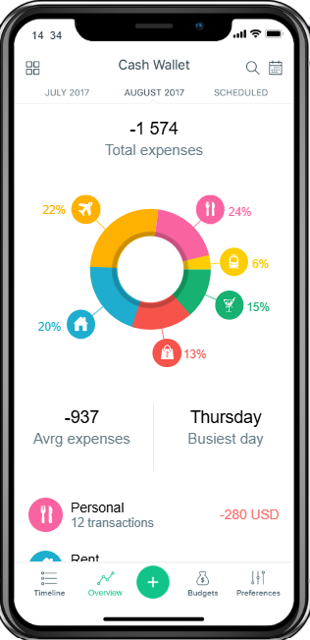
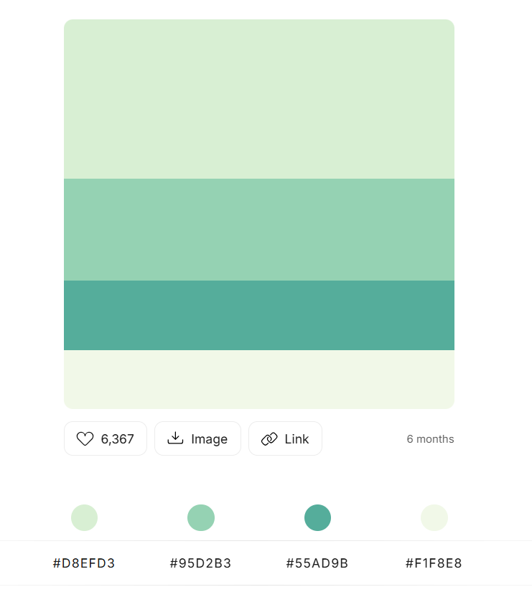



PRICING
BANKING
HELP
ABOUT US
LOGIN
GET FINANCIAL MANAGEMENT DIRECTIONS AT ONE CLICK
WINNER OF MOBILE UX AWARDS
FEATURED ON APP STORE AND PLAY STORE
4 OUT OF 5 RATED ON PLAY STORE
HAVE FULL CONTROL
GET QUICK OVERVIEW
MANAGE BUDGET EASILY
HOW TO GET YOUR MONEY INTO SHAPE?

Slide 2
GET FINANCIAL MANAGEMENT DIRECTIONS AT ONE CLICK
PRICING
BANKING
HELP
ABOUT US
LOGIN
WINNER OF MOBILE UX AWARDS
FEATURED ON APP STORE AND PLAY STORE
4 OUT OF 5 RATED ON PLAY STORE
HAVE FULL CONTROL
GET QUICK OVERVIEW
MANAGE BUDGET EASILY
HOW TO GET YOUR MONEY INTO SHAPE?
1,23,2333 INR
23,2333 INR
STEP 1:
Connect your Bank Account to CASHCOMPASS.
Connect your E-Wallet for complete overview.
Add your cash expenses manually
2333 INR

Slide 3
GET FINANCIAL MANAGEMENT DIRECTIONS AT ONE CLICK
WINNER OF MOBILE UX AWARDS
FEATURED ON APP STORE AND PLAY STORE
4 OUT OF 5 RATED ON PLAY STORE
HAVE FULL CONTROL
GET QUICK OVERVIEW
MANAGE BUDGET EASILY
PRICING
BANKING
HELP
ABOUT US
LOGIN
HOW TO GET YOUR MONEY INTO SHAPE?
1,23,2333 INR
23,2333 INR
STEP 1:
Connect your Bank Account to CASHCOMPASS.
Connect your E-Wallet for complete overview.
Add your cash expenses manually
2333 INR

