Slide 1

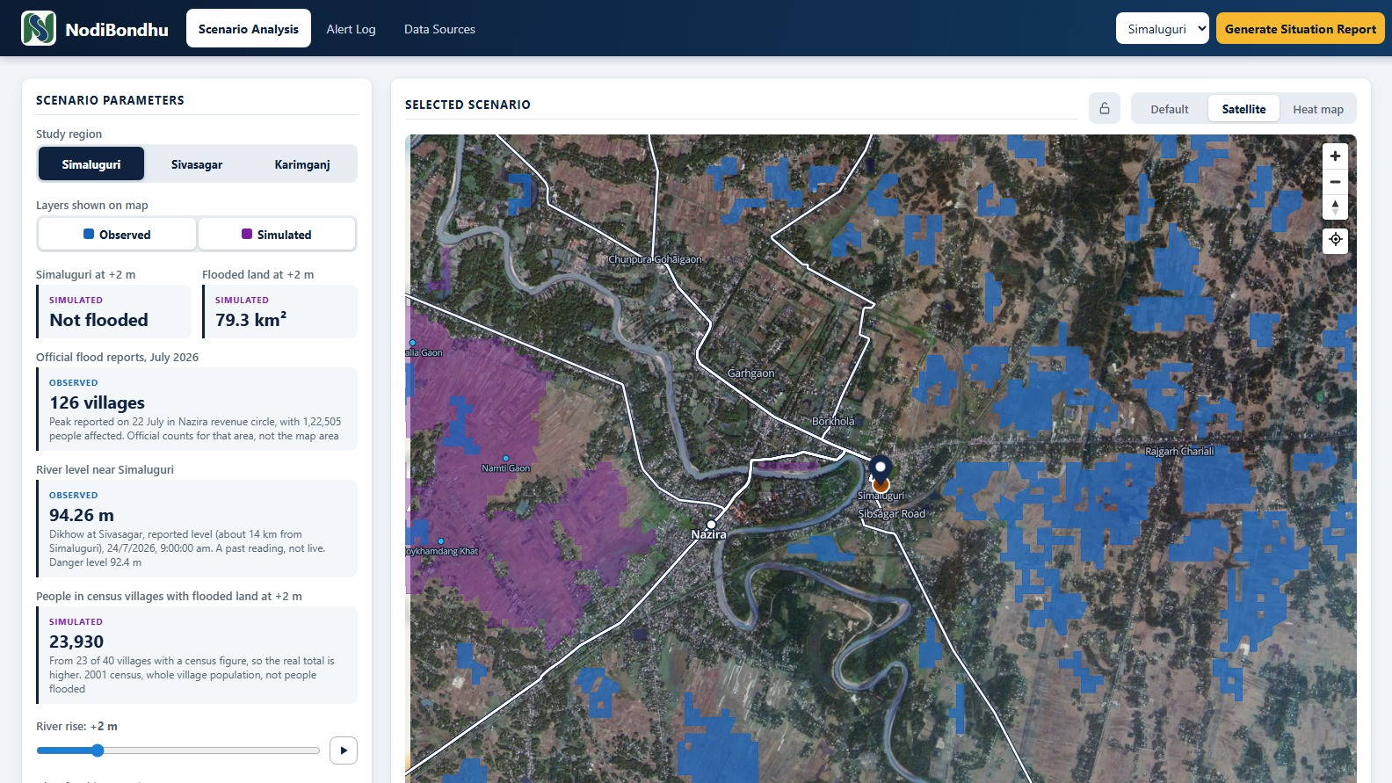
NodiBondhu
Flood digital twin for Assam | Idea presentation
Problem Statement ID
NESFIC-D-18
Problem Statement Title
Digital Twin for Flood Management, Simulation and Early Warning Using Space Technology
Theme
To be added
PS Category
Software
Team ID
To be added
Team Name (Registered on portal)
To be added
Working prototype: Simaluguri at +2 m river rise. Blue is flood seen by radar in July 2026, purple is simulated.
NodiBondhu | NESFIC-D-18
Notes:
Team ID, team name and theme are still to be added before submission.

Slide 2
NODIBONDHU: FLOOD DIGITAL TWIN
NodiBondhu
See what a river rise would reach, and how far to trust that answer, on one map
Proposed solution
Flood scenarios for Simaluguri, Sivasagar and Karimganj
Flooded land, census villages, land use and road routes for each
Situation Report and a demo alert log, which sends nothing
How it addresses the problem
Brings satellite, terrain, river, rain and official flood data together
Shows what a rise would reach, so response can be planned ahead
Puts rain forecast and modelled river flow beside the scenarios
Innovation and uniqueness
Every figure is marked observed, forecast or simulated, with its source
The model is scored against satellite radar, and the score is shown
Built on free data, with scripts that rebuild it for a new area
+1 to +6 m
river rise scenarios
3
study regions in Assam
17
days of official flood reports
22-31%
overlap with radar at +2 m
Notes:
This is a prototype, not an operational warning system. The 22-31% overlap is against one radar image of the July 2026 flood.

Slide 3
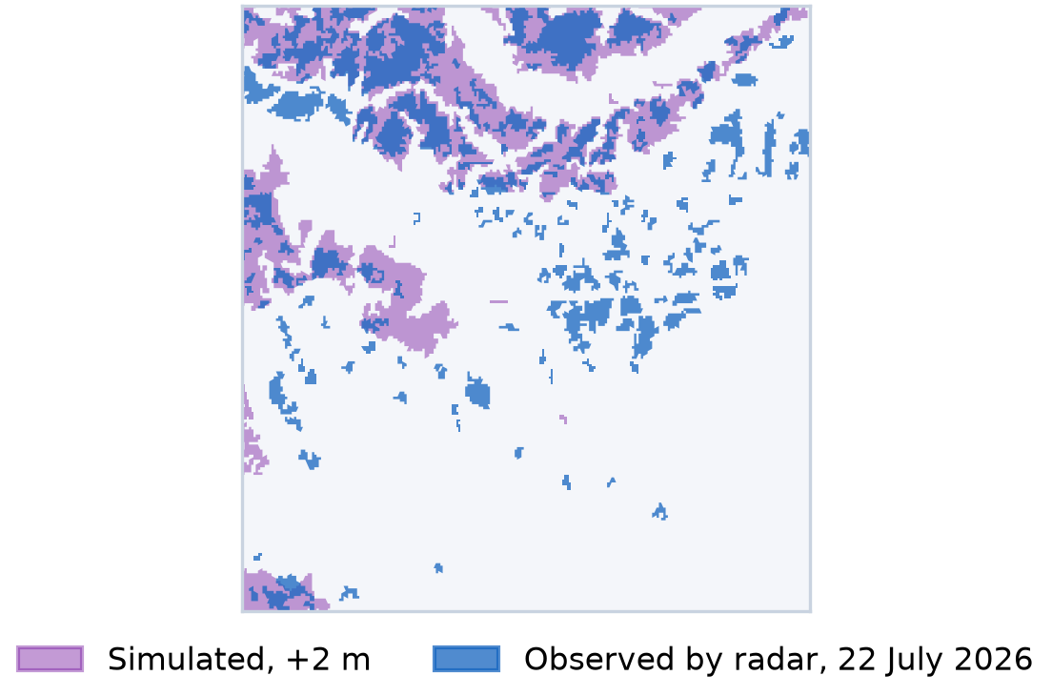
TECHNICAL APPROACH
NodiBondhu
From public satellite data to a checked flood map, in five steps
1 Collect
2 Simulate
3 Check
4 Count
5 Show
Elevation, radar, Bhuvan villages, land use and routes, OpenStreetMap, ASDMA reports
Height above nearest river (HAND) on a 90 m grid, for rises of +1 to +6 m
Radar flood: at most -15 dB, a drop of 3 dB or more, slope up to 5°. Scored per scenario
Census villages, land use and road routes that meet each flood scenario
FastAPI serves GeoJSON with source and date. MapLibre draws it on Bhuvan imagery
Technologies
Frontend: React 19, TypeScript, Vite, MapLibre GL
Backend: Python, FastAPI, httpx
Data work: Python with rasterio and scipy
Storage: GeoJSON and JSON files, no database yet
API keys stay on the server, never in the browser
Three kinds of data, never mixed
Observed
Radar, reported river levels and official flood reports
Forecast
Rain and GloFAS river flow, from Open-Meteo
Simulated
What-if flood scenarios from terrain
Simaluguri check: 31% overlap, and 58% of radar flood falls inside the +2 m area
Notes:
HAND follows Nobre et al. 2011. About 70 model settings were tested and none clearly beat the current one, so the model was left unchanged.

Slide 4
FEASIBILITY AND VIABILITY
NodiBondhu
The prototype already runs. Its accuracy limits are measured and shown
Why it is feasible
Working prototype for 3 regions, with open code
All data is free to access. Bhuvan APIs need keys
Scripts rebuild each data layer, so new areas can be added
Needs no paid model or database today
Challenge or risk | How we will handle it
Model only partly matches radar | Show the score. Add multi-date radar, rain and drainage
Checked on one flood event | Test past floods. Backtest warnings against the July 2026 reports
No live river gauge | Connect CWC or SMART AXOM. Readings are by hand for now
Embankments not in the model | Add embankment data, and mark protected areas
Radar misses water under trees and in towns | Read it with official reports. Sivasagar coverage is 65%
Census from 2001, many villages lack figures | Label it on screen. Replace when newer counts are available
Site not hosted yet | Deploy the backend so keys stay on the server
Overlap with radar at +2 m, the best rise everywhere
31%
Simaluguri
22%
Sivasagar
23%
Karimganj
58-66% of the flood seen by radar lies inside the +2 m area, but the model also floods far more land
Notes:
An early scratch test of multi-date radar reached 24-39% overlap. It is not on the site yet.

Slide 5
IMPACT AND BENEFITS
NodiBondhu
July 2026 shows the scale: one district, 3,92,195 people affected in a day
3,92,195
people affected, 22 July
328
villages affected, 22 July
26,026 ha
crop area submerged, 24 July
Intended users
ASDMA and district disaster teams
Revenue circle officers planning relief and routes
Volunteers and residents of flood-prone villages
Social
Earlier view of the villages and roads a rise could reach
Economic
Flooded land by type helps target crop and relief planning
Environmental
Estimates flooded forest, farmland and water bodies in two regions
Notes:
These are potential benefits. The prototype has not yet been tried with these users. Official counts cover the whole district, not the map area. Land use data covers Simaluguri and Karimganj only.

Slide 6
RESEARCH AND REFERENCES
NodiBondhu
Every layer comes from a named public source
Data | Source | Used for
Elevation, 30 m | Copernicus DEM GLO-30 | Flood model
Flood radar, July 2026 | Sentinel-1 RTC, Planetary Computer | Checking the model
Imagery, villages, land use, routes | Bhuvan, NRSC/ISRO | Base map and counts
Rivers, settlements, boundaries | OpenStreetMap | River network, names
Rain forecast and past rain | Open-Meteo | Forecast panel
River flow | GloFAS, Open-Meteo Flood API | Forecast panel
Daily flood reports, 12-28 July 2026 | ASDMA DRIMS | Timeline, event check
River levels, July 2026 | CWC reading in Morung Express; ASDMA alert | Past readings
Research and reports
Nobre et al. 2011, HAND terrain model, Journal of Hydrology 404
NRSC, Flood Hazard Zonation Atlas of Assam, 1998-2023
SPRF report on the 2026 Assam floods
NESFIC-D-18 problem statement
NodiBondhu code on GitHub
Tested and not used
CartoDEM: lower overlap with radar than Copernicus
Postal and Hospital API: documented for Andhra Pradesh only
Notes:
The Kushiyara reading of 22 July came from an ASDMA alert. Sources are also listed in Resources.md in the repository.

