Slide 1
Synchronization Circuits
What is a synchronization circuit?
  Captures an asynchronous input signal and outputs it on a clock edge
Why do you need synchronization circuits?
  To prevent setup and hold time violations
  To ensure a more reliable design
When do you need synchronization circuits?
  Signals cross between unrelated clock domains
    Between related clock domains, relative PERIOD constraints are sufficient
  Chip inputs that are asynchronous
Notes:
For clock domains that have a clearly defined and constant phase relationship, proper timing constraints ensure that there are no setup or hold time violations. For more information on constraining paths between clock domains, refer to the “Path-Specific Timing Constraints” module.

Slide 2
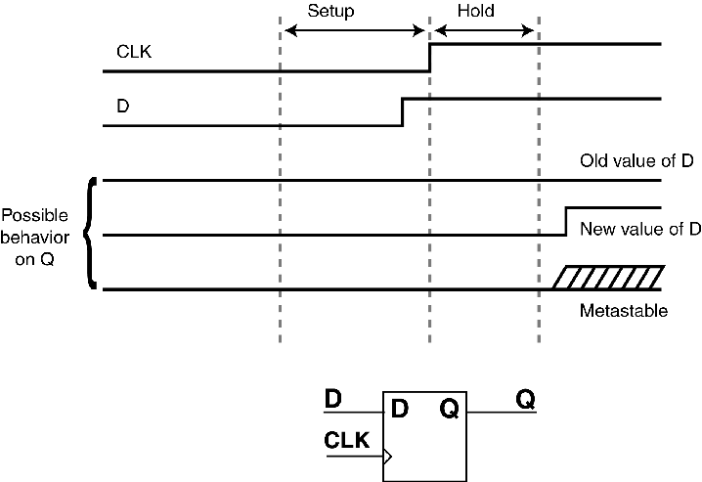
Setup and Hold Time Violations
Violations occur when the flip-flop input changes too close to a clock edge
Three possible results:
  Flip-flop clocks in an old data value
  Flip-flop clocks in a new data value
  Flip-flop output becomes metastable

Slide 3
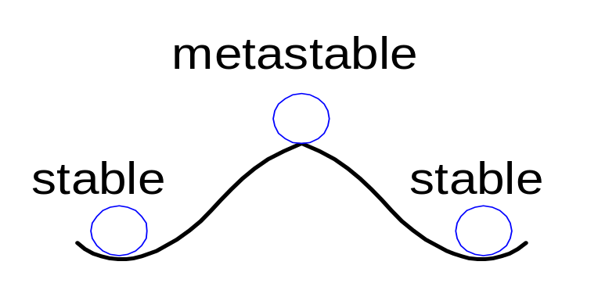
Metastability
Any bistable device has two stable states and a metastable state between them
A flip-flop has two stable states (1 and 0) and one metastable state
If a flip-flop lands in the metastable state, it could stay there for an undetermined amount of time

Slide 4
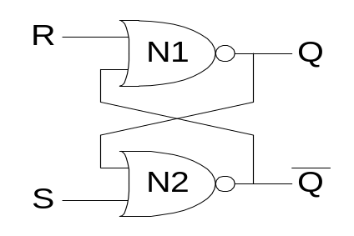
Flip-flop Internals
Because the flip-flop has feedback, if Q is somewhere between 1 and 0, the cross-coupled gates will eventually drive the output to either rail (1 or 0, depending on which one it is closer to).
A signal is considered metastable if it hasn’t resolved to 1 or 0
If a flip-flop input changes at a random time, the probability that the output Q is metastable after waiting some time, t, is:
P(t_{res} > t) = (T₀/T_{c} ) e^{-t/τ}
t_{res} : time to resolve to 1 or 0
T₀, τ : properties of the circuit

Slide 5
Metastability
Intuitively:
  T₀/T_{c} describes the probability that the input changes at a bad time, i.e., during the aperture time
P(t_{res} > t) = (T₀/T_{c} ) e^{-t/τ}
  τ is a time constant indicating how fast the flip-flop moves away from the metastable state; it is related to the delay through the cross-coupled gates in the flip-flop
P(t_{res} > t) = (T₀/T_{c} ) e^{-t/τ}
In short, if a flip-flop samples a metastable input, if you wait long enough (t), the output will have resolved to 1 or 0 with high probability.

Slide 6
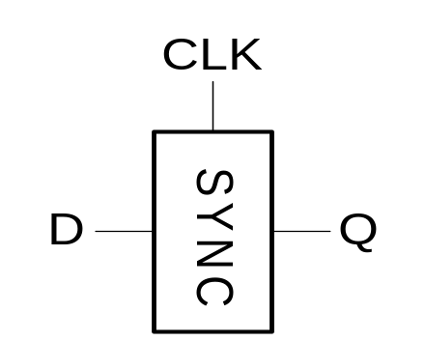
Synchronizers
Asynchronous inputs (D) are inevitable (user interfaces, systems with different clocks interacting, etc.).
The goal of a synchronizer is to make the probability of failure (the output Q still being metastable) low.
A synchronizer cannot make the probability of failure 0.

Slide 7
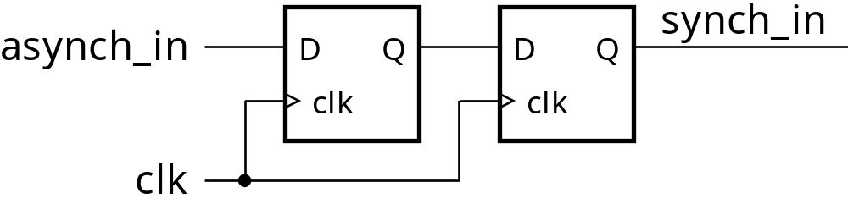
Synchronizers
If input changes outside setup/hold window
  Change is simply delayed by one cycle
If input changes during setup/hold window
  First flipflop has a whole cycle to resolve metastability
See data sheets for metastability parameters

Slide 8
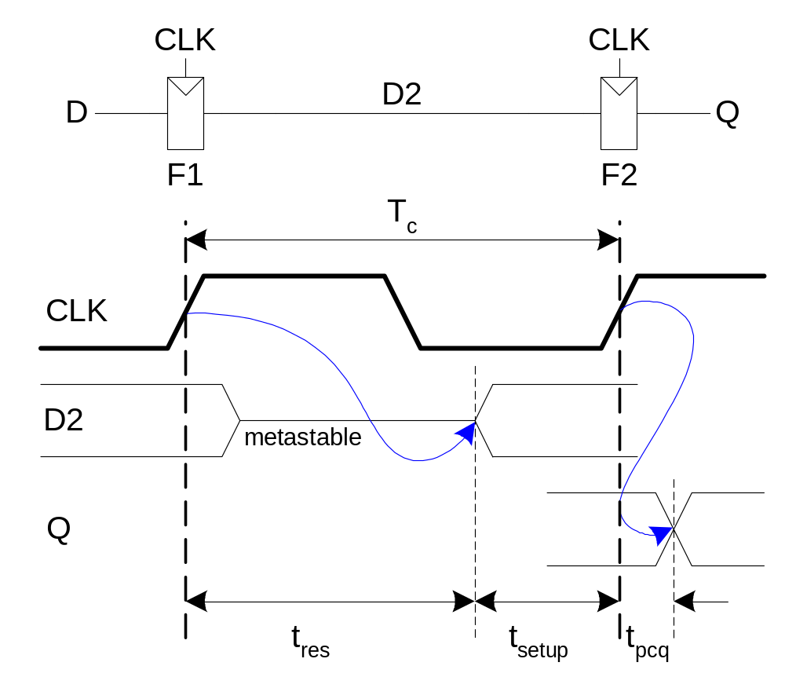
Synchronizer Internals
A synchronizer can be built with two back-to-back flip-flops.
Suppose the input D is transitioning when it is sampled by flip-flop 1, F1.
The amount of time the internal signal D2 can resolve to a 1 or 0 is (T_{c} - t_{setup}).

Slide 9
Synchronizer Probability of Failure
For each sample, the probability of failure of this synchronizer is:
P(failure) = (T₀/T_{c} ) e^{-(T}_{c} ^{- t}_{setup}^{)/τ}

Slide 10
Metastability
Flip-flop output enters a transitory state
  Neither a valid 0 nor a valid 1
    Can be interpreted as 0 by some loads and as 1 by others
  Remains in this state for an unpredictable length of time before settling to a valid 0 or 1
Due to a statistical nature, the occurrence of metastable events can only be reduced, not eliminated
Mean Time Between Failure (MTBF) is exponentially related to the length of time the flip-flop is given to recover
  A few extra ns of recovery time can dramatically reduce the chances of a metastable event
Notes:
When a signal is at a metastable value, it can be interpreted as a logic 0 by some parts of the circuit and as a logic 1 by other parts. This inconsistency will never be shown during simulation and can be very hard to track down during board-level testing.
When the flip-flop leaves the metastable state, it can go to either a logic 0 or 1. There is no known “correct” state when the flip-flop input changes so close to the clock edge. Still, having an “incorrect” value propagating through your circuit is better than having a metastable value.
<recovery time> = <time before the data is used> - <datapath delay>
Example: If CLK1 has a period of 50 ns, and the datapath delay is 45 ns, then the recovery time of FF1 is 50 to 45 = 5 ns.

Slide 11
Synchronization Circuit 1
Use when input pulses will always be at least one clock period wide
The “extra” flip-flops guard against metastability
Guards against metastability
Asynchronous input
Synchronized signal
D
Q
D
Q
FF1
FF2
CLK
Notes:
This circuit is a simple 2-bit shift register.
The recovery time for FF1 is: <CLK period> - <datapath delay>
<datapath delay> = <FF1 CLK-to-Q> + net delay + <FF2 setup>
If the flip-flops are placed in the same slice, the net will use a fast-feedback routing connection to give FF1 the maximum possible recovery time.

Slide 12
Synchronization Circuit 2
Use when input pulses may be less than one clock period wide
  FF1 captures short pulses
VCC
Guards against metastability
Synchronized signal
D
Q
D
Q
D
Q
FF1
FF2
FF3
Asynchronous input
CLK
CLR
Notes:
To obtain this circuit, add a flip-flop that is clocked by the asynchronous input to the front of Synchronization Circuit 1 and an AND gate.
FF1 is a flip-flop with asynchronous clear.
The AND gate prevents FF1 from being reset if the input to the circuit is still HIGH. This allows for long input pulses as well as short ones. If multiple short pulses occur on the input within a space of three clock cycles, only the first pulse will be seen by this circuit. This is always a danger when passing data from a fast clock domain into a slower clock domain.
FF2 and FF3 act in the same way as FF1 and FF2 in Synchronization Circuit 1.
To avoid using this circuit, which uses the input as a clock signal (probably not on a global buffer), you can use a faster clock signal to synchronize inputs (allowing you to use Synchronization Circuit 1). You can then use a divided version of the same clock signal in the rest of the design.
Because the clocks have a fixed-phase relationship, you will not need to resynchronize the signals as they cross between the clock domains; however, you will need to use timing constraints to prevent setup or hold violations.
Use the CLK2X output of a DLL or the CLKFX output of a DCM to get a faster clock signal for synchronizing inputs.

Slide 13
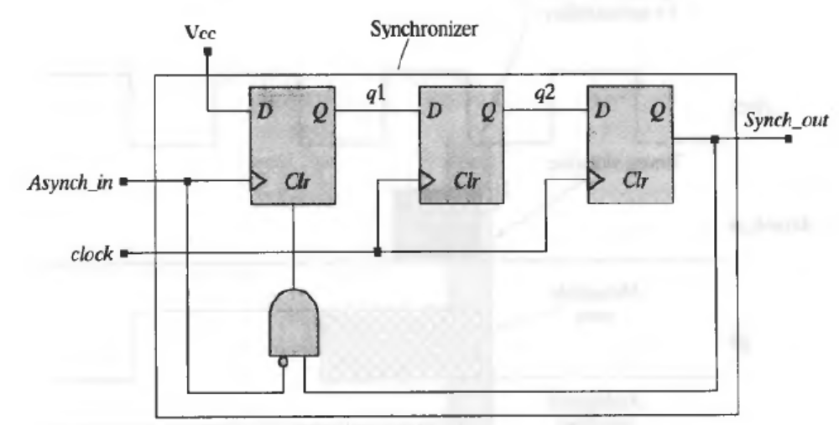
Edge Trap

Slide 14
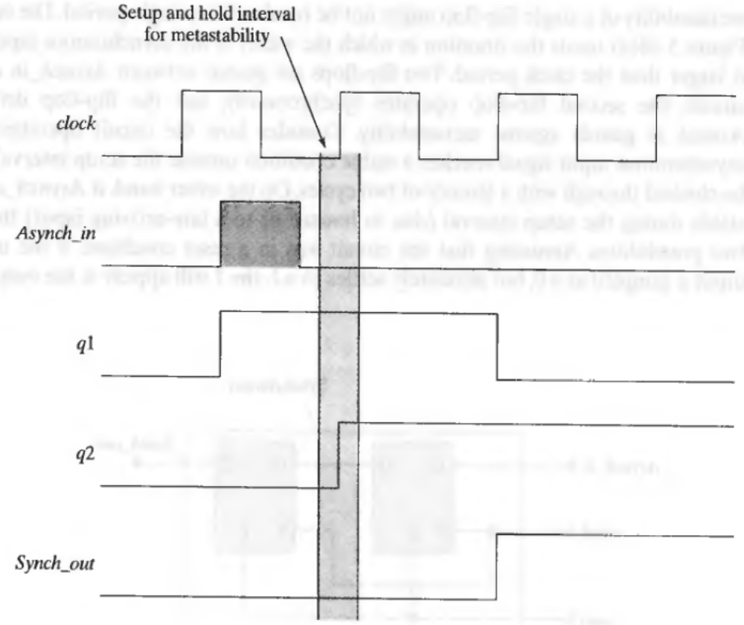
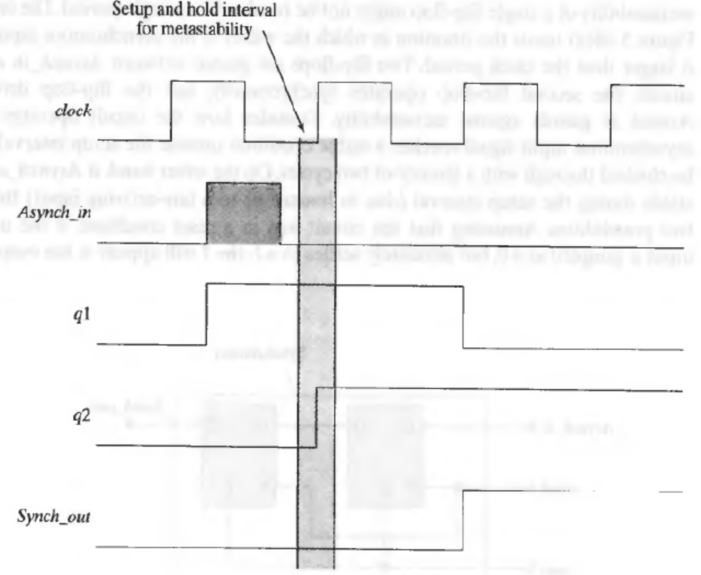

Slide 15
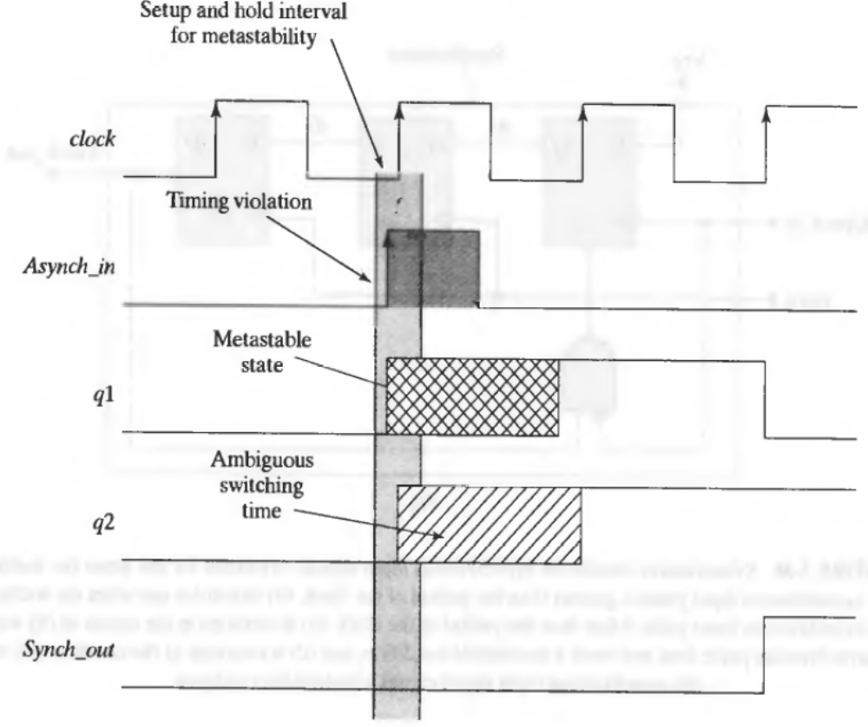

Slide 16
Capturing a Bus
Leading edge detector
  Input pulses may be less than one CLK period wide
VCC
One-shot enable
D
Q
D
Q
D
Q
Asynchronous
Input CLK
FF1
FF2
FF3
CLK
CLR
D
Q
Synchronized
bus inputs
CE
n bit
bus
Sync_Reg
D
Q
Notes:
First, the data bus is registered by the asynchronous clock. Second, the one-shot enable (synchronized to CLK) signals to the internal circuit that data is captured (via CE).
Note: Now, there is a level of logic between the one-shot enable generator and the synchronization register. If FF2 becomes metastable, it has less time to recover before its output is used to enable Sync_Reg:
Recovery time = <CLK period> - <datapath delay>
<datapath delay> = <FF1 CLK-to-Q> + net delay + <LUT delay> + <Sync_Reg setup>
A Falling Edge detector can be designed a couple of different ways:
1. Invert asynchronous input Clk.
2. Change the one-shot enable AND gate to have bubble on the top instead of on the bottom, remove Reset AND gate bubble, and, finally, change VCC to GND.

Slide 17
Synchronization Circuit 3
Use a FIFO to cross domains
FIFO16
DI
RAMB16
CORE
DO
WRCOUNT
Write
Pointer
waddr
raddr
Read
Pointer
RDCOUNT
mem_wen
mem_ren
oe
WRCLK
Status Flag
Logic
RDCLK
WREN
RDEN
RESET
FULL
AFULL
EMPTY
RDERR
AEMPTY
WRERR
Notes:
You must still synchronize FIFO status flags (FULL, HALF_FULL, ALMOST_FULL, EMPTY, HALF_EMPTY, ALMOST_EMPTY) based on read and write operations, synchronized to read and write clocks, respectively. In general, this can be accomplished by synchronizing the slower enable (read/write) to the faster clock by using Synchronization Circuit 1. If synchronizing to the slower clock, use Synchronization Circuit 2.

Slide 18
Hierarchical Design
Using Hierarchy
leads to greater
design readability,
reuse, and debug
Top Level of Design
Infer or instantiate I/O here
Datapaths
State Machines
Pipelining
Muxing/De-Muxing
Arithmetic
Counters
Building Blocks
Adders/Subtractors
Standard Widths
Bit Shifters
Pipeline RAMs
Accumulators
Specific Functions
RAM
Other IP/Cores
CoreGen
FIFOs
Parametizable functions
FIR Filters
RAM
Technology-Specific Functions
Notes:
A hierarchical design is composed of several large blocks. Each block may be composed of smaller blocks, and so on. Designs that do not have this type of structure are called flat designs.
We will use the term block in this section to mean any of the following:
A macro or symbol on a schematic
An entity in VHDL
A module in Verilog
One way to divide your design into hierarchical blocks is by logic type, as this drawing illustrates. You will see in a later slide why this type of division is recommended for HDL designs.

Slide 19
Benefits of Using Hierarchy
Design readability
  Easier to understand the design functionality and data flow
  Easier to debug
Easy to reuse parts of a design
Notes:
This slide lists some of the benefits of hierarchical design. The next few slides will go into more detail on each benefit.
One major benefit of hierarchical design, not listed here, is team-based design.

Slide 20
Design Readability Tips
Choose hierarchical blocks that have the following:
  Logical data flow between blocks
  Minimum of routing between blocks
Choose descriptive labels for blocks and signals
Keep clock domains separated
  Makes the interaction between clocks very clear
Keep the length of each source file manageable
  Easier to read, synthesize, and debug
Notes:
File length: This recommendation is strictly for readability of your code. Your synthesis vendor may have additional recommendations on block size.
Descriptive Labels: Good naming conventions help you locate trouble spots in your design during simulation and implementation. For example, U1 for an instantiated component may not be as useful as a name such as FIFO_CTRL.

Slide 21
Design Reuse Tips
Build a set of blocks that are available to all designers
  Register banks
  FIFOs
  Other standard functions
  Custom functions commonly used in your applications
Name blocks by function and target Xilinx family
  Easy to locate the block you want
  Example: REG_4X8_S3 (bank of four 8-bit registers targeting Spartan-3)
Store in a directory that is separate from the Xilinx tools
  Prevents accidental deletion when updating tools

Slide 22
Why Synchronous Design?
Synchronous circuits are more reliable
  Events are triggered by clock edges that occur at well-defined intervals
  Outputs from one logic stage have a full clock cycle to propagate to the next stage
    Skew between data arrival times is tolerated within the same clock period
Asynchronous circuits are less reliable
  Delay may need to be a specific amount (for example, 12 ns)
  Multiple delays may need to hold a specific relationship (for example, DATA arrives 5 ns before SELECT)
Notes:
For reliability reasons, Xilinx strongly recommends synchronous design.
Asynchronous circuits may work correctly in one device but fail in another identical device due to normal variations of delays inside the chip.

Slide 23
Asynchronous Design
Case Studies
The design I created two years ago no longer works. What did Xilinx change in their FPGAs?
  SRAM process improvements and geometry shrinks increase speed
  Normal variations between wafer lots
My design passes a timing simulation test but fails in-circuit. Is the timing simulation accurate? YES
  Timing simulation uses worst-case delays
  Actual board-level conditions are usually better

Slide 24
Clock Skew
INPUT
D
Q_B
3.1
D
Q_A
3.1
3.3
D
Q_C
CLOCK
3.0
12.5
3.0
A
B
C
This shift register will not work because of clock skew!
2 cycles
3 cycles
A & C Clock
Clock
B Clock
Q_A
Q_A
Expected operation
Clock skewed version
Q_B
Q_B
Q_C
Q_C
Notes:
In synchronous circuits, events are controlled by the clock signal. If the clock arrives at different flip-flops at different times, your circuit may not function correctly. This is an example of a clock skew problem.

Slide 25
Use Global Buffers to Reduce Clock Skew
Global buffers are connected to dedicated routing
  This routing network is balanced to minimize skew
All Xilinx FPGAs have global buffers
  Virtex™-II and Virtex-II Pro devices have sixteen BUFGMUXes
  Spartan™-3 devices have eight BUFGMUXes
  Virtex-4 devices have 32 BUFGCTRLs
You can always use a BUFG symbol, and the software will choose an appropriate buffer type
  All major synthesis tools can infer global buffers onto clock signals that come from off-chip

Slide 26
Using Global Lines
Most synthesis tools will automatically infer a BUFG on clocks
  Clock signals must come from a top-level port
  Internally generated clocks are not automatically placed on a BUFG
Sample instantiation of BUFGMUX (Verilog)
    BUFGMUX U_BUFGMUX
    (.I0( ), // insert clock input used when select(S) is Low
    .I1( ), // insert clock input used when select(S) is High
    .S( ), // insert Mux-Select input
    .O( ) // insert clock output);
Note: These templates, and templates for other BUFGMUX configurations, are available in the ISE™ language templates
Notes:
component BUFGMUX
port (I0 : in std_logic;
I1 : in std_logic;
S : in std_logic;
O : out std_logic);
end component;
U_BUFGMUX: BUFGMUX
port map (I0 => , -- insert clock input used when select (S) is Low
I1 => , -- insert clock input used when select (S) is High
S => , -- insert Mux-Select input
O => -- insert clock output );

Slide 27
Traditional Clock Divider
Introduces clock skew between CLK1 and CLK2
Uses an extra BUFG to reduce skew on CLK2
D
Q
CLK2
D
Q
CLK1
BUFG
BUFG
Notes:
This is a typical circuit that divides CLK1 by two.
This circuit has a potential problem: skew between CLK1 and CLK2. If this skew does not cause a problem in your design, it is okay to use this circuit.

Slide 28
Recommended Clock Divider
No clock skew between flip-flops
CLK2_CE
D
Q
D
Q
CE
CLK1
BUFG
Notes:
This implementation is very similar, but it eliminates the skew because all flip-flops are clocked with CLK1.
Note, if you use a Virtex™-II or Spartan™-3 device, you can use the DCM to generate a divided clock with no skew. You can use the DLL to generate a divided clock with no skew.

Slide 29
Avoid Clock Glitches
Because flip-flops in today’s FPGAs are very fast, they can respond to very narrow clock pulses
Never source a clock signal from combinatorial logic
  Also known as “gating the clock”
MSB
0111 1000 transition can become
0111 1111 1000 due to faster MSB
MSB
Shorter routing
FF
LSB
Glitch may occur here
Binary
Counter
Notes:
Again, because it is such an important signal, you must avoid glitches on the clock.
In the past, flip-flops were slower and would ignore brief glitches on the clock. The flip-flops of today are so fast that they can react to clock glitches that are less than 1-ns wide.

Slide 30
Avoid Clock Glitches
This circuit creates the same function, but it creates the function without glitches on the clock
INPUT
D
D
Q3
Q2
CE
Q
Q1
Q0
FF
CLOCK
Counter
Notes:
Notice two things:
1. The output of the AND gate is connected to the clock enable of the flip-flop instead of to the clock pin.
2. The AND gate is decoding the 1110 state of the counter. The flip-flop will be enabled when the counter reaches 1111.

Slide 31
Coding Clock Enables
VHDL
FF_AR_CE: process(CLK)
begin
if (CLK’event and CLK = ‘1’) then
if (ENABLE = ‘1’) then
Q <= D_IN;
end if;
end if;
end process
Verilog
always @(posedge CLOCK)
if (ENABLE)
Q = D_IN;
If ENABLE is not a top-level port, write the code for ENABLE in another process
  Makes the code more readable
  Helps the synthesis tools create better netlists
Control signal precedence: Reset, Set, Enable
  Use this order in your code
Notes:
Control signal precedence: If you do not follow the correct order of precedence in your HDL code, the synthesis tool may build extra logic.
For example, if your code gives precedence to set over reset, the synthesis tool must add inverters to the D and Q pins of the flip-flop and swap the set and the reset signal connections.

Slide 32
Avoid Set/Reset Glitches
Glitches on asynchronous set and asynchronous reset inputs can lead to incorrect circuit behavior
INPUT
Asynchronous
Reset
D
Q
FF
Binary
Counter
CLR
Q[x]
RESET
Q[0]
CLOCK
Notes:
Other than the clock, there may be other signals in your design that must be glitch-free. One example is asynchronous sets or resets.
In this circuit, a glitch could occur on RESET during the 01 → 10 transition of the counter output (01 → 11 → 10).

Slide 33
Avoid Set/Reset Glitches
Convert to synchronous set and synchronous reset when possible
INPUT
Synchronous
Reset
D
Q
FF
Counter
R
Q[x]
RESET
Q[0]
CLOCK
Notes:
Convert to synchronous reset by placing a different library component on your schematic (FDR and FDS have synchronous control; FDC and FDP have asynchronous control) or by modifying your HDL code.
Notice that the lower AND gate is decoding the 10 state of the counter instead of the 11 state; therefore, the flip-flop resets when the counter transitions to 11.

Slide 34
Coding Synchronous Flip-Flops
Asynchronous Reset
always @(posedge CLOCK or posedge RESET)
if (RESET)
Q = 0;
else
Q = D_IN;
Synchronous Reset
always @(posedge CLOCK)
if (RESET)
Q = 0;
else
Q = D_IN;
Notes:
Asynchronous Reset (VHDL)
process(CLK, RESET)
begin
if (RESET = ‘1’) then
Q <= ‘0’;
elsif (CLK’event and CLK = ‘1’) then
Q <= D_IN;
end if;
end process
Synchronous Reset (VHDL)
process(CLK)
begin
if (CLK’event and CLK = ‘1’) then
if (RESET = ‘1’) then
Q <= ‘0’;
else
Q <= D_IN;
end if;
end if;
end process

Slide 35
Skills Check

Slide 36
Review Questions
List two benefits of hierarchical design
Why should you use global buffers for your clock signals?
What is an alternative to gating a clock?

Slide 37
Answers
List two benefits of hierarchical design
  Design readability
  Design reuse
Why should you use global buffers for your clock signals?
  To reduce clock skew
What is an alternative to gating a clock?
  Use a clock enable

Slide 38
Duplicating Flip-Flops
High-fanout nets can be slow and hard to route
Duplicating flip-flops can fix both problems
  Reduced fanout shortens net delays
  Each flip-flop can fanout to a different physical region of the chip to reduce routing congestion
Design trade-offs
  Gain routability and performance
  Increase design area
  Increase fanout of other nets
fn1
D
Q
fn1
D
Q
fn1
D
Q

Slide 39
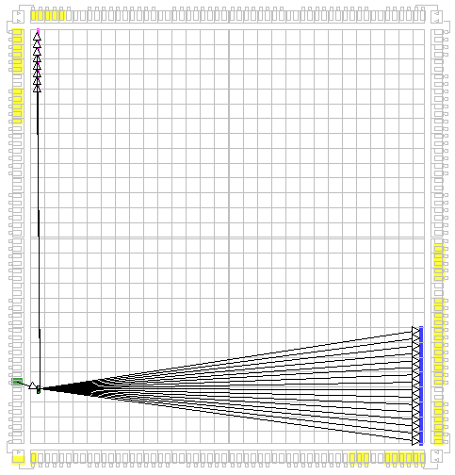
Duplicating Flip-Flops Example
The source flip-flop drives two register banks that are constrained to different regions of the chip
The source flip-flop and pad are not constrained
PERIOD = 5 ns timing constraint
Implemented with default options
Longest path = 6.806 ns
  Fails to meet timing constraint
Notes:
In this simple design, the source flip-flop is “trapped” between the two sets of loads. Moving the source flip-flop closer to one register moves it farther away from the other register. The overall result is that timing cannot be met.

Slide 40
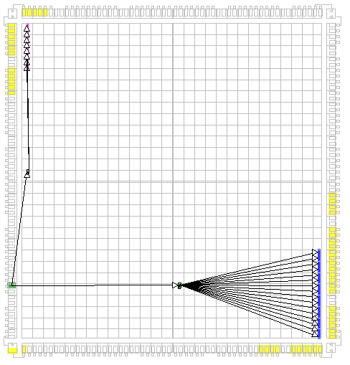
Duplicating Flip-Flops Example
The source flip-flop has been duplicated
Each flip-flop drives a region of the chip
  Each flip-flop can be placed closer to the register that it is driving
  Shorter routing delays
Longest path = 4.666 ns
  Meets timing constraint
Notes:
By duplicating the source flip-flop, the tools are able to move each flip-flop closer to its set of loads.
The trade-off is that the paths from the input pad to the duplicated flip-flops are increased. This design does not contain an OFFSET IN constraint. If you have an OFFSET IN requirement, you must consider how much slack you have on the OFFSET before deciding to duplicate the flip-flop.
You can also consider duplicating the input pad that is connected to the flip-flops. This method allows the implementation tools to keep the input setup time short, while improving the internal clock frequency. The trade-off is that an additional I/O pin is used, and you must route the external signal to two I/O pins.

Slide 41
Tips on Duplicating Flip-Flops
Name duplicated flip-flops _a, _b; NOT _1, _2
  Numbered flip-flops are mapped into the same slice by default
  Duplicated flip-flops should be separated
    Especially if the loads are spread across the chip
Explicitly create duplicate flip-flops in your HDL code
  Most synthesis tools have automatic fanout-control features
    However, they do not always pick the best division of loads
    Also, duplicated flip-flops will be named _1, _2
  Many synthesis tools will optimize-out duplicated flip-flops
    Set your synthesis tool to keep redundant logic
Do not duplicate flip-flops that are sourced by asynchronous signals
  Synchronize the signal first
  Feed the synchronized signal to multiple flip-flops
Notes:
If duplicated flip-flops are named numerically (for example, signal_rep0 and signal_rep1), the implementation tools see this as a bus, and the flip-flops are mapped into the same slice. If this happens, routing congestion will still be a problem.
You can work around this problem by using the timing-driven packing option, which is covered in the “Advanced Implementation Options” module.
“Synchronize the signal first:” Synchronization circuits will be discussed later in this module.

Slide 42
Pipelining Concept
f_{MAX} =
n MHz
D
Q
two logic levels
D
Q
f_{MAX} ≈
2n MHz
one level
one level
D
Q
D
Q
D
Q
Notes:
Inserting flip-flops into a datapath is called pipelining.
Pipelining increases performance by reducing the number of logic levels (LUTs) between flip-flops.
All Xilinx FPGA device families support pipelining. The basic slice structure is a logic level (four-input LUT) followed by a flip-flop.
Adding a pipeline stage, as shown in this example, will not exactly double f_{MAX}. The flip-flop that is added to the circuit has an input setup time and a clock-to-Q time that make the pipelined circuit run at less than double the original frequency.
You will see a more detailed example of increasing performance by pipelining later in this section.

Slide 43
Pipelining Considerations
Are enough flip-flops available?
  Refer to the MAP Report
  In general, you will not run out of flip-flops
Are there multiple logic levels between flip-flops?
  If there is only one logic level between flip-flops, pipelining will not improve performance
  Refer to the Post-Map Static Timing Report or Post-Place & Route Static Timing Report
Can the system tolerate latency?
Notes:
Available flip-flops: The Design Summary section of the MAP Report contains resource utilization information. In most cases, you will have enough flip-flops available to add pipeline stages.
Logic levels: Timing reports show which paths are the longest and how many logic levels are in each path. Look at the detailed path analysis section of the report and count the number of look-up table delays (Tilo) to determine the number of logic levels in the path.
Latency is explained in greater detail on the next page.

Slide 44
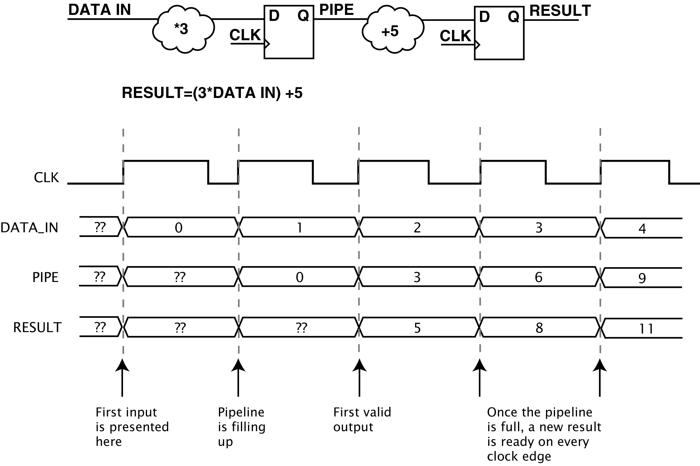
Latency in Pipelines
Each pipeline stage adds one clock cycle of delay before the first output will be available
  Also called “filling the pipeline”
After the pipeline is filled, a new output is available every clock cycle
Notes:
This is an example of a pipelined circuit. Follow the data as it goes through the multiplication and then the addition.
Latency in pipelines can be visualized as a factory assembly line. Raw materials enter the assembly line and then go through several stations. At each station, one production step is performed. When you start the assembly line, you have to wait before the first finished product is produced. After that waiting period, a constant stream of products comes off the assembly line.

Slide 45
Pipelining Example
Original circuit
  Two logic levels between SOURCE_FFS and DEST_FF
  f_{MAX} = ~233 MHz
LUT
D
Q
LUT
D
Q
LUT
SOURCE_FFS
DEST_FF
LUT
Notes:
This path has two logic levels between SOURCE_FFS and DEST_FF. The first logic level is the column of three LUTs in parallel. The second logic level is the single LUT on the right.
The delays in this path are:
SOURCE_FFS clock-to-Q
Net delay
LUT delay
Net delay
LUT delay
DEST_FF setup time
Estimating no clock skew and routing delays to be approximately 1.5 ns each, this circuit could run at about 207 MHz in a Virtex™-II device (slowest speed grade).

Slide 46
Pipelining Example
Pipelined circuit
  One logic level between each set of flip-flops
  f_{MAX} = ~385 MHz
LUT
D
Q
D
Q
LUT
D
Q
LUT
D
Q
SOURCE_FFS
DEST_FF
LUT
D
Q
PIPE_FFS
Notes:
After adding a pipeline stage, the circuit has been split into two paths. The first path is from SOURCE_FFS through one logic level to PIPE_FFS. The second path is from PIPE_FFS through one logic level to DEST_FF.
The delays in either path are:
Starting FF clock-to-Q
Net delay
LUT delay
Ending FF setup time
Estimating each routing delay to be approximately 1.5 ns, as in the original circuit, this circuit could run at about 347 MHz (a 67 percent increase).
In this example, the performance increase was much less than double because the net delays were estimated to be short. If you estimated routing delays to be 3 ns, the performance would jump from 128 MHz to 228 MHz (a 78 percent increase).

Slide 47
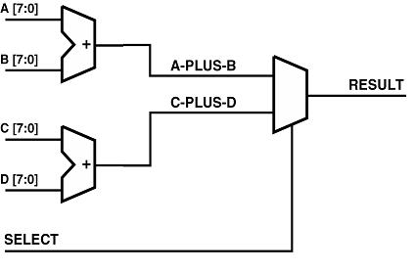
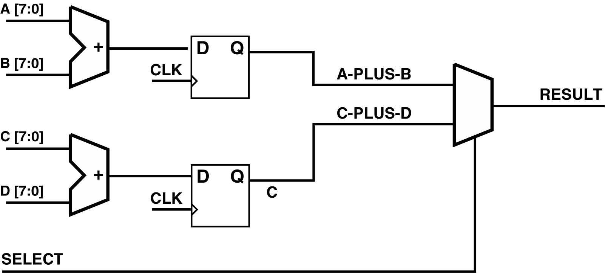
Review Questions
Given the original circuit, what is wrong with the pipelined circuit?
How can the problem be corrected?
Original Circuit
Pipelined Circuit
Notes:
This simple circuit is a multiplexed adder where the SELECT signal determines whether the output is (A + B) or (C + D).
The designer decides to add a pipeline stage to the circuit to improve performance, but something is not quite right. What is the correct way to pipeline this circuit?

Slide 48
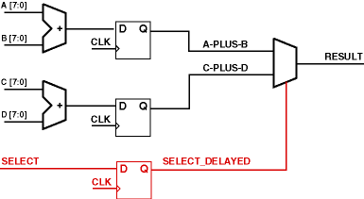
Answers
What is wrong with the pipelined circuit?
  Latency mismatch
  Older data is mixed with newer data
  Circuit output is incorrect
How can the problem be corrected?
  Add a flip-flop on SELECT
  All data inputs now experience the same amount of latency
Notes:
When the designer simulated the circuit on the previous page, the designer saw that the multiplexer was not selecting the correct sum. The designer forgot to add a pipeline stage to the SELECT input.
This concept of matching latency in pipelines can be easily overlooked, especially when you have multiple pipelined circuits in your design. If the outputs of two different pipelines need to be combined, you must ensure that the pipelines have the same amount of latency. You can use the Shift Register LUT (SRL) feature of Virtex™ devices to match latency without using large numbers of flip-flops.

Slide 49
Outline
Duplicating Flip-Flops
Pipelining
I/O Flip-Flops
Synchronization Circuits
Summary

Slide 50
I/O Flip-Flop Overview
Each I/O block in the Virtex™-II Pro device contains six flip-flops
  IN FF on the input, OUT FF on the output, EN FF on the 3-state enable*
  Single data rate or double data rate support
I/O flip-flops provide guaranteed setup, hold, and clock-to-out times when the clock signal comes from a BUFG
Notes:
* These are the flip-flop names that you will see in the MAP Report when I/O flip-flops are used. They do not correspond to library components.
These features are also present in the Virtex-II Pro and Spartan™-3 device families.
For the Virtex-4 device, the MAP Report lists registers as INFF2, OFF2, and ENFF2 to indicate double data rate.

Slide 51
Accessing I/O Flip-Flops
During synthesis
  Timing-driven synthesis can force flip-flops into Input/Output Blocks (IOBs)
  Some tools support attributes or synthesis directives to mark flip-flops for placement in an IOB
Xilinx Constraint Editor
  Select the Misc tab and specify registers that should be placed into IOBs
    You need to know the instance name for each register
During the MAP phase of implementation
  In the Map Properties dialog box, the Pack I/O Registers/Latches into IOBs option is selected by default
  Timing-driven packing will also move registers into IOBs for critical paths
Check the MAP Report to confirm that IOB flip-flops have been used
  IOB Properties section
Notes:
Refer to your synthesis tool documentation for details on how to access IOB flip-flops.
The Constraints Editor Misc tab is covered in the “Path-Specific Timing Constraints” module.
Timing-driven packing is covered in the “Advanced Implementation Options” module.

Slide 52
Skills Check

Slide 53
Review Questions
High fanout is one reason to duplicate a flip-flop. What is another reason?
Provide an example of when you do not need to resynchronize a signal that crosses between clock domains
What is the purpose of the “extra” flip-flop in the synchronization circuits shown in this module?

Slide 54
Answers
High fanout is one reason to duplicate a flip-flop. What is another reason?
  Loads are divided among multiple locations on the chip
Provide an example of when you do not need to resynchronize a signal that crosses between clock domains
  Well-defined phase relationship between the clocks
  Example: Clocks are the same frequency, 180 degrees out of phase
  Use related PERIOD constraints to ensure that datapaths will meet timing
What is the purpose of the “extra” flip-flop in the synchronization circuits shown in this module?
  To allow the first flip-flop time to recover from metastability

Slide 55
Summary
You can increase circuit performance by:
  Duplicating flip-flops
  Adding pipeline stages
  Using I/O flip-flops
Some trade-offs
  Duplicating flip-flops increases circuit area
  Pipelining introduces latency and increases circuit area
Synchronization circuits increase reliability

Slide 56
Where Can I Learn More?
User Guides: www.xilinx.com → Documentation → User Guides
  Switching Characteristics
  Detailed Functional Description → Input/Output Blocks (IOBs)
Application Notes: www.xilinx.com → Documentation → Application Notes
  XAPP094: Metastability Recovery
  XAPP225: Data-to-Clock Phase Alignment

