Slide 1

Automated Multi-Label Classification
Code Gladiators 2020
Team Name : AI Enthusiasts
Team Member: Anand P V
M. Tech CSE, IIT Bombay
VP of Technology, IIA Pvt Ltd.

Slide 2
Executive Summary
Innovative way to do news classification with a unique combination of LDA, NMF and One Vs Rest classifier.
LDA is a probabilistic generative process adapted to different kind of analysis.
NMF is a linear-algebraic method to calculate the value of keywords in the document and assign document to topic which keyword has maximum value.
Google’s 300-dimensional word vectors for a vocabulary of 3 million words, which are trained on around 100 billion words from a Google News dataset is used to compute word distance metrics.
Category Tree information embedded in HTTP link is extracted using interesting properties of word vectors.
Significant words in “Description” is correlated with categories in given enriched Category Tree by TIL.
Breadth-First Search of category tree is done to find out the best category tree allocation based on W2V
One Vs Rest classifier is used to resolve classification ambiguities.
Politics News Election
The outcome of NMF and LDA are normalized and conjugated before figuring out the topic.

Slide 3
Problem at hand
The problem at hand is Automated Multi-Label Classification .
The requirement is to classify the news category based on the collated news article data containing text and URL.
News can belong to one or more category based on content of the news.
For example: News about sports personality may belong to the Sports category and Entertainment category too.
There are certain entities/keywords in the news article which can help to determine category of the news.
All the URL’s visited on TIL network. Given set of URL’s, their short/Long description, participants have to classify
them across multiple categories.
Tasks:
Identification of Keywords : The content which can help in categorizing the news to different categories
Formation of category tree on the basis of the identified keywords with ML.

Slide 4
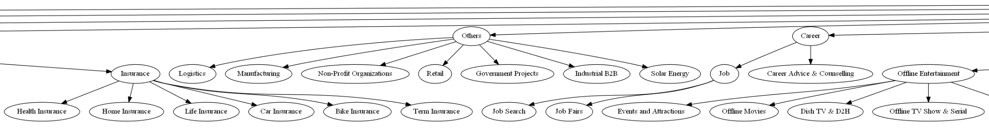
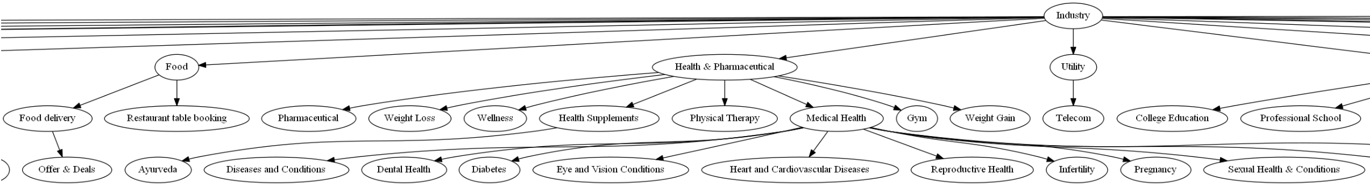
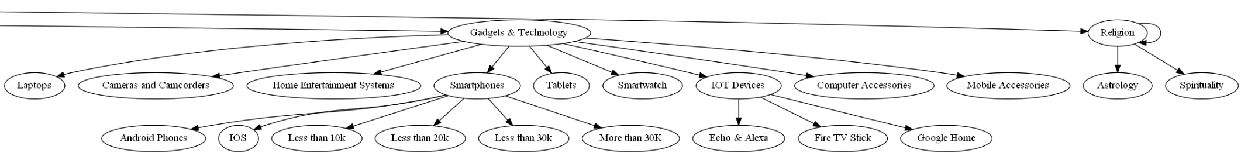
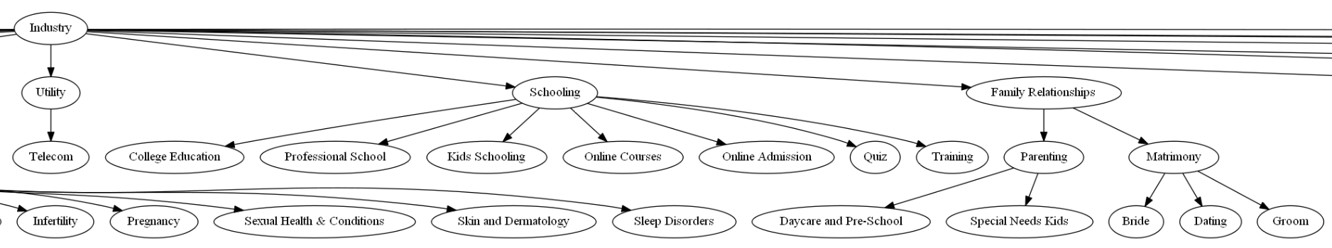
Category Tree Depiction

Slide 5
Solution
As the dataset is very huge, the task to label articles in to a category hierarchy would take huge amount of time. The aim is to reduce the manual work to the extend possible.
When I used the state-of-the-art Topic-Modelling technique LDA (Latent Dirichlet Allocation), it gave high number of wrong classification. Hence NMF (Non Negative Matrix Factorization) is also used along with Multi Class Binarizer to refine results.
As LDA, NMF and MC-Binarizer resulted in fairly high number of miss-classification, we have found a unique way to numerically combine LDA matrix output with factorized output of NMF, post-normalization and then match with MC-Binarizer to improve accuracy.
LDA is a probabilistic model and NMF a linear algebraic model used to find common keywords that appear in number of documents and assign those to the topics.
For example: consider you have around 100000 doc’s and specify n_topics = 10 while applying LDA function. LDA will sort all doc’s into 10 and assign keyword’s to the topics.
# Topic 1 : 0 – 9999
# Topic 2 : 10000 – 19999
-
-
# Topic 10 : 90000 – 99999
After finding keywords I manually assigned keywords to the Topics. Then, assigned keywords to the topic which has maximum value.
For example: if we have keywords “bjp, election, modi”, then such document will be assigned to topic politics and election.
After that used One Vs Rest classification algorithm with Logistic Regression to resolve ambiguities, for instance
- the bjp, modi keywords into Politics
- then election keyword into Election.

Slide 6
Solution
Though LDA and NMF methods provide the necessary categorization, it wont be able to provide the multi-level category-tree differentiation of data, as required by TIL enriched category tree.
Hence, I have extracted the category-tree information hidden in the sequence of URL text, corresponding to each article.
A custom algorithm which peruses GoogleNews vectors and category tree to parse each URL is coded. The corresponding confidence score of category prediction is computed using a mathematical formula based on the numerical distribution of values in the list. Saved the (id, tree, confidence) information into CSV file.
Another deep algorithm is used to analyze each article text correlated to each category node. Multi-word categories are intelligently handled not to hike up the similarity scores. This function is the core of the solution. Here also, I have saved the (id, tree, confidence) information into CSV file.
Next step, I have merged the Article Description Classifier with URL Classifier as first fallback and LDA-NMF Classifier as second fallback. The confidence score is used to decide the relative relevance of the classification method. Article Description Classifier is considered as the final fallback as it is the most analytical.

Slide 7
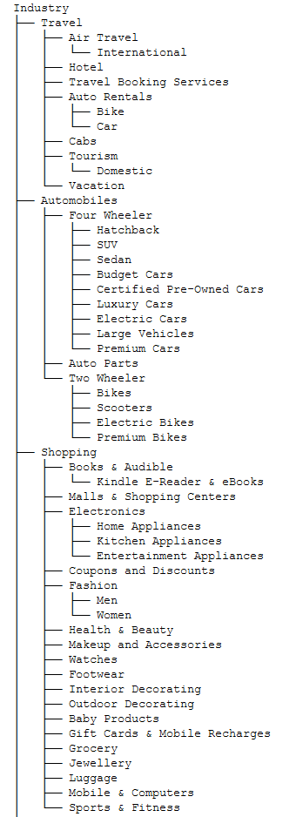
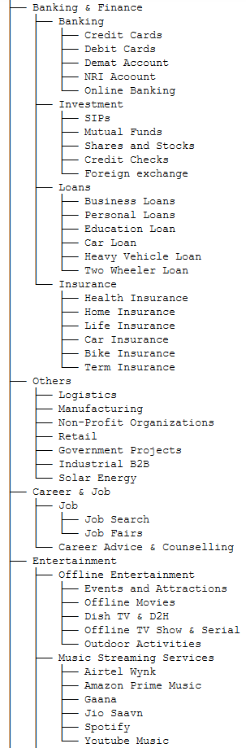
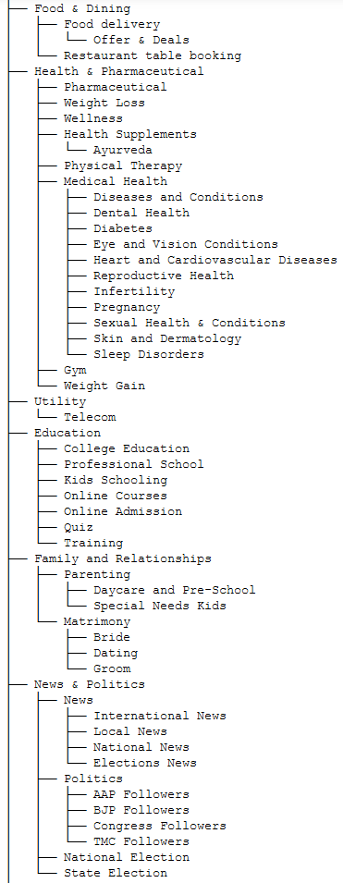
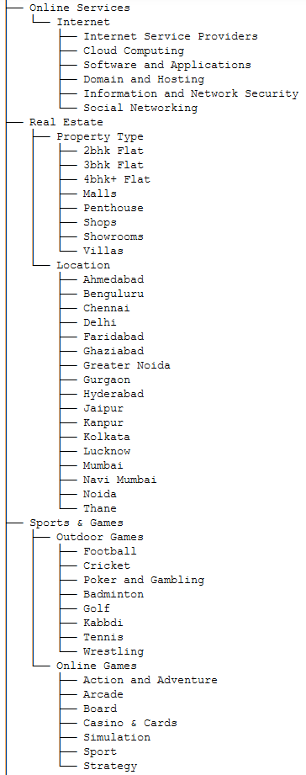
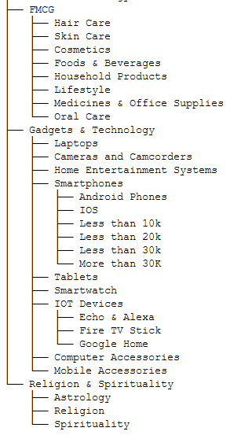
Solution Details
AnyTree package in Python is used to create, manipulate and traverse the category tree information given as input. The below tree structure is programmatically generated using the given csv input and visualized using graphviz.

Slide 8
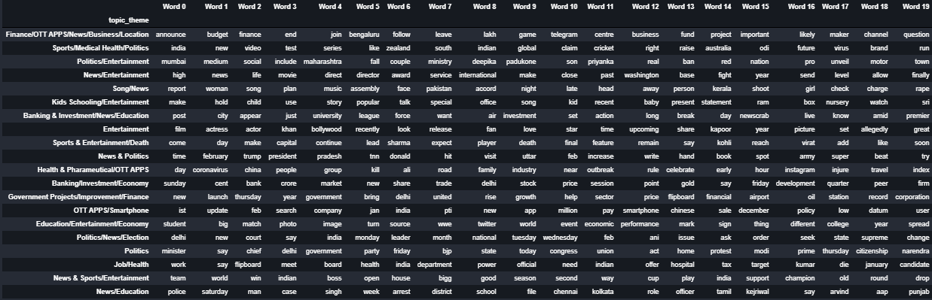
Solution Demo
LDA Output:
These are the Common Keywords extracted from docs using LDA and labelled topics,

Slide 9
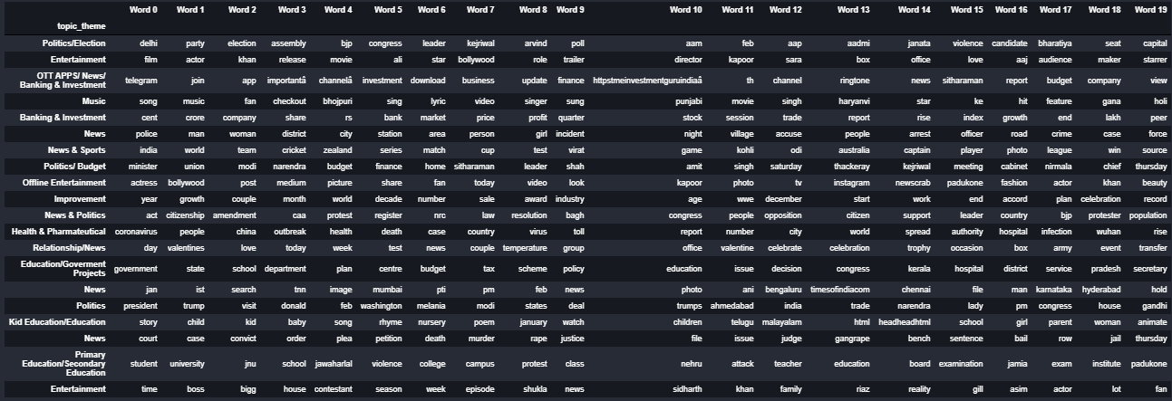
NMF Output:
These are the Common Keywords extracted from docs using NMF and labelled topics,

Slide 10
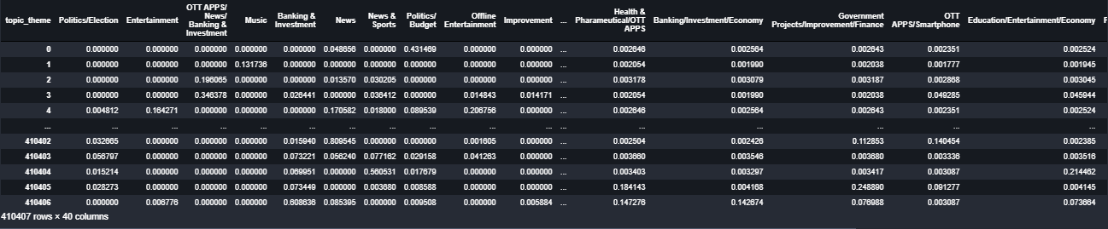
Combined LDA and NMF output:
After finding top keywords from both LDA & NMF. Then found probability of documents in LDA and NMF. Then I combined both models .

Slide 11
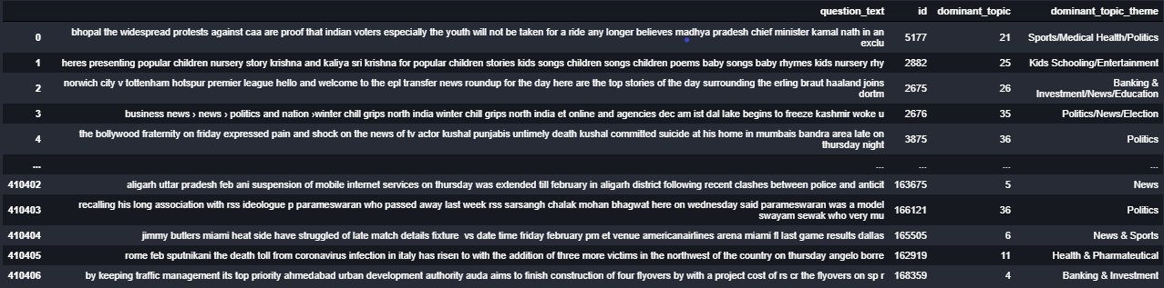
LDA-NMF Result:
After combining the models I assigned topic to the document which topic has maximum percentage.

Slide 12
Data Pre-processing
In the dataset we have large number of dataset so we cleaned that before doing topic modelling.
First problem I encountered is we have some missing content in the long description so I replaced the content with values in the short description.
And made the description column NAN Free.
Then the main problem in the dataset is languages since LDA only work with English Language.
So I used Google Translate API to translate all languages into English.
After that removed stopword’s, punctuation, brackets and numbers.
Lowercase and Lemmatization using Spacy then removing “PRON” & Stemming
For word vector similarity computation, lemmatization and stemming are avoided as the Google Word vectors are not trained on lemmatized English words.
The category tree node words are tweaked because multi-words categories having different meanings are combined into similar meaning words so that distance metrics won't go awry. This can easily be mapped back to the original category info. The meaning of the tweaked node names are also meaningful, nevertheless.

Slide 13
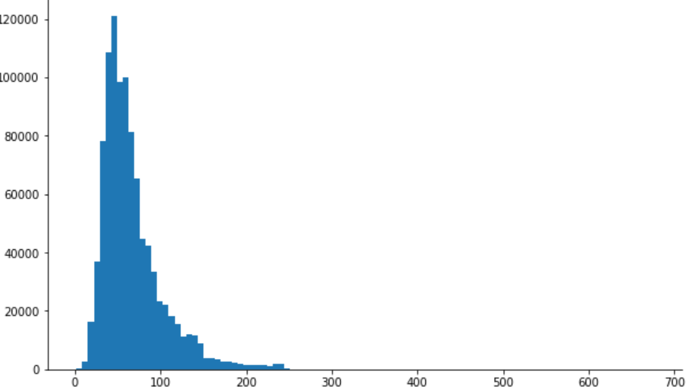
Exploratory Data Analysis:
Using Exploratory Data Analysis, visualized how the descriptions are in general,
Distribution of Description character Length
Description character Length

Slide 14
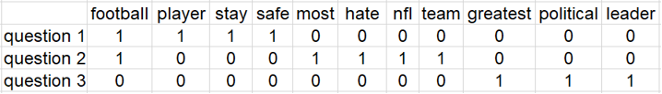
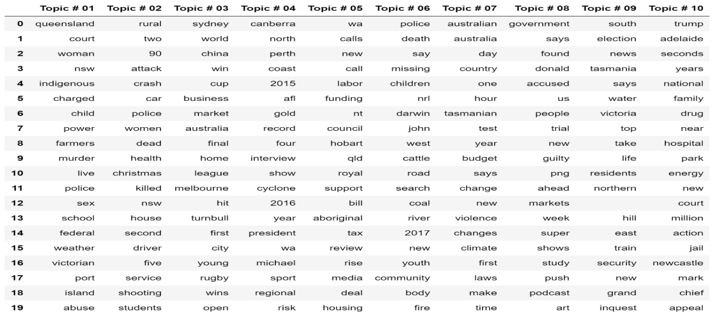
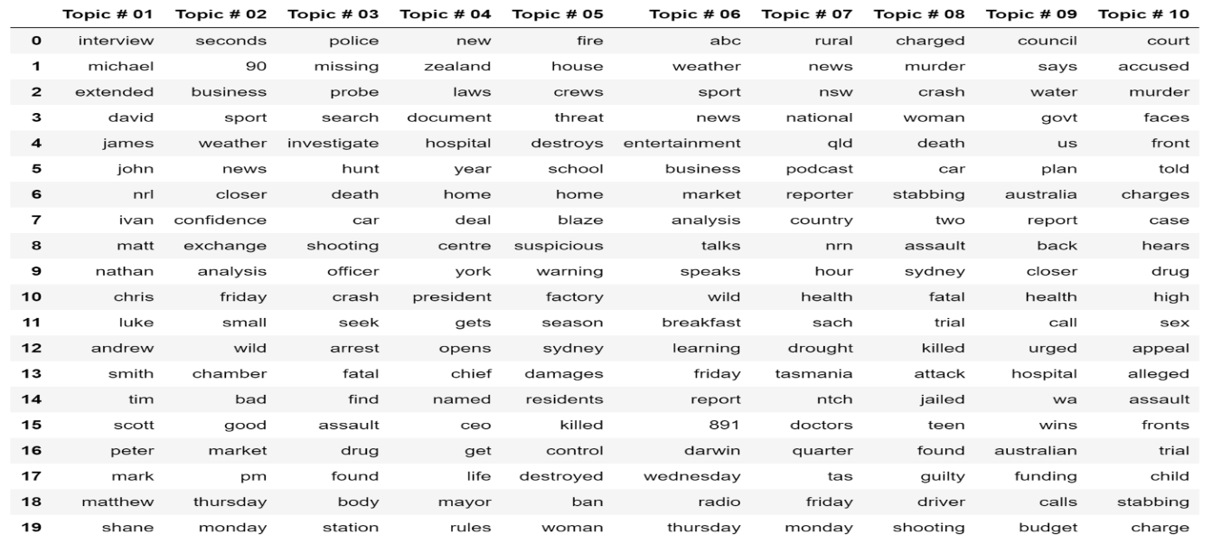
Topic Modelling with LDA and NMF
Latent Dirichlet Allocation (LDA) and Non Negative Matrix Factorization takes only input as a document-term matrix
So I calculated document matrix for every documents. Here is my example document matrix,
each row is a document ,each column is word , we label “0” if document doesn’t contain word otherwise label as “1”.
LDA & NMF Output
Top words extracted from all the documents using LDA & NMF.
LATENT DIRICHLET ALLOCATION (LDA)
NON NEGATIVE MATRIX FACTORIZATION (NMF)

Slide 15
Evaluate LDA model Performance with Perplexity and Log-likelihood
A LDA(Latent Dirichlet Allocation) model with higher Log-Likelihood and lower Perplexity is considered to be good.
Here is our model perplexity and Log-Likelihood results,
Perplexity: -9965645.21463
Log=Likelihood: 2061.88393838
Multi Label Classification using One Vs Rest Classifier:
After getting LDA and NMF outputs. I combined it and found probability of each topic assigned documents to specific topics which has highest
probability.
After that used Multi-Class Classification algorithm, One Vs Rest Classifier to split the topics,
-> For example: consider we have keywords bjp, vote, election, modi we will assign to topic Politics/Election
-> Using One Vs Rest classifier we split,
bjp, modi into Politics.
vote, election into Election.
Evaluated One Vs Rest classifier model with F1 score Metrics and got highest score of around 81%.

Slide 16
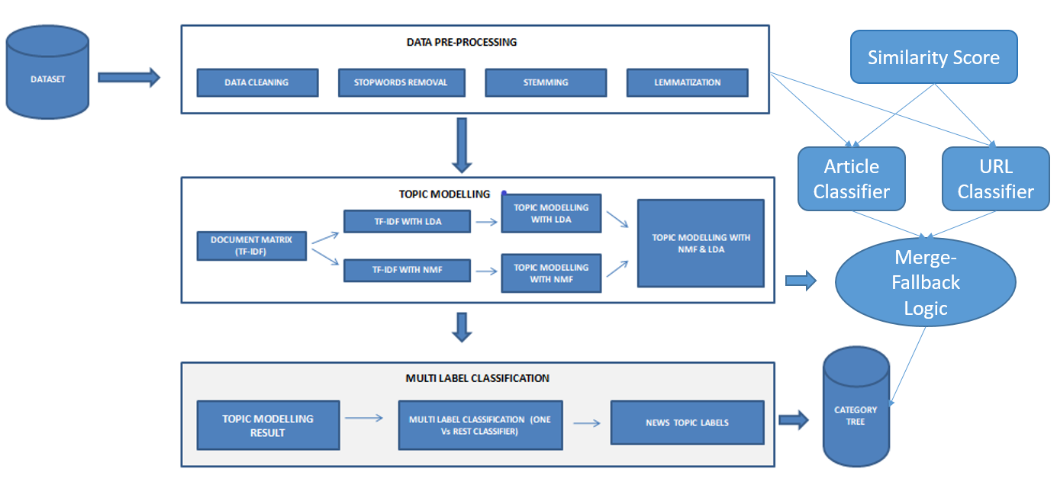
Architecture

Slide 17
Why our team is the best!
I have done background reading and also put in deep thought on the given problem. There are more ideas to implement but couldn’t implement due to compute and memory and human resource limitations (individual participation). I will mention some of those techniques in the next slide.
Have in-depth knowledge in DL, NLP, Computer Vision.
Have worked on all formats: Images, Text and Speech also as input to our Deep Learning system
Have experience on similar problems.
Moreover, there is passion in my work.
I believe in continuous improvement.
Working as VP of Technology in a company which uses state-of-the-art technologies.

Slide 18
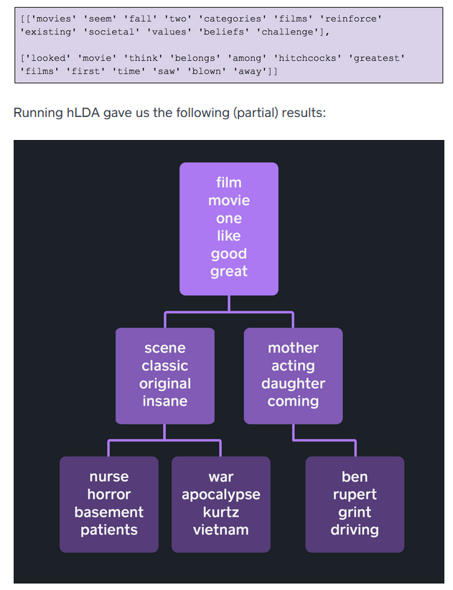
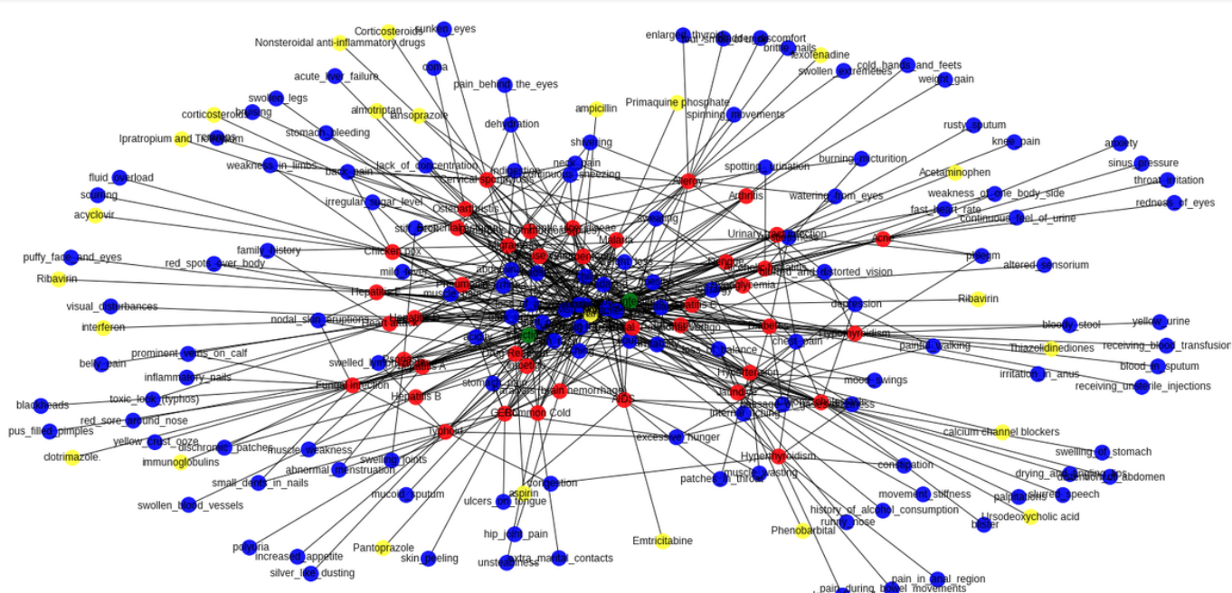
Improvements
hLDA: Hierarchical-LDA to group documents by hierarchies of topics
Knowledge Graph
Knowledge graph of article text would generate hierarchical relation of words, akin to a category tree.

Slide 19
Associated attachments/ files
Multi-Lingual_Category_Tree_Classification.ipynb: Source code in Main Code in Jupyter notebook
News_Classification.ipynb: Fall-back method of LDA-NMF classification
Result_Submission.csv: Result in the format specified
Input files = [Train_data.csv, one.csv, two.csv, three.csv, four.csv, four1.csv, noun.csv, result.csv,result2_today.csv]
Presentation: contains architecture, solution pipeline, thoughts, techniques etc.
Readme.txt: step by step guidance to run the code

Slide 20
Challenges
First challenge was on input data. It took time to clean the data.
Another challenge was the usage of multiple languages in the input dataset. I have used Spacy language detector & Watson API to solve.
The classic solution to such problem was Latent Dirichlet Allocation (LDA) and Non Negative Matrix Factorization
(NMF). But for this input document set, LDA and NMF was just giving important keywords and not topics as required.
Since LDA and NMF only gives the keywords not topics so labelled the topics based on keywords.
As neither LDA nor NMF was giving great results, we had to find an innovative way to combine the two methods.
After that also some miss-classification in topics happened. To solve this problem, used Multi Label Classification method One Vs Rest Classifier.
There are more ideas to implement but couldn’t implement due to compute and memory and human resource limitations (individual participation).

Slide 21
Thank You

