Slide 1
Inception to Workflow
Configuration, Containerization, and Cloud

Slide 2
Architecture

Slide 3


Slide 4
What
Terraform is...
Open Source
X-Platform
AWS, GCP, VMware, Virtual Box, etc

Slide 5
Use Cases
Autopilot Patterns
Multi-tier Applications
Deploying Across Platforms
Disposable Environments
Software Defined Networking
Resource Schedulers
Multi-cloud Deployment

Slide 6
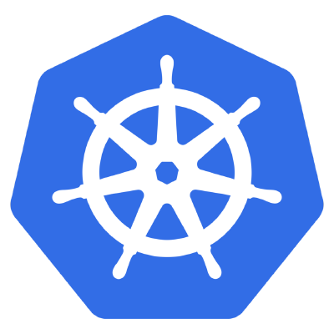
Kubernetes

Slide 7
What
Kubernetes is...
Portable
Extensible
Self-healing

Slide 8
Use Cases
Continuous Dev, CI, & CD
Dev & Ops SoC
Environmental Consistency
Distribution Portability
Notes:
Continuous development, integration, & deployment per image immutability for reliable container image build & deployment w/ rollbacks.
Dev & Ops Separation of Concern: app container images can be built at build/release time rather than deployment time, decoupling apps from infrastructure.
Environmental consistency across development, testing, and production: Runs the same on a laptop as it does in the cloud.

Slide 9


Slide 10
Azure
What we’ll see...
Virtual Machines

Slide 11


Workflow

Slide 12
Phase 1

Slide 13
Phase 2

