Slide 1
Inception, Workflow, to $Deployed$
Configuration, Containerization, and Cloud

Slide 2


Slide 3
What
Terraform is...
Open Source
X-Platform
AWS, GCP, VMware, Virtual Box, etc

Slide 4
Use Cases
Autopilot Patterns
Multi-tier Applications
Deploying Across Platforms
Disposable Environments
Software Defined Networking
Resource Schedulers
Multi-cloud Deployment

Slide 5
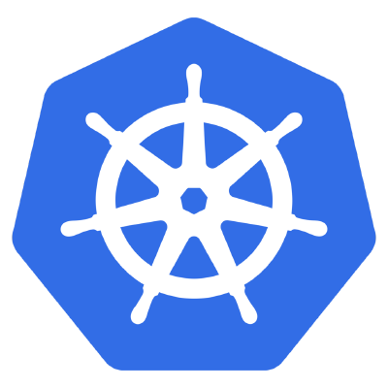
Kubernetes

Slide 6
What
Kubernetes is...
Portable
Extensible
Self-healing

Slide 7
Use Cases
Continuous Dev, CI, & CD
Dev & Ops SoC
Environmental Consistency
Distribution Portability
Notes:
Continuous development, integration, & deployment per image immutability for reliable container image build & deployment w/ rollbacks.
Dev & Ops Separation of Concern: app container images can be built at build/release time rather than deployment time, decoupling apps from infrastructure.
Environmental consistency across development, testing, and production: Runs the same on a laptop as it does in the cloud.

Slide 8


Slide 9
Azure
What we’ll see...
Virtual Machines

Slide 10


Workflow

Slide 11
Phase 1

Slide 12
Phase 2

