Slide 1
Node.js
Nodal Inception
Notes:
Hello. I’m Adron and I’m going to take you through a kind of journey via Node.js and JavaScript today. This is going to be a little bit about a range of things, and it’ll largely seem kind of sporadic.

Slide 2
Objectives
Break Things
Create New
Build Better
Notes:
However, the objective of my talk today is to invoke some ideas on how to build things with Node.js that might break the traditional mold. By breaking the existing ways we do things we can hopefully build better, bigger, more capable things with Node.js, JavaScript, and the litany of tooling that exists with the ecosystem. All of this, by going smaller, simpler, and easier with our designs and systems for the future.

Slide 3
Context
Short History
New Containment
Future Shipping
Notes:
Before getting into the topic, let’s talk about where we’ve been, where we are, and what we might make possible in our future.

Slide 4
Short History
Ryan Dhal
Focused Deployments
Simplified Web
Huge Community
Notes:
Created in 2009
Helped better deployments vs. traditional JVM/.NET stack.
Simplified web dev by enabling js on server & client…
A huge community got involved.

Slide 5
New Containment
Docker (Rocket?)
Kubernetes
Beanstalk (PaaS?)
Notes:
Containers
Container Schedulers & Management
AWS

Slide 6
Future Shipping
Observing Events
Teach Your Machines
Bigger Code
Transparency
Notes:
Observability
Machine Learning
Transparency of Application & Service Operations

Slide 7
Demo: Today

Slide 8
Steps
Kubernetes
Node.js Server
Run It…

Slide 9
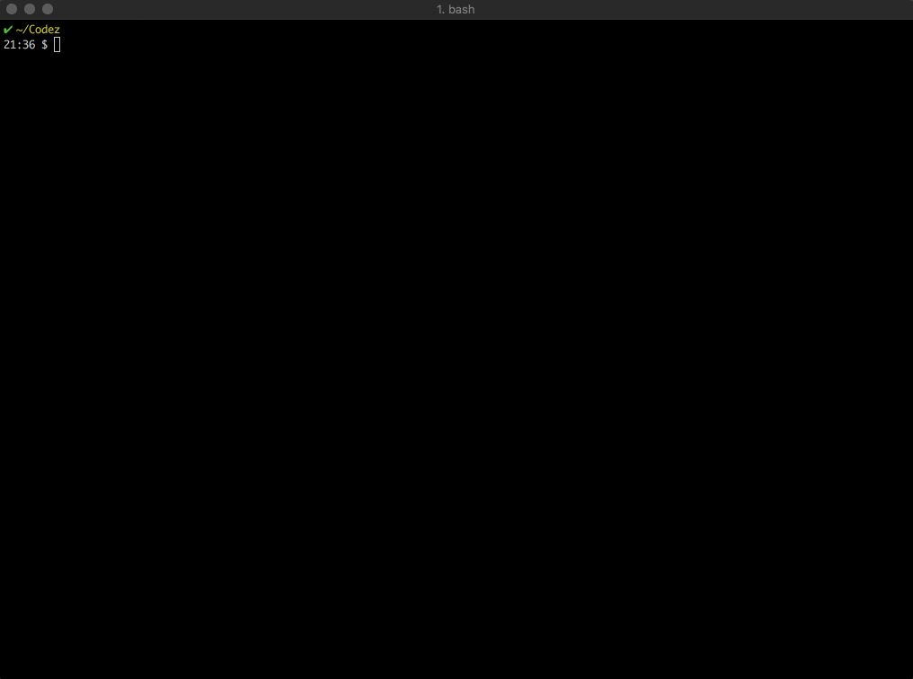
Notes:
First… we’ll check that my kubernetes connection is setup with a `kubectl` command.
Then create the base files - open code.
Now let’s create a basic server…

Slide 10
Next Steps
Dockerfile
Build Image

Slide 11
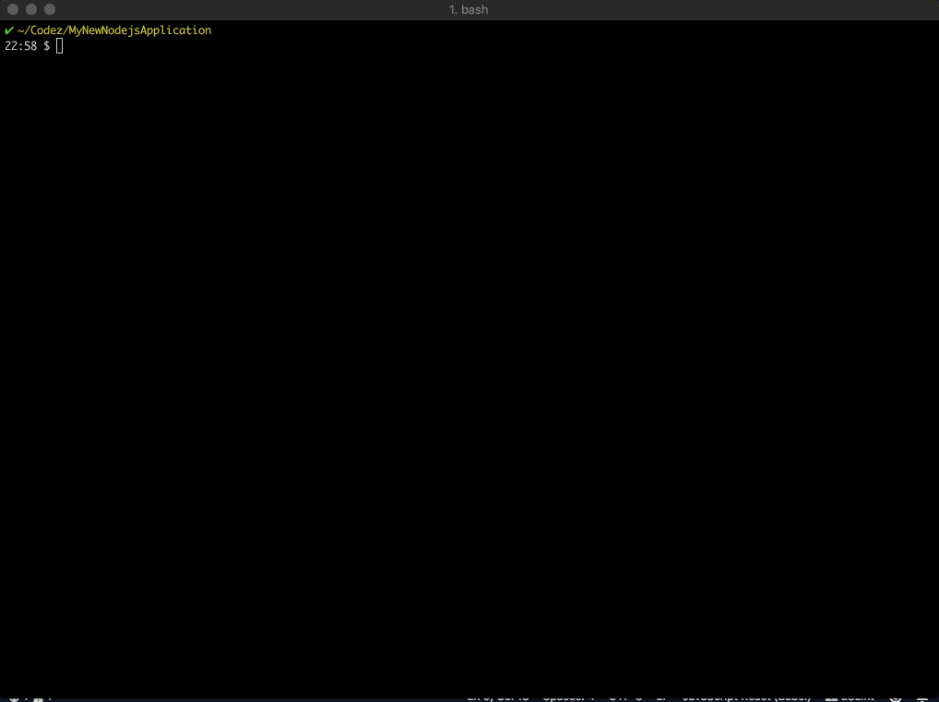

Slide 12
Deployment
Notes:
Now the application, packaged in a docker image, can be deployed via kubernetes.

Slide 13
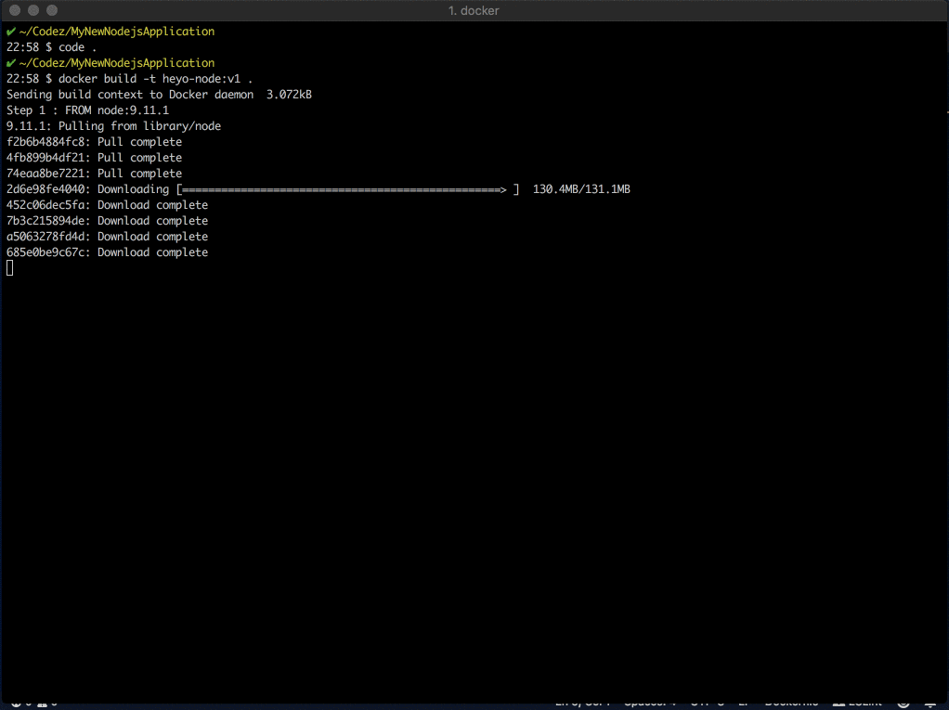
Notes:
While that finishes up, the image gets built, basic elements of the app - namely the server.js file is copied and the startup for the container is setup to execute that via node.

Slide 14
Minimal
Alpine w/ Node.js 9.11.1
~Microservice Like
Quick Baseline
Notes:
That was a minimal example but it proves out some elements that quickly…

Slide 15
Recent Events
Node.js v4 is Dead!
It’s on v10.x! - Long live Node.js
Notes:
Node v4 is dead, 10 is the new node, long live node.

Slide 17
Node.js v10.x
7th Major Release
http 2
N-API
TTD Support for generators
… more …

Slide 18
Future
Notes:
Obviously, no demos of the future yet, because we’re building that. But the talk title comes into play here.

Slide 19
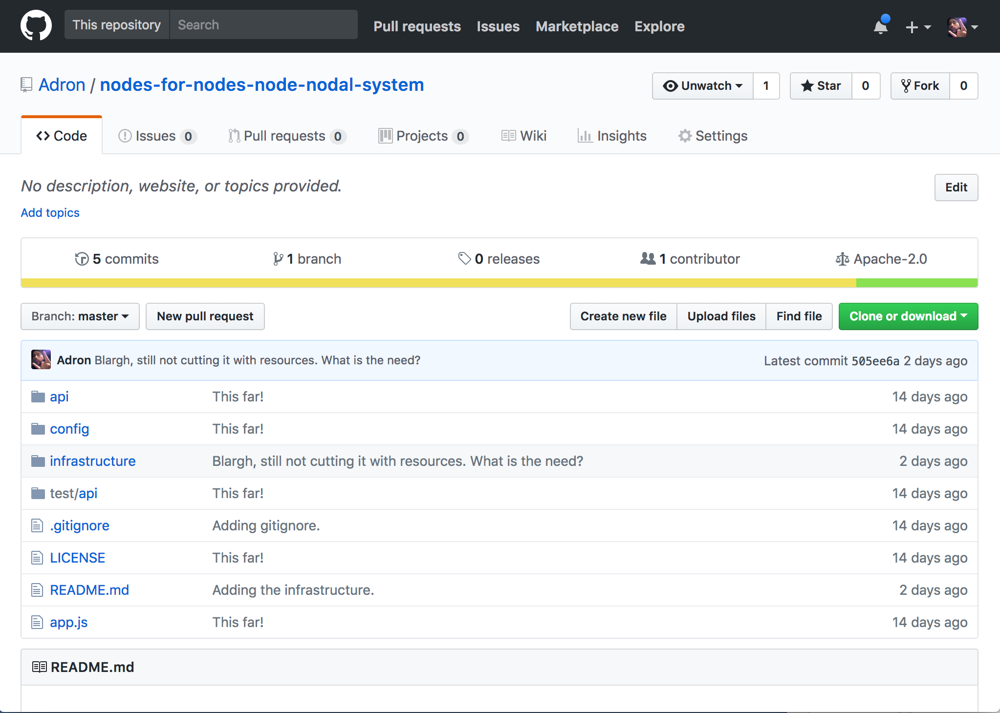
Notes:
I’m currently building a reference application with the elements previously mentioned. This is where I could really use your help to build the future.

Slide 20
Node.js
Observability
Machine Learning
Transparency
Operations
Notes:
The focus of the project is around building the application so it is at inception has observability, machine learning, transparency, and operational efficiencies built in.

Slide 21
Notes:
Here’s a simple Cassandra Cluster plus Application Tier of Node.js Servers.

Slide 22
Observability
Monitoring, APM, Tracing …
The closest is tracing…
About tracking app/services events…
https://compositecode.blog/2018/02/02/reading-up-on-observability-and-monitoring/

Slide 23
ML/AI
Rooted in Tracing & Events Data
Ops vs. App Observability
Alerting, But Actions
Informed Distributed Systems Tracing

Slide 24
Notes:
Nodes. Connecting everything.

Slide 25
Adron Hall
Twitter @Adron
Github @Adron
https://compositecode.blog

