Slide 1
NAME: Adarsh Azad PGI HOSPITAL REGISTRATION NUMBER: -11902794 ROLL NO: - 20 SECTION: K19KH

Slide 2
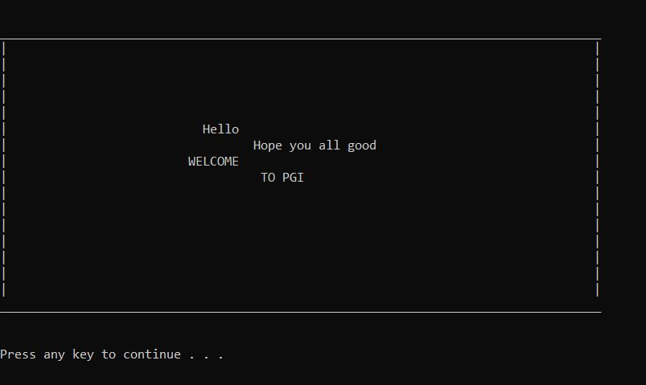
PASSWORD: Adarsh_Azad

Slide 3
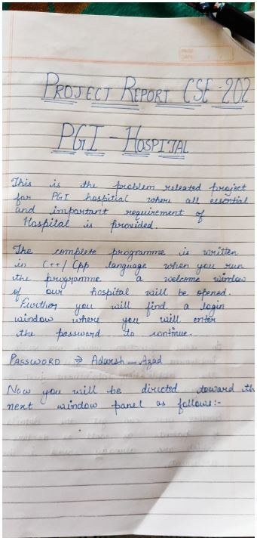
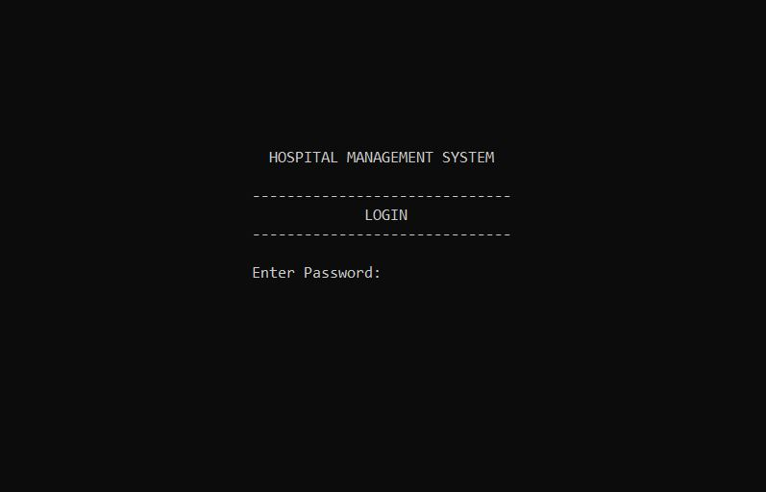

Slide 4
