Slide 1

Airline Review Insights
Insights based on verified and not verified traveler reviews.

Slide 2

Key Highlights
1. Review Verification:
- Verified Reviews: 739 (74%)
- Not Verified Reviews: 261 (26%)
- Majority of reviews are from verified travelers.
2. Sentiment Analysis:
- Positive Sentiments: 532 (53%)
- Negative Sentiments: 448 (44%)
- Neutral Sentiments: 20 (2%)
- Positive feedback prevails, but negative reviews indicate areas for improvement.
3. Sentiment by Verification:
- Verified Reviews: 395 Positive, 327 Negative, 17 Neutral
- Not Verified Reviews: 137 Positive, 121 Negative, 3 Neutral

Slide 3
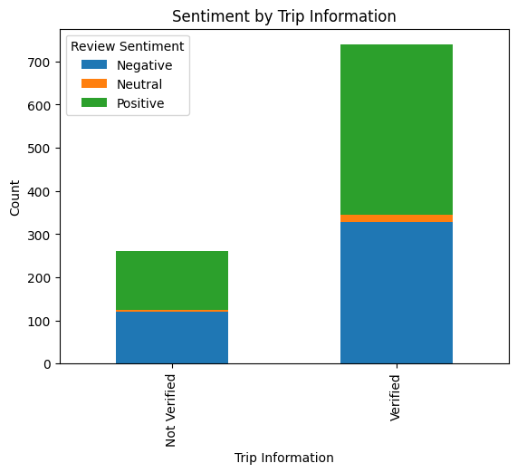
Sentiment Distribution

Slide 4
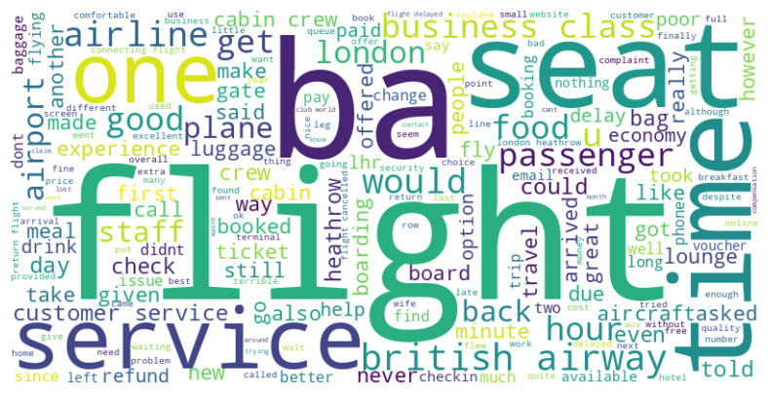
Word Cloud Insights

Slide 5
Key Takeaways
1. Strengths:
- Positive feedback from most verified travelers.
2. Improvement Areas:
- Address common complaints about 'delay,' 'refund,' and 'luggage.'
3. Actionable Insights:
Focus on enhancing customer service and operational efficiency.

Slide 6
Next Steps
1. Implement targeted strategies to address key areas of dissatisfaction.
2. Monitor future reviews to measure the impact of implemented changes.

