Slide 1
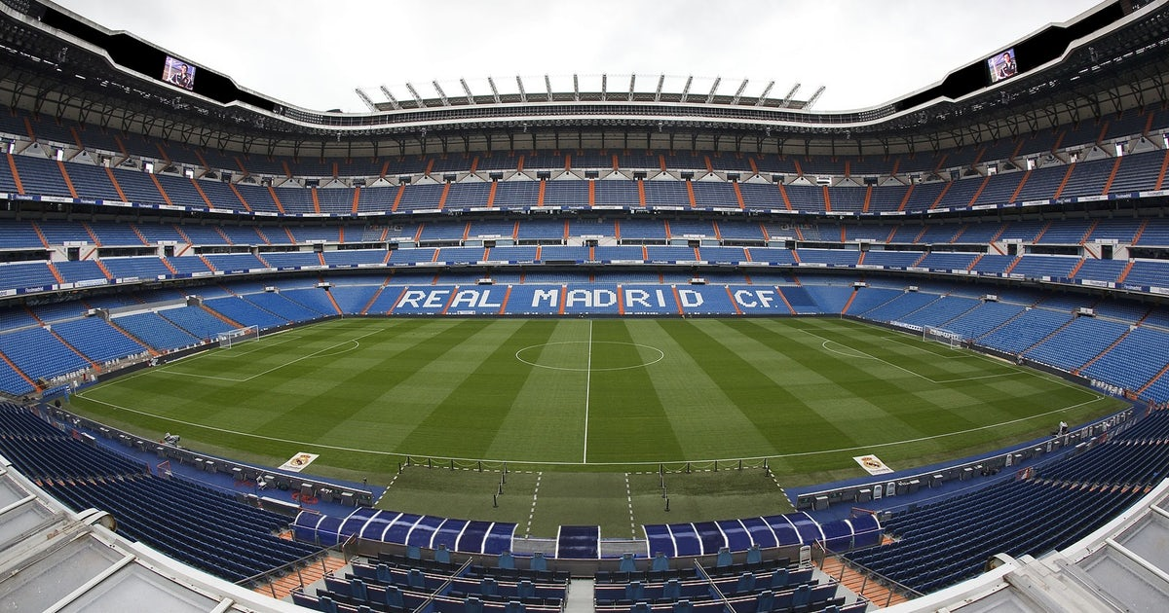
Popular Trends in European Football
Adrian Sandoval-Vargas

Slide 2







Leagues

Slide 3
Tools
Tweepy
Library to fetch api calls to twitter
Standard python data processing libraries.

Slide 4
Data
Fetching
@LaLiga, @premierleague, @Championsleague
Twitter
Limits ~3,234 tweets
Top Tweeters
Premier league (9/12/2019 – 12/04/2019)
La Liga (8/25/2019 – 12/04/2019)
Champions League (5/7/2019 – 12/04/2019)

Slide 5
Data Processing
Start from same date

