Slide 1
CSI 5810 Project 1
Adrian Sandoval-Vargas

Slide 2
Credit Card Domain
Credit Card Businesses are in the business to make money by collecting interest on money barrowed.
The longer unpaid money stays on the credit card holder’s account, the more money the Credit Card Issuer makes.
What happens when credit card holders do not pay there debt?
Usually upon 180 days, the Credit Card Issuer deems the holder will no longer pay the account. So It closes it, writes off the debt owed and sells it to a collection agency.
It would be in the Credit Card Issuer’s interest to find a way to mitigate the default risk factor of it’s credit card holders.

Slide 3
Data Selection
The data being used:
https://archive.ics.uci.edu/ml/datasets/default+of+credit+card+clients
History of non-default and default payments in Taiwan
Data holds integrity to determine potential defaults

Slide 4
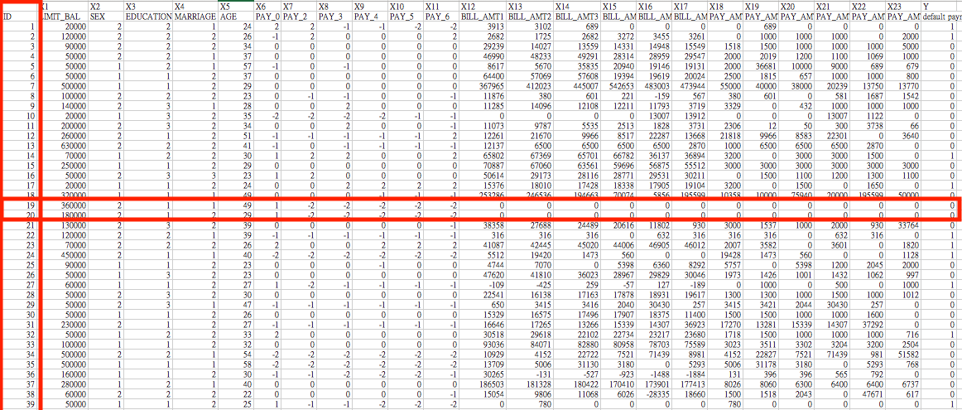
Data Cleaning and Preprocessing
I will be removing
the ‘ID’ Column
records of previous 6 month where no payment information is shown

Slide 5
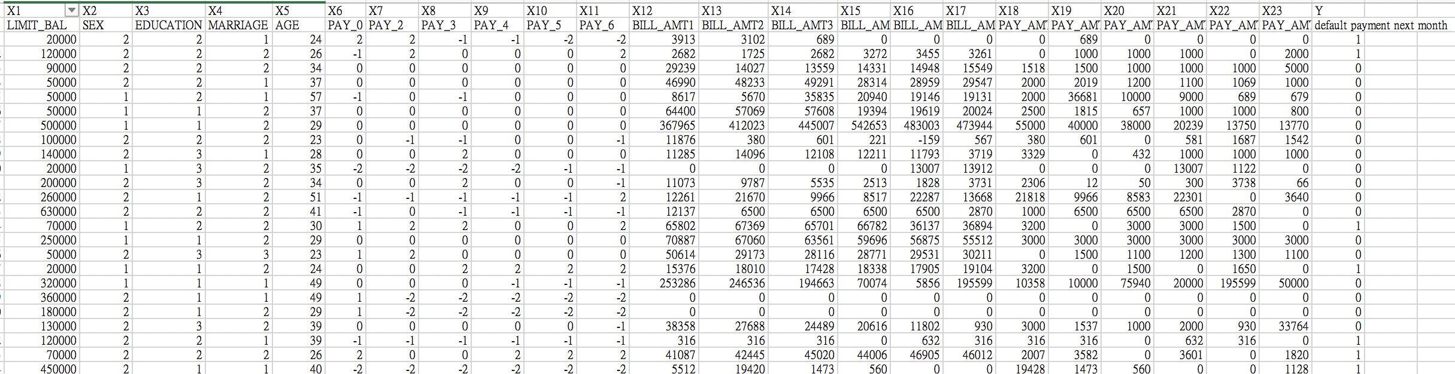
Preprocessing
Approaches to achieve a maximum accuracy
Input all data Categories

Slide 6
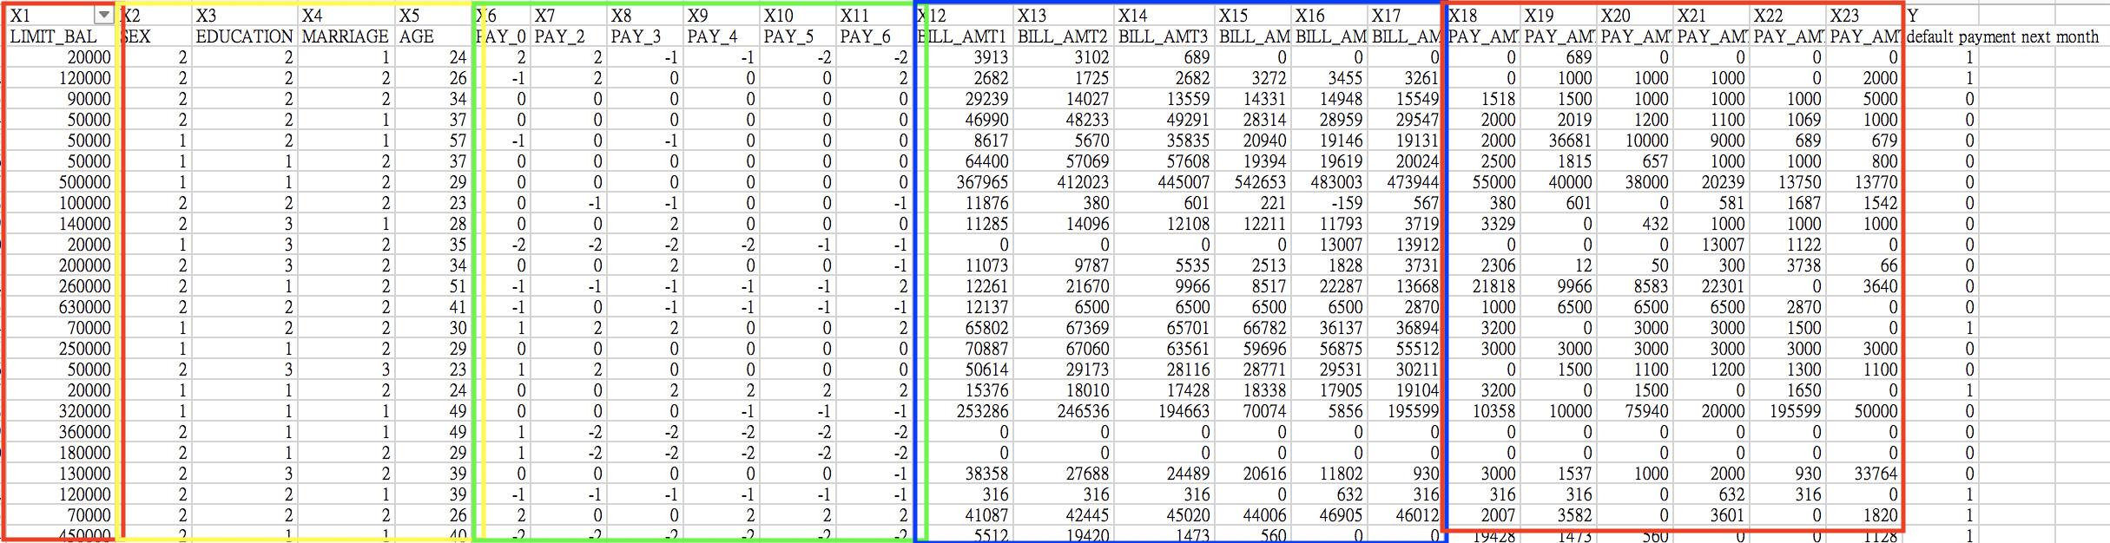
Preprocessing
Approaches to achieve a maximum accuracy
Splitting Data into particular categories

Slide 7
Patterns Using KNN

Slide 8
Patterns Using RandomForest

