Slide 1

Bistro! Bistro!
Custom Restaurant Management Console
John Devine, Peirce College
May, 2019

Slide 2
Introduction
Bistro! Bistro! is a model restaurant for the project
The B!B! website has a “Reservations” section
To “reserve” you submit a request for a table
The request is entered in a database
The restaurant manager checks the management console
The manager can deny or confirm requests
Confirmed requests become reservations in the database

Slide 3
Overview
Reasoning
The goal is simplicity & direct customer interaction
Management has more control
Customers get feedback from the restaurant
Tech Utilized
“Static” website with PHP form
MySQL database
PHP-based management console

Slide 4
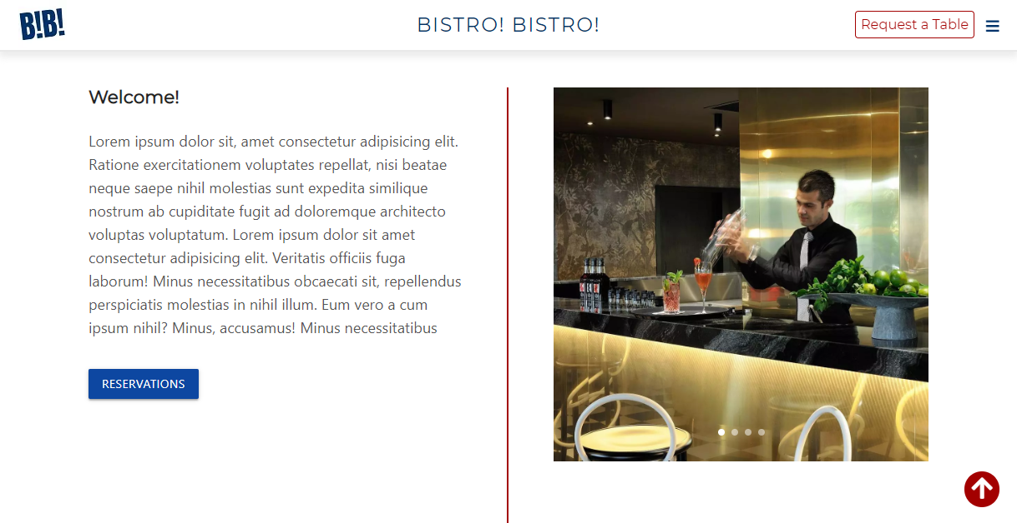
Features – Bistro! Bistro! Restaurant Website

Slide 5
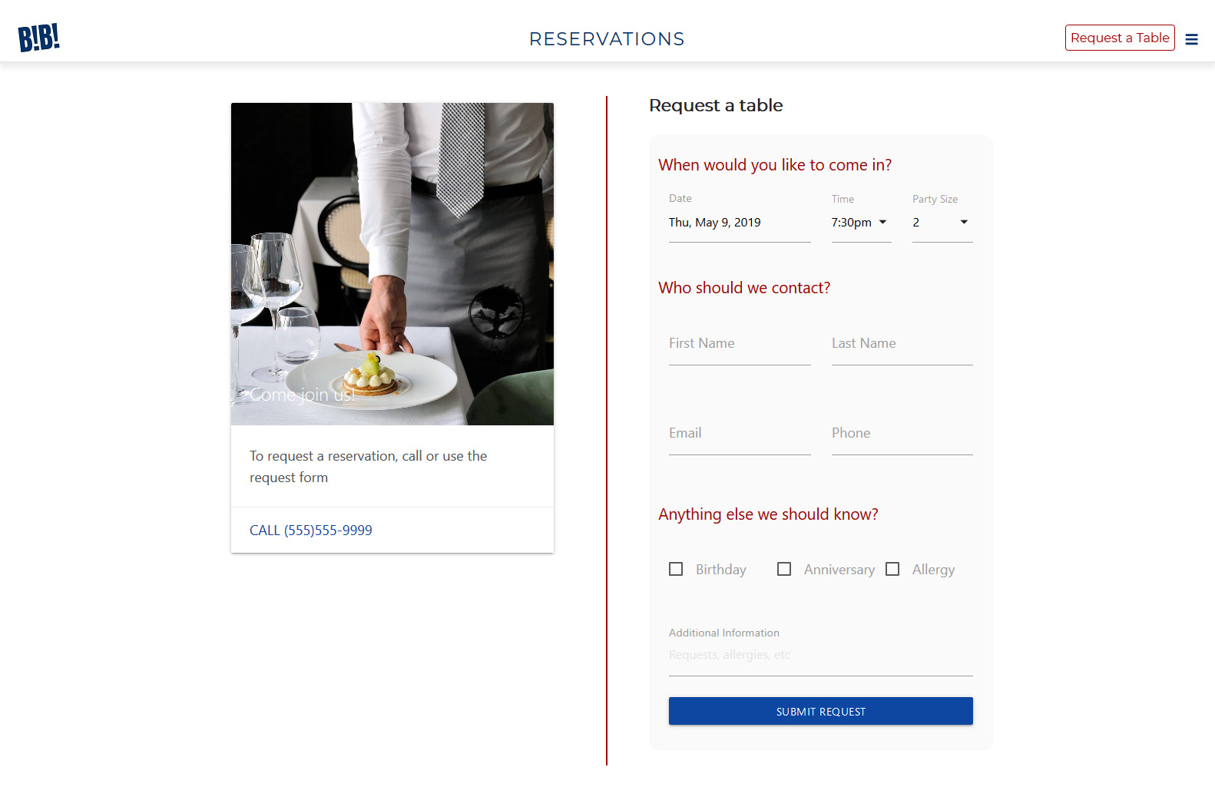
Features – Requests Form

Slide 6
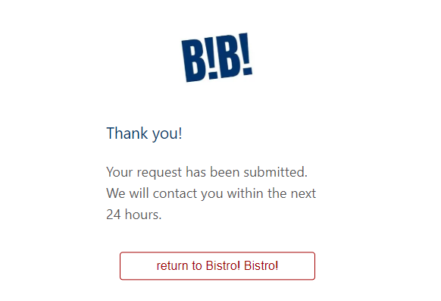
Features – Submit Request Confirmation

Slide 7
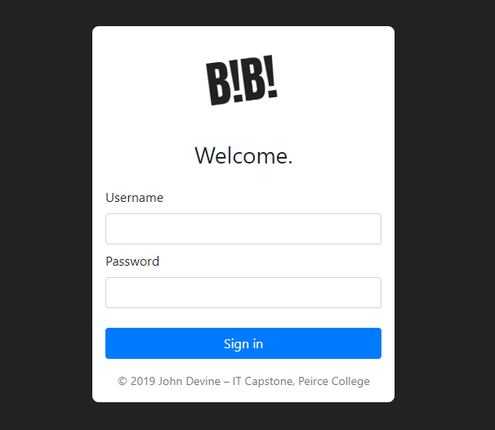
Features – Management Console Login

Slide 8
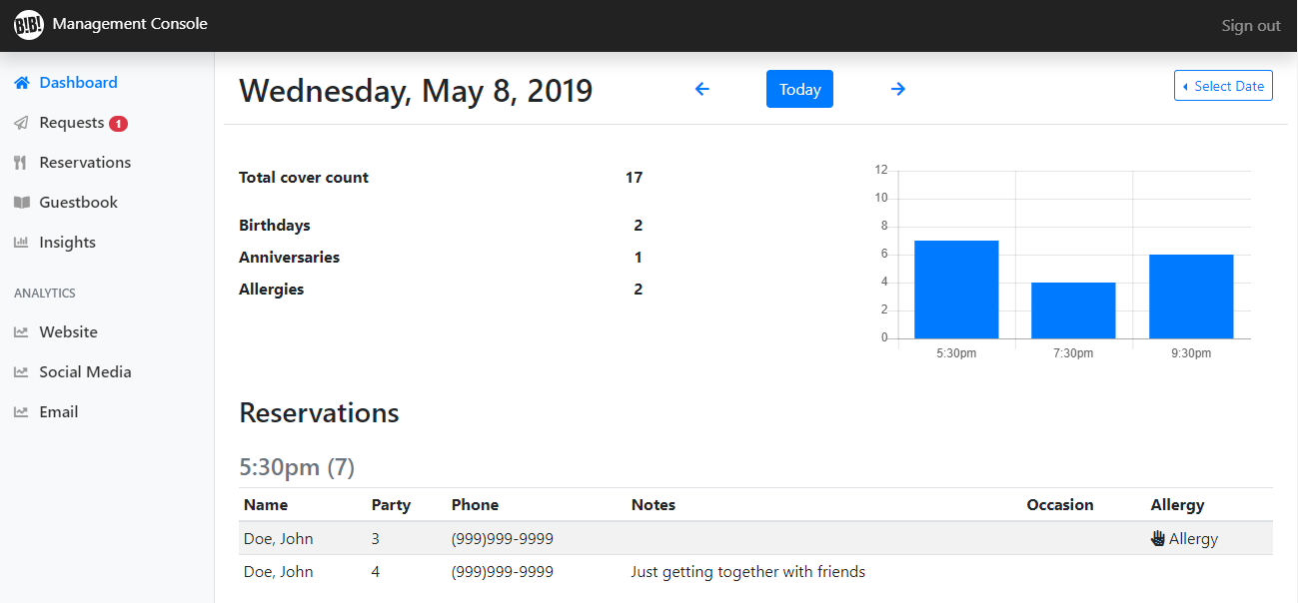
Features – Management Console Dashboard

Slide 9
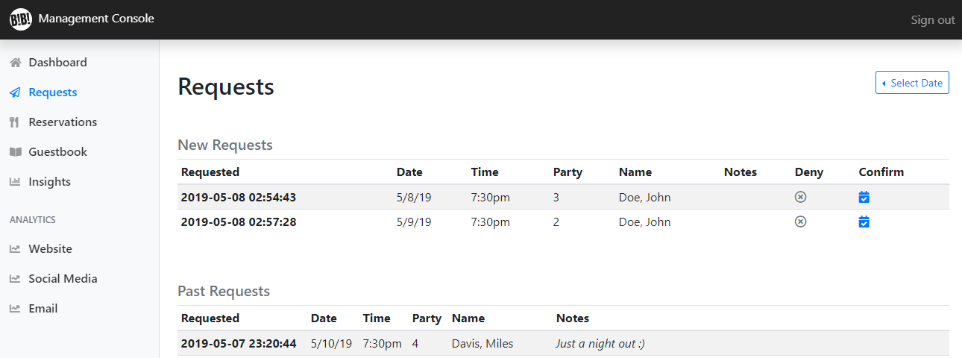
Features – Requests Page

Slide 10
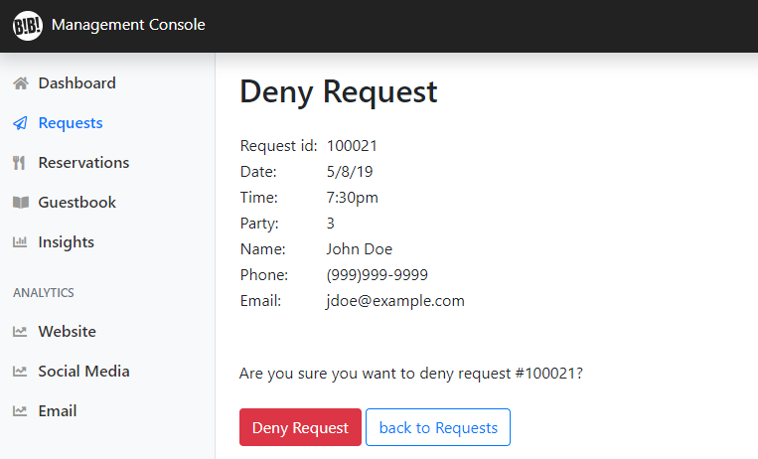
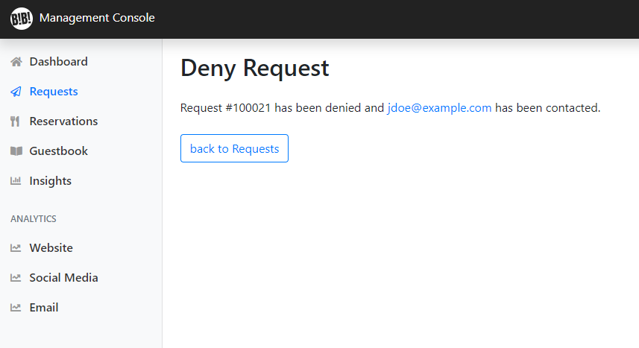
Features – Deny Request

Slide 11
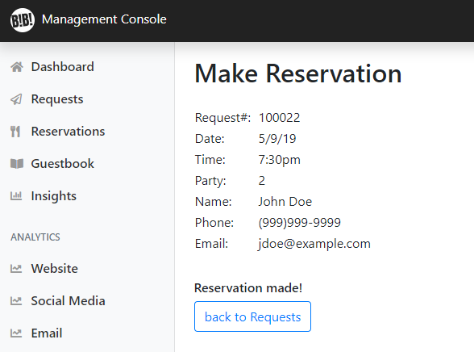
Features – Confirm (Make) Reservation

Slide 12
Website
Website was designed and written from scratch
Features a custom “sticky” header for sections
Uses Materialize CSS for UI elements
Slide menu
Image carousel
Image cards
Buttons
HTML Form UI
Features prominent button for Requests
Responsive design

Slide 13
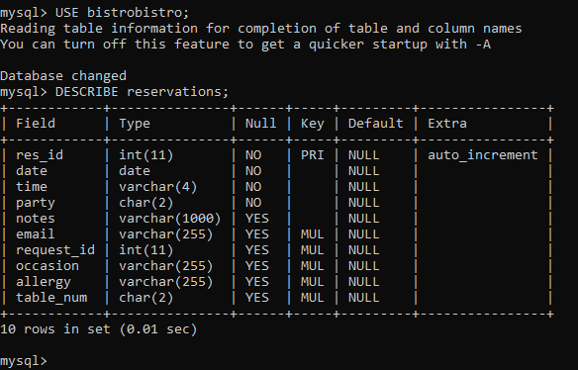
Database
Custom MySQL database
Tables for
Users/managers
Requests
Reservations
Guests
Allergies
Occasions
Table numbers
Example of reservations table

Slide 14
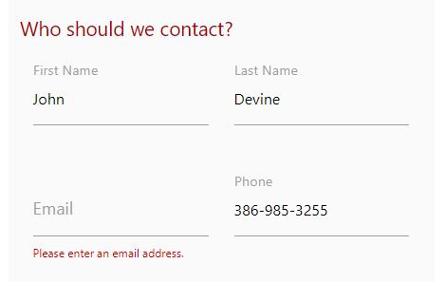
Requests Form
Using modern form design
Input validation
First name, last name, email, phone are required
Checks for valid email (@/extension, e.g.)
Checks for phone – 10 digits, allows parentheses, hyphens, periods
Submission creates JSON file that is stored as JSON MySQL data type
Example of input validation

Slide 15
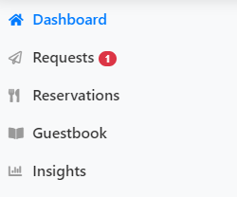
Management Console
Checks if user in session, redirects to login if not
Each page runs query on last page load time
Stored in cookie
If a new request since last page load, notifies with red badge
Confirm/deny requests
Guestbook (add/view/delete)
Example of notification

Slide 16
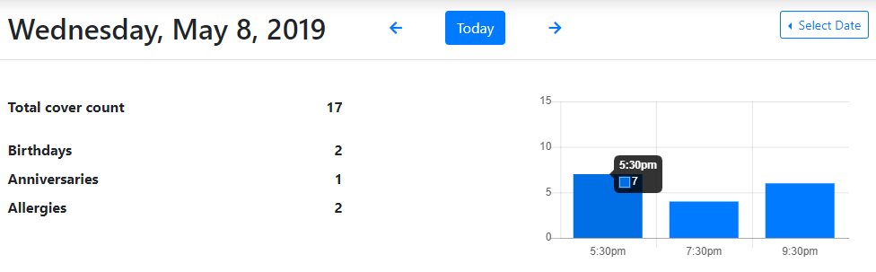
Management Console cont’d
Example of dashboard view
Move through days
Select a date (datepicker)
View counts:
Covers
Birthdays
Anniv’s
Allergies
Bar graph shows total covers per turn
Click “Today” to return to today (default page)
Uses unix timestamps as page IDs in GET request

Slide 17
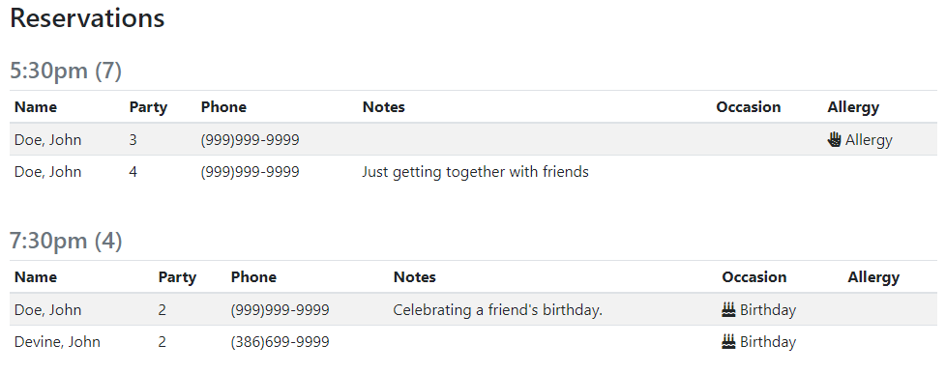
Management Console cont’d
Reservations tables based on reservation time
Relevant info for reservation
Example of dashboard view (reservations)

Slide 18
Technologies Used
LAMP stack
HTML5
CSS3 w/ Flexbox
JavaScript
Materialize CSS Framework
Google Fonts
jQuery
JSON
PHP
HTTP POST/GET
MySQL
Bootstrap UI Framework
HTTP session & cookies
Chart.js
Font Awesome Icons
AWS Lightsail server instance

Slide 19
Future Features
HTML email notifications
Management & customer both receive
Customer receives upon deny or confirm
Customer can cancel via email
Alerts on website
“No longer accepting reservations today”
“Restaurant is closed today”
Etc.
Edit reservations in dashboard view
Change allergy
Add notes
Add table number
Edit guestbook entries
“Live search” with AJAX on guestbook
Various insights/analytics

Slide 20
Thank You
Thank you for viewing this presentation
Find me on social media @jpatrickdevine

