Slide 1
E-commerce Sales Dashboard
Revenue Analysis by Category and Month
Prepared by: Adulis Tesfai

Slide 2
Business Objective
The objective of this analysis is to evaluate e-commerce sales performance across product categories and time in order to identify key revenue drivers, uncover trends, and support data-driven decision-making.
This dashboard enables quick identification of high-performing categories and seasonal trends.

Slide 3
Data Overview
Dataset: E-commerce transactions
Key fields: Order ID, Product Category, Revenue, Date
Data cleaning performed using Power Query
Removed duplicates and ensured correct data types
Created derived fields: Month and Year for trend analysis

Slide 4
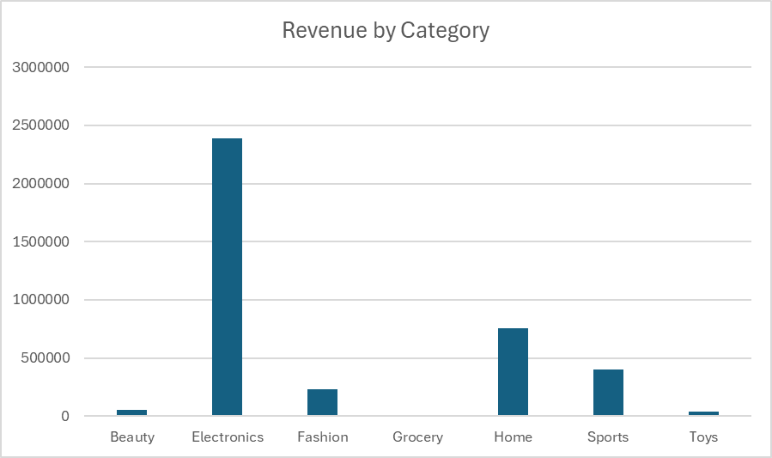
Revenue by Category
Electronics is the highest revenue-generating category, significantly outperforming others and acting as the primary driver of total sales.

Slide 5
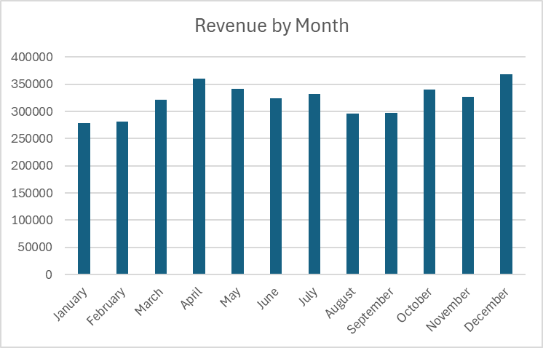
Revenue by Month
Revenue shows a generally stable trend throughout the year, with noticeable peaks in April and December, suggesting potential seasonal demand patterns.
Lower performance in mid-year months may indicate opportunities for targeted promotions.

Slide 6
Key Insights
Electronics is the dominant revenue driver, significantly outperforming all other categories
Home and Sports contribute moderate but meaningful revenue
Revenue remains relatively stable throughout the year with peaks in April and December
Seasonal patterns suggest opportunities for targeted marketing and promotions

Slide 7
Recommendations
Focus marketing and inventory efforts on Electronics to maximize revenue growth
Leverage peak months (April and December) with targeted campaigns and promotions
Implement strategies to boost performance in lower-performing months
Explore opportunities to grow underperforming categories through pricing or promotions

