Slide 1

T-Pot CE – A Multi-Honeypot Platform for Threat Intelligence
Presented by Tri-Force Team
Team Members - Yash yadav, Aditya Dongare, Anirudh Mehandru
Date: 13/05/2024

Slide 2
Introduction to T-Pot CE
What is T-Pot CE?
Modular multi-honeypot platform
Combines honeypots like Cowrie, Conpot ADBHoney, Wordpot
Purpose
Collect real-world attack data
Enhance threat intelligence
Analyze attacker behavior

Slide 3
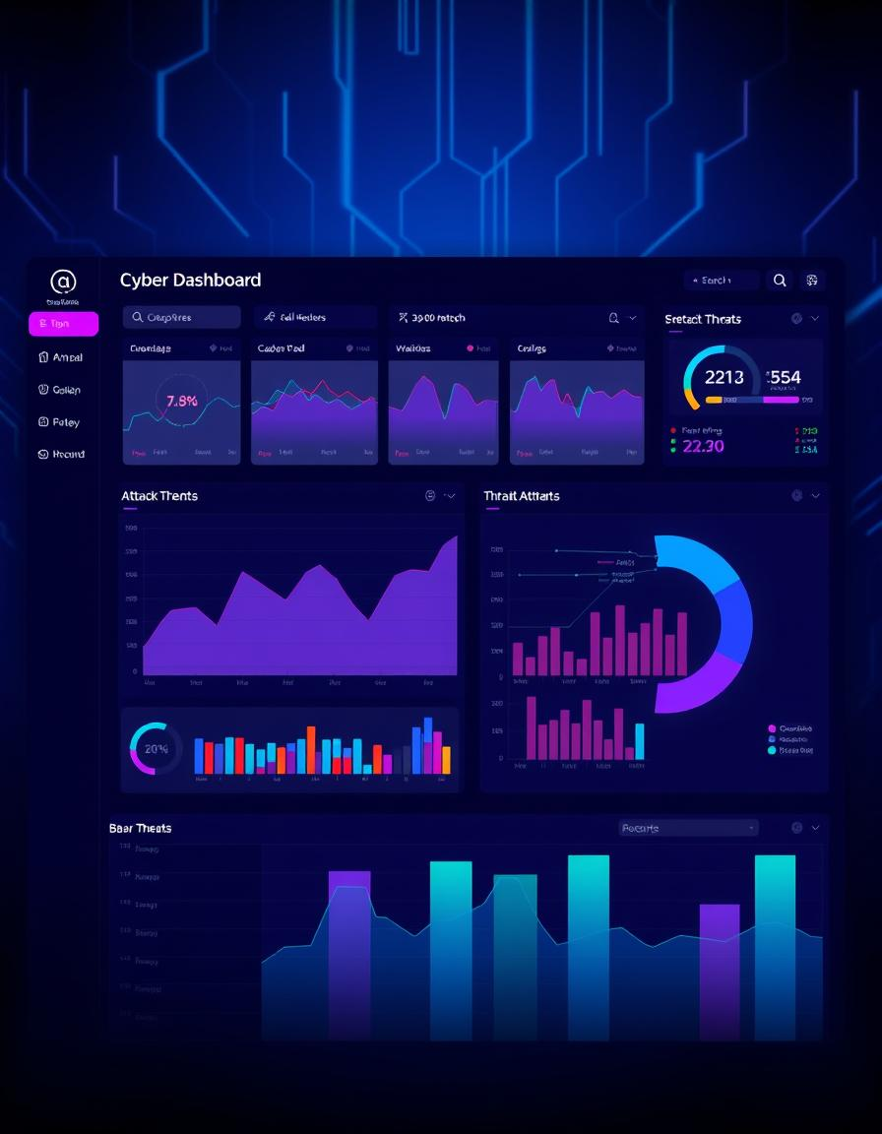
Key Features of T-Pot CE
Multi-honeypot Support
20+ honeypots in one platform
Dockerized Development
Easy setup and management
Elastic Search Integration
Powerful visualisation with Kibana
Attack Data Collection
Includes ssh, RDP, IOT, exploits

Slide 4
Popular Honeypots Included
Cowrie: SSH & Telnet
Dionaea: Malware trap
Conpot: ICS/SCADA
Glastopf: Web honeypot
Adbhoney: Android attacks
ElasticPot: Elasticsearch exploits

Slide 5

Architecture Overview
Docker Containers
Isolated honeypot deployment
Data Pipline
Logstash -> ElasticSearch -> Kibana
Additional Tools
Suricata IDS, Filebeat, NGINX Proxy

Slide 6

Installation & Setup
System Requirements
Ubuntu/Debian, 4+ CPU cores, 8GB RAM, 128GB+ storage
Installation Steps
Clone repo and run install script
Automated dockerized setup
Access Dashboard
Web UI at https://<ip>:64297 (Kibana)

Slide 7

Use Cases of T-Pot CE
Threat Intelligence
Track attacker tactics and techniques
Security Research
Analyze malware and exploits deeply
Incident Response Training
Simulate realistic attacks
Cyber Deception
Distract attackers from real assets

Slide 8
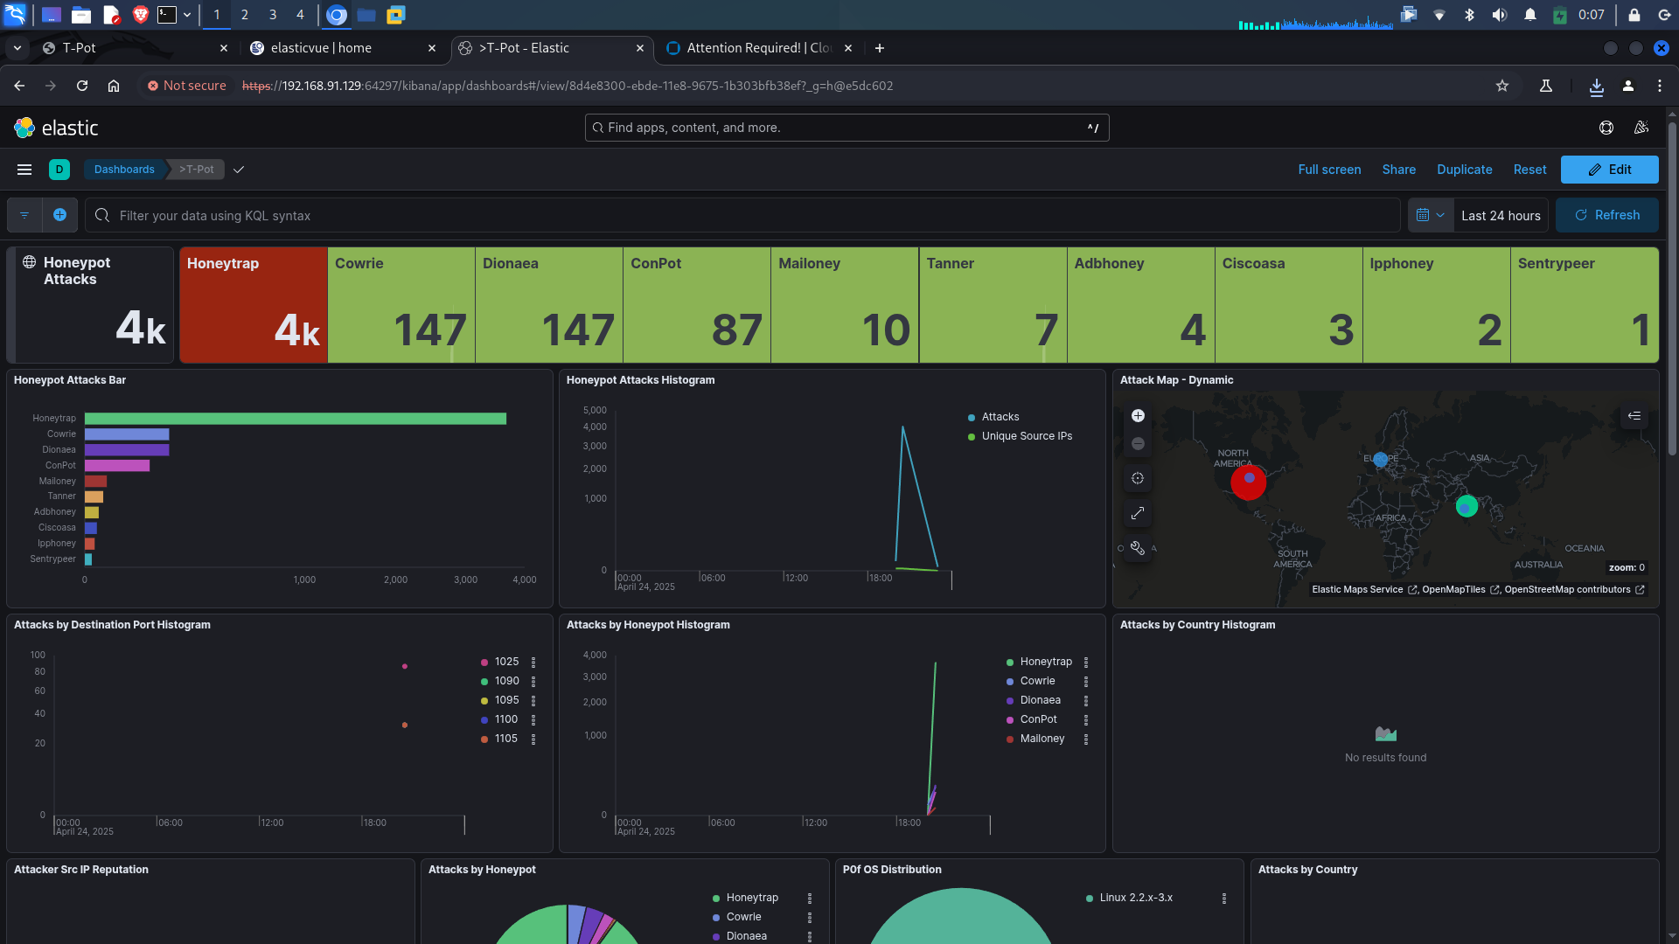
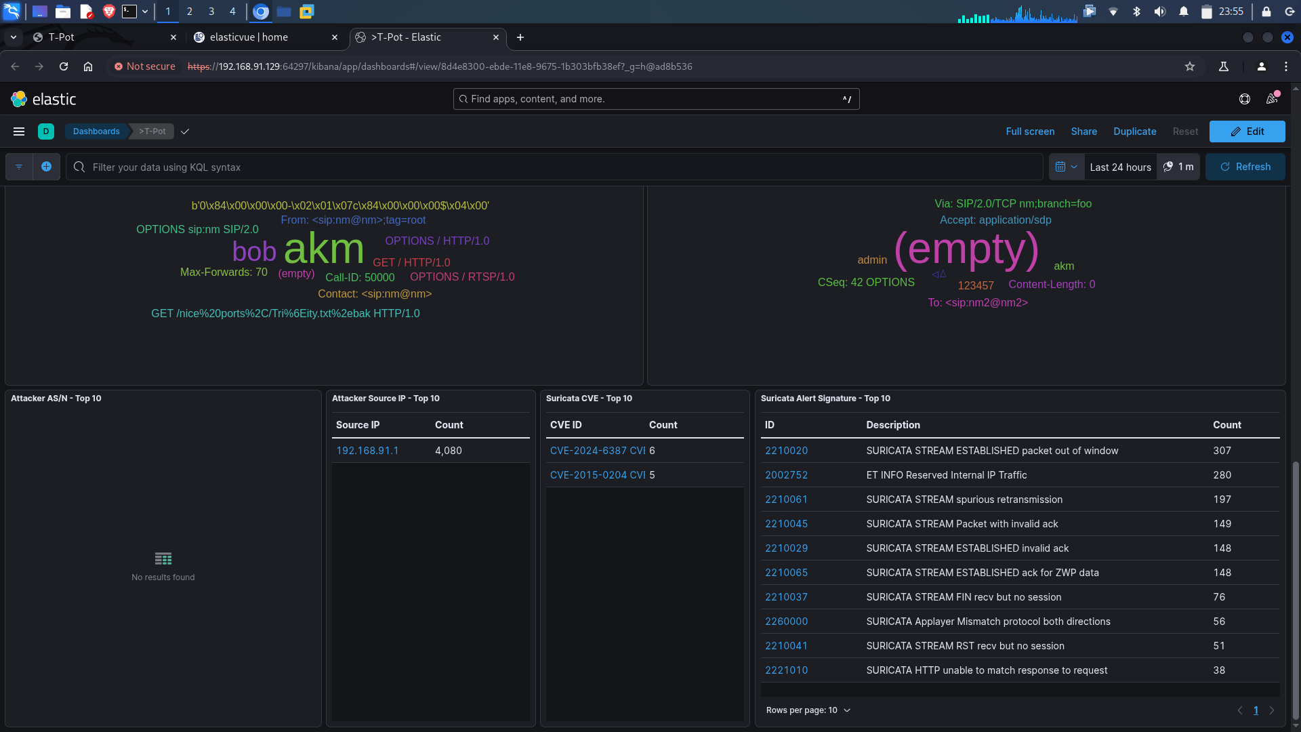
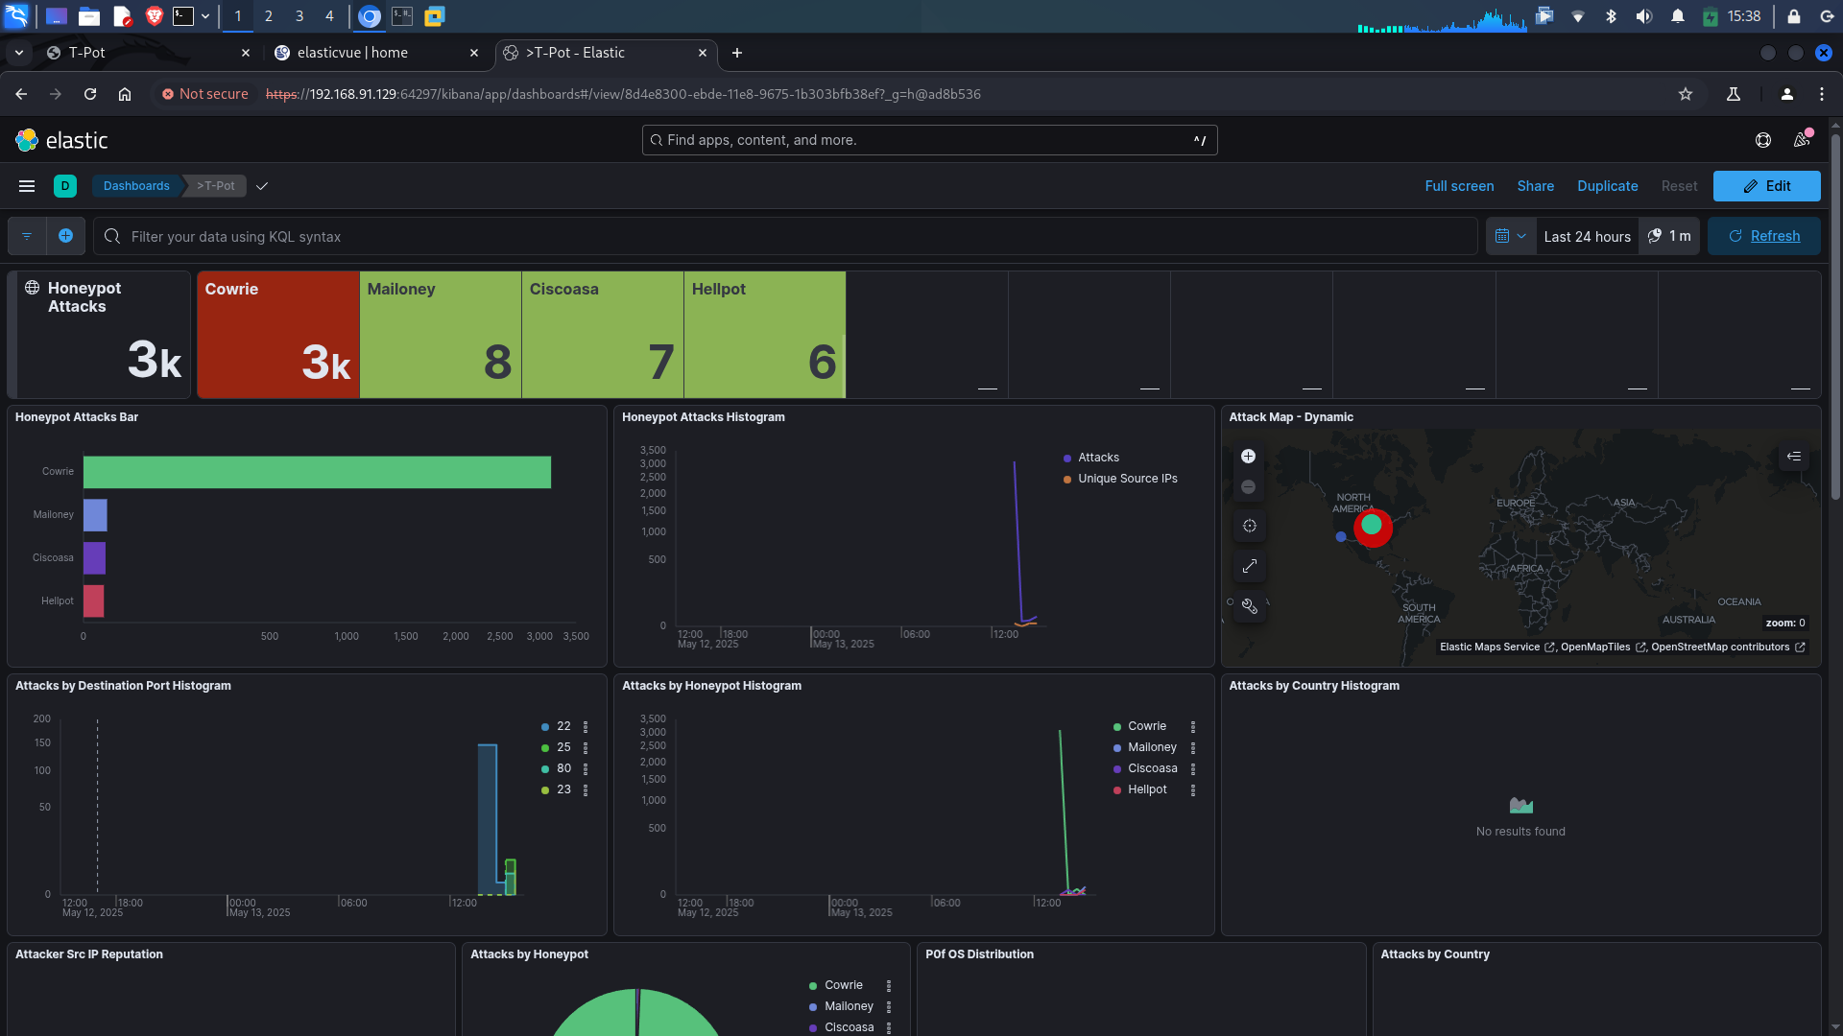
Demo & Screenshots

Slide 9
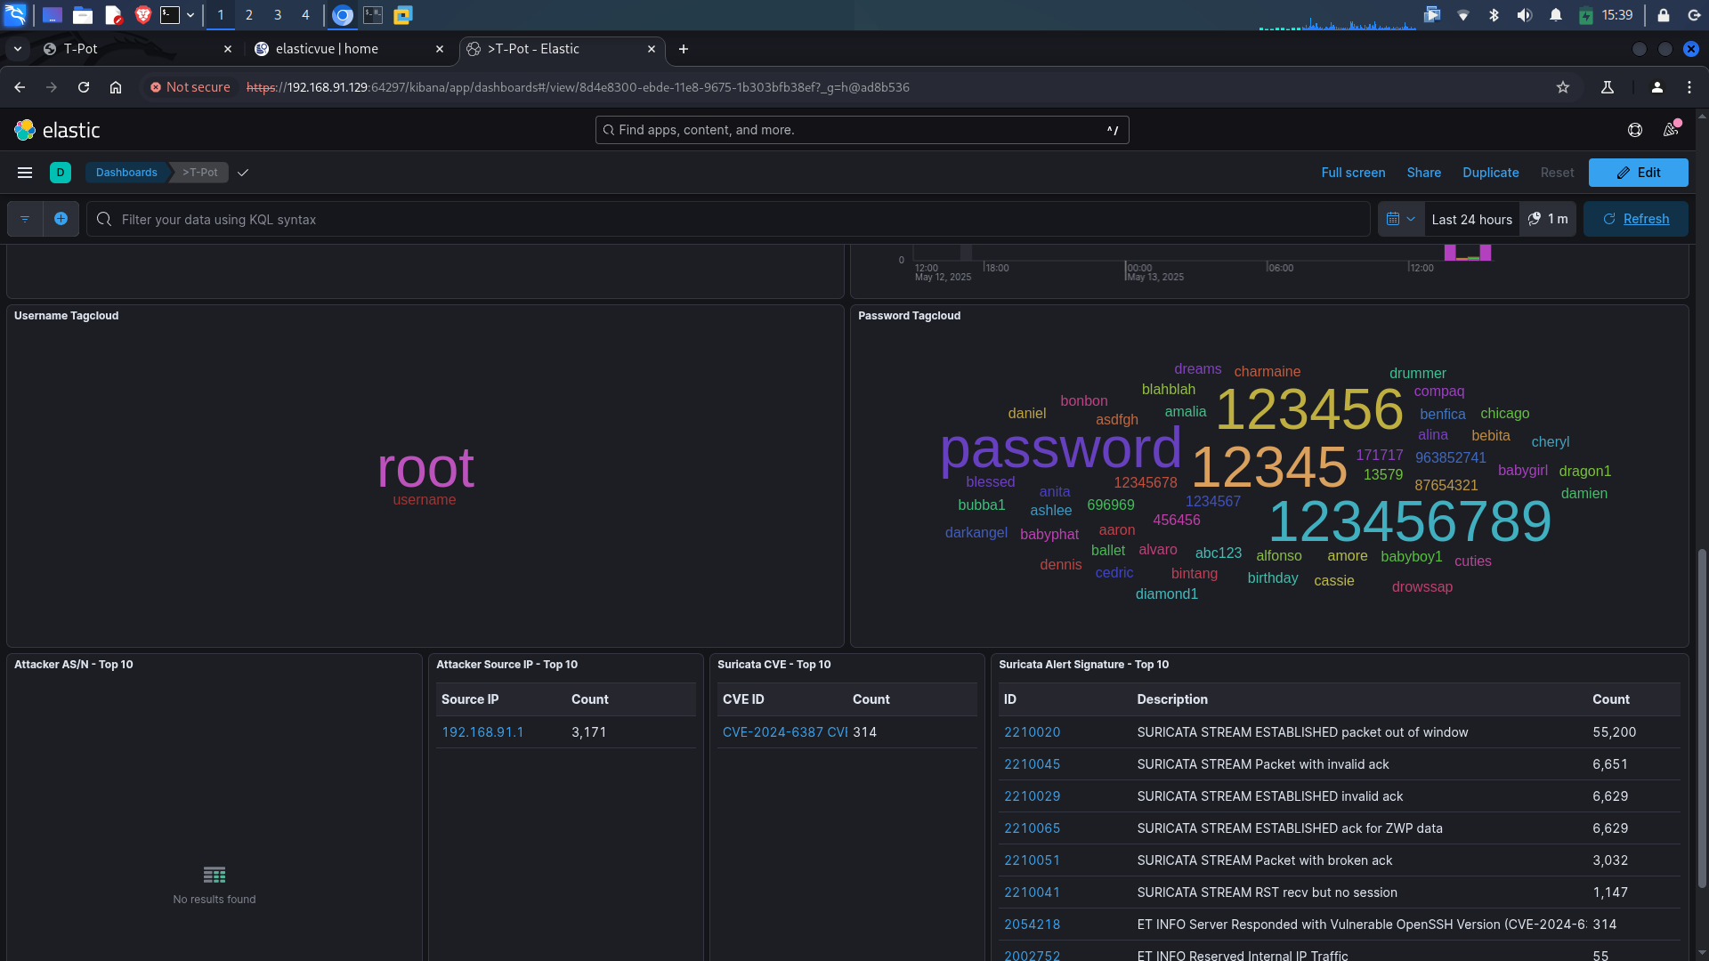
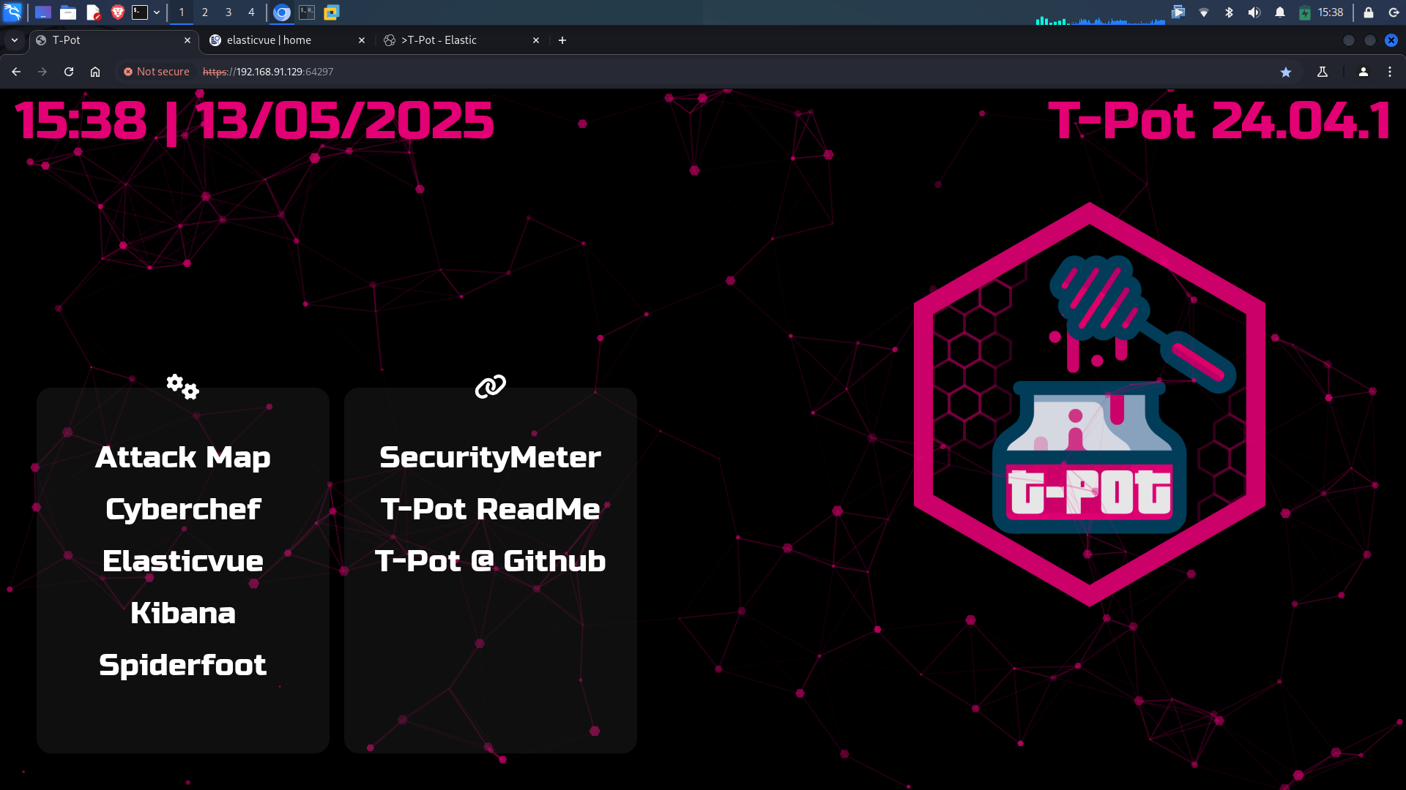

Slide 10
Advantages & Limitations
Advantages
Easy to deploy
Rich data visualization
Open-source and customizable
Strong community support
Limitations
Resource intensive
Only passive logging
No active prevention

Slide 11
Conclusion & Resources
Why Use T-Pot?
For teams, researchers, and SOC analysts to understand attacks
Resources:-
github- https://github.com/Anirudhx7/tpotce.git
Purpose
Collect real-world attack data
Enhance threat intelligence
Analyze attacker behavior

