Slide 1
A Weight-Based Personalized Recommendation using Idiocentric and Collaborative Filtering
By:
Sanjay G Huilgol
Vijay Mahantesh SM
Vijesh M
Guided By:
Dr. Kavi Mahesh
Professor
CSE, PESIT

Slide 2



What is Recommendation?
Users
Items
consumes

Slide 3
Aggregated MovieLens Dataset
Item Dataset: {“rating” : “string”, “id” : “string” …}
{
“id” : [“lorem”],
“title” : [“ipsum”],
“director”: [“d1”, “d2”, …],
…
}
…
User Dataset: {“user1” : [(“m1”, “r1”), (“m2”, “r2”), … ]}
{“user2” : [(“m3”, “r3”), (“m4”, “r4”), … ]}
…

Slide 4

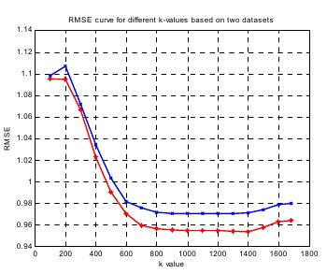
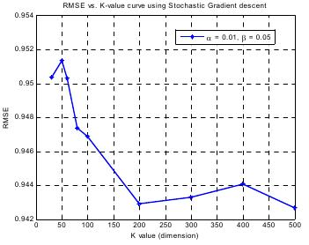
“Movie Rating Estimation and Recommendation”
Evaluation Metric:
K-Nearest Neighbor (0.95)
Stochastic Gradient (0.943)

Slide 5
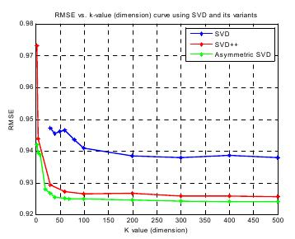
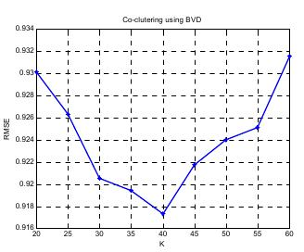
“Movie Rating Estimation and Recommendation”
Evaluation Metric:
SVD and variants (0.939, 0.926, 0.924)
Co-clustering using BVD (0.917)

Slide 6
“Movie Rating Estimation and Recommendation”
Technique | Least RMS Error
Baseline Predictor on ua dataset ub dataset | 0.96648 0.97737
K-Nearest Neighbor | 0.95
Stochastic Gradient | 0.943
SVD | 0.939
SVD ++ | 0.926
Asymmetric SVD | 0.924
Global Neighborhood | 0.931926
Co-clustering BVD | 0.917
Our Approach | 0.9031

Slide 7
Highlights of the Project
In-homogeneity in Item Properties
Unsupervised Dimensionality Reduction
User Profiling - deducing the weights of attributes just by using ratings
User Profiling - deducing the weights of values for each attributes just by using ratings
Rating prediction algorithm
Extendibility of the approach to items with no ratings
Possibility of modifying this algorithm to the Link Prediction problem if the user set and the item set are the same
Idiosyncrasy factor for each user

Slide 8
Thank You

