Slide 1
Predicting Gender Based on Voice
By Group 18: Kartik, Advait, Nikhil, Harshvardhan

Slide 2
Can we predict the gender of a person based on their voice?

Slide 3
Dataset

Slide 4
VoiceGender Dataset
For training and testing models for classiﬁcation on the basis of extracted features.
2 kinds of data
For 2 kinds of analysis
Csv ﬁle consisting of features and labels
VoxCeleb Dataset
To implement our own feature engineering.
.wav ﬁles for each gender.

Slide 5
Experiments

Slide 6
VoiceGender
The input vectors were 20 dimensional consisting of features like mean frequency, kurtosis etc. Roughly 3000 samples in all. Around 1600, or 53% of which were male samples
There was a unique label, either ‘male’ or ‘female’
Thus, our problem was ﬁnding a hypothesis H, such that H(X) = Y for X as vector in the feature space and Y being the label
We used a multilayer perceptron to model the hypothesis function H.
We also used Support Vector Machines using Kernels to transform and linearly separate the samples of each label in the feature space.

Slide 7
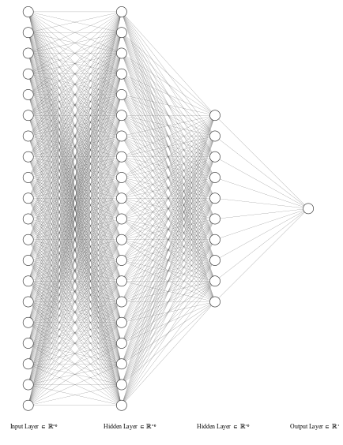
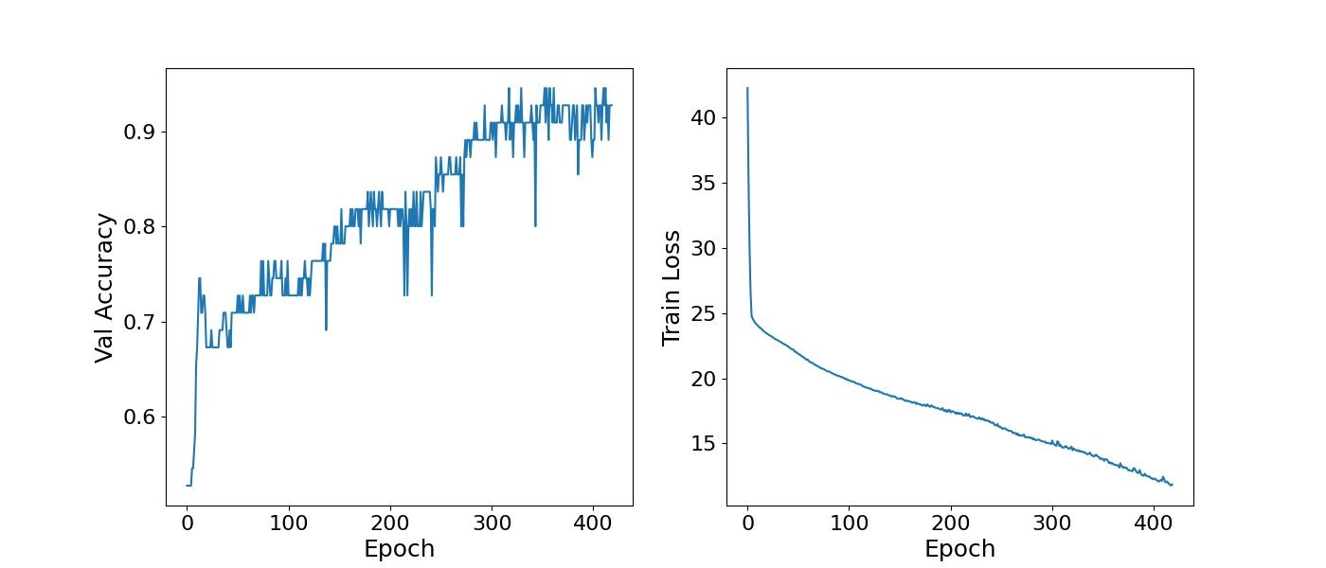
VoiceGender - MultiLayer Perceptron
We used a multilayer (2 hidden layers) perceptron to model the hypothesis function H. Using the binary cross entropy loss function and the Adam optimiser, we attained an accuracy of 93% on the validation dataset.

Slide 8
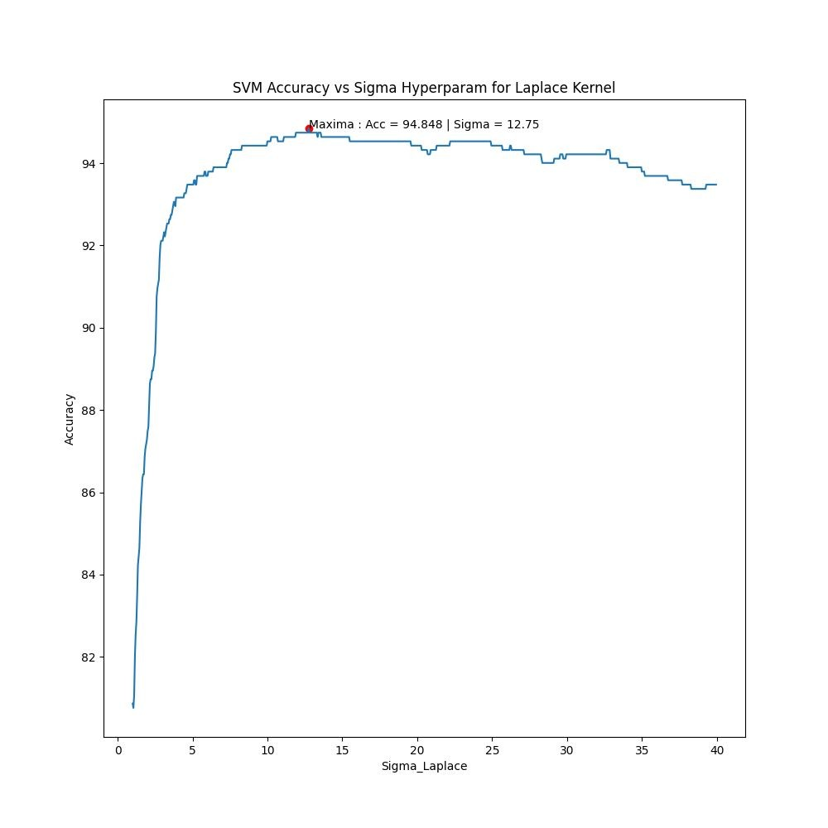
VoiceGender - SVM with kernels
We used 4 different kernels to transform and separate the data.
RBF
Laplace
Gaussian
Polynomial
Accuracy obtained: 94% validation accuracy

Slide 9
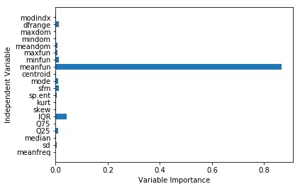
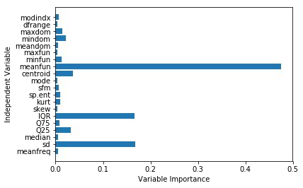
VoiceGender - Decisions Trees & Random Forests
We receive roughly 96% and 97% validation accuracy on the dataset using decision trees and random forests respectively. The results on the left are by decision trees and on the right by random forests.

Slide 10
VoxCeleb - Feature Engineering
The MFCC are state-of-the-art features for analysing audio sample data
Start by taking a short window frame (20 to 40 ms) in which we can assume that the audio signal is stationary. We then select a frame step of around 10 ms.
We then compute the power spectrum of each frame through a periodogram. To do so, start by taking the Discrete Fourier Transform of the frame.
We then take the logarithm of the all those 26 series of energy of those ﬁlter-banks since we do not perceive loudness linearly, but close to logarithmically.
We ﬁnally apply a Discrete Cosine Transform to the 26 log ﬁlterbank energies in order to decorrelate the overlapping ﬁlterbanks energies. This gives us 26 coefﬁcients,
called the MFCC.
We extract the mean, variance, quartiles, median etc as a descriptive statistic at the end of an audio sample, and compare several audio samples on this basis.

Slide 11
VoxCeleb - Model
Once the feature engineering was completed, we had vectors in the feature space. We simply trained a classiﬁcation model on these feature vectors.
Models tried: -
Decision tree
K Nearest Neighbors
Random forest
Support Vector Machine
Multilayer Perceptron

Slide 12
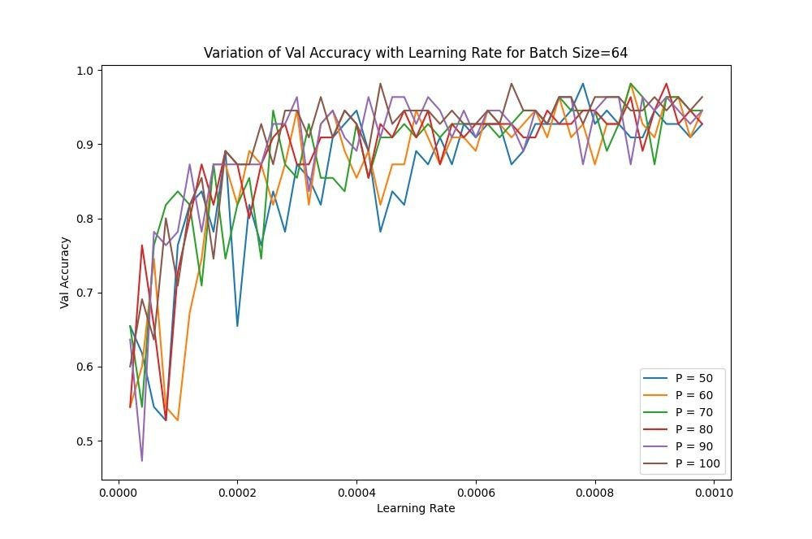
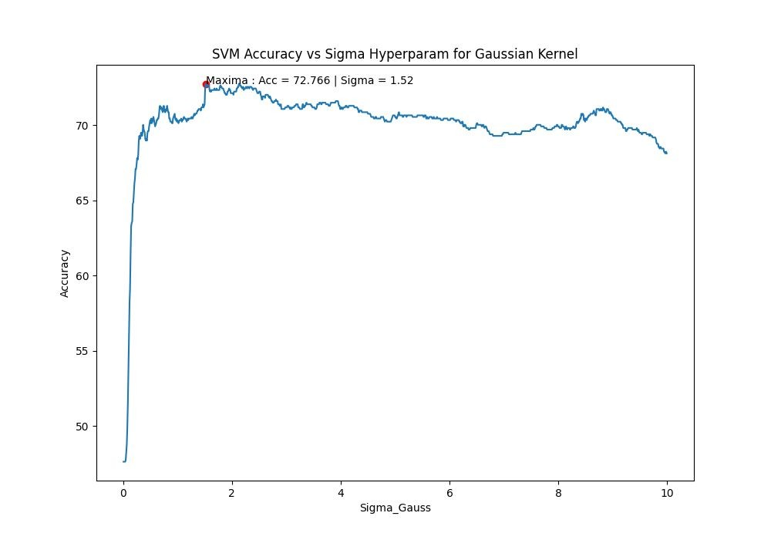
Hyperparameter Tuning
Using methods like grid search, we tuned the models across various parameters

Slide 13
Results

Slide 14
Summarising all Results
VoiceGender
VoxCeleb
Multilayer Perceptron: 0.93
SVM: 0.94
Decision Trees: 0.96
Random Forests: 0.97
Decision tree accuracy: 0.76
Logistic regression accuracy: 0.89
Hard voting accuracy: 0.89
K Nearest Neighbors accuracy: 0.73
Random forest accuracy: 0.88
svm accuracy: 0.79
Note: All values are measured on the validation set

Slide 15
Conclusion
The voice of a person is a complicated data sample, which is affected by many factors. However, there is a distinct correlation between gender and certain extractable features of voice which makes it possible for us, with reasonable accuracy, to predict gender on the basis of voice.
This ability to predict gender becomes increasingly accurate with more number of features and the model’s ability to learn and generalise the provided data, as seen in both datasets.

Slide 16
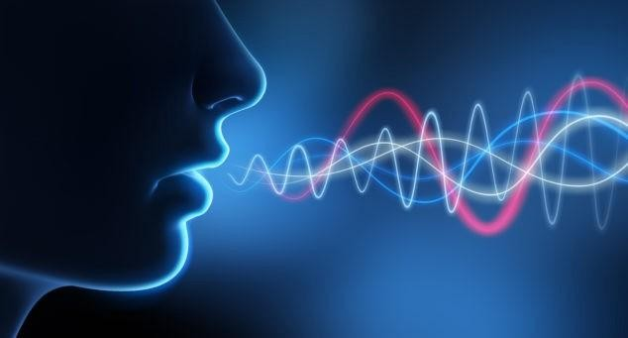
Thank You!

