Slide 1
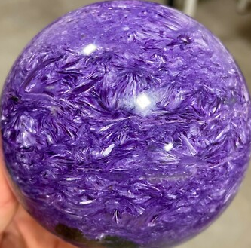
Metal
Goods
QUIT
REGENERATE
Food
QUIT
REGENERATE

