Slide 1
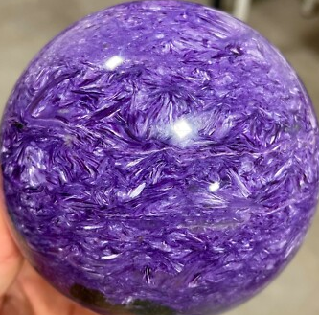
QUIT
REGENERATE
QUIT
REGENERATE

