Slide 1
CSE141L
Week 1: "The Saga Begins"
Apologies to Weird Al Yankovic

Slide 2
The Saga Begins
www.youtube.com/watch?v=hEcjgJSqSRU

Slide 3

Introductions

Slide 4
Introductions
Prof
  John Eldon jeldon@ucsd.edu
TAs and Tutors
  Wei Thang Chai wtchai@ucsd.edu
  Link Lin yul065@ucsd.edu
  Ziyu Lin zil332@ucsd.edu
  Sudhanshu Ranjan sranjan@ucsd.edu
  Yajie Sun yas@ucsd.edu
  Kanlin Wang kaw008@ucsd.edu

Slide 5
Office Hours
Google calendar link on Piazza or TED
Prof office hours on Zoom
  Tu 1200-1500, F 1000-1300
  Plus by appointment most afternoons, either weekday or weekend

Slide 6
Extracurriculars
First Lego League
  ***In suspension for COVID***
  Middle weekend in May & December
  Legoland Carlsbad
  Project and robot design judges

Slide 7
Relevant websites
Canvas
  lots of links, incl. assignments, under Content
Piazza
  for class discussions, Q&A
IntelFPGA.com model.com
edaplayground.com (Doulos)
OpenCores.org
  pipelined 5-stage MIPS

Slide 8

Class Outline
Lab 1 – design an ISA
  Special purpose
  Due 3rd wk of class
Lab 2 – verify modules
  ALU
  Data memory
  Instruction fetch
  Due 5th week of class

Slide 9
Course Outline, C'td.
Lab 3 – Write an Assembler
  Assembly code => Machine code
  Somewhat human-readable => Binary
Lab 4 – Verify whole design

Slide 10

Housekeeping
All sections are recorded
Lecture TuTh 0800
Discussion
Open
attendance
policy

Slide 11
Housekeeping
Grading
  4 lab writeups
  Class & Piazza participation
  Everyone can pass w/ a little effort
  Large majority of students get at least a B-
  A reserved for those who really work at it
  A+ for Labs 1 – 4, plus 5

Slide 12
FPGA
Field Progammable Gate Array
Macro Architecture
  array of logic cells, memory
Micro Architecture
  anatomy of a logic cell

Slide 13
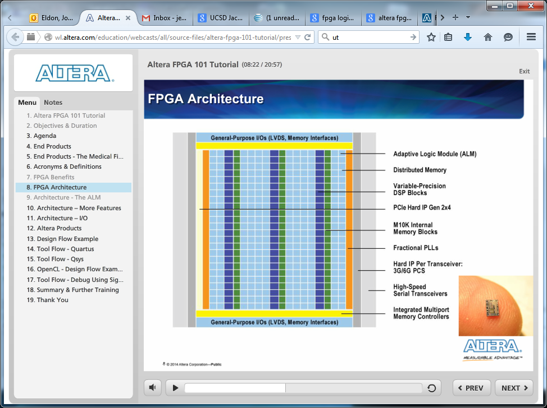
Macro Architecture

Slide 14
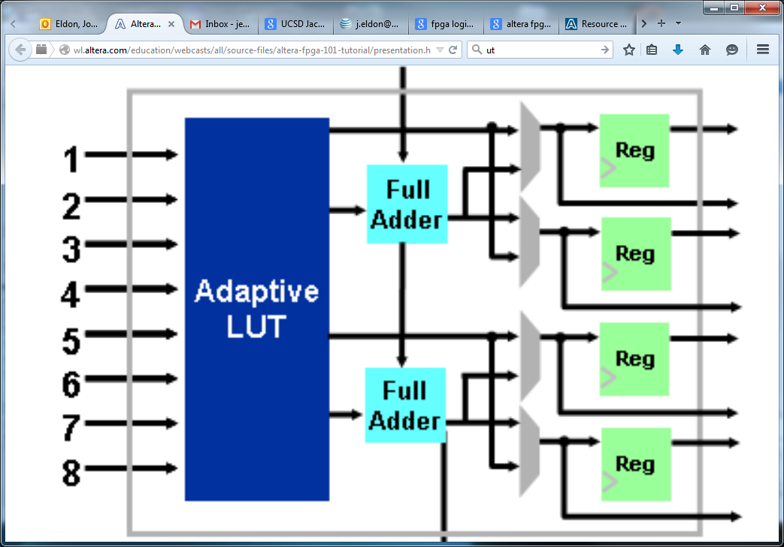
Anatomy of a Cell

Slide 15
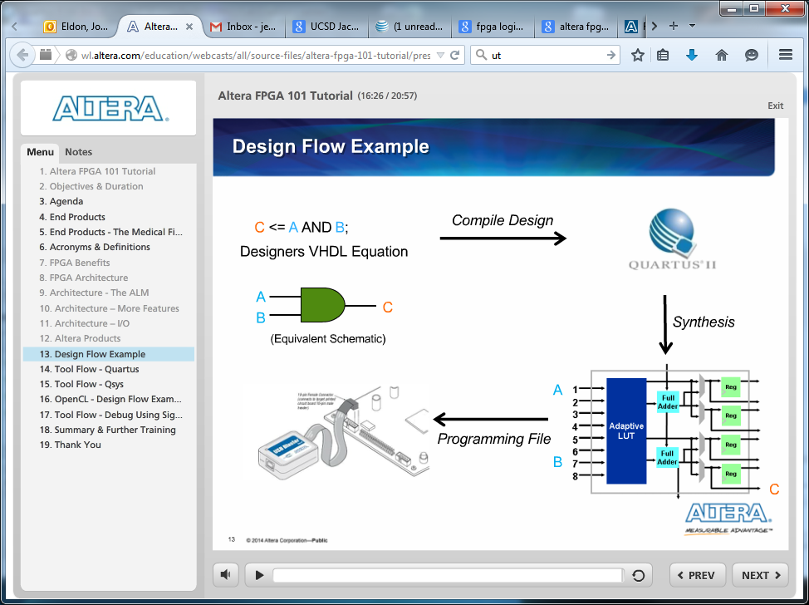
Design Flow

Slide 16
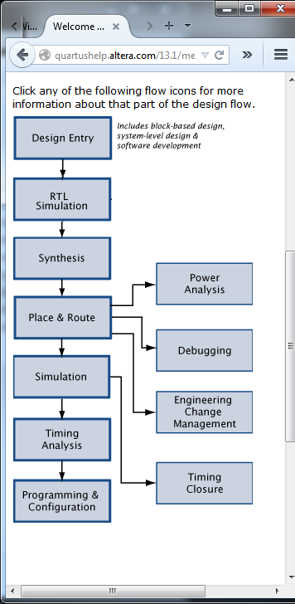

Slide 17
Simulation vs. Synthesis
We simulate the testbench and the device under test (DUT), using ModelSim logic simulator, to VERIfy LOGic
We synthesize just the DUT, never the bench, using Quartus, to build real hardware
  In this class we used this to make sure our design is realizable in hardware and to estimate how fast it could be clocked

Slide 18
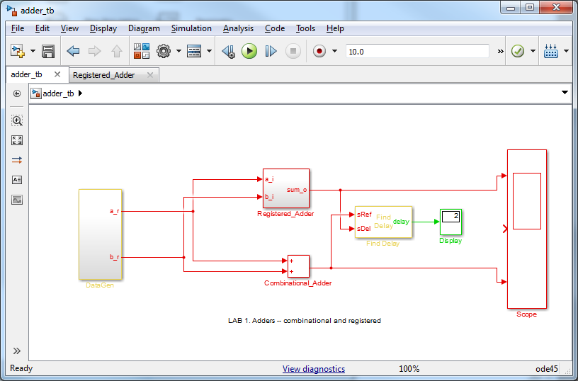
Test Bench and DUT

Slide 19
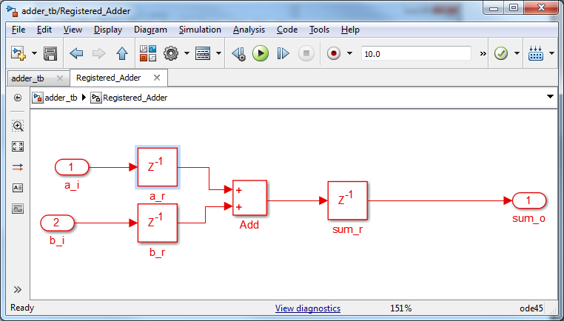
Inside a DUT

Slide 20

Verilog
"Verify Logic“
1984, Phil Moorby
Shift from schematic to text based design

Slide 21
SystemVerilog
"Verify Logic" enhanced
logic
typedef struct
typedef enum
always_ff, always_comb
array notation
a**n and $clog2

Slide 22
ModelSim (Mentor Graphics)
Simulation tool
Behavior modeling of .sv files
  no real sense of timing
  verifies logical correctness only
Post-synthesis timing simulation
  uses .svo and .sdo files from Quartus
  verifies logic & timing
  beyond scope of this class ☺

Slide 23
Quartus (IntelFPGA)
logic synthesis tool
turns Verilog (.sv) into netlist (.svo)
We need Quartus for three reasons:
  1. Verify that our design can be built in REAL hardware
  2. Obtain an estimate of how fast said hardware can be clocked/run (Lab 4)
  3. Estimate how much of our FPGA is needed

