Slide 1


Integer Multiplier
ECE-111 Advanced Digital Design Project
Vishal Karna

Slide 2
Homework Assignment : Integer Multiplier
Develop SystemVerilog RTL model for N-bit Integer Multiplier
Develop Finite state machine and state transition diagram for SHIFT and ADD multiplier algorithm
FSM coding style recommended : Single always block with non-blocking assignment statements within always block.
Synthesize integer multiplier design for parameter N=4 and run simulation using testbench provided
Review synthesis results (resource usage and RTL netlist/schematic)
Review input and output signals in simulation waveform.
Assume below mentioned primary port names and SystemVerilog RTL module integer_multiplier.
Note : FSM code framework is provided in Lab folder with comments to help develop the code.
Testbench provided has built in checker to ensure design output is expected. See messages in Modelsim transcript window when performing simulation
Primary Ports for integer_multiplier module
input clock, reset (asynchronous posedge reset)
Input start (1 cycle pulse generated. Indicates to FSM to start multiplication operation)
input logic[N-1:0] multiplicand, multiplier
output logic[(2*N):0] product (result of multiplication includes carry bit as MSB bit)
output logic done (inidicates that product is available. This is one cycle pulse generated by FSM)
clock
integer_multiplier
reset
product
multiplicand
done
multiplier
start

Slide 3
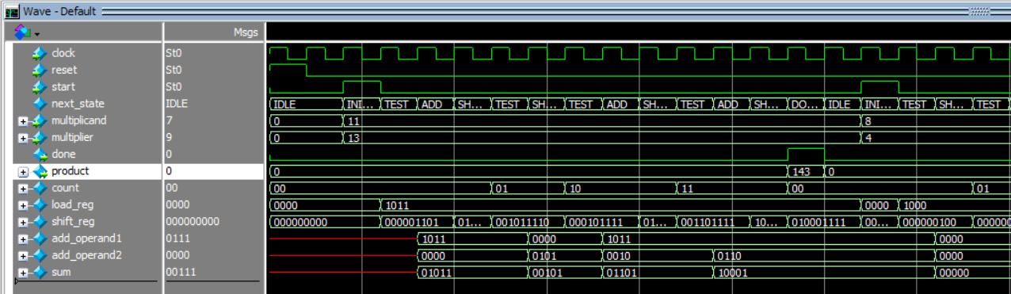
Homework Assignment : Integer Multiplier
Report should include :
SystemVerilog design, State diagram (hand drawn snapshot or Snapshot from Quartus either way is fine)
Synthesis resource usage and schematic generated from RTL netlist viewer
Simulation snapshot and explain simulation result to confirm RTL model developed works as a integer multiplier
Reference Output Snapshot
Once Start is ‘1’ multiplicand value 11 and multipler value 13 are loaded in load_reg
Once ‘done’ signal is ‘1’ for single clock cycle, ‘product’ value of 143 is available from multiplier FSM
Since N=4, ie. Inputs are 4 bit values, count value will increment from 00, 01, 10, 11 which indicates 4 stages of ADD/SHIFT operation

Slide 4
SHIFT And ADD Method to Perform Integer Multiplier
Multiplier : 4’b1101 (13), Multiplicand : 4’b1011 (11), Expected Product = 11 x 13 = 143 (9’b0_1000_0111)
N-bit Multiplier has N stages of SHIFT and ADD round of computation
If Multiplier LSB[0] = 1 Perform ADD of Accumulator + Multiplicand and store back to Accumulator and then perform Right Shift by 1
If Multiplier LSB[0] = 0 Perform Right Shift by 1
Stage-1 | Carry | Accumulator | Multiplier | Operation Performed
0 | 0 | 0 0 0 0 | 1 1 0 1 | Initialize
1 | 0 | 1 0 1 1 | 1 1 0 1 | ADD
 | 0 | 0 1 0 1 | 1 1 1 0 | SHIFT >> 1
2 | 0 | 0 0 1 0 | 1 1 1 1 | SHIFT
3 | 0 | 1 1 0 1 | 1 1 1 1 | ADD
 | 0 | 0 1 1 0 | 1 1 1 1 | SHIFT >> 1
4 | 1 | 0 0 0 0 | 1 1 1 1 | ADD
 | 0 | 1 0 0 0 | 0 1 1 1 | SHIFT >> 1
acc + multiplicand
0 0 0 0 + 1011 = 01011
acc + multiplicand
0 0 1 0 + 1011 = 01101
acc + multiplicand
011 0 + 1011 =1000

Slide 5
SHIFT And ADD Integer Multiplier Algorithm Summary
Multiplication Process and FSM States :
IDLE: Wait in this state until Start=1. Then move to INITIALIZE state if input signal Start==1
INITIALIZE: Multiplicand and multiplier are loaded into a load register and a shift register, respectively;
TEST: The LSB in the shift register which contains the multiplier is tested to decide the next state. If shift register LSB is ‘1’, then next state is to ADD otherwise next sate is to SHIFT_AND_COUNT
ADD: the Adder adds previous stage add result with Multiplicand and stores the product to the accumulation result, back to shift register and then the state machine transits to SHIFT_AND_COUNT state
SHIFT_AND_COUNT: If shift register content is right shifted by 1 bit position. MSB of shift register ‘0’ is entered
When the counter reaches to N, then next state is DONE stage otherwise next state is TEST state for next stage ADD/SHIFT operation
DONE: Done signal is asserted to ‘1’ and shift register content is sent to ‘product’ output signal

Slide 6
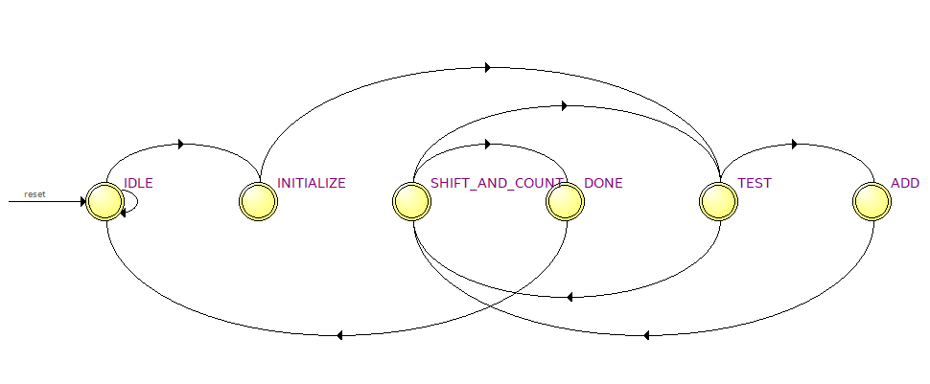
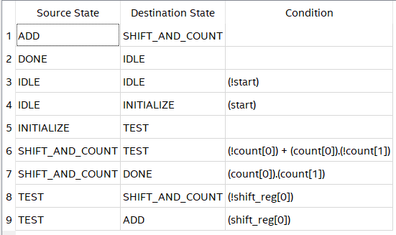
Homework Assignment : Integer Multiplier
Quartus Generated State Machine Diagram and State Table for reference purpose
Unconditionally transition to TEST state
if count < N
start ==1
if shift_reg[0] ==1
if count == N
if shift_reg[0] ==0
Unconditionally transition to IDLE state
Note : When FSM transition to DONE state, load “shift_reg” value to “product”
And set done = 1 from separate logic using assign statement

Slide 7
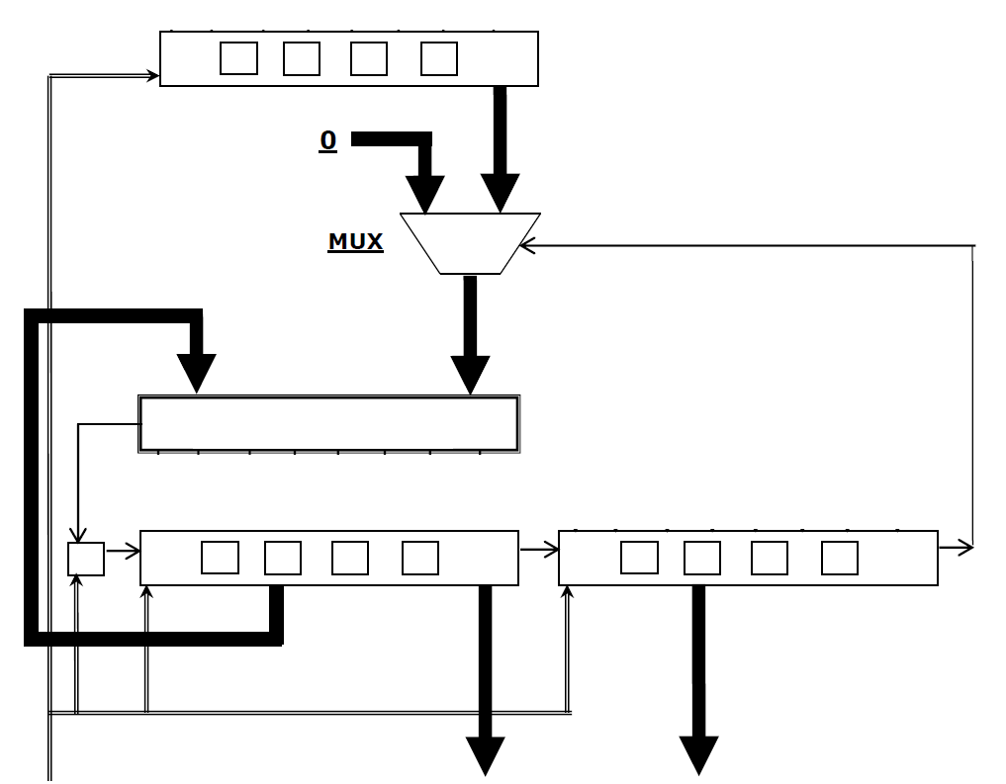
Block Diagram of Integer Multiplier Using SHIFT and ADD
4-bit Multiplicand Input
load_reg
(when start=1, Multiplicand loaded to load register)
If shift_reg[0] ==1 then ADD operation, Multiplicand input in load_reg is selected by MUX and sent to Carry Look Ahead Adder otherwise select ‘0’ and sent to the input of adder
add_operand2
add_operand1
Second Input to Carry LookAhead adder is the previous stage 4 bit adder result
4-bit Carry LookAhead Adder
4-bit Multiplier Input
shift_reg>>1
accumulator
Check If shift_reg[0]==1 then ADD operation followed by SHIFT>>1 operation
Check If shift_reg[0]==0 then SHIFT>>1 operation (no ADD operation performed)
shift_reg[8]
(Carry out from Adder)
shift_reg[7:5]
(4 bit adder output without carry out)
shift_reg[3:0]
product = shift_reg[8:0] when done = 1

Slide 8
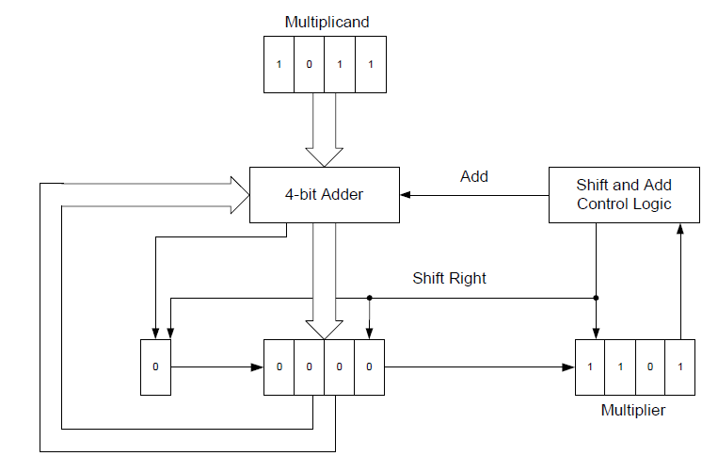
SHIFT And ADD Integer Multiplier Algorithm Steps Summary
1. Multiplicand Value = 4’b1011 loaded to register
2. Select and connect Multiplicand to Carry LookAhead Adder input-1 port
2. Select and connect shift_reg[7:4] which is accumulator value to Carry LookAhead Adder input-2 port
2. Since Initialize shift_reg[0] == 1,
Perform ADD operation
3. Perform ADD operation
3. Load result of Multiplicand +
Accumulator carry out value to shift_reg[8]
3. Load result of Multiplicand +
Accumulator value to shift_reg[8:5]
2. Check if shift_reg[0] == 1 ?
4. shift_reg entire 9 bits register right shift by 1
1. Initialize carry out bit in shift_reg[8] to 4’b0
1. Initialize accumulator to 4’b000. accumulator is represented as shift_reg[7:4]
1. Initialize shift_reg[3:0] to Multiplier value 4’b1101
At end of stage-0 count, shift_reg = {0, 4’b0101, 4’b1110}, Repeat these steps until count value == N. And end of stage-3 count, final product will be available

Slide 9
Let’s us do simulation of 4-bit Integer Multiplier using SHIFT and ADD Multiplier Algorithm

Slide 10
SHIFT And ADD Integer Multiplier Algorithm Example Steps
Step 1 : Initialize registers
N-Bit Counter to 0
Multiplicand Value = 4’b1011 loaded to register
Initialize carry out bit in shift_reg[8] to 4’b0
1. Initialize accumulator to 4’b0000 accumulator is represented as shift_reg[7:4]

Slide 11
SHIFT And ADD Integer Multiplier Algorithm Example Steps
Step 2 : Test LSB, check if shift_reg[0] == 1 ?
If ‘1’ then load multiplicand and accumulator (shift_reg[8:5]) bits to multiplier
Select and connect Multiplicand to Carry LookAhead Adder input-1 port
Select and connect shift_reg[8:5] which is accumulator value to Carry LookAhead Adder input-2 port
Since Initialize shift_reg[0] == 1,
Perform ADD operation
Check if shift_reg[0] == 1 ?
N-bit counter value is still ‘0’ at end of this step

Slide 12
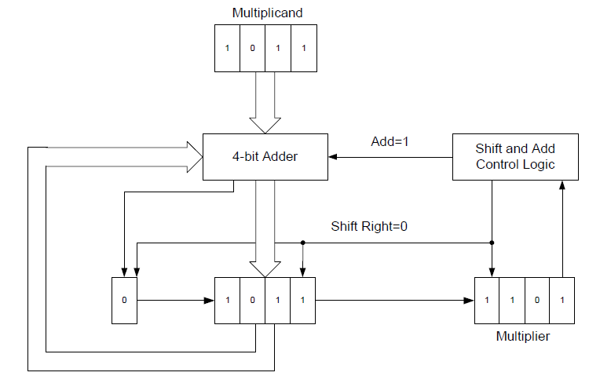
SHIFT And ADD Integer Multiplier Algorithm Example Steps
Step 3 : Perform ADD Operation
Perform ADD operation
Load result of Multiplicand +
Accumulator carry out value to shift_reg[8]
Load result of Multiplicand +
Accumulator value to shift_reg[8:5]
N-bit counter value is still ‘0’ at end of this step

Slide 13
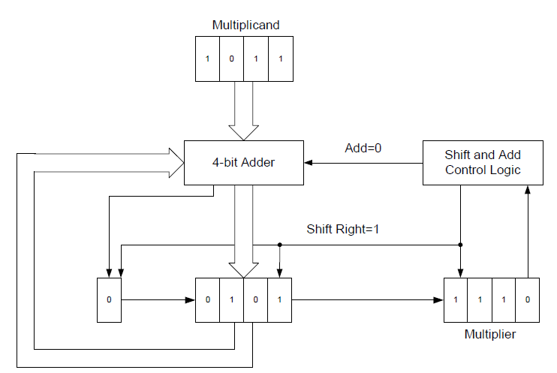
SHIFT And ADD Integer Multiplier Algorithm Example Steps
Step 4 : Perform SHIFT Operation
shifg_reg = shift_reg >> 1
And increment N-bit counter by 1
shift_reg entire 9 bits register right shift by 1
At end of N-bit count==0 stage, value of shift_reg = {0, 4’b0101, 4’b1110}

Slide 14
SHIFT And ADD Integer Multiplier Algorithm Example Steps
Step 5 : Check if shift_reg[0] == 0 or 1 ?
Load operand-1 of adder with value 4’b0000 and do not load multiplicand value
Select and connect shift_reg[7:4] which is accumulator value to Carry LookAhead Adder input-2 port
Do not perform Add
Select Shift Operation
Check if shift_reg[0] == 0 ?
N-bit Counter value is ‘1’

Slide 15
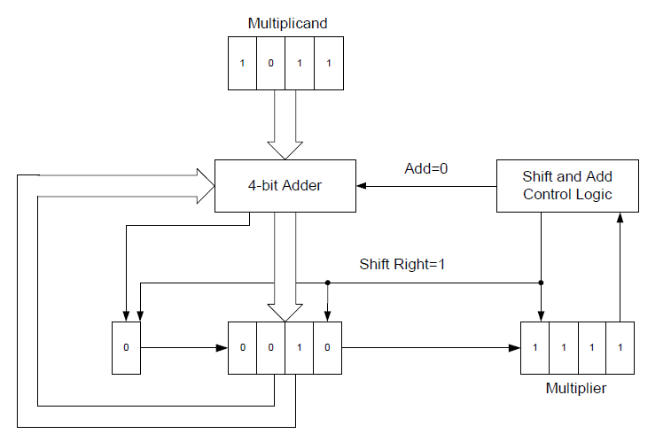
SHIFT And ADD Integer Multiplier Algorithm Example Steps
Step 6 : Perform SHIFT Operation
shifg_reg = shift_reg >> 1
And increment N-bit counter by 1
4. shift_reg entire 9 bits register right shift by 1
At end of N-bit count==1 stage, value of shift_reg = {0, 4’b0010, 4’b1111}

Slide 16
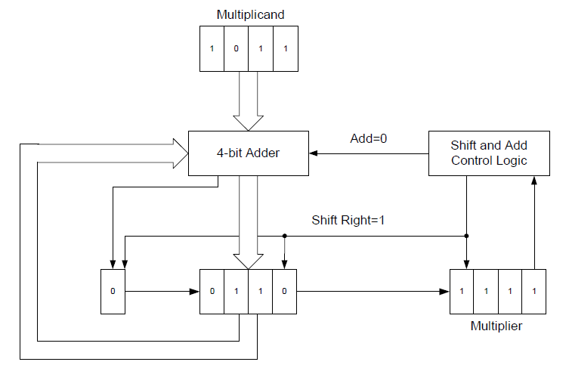
SHIFT And ADD Integer Multiplier Algorithm Example Steps
Step 7 : Check shift_reg[0] == 1 or 0 ?
Step 8 : since since shift_reg[0] == 1 then Perform Add Operation
Step 9 : Perform Shift operation shift_reg >> 1 and then increment N-N-bit counter value
At end of N-bit count==2 stage, value of shift_reg = {0, 4’b0110, 4’b1111}

Slide 17
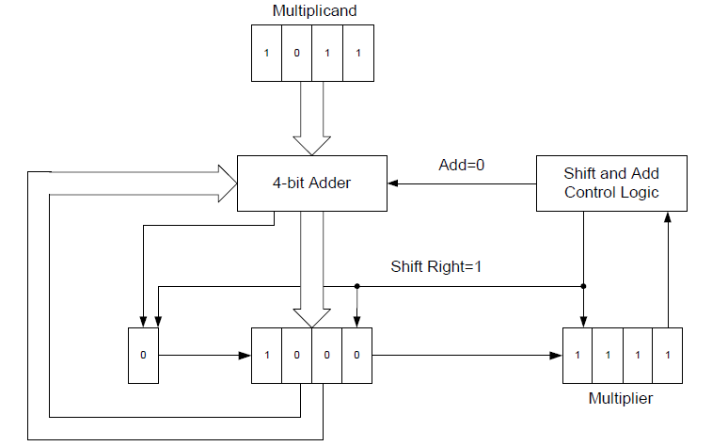
SHIFT And ADD Integer Multiplier Algorithm Example Steps
Step 10 : Check shift_reg[0] == 1 or 0 ?
Step 11 : since since shift_reg[0] == 1 then Perform Add Operation
Step 12 : Perform Shift operation shift_reg >> 1 and then increment N-bit counter value
At end of N-bit count==3 stage, value of shift_reg = {0, 4’b1000, 4’b1111}
Since count == 3, set done = 1 and product = shift_reg (9’b0_1000_1111) = 143

Slide 18
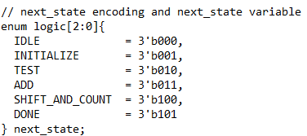

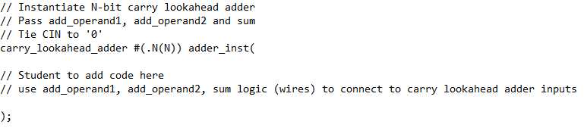
Integer Multiplier Code Development Hint
Define 6 FSM States
For N-bit Integer Divider, ensure size of shift register is = N + N + 1 bits
N bits to store adder output without carry out in shift register (this is also know as accumulator)
N bits to store multiplier value
1 bit to store carryout bit from adder
shift register format = {carryout, N-bit Adder output, N-bit Multiplier}
Use Carry Look Ahead Adder and Full Adder Module implementation from previous homework assignment

Slide 19
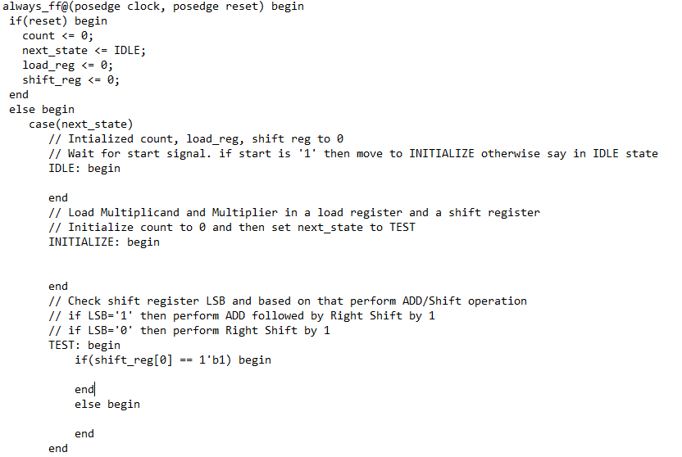
Integer Multiplier Code Development Hint
Develop FSM code using single always block approach with non-blocking assignment statements within

Slide 20
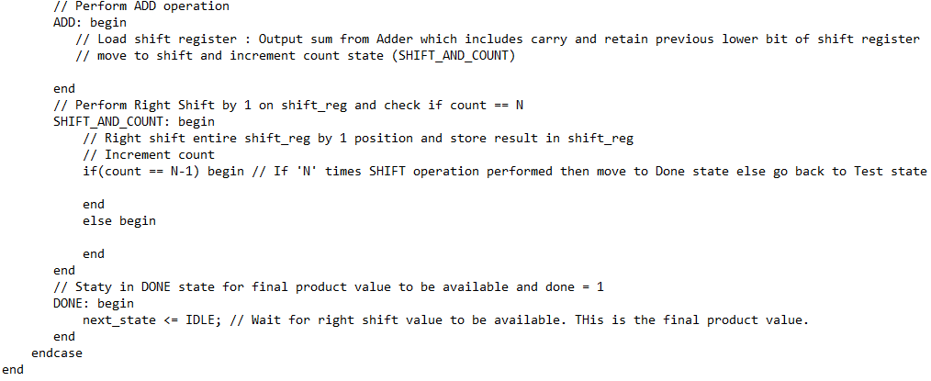
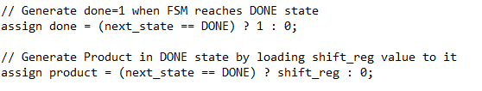
Integer Multiplier Code Development Hint
FSM code framework…. Continued
Using assign statement generate output ‘done’ and final ‘product’ value when FSM transitions to DONE state

