Slide 1
BASICS OF STATISTICS

Slide 2
Introduction
Method for collecting and analysing the data
Provides methods for design, description and inference
Design: planning and carrying out research studies
Description: summarizing and exploring data
Inference: making predictions and generalizing

Slide 3
Importance of Statistics
Statistics executes the work simply and gives a transparent picture of the work we do regularly.
The statistical methods help us to examine different areas such as medicine, business, economics, social science and others.
Statistics equips us with different kinds of organized data with the help of graphs, tables, diagrams and charts.
Statistics helps to understand the variability of the data pattern in a quantitative way
Statistics makes us understand the bulk of data in a simple way
Statistics is the way to collecting accurate quantitative data

Slide 4
Importance of statistics in Business
There are three major functions in any business enterprise in which the statistical methods are useful.
These are as follows:
I. The planning of operations: This may relate to either special projects or to the recurring activities of a firm over a specified period.
II. The setting up of standards: This may relate to the size of employment, volume of sales, fixation of quality norms for the manufactured product, norms for the daily output, and so forth.
III. The function of control: This involves comparison of actual production achieved against the norm or target set earlier. In case the production has fallen short of the target, it gives remedial measures so that such a deficiency does not occur again.

Slide 5
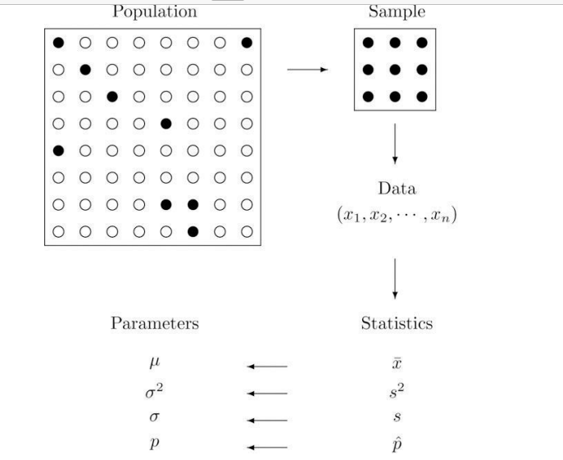
Introduction to Basic Terms
Definitions: populations and samples
A population is any specific collection of objects of interest. A sample is any subset or sub collection of the population, including the case that the sample consists of the whole population, in which case it is termed a census.
5

Slide 6
Definition: Qualitative data
data Qualitative data are measurements for which there is no natural numerical scale, but which consist of attributes, labels, or other non-numerical characteristics.
Definition: Quantitative data
Quantitative data are numerical measurements that arise from a natural numerical scale characteristics.
2types
1.Discrete : score of a team(whole number)
2.Continuous : height or weight of team members (decimal)

Slide 7
Variable : Characteristics that are measurable and are expressed on a numerical scale are called variables like, length, width, height, diameter, surface finish, etc.
Attribute : A quality characteristic that cannot be measured on a numerical scale is expressed as an attribute. Eg : intelligence, colour, gender, names

Slide 8
TYPES
Mainly 2 types
Descriptive statistics: consist of methods for organizing and summarizing information
Eg: mean, median, mode, sd, variance, covariance etc
Includes graphs, charts, tables & calculation of averages , percentiles
Inferential statistics: consist of methods for drawing and measuring the reliability of conclusions about population based on information obtained.
Includes point estimation, interval estimation , hypothesis testing

Slide 9
Descriptive Statistics
Data described in a summarized way.
Summarization is done from the sample of the population using different parameters like Mean or Standard deviation.
It is a way of using chart , graph to organize , represent and explain set of data
It is categorized into 4 different categories:
1) Measure of frequency
2) Measure of dispersion
3) Measure of central tendency
4) Measure of position

Slide 10
1) Measure of frequency: the number of times a particular data occurs.
2) Measure of dispersion: Range, Variance, and Standard Deviation
3) Measure of central tendency: mean, median, and mode
4) Measure of position: percentile and quartile ranks

Slide 11
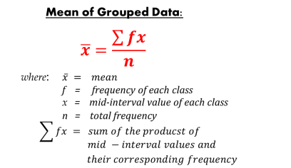
The measure of Central Tendency: Introduction
The measures of central tendency enable us to compare two or more distributions pertaining to the same time period or within the same distribution over time.
A. Arithmetic Mean

Slide 12
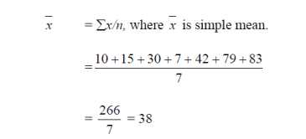
Suppose we have the following observations: 10, 15,30, 7, 42, 79 and 83 These are seven observations. Symbolically, the arithmetic mean, also called simply mean is

Slide 13
2. Median
Median is defined as the value of the middle item (or the mean of the values of the two middle items) when the data are arranged in an ascending or descending order of magnitude.
Thus, in an ungrouped frequency distribution if the n values are arranged in ascending or descending order of magnitude, the median is the middle value if n is odd.that is (n+1)/2
When n is even, the median is the mean of the two middle values.

Slide 14
Suppose we have the following series: 15, 19,21,7, 10,33,25,18 and 5
We have to first arrange it in either ascending or descending order. These figures are arranged in an ascending order as follows: 5,7,10,15,18,19,21,25,33
Now as the series consists of an odd number of items, to find out the value of the middle item.
Now as the series consists of an odd number of items, to find out the value of the middle item, we use the formula (n+1)/2. Where n is the number of items.
In this case, n is 9, as such (n+1)/2=5, that is, the size of the 5th item is the median. This happens to be 18.

Slide 15
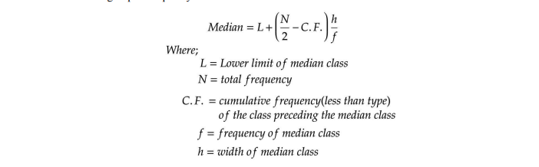

Slide 16
3. Mode
It is the value at the point around which the items are most heavily concentrated.
or A number that appears most often is the mode
To find the mode it is best to put the numbers in order (makes it easier to count them), then count how many of each number.
Example: 3, 7, 5, 13, 20, 23, 39, 23, 40, 23, 14, 12, 56, 23, 29
In order these numbers are: 3, 5, 7, 12, 13, 14, 20, 23, 23, 23, 23, 29, 39, 40, 56
We can now easily see which numbers appear most often. In this case the mode is 23.

Slide 17
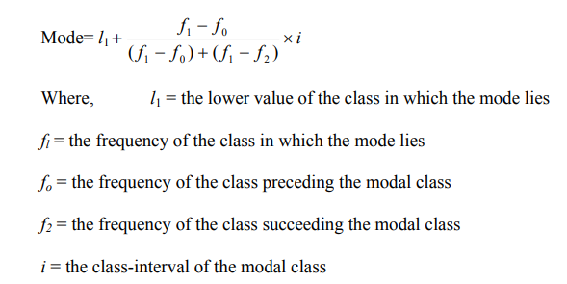
In the case of grouped data, mode is determined by the following formula :

Slide 18
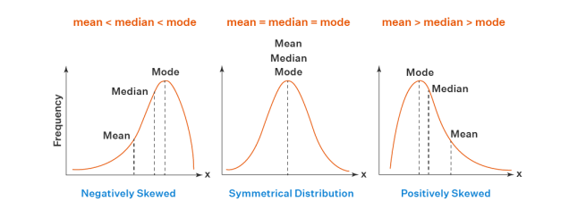
Relationships of the Mean, Median and Mode
In case, a distribution is skewed to the right, then mean> median> mode.
When a distribution is skewed to the left, then mode> median> mean.

Slide 19
THE BEST MEASURE OF CENTRAL TENDENCY

Slide 20
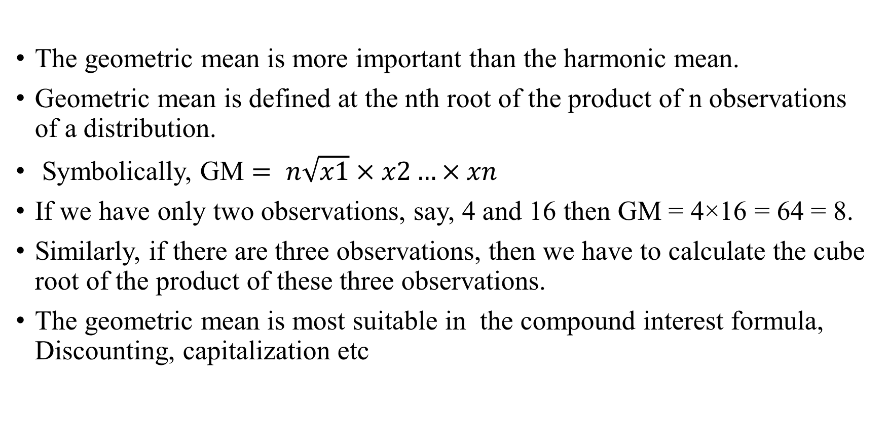
Geometric Mean
The geometric mean is more important than the harmonic mean.
Geometric mean is defined at the nth root of the product of n observations of a distribution.
Symbolically, GM $= n\sqrt{x1}×x2…×xn$
If we have only two observations, say, 4 and 16 then GM = 4×16 = 64 = 8.
Similarly, if there are three observations, then we have to calculate the cube root of the product of these three observations.
The geometric mean is most suitable in the compound interest formula, Discounting, capitalization etc

Slide 21
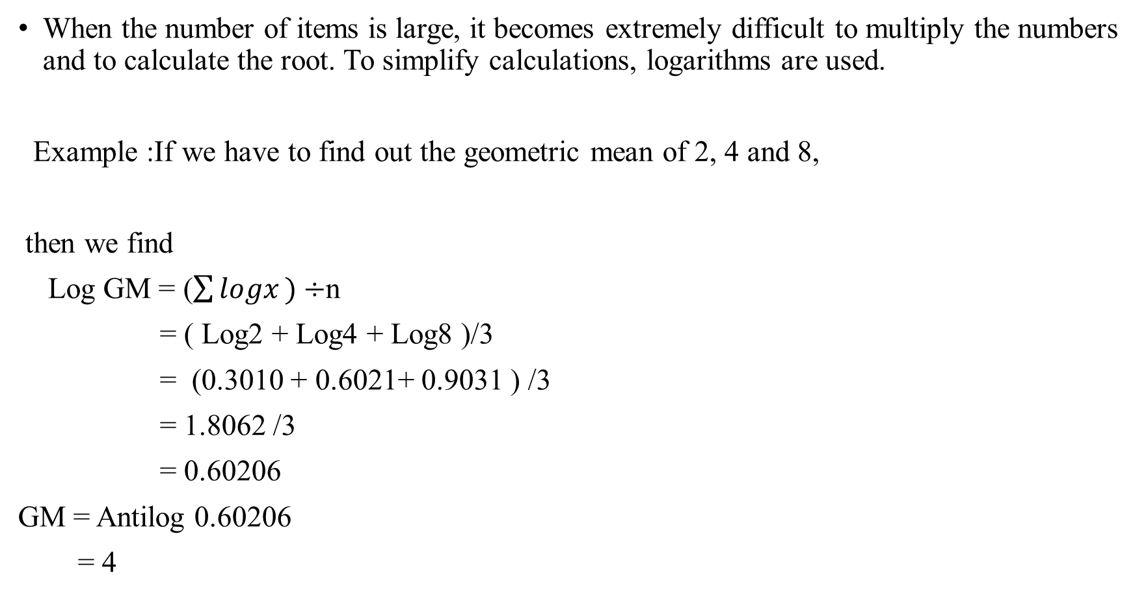
When the number of items is large, it becomes extremely difficult to multiply the numbers and to calculate the root. To simplify calculations, logarithms are used.
Example :If we have to find out the geometric mean of 2, 4 and 8,
then we find
Log GM = ($\sum{logx}⁡)÷$n
= ( Log2 + Log4 + Log8 )/3
= (0.3010 + 0.6021+ 0.9031 ) /3
= 1.8062 /3
= 0.60206
GM = Antilog 0.60206
= 4

Slide 22

Harmonic Mean
The harmonic mean is defined as the reciprocal of the arithmetic mean of the reciprocals of individual observations.

Slide 23
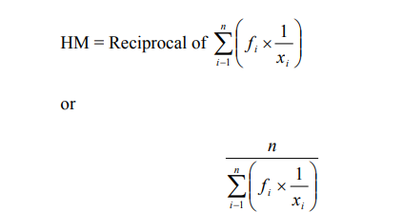

Slide 24
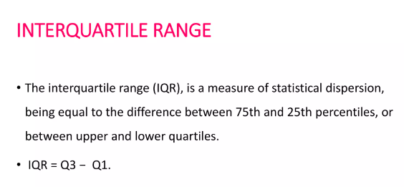
Measure of Position
percentile : divide data into hundredths , represents as percentages
Quartile : divide data into quarters , expressed as decimals
24

Slide 25
What is interquartile range?
Interquartile range is the difference between the upper quartile (or third
quartile) and the lower quartile (or first quartile) in an ordered data set.
Interquartile range == upper quartile −− lower quartile
IQR=UQ−LQ or IQR=Q3​−Q1​
The data must be in order (smallest to largest).
Remember,
The first quartile, Q1​ is 1/4 ​ of the way through the data – the lower quartile.
The second quartile, Q2​ is 1/2 of the way through the data – the median value.
The third quartile, Q3​ is 3/4 ​ of the way through the data – the upper quartile.

Slide 26
We can also consider each quartile as a percentile where,
The lower quartile LQ is the 25th percentile as 25% of the data lies below this value.
The median M is the 50th percentile as 50% of the data lies below (or above) this value.
The upper quartile UQ is the 75th percentile as 75% of the data lies below this value.

Slide 27
Five Figure Summary
To describe the centre and spread of a univariate data set by way of a 5-figure summary and visually by a box & whisker plot.
When describing a group of data, there are generally two main types of things to consider:
a) Measure of centre – this is a single value that could be used as a representative of the entire data set (e.g. mean, median, mode)
b) Measure of spread – this is a number that indicates how spread out the data are (e.g. standard deviation, range, inter-quartile range)

Slide 28
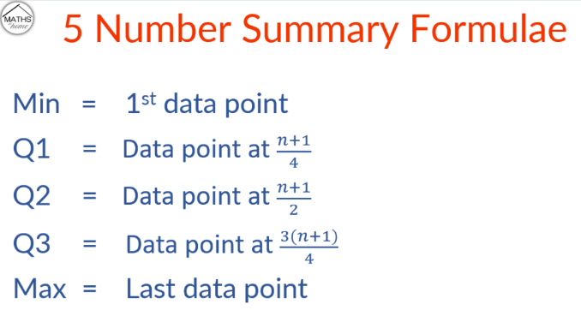

Slide 29
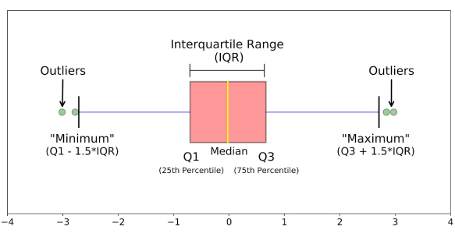

Slide 30
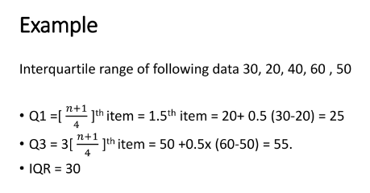

Slide 31
Example: 1,2,2,2,3,3,4,5,5,5,6,6,6,6,7,8,8,9,27
Q1=(n+1)/4 = (19+1)/4 = 5 (position)
ie Q1 = 3
Now Q3 = ¾*(n+1) =3/4*20 =15(position)
ie Q3 = 7
IQR = Q3-Q1 = 7-3 = 4
lower fence = Q1 – 1.5*IQR = 3 – (1.5*4) =3 -6 = -3
Upper fence = Q1+ 1.5*IQR =7+6 = 13
ie numbers less than -3 and greater than 13 is considered as outlier
Q2 = 2/4 * 20 = 10 th position
Q2 = 5

Slide 32
Application of boxplot
Box plots are used to show distributions of numeric data values, especially when you want to compare them between multiple groups.
They are built to provide high-level information at a glance, offering general information about a group of data’s symmetry, skew, variance, and outliers

Slide 33
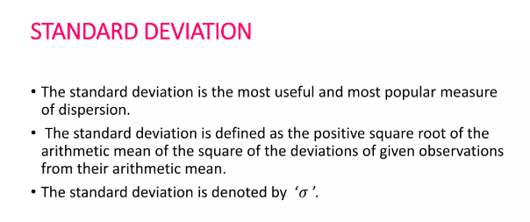
Measure of dispersion: identifies the spread of data
33
33

Slide 34
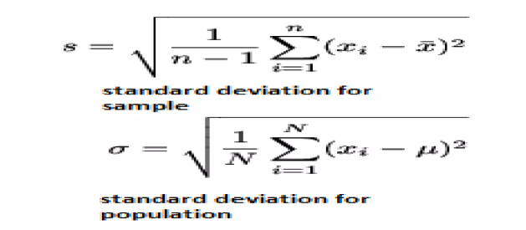

Slide 35
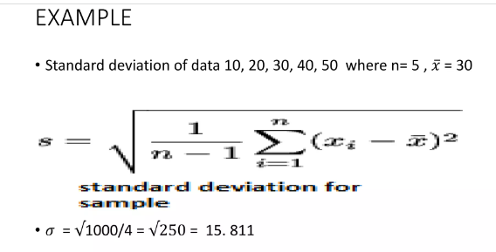

Slide 36
variance
The term variance refers to a statistical measurement of the spread between numbers in a data set.
More specifically, variance measures how far each number in the set is from the average(mean) , and thus from every other number in the set.
Variance is often depicted by this symbol: σ²
The square root of the variance is the standard deviation.
​σ2=(xi​−x)2/N
​where:
xi​=Each value in the data set
x=Mean of all values in the data set
N=Number of values in the data set​

Slide 37
RANGE
The difference between highest and smallest values
R=xmax−xmin
The range is a measure of variability because it indicates the size of the interval over which the data points are distributed.
A smaller range indicates less variability (less dispersion) among the data, whereas a larger range indicates the opposite.

Slide 38
Standard deviation is the spread of a group of numbers from the mean.
standard deviation is the square root of the variance.
can be used to determine whether a particular data value is close to or far from the mean.
variance is the average of all data points within a group.
The variance measures the average degree to which each point differs from the mean

Slide 39
Inferential Statistics
In the Inferential Statistics, we try to interpret the Meaning of descriptive Statistics
After the Data has been collected, analysed, and summarized we use Inferential Statistics to describe the Meaning of the collected Data.
For example, deriving estimates from hypothetical research.

Slide 40
Inferential Statistics use the probability principle to assess whether trends contained in the research sample can be generalized to the larger population from which the sample originally comes.
Inferential Statistics are intended to test hypotheses and investigate relationships between variables and can be used to make population predictions.
Inferential Statistics are used to draw conclusions and inferences, i.e., to make valid generalizations from samples

Slide 41
THANKYOU

