Slide 1
LEOBEATS: MUSIC WEBSITE
URL: http://leobeats.epizy.com/?i=3
Repository: https://drive.google.com/file/d/1PAUW10ZV707dorMBpJflxgT194mmzHiO/view?usp=sharing
AARON DURAN

Slide 2
Project Charter
Purpose: The website serves as storage for a music information database with useful tools for adding, deleting, and searching information to find a specific song while featuring a toggle for dark and light mode.
Anticipated completion: December 2020
Every participant is familiar with general CS skills. These skills include various coding languages, various windows programs(PowerPoint) and database knowledge to successfully complete the project.

Slide 3
Project Scope
Description: For one person to memorize all their favorite music is near impossible. This website serves as a location for an individual to contain all records of the music they enjoy with easy to use tools for efficient searching and sorting.
Capabilities:
Storage of music information: Artist name, song name, genre, year created, and a url link.
Adding and deleting information.
Advanced search tool: filtering to find specific data.
Dark Mode to ease the user’s eyes.

Slide 4
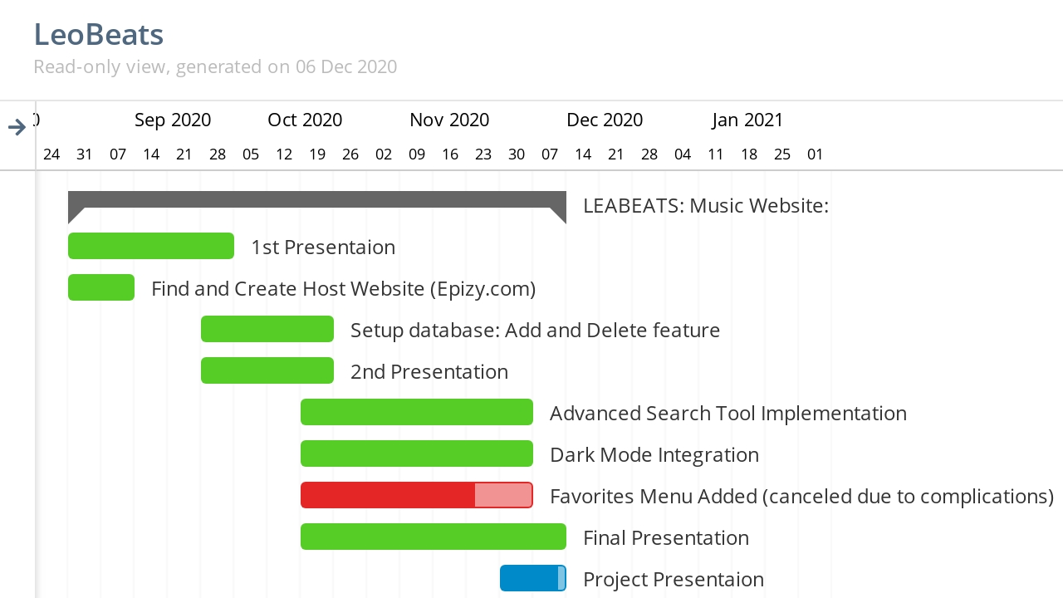
Schedule

Slide 5
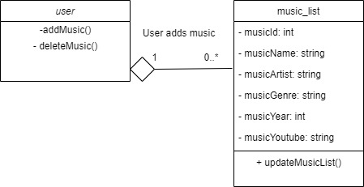
Design Class

Slide 6
Use Case - Add Music
Use case name: | Add Music
Scenario: | User adds a song to the music_list table.
Triggering event: | User wants to add a new song to the database.
Description: | A user adds song name, artist, genre, year, and link to their music list.
Actors: | User
Related use cases: | None
Stakeholders: | User, potential for business relationship with music platform.
Preconditions: | Song choice must have a link available.
Postconditions: | Song added to database must address all attributes. Apply null to empty fields.
Flow of activities:
Exception Conditions: | Link to song is invalid.
Actor User clicks ADD NEW. User clicks SAVE. | System 1.1 System opens window prompting user to enter song Name, Artist, Genre, Year, and Link. 2.1 System saves values into the music_list table.

Slide 7
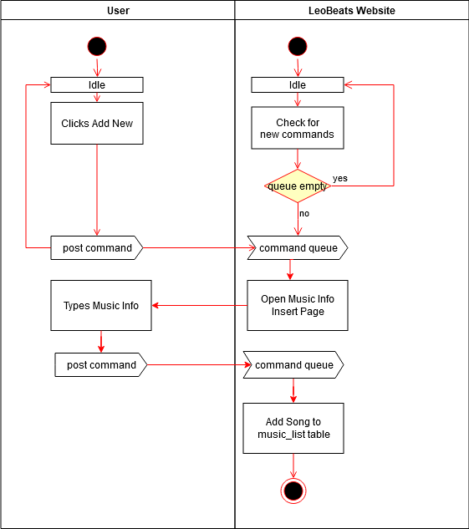
Use Case - Add Music

Slide 8
Use Case - Delete Music
Use case name: | Delete Music
Scenario: | User removes a song from the music_list table.
Triggering event: | User wants to delete a song to the database.
Description: | A user erases a song from their music list.
Actors: | User
Related use cases: | None
Stakeholders: | User, potential for business relationship with music platform.
Preconditions: | Song must already be present in the music_list table.
Postconditions: | Song must be entirely removed from the music_list table.
Flow of activities:
Exception Conditions: | Website can’t connect to database.
Actor User clicks DELETE. | System 1.1 System updates music_list table and deletes the song entry.

Slide 9
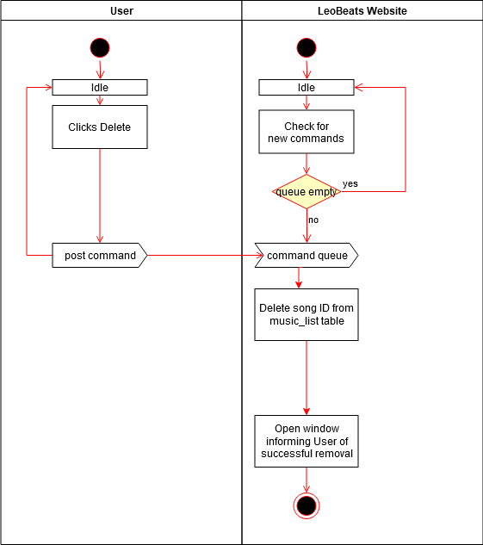
Use Case - Delete Music

Slide 10
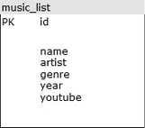
Database

Slide 11
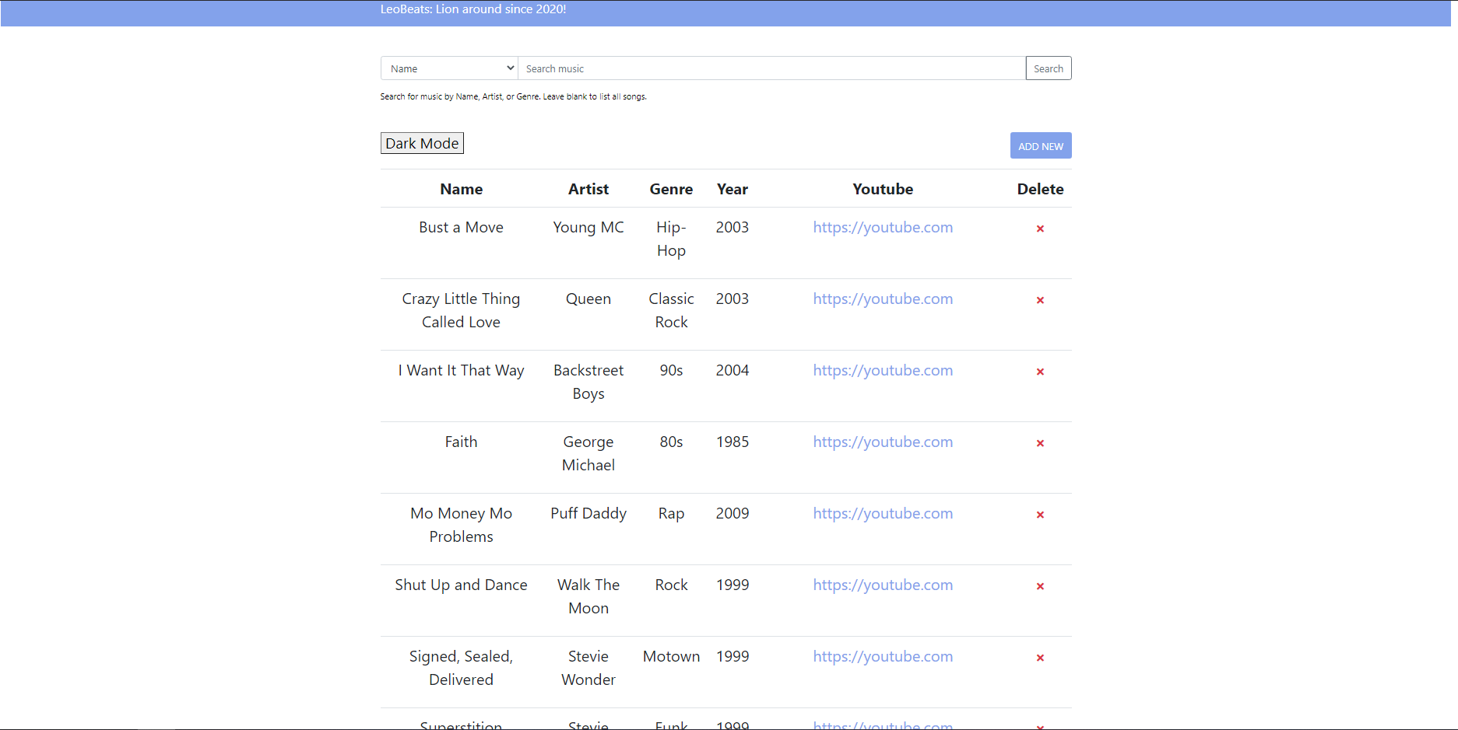
Sample GUI

Slide 12
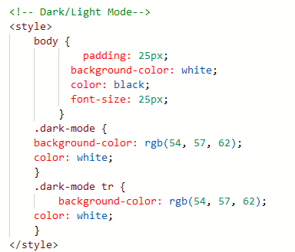
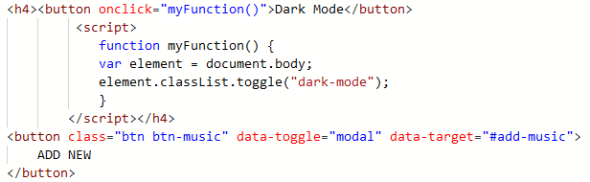
Dark / Light Code

Slide 13
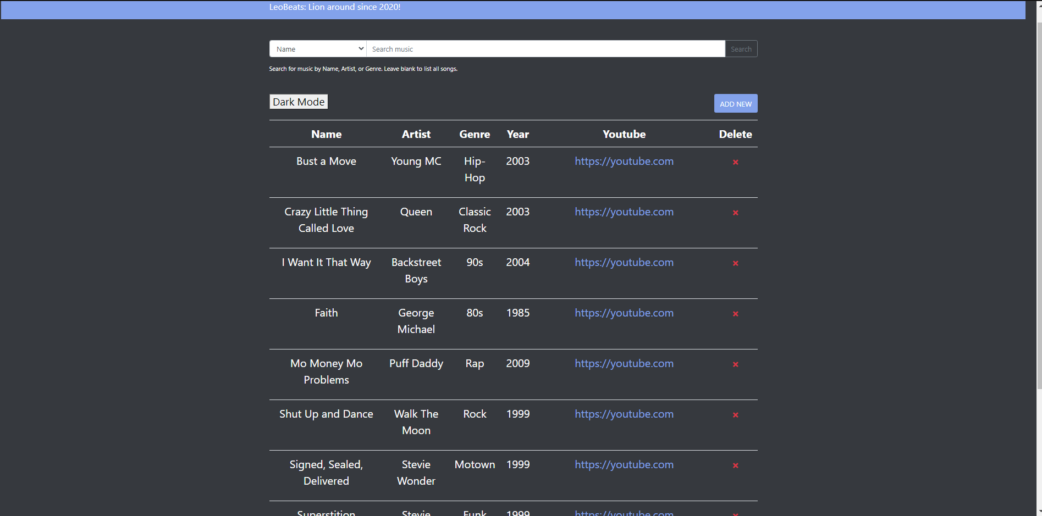
Dark Mode GUI

Slide 14
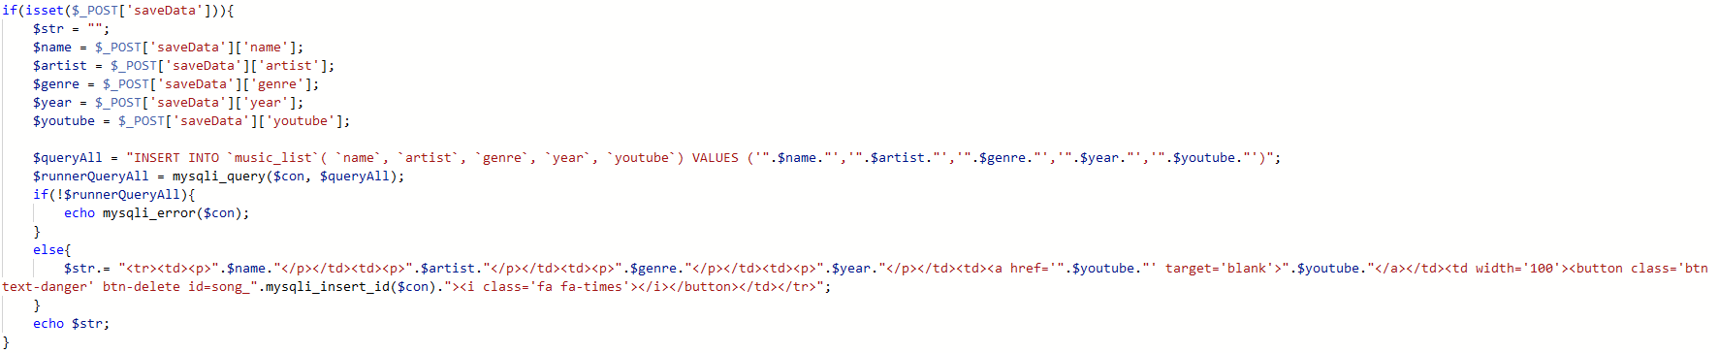
PHP Code (Insert Song)

Slide 15
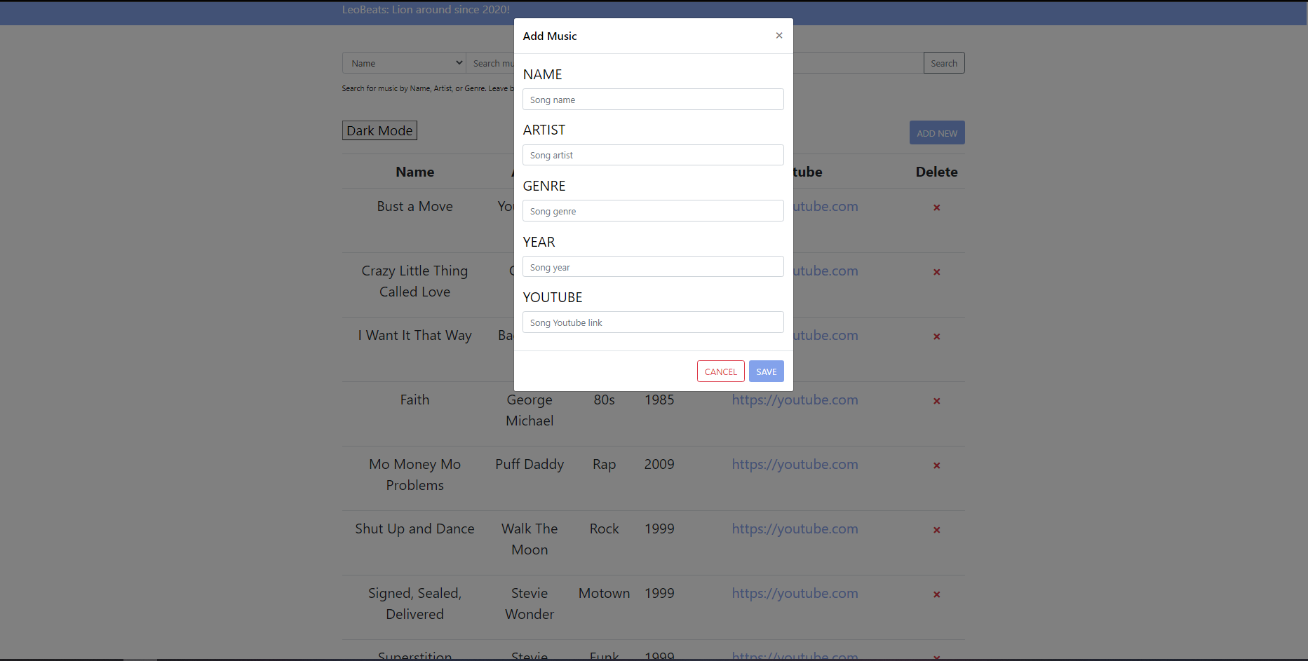
Add New GUI

Slide 16
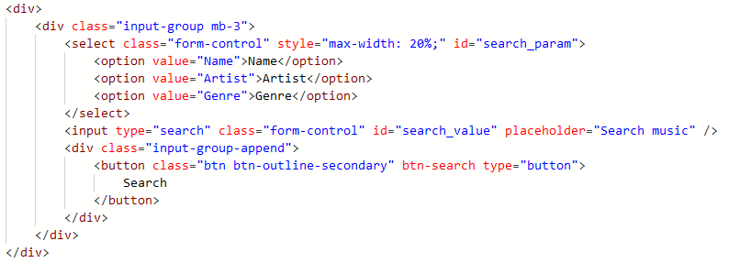
Search Code

Slide 17
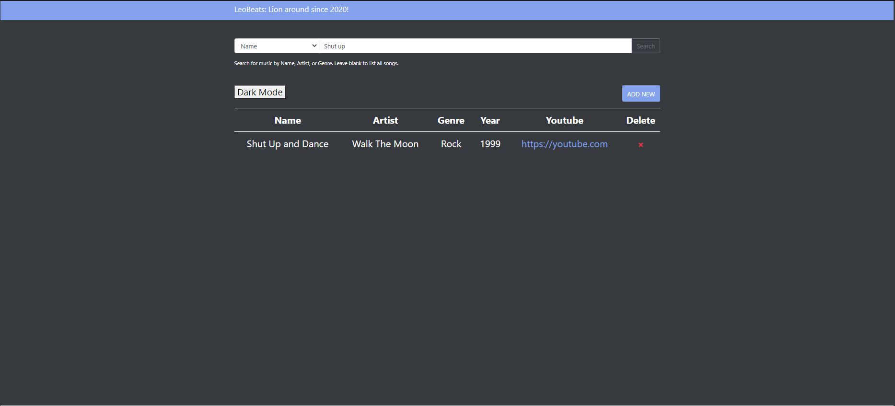
Search Feature

Slide 18

LeoBeats Music
Lion around since 2020!

