Slide 1


Session 4 of 14
Developing CRUD operations in gRPC Service
using
ASP.Net Core, EF Core, and SQL Server
Viswanatha Swamy
LinkedIn: https://www.linkedin.com/in/viswanatha-swamy-b57326128/
Twitter: https://twitter.com/vishipayyallore
The Tech Platform

Slide 2
Information
Today is session 4.
All the sessions will be hands on.
Sessions will be two per week.
Will have parking lots for queries and other topics.
Some of the concepts we will introduced and revisited in next sessions.
There are multiple ways to do, we will use one of the way.
The focus was more on concepts and demos are kept simple.
I am still a learner. What!!! … wait … Yes, I am still a learner.
The Tech Platform

Slide 3
Tools we use
Visual Studio 2019 Professional
Visual Studio Code
Azure Data Studio
SQL Server
The Tech Platform

Slide 4

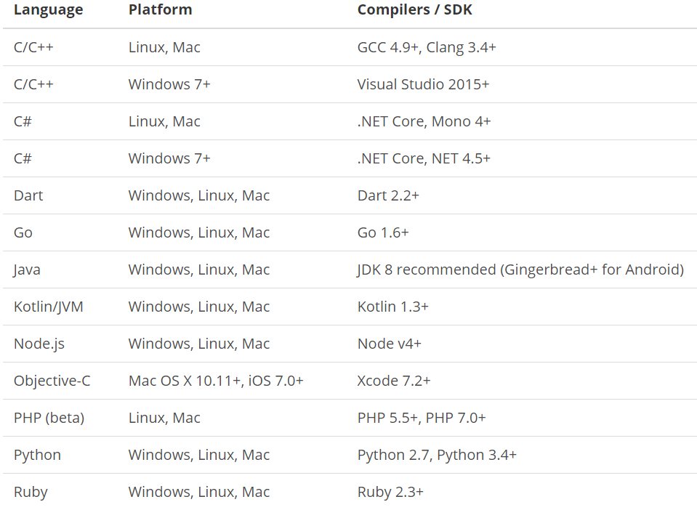
What is gRPC ?
is a modern open source high performance RPC framework that can run in any environment. It can efficiently connect services in and across data centers with pluggable support for load balancing, tracing, health checking and authentication. It is also applicable in last mile of distributed computing to connect devices, mobile applications and browsers to backend services.
https://docs.microsoft.com/en-us/aspnet/core/tutorials/grpc/grpc-start?view=aspnetcore-3.1&tabs=visual-studio
https://grpc.io/docs/guides/
https://grpc.io/docs/guides/concepts/
Motivation:
High Performance
IDL / Contract Based
Streaming (Unary, Client, Server, Bi-directional)
Security (https://developers.google.com/web/fundamentals/performance/http2)
Available across ecosystems
Supported Languages:
URL: https://grpc.io/about/#officially-supported-languages-and-platforms
The Tech Platform

Slide 5
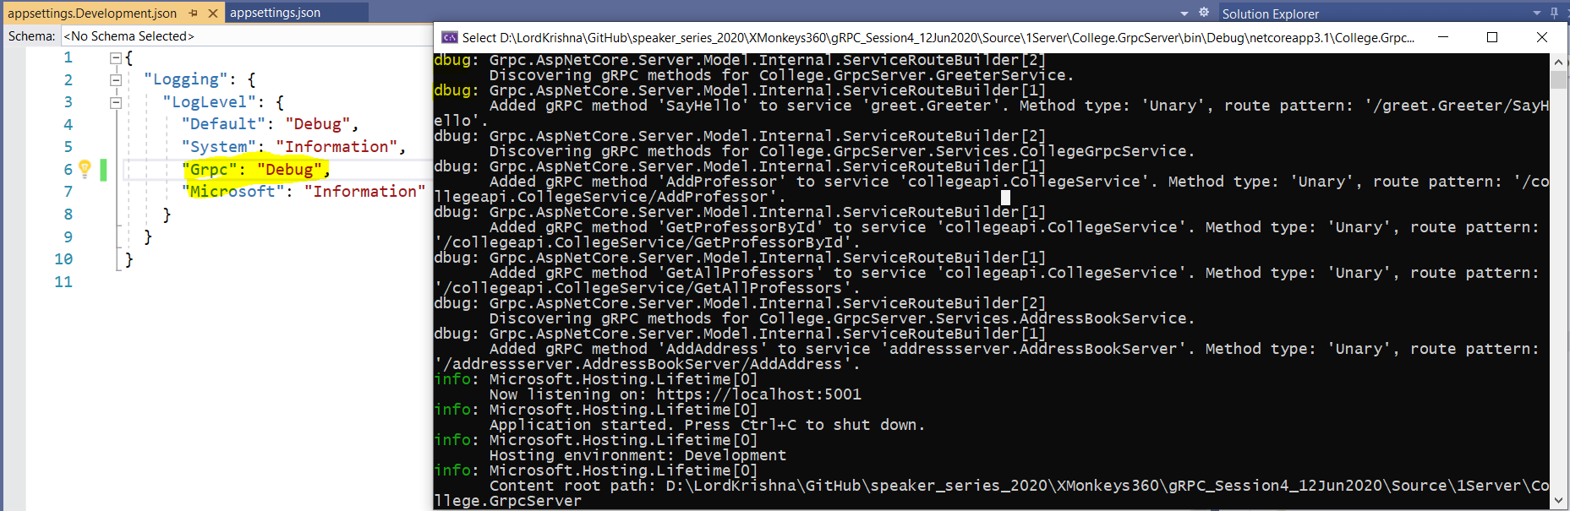
Adding gRPC Logging inside Server
The Tech Platform

Slide 6
Adding gRPC Logging inside Server
Demo
Adding gRPC Logging
inside Server
The Tech Platform

Slide 7
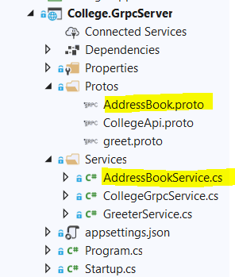
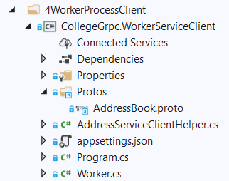
.NET Core Worker Process as gRPC Client
The Tech Platform

Slide 8
.NET Core Worker Process as gRPC Client
Demo
.NET Core Worker Process
as gRPC Client
The Tech Platform

Slide 9
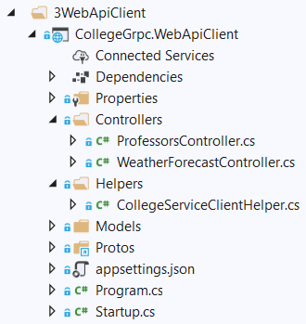
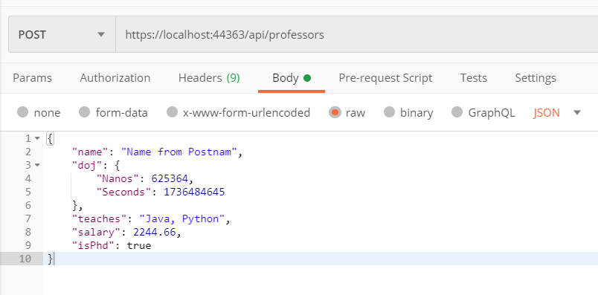
.NET Core Web API as gRPC Client
The Tech Platform

Slide 10
.NET Core Web API as gRPC Client
Demo
.NET Core Web API
as gRPC Client
The Tech Platform

Slide 11
What is next?
What is next ???
What we will discuss in next session ….
Setting up and verifying Redis Cache in our Laptop.
To Install on WSL on Windows 10
To Start and Stop the Redis Service
To connect to Redis Server
Improving the Retrieval Time by using Redis Cache.
Verify the Time of retrieval of data with and without Redis Cache.
Creating .Net Core + Angular 10 UI as Client to gRPC Server.
Using Auto-Mapper.
The Tech Platform

Slide 12
Q & A
The Tech Platform

Slide 13
Thank You
Viswanatha Swamy
LinkedIn: https://www.linkedin.com/in/viswanatha-swamy-b57326128/
Twitter: https://twitter.com/vishipayyallore
The Tech Platform

