Slide 1
Paperless Restaurant
Group 3
Francis Dippnall (17003003) – Back-End + Client APIs
Robert Flynn (16026255) – Counter + Kitchen Front-End
Jacob Croker (17083659) – Waiter View + Mobile Accessibility

Slide 2
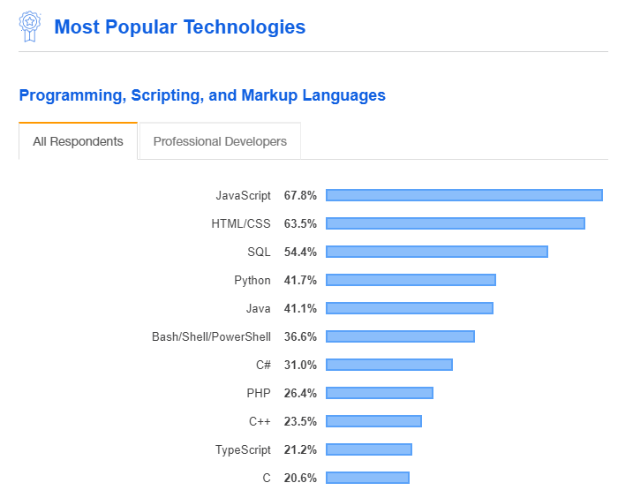
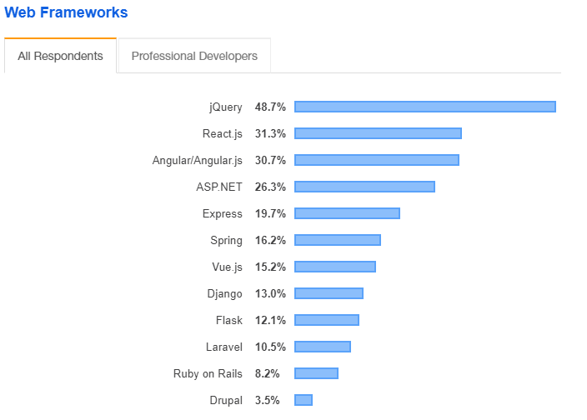
Research
Source: https://insights.stackoverflow.com/survey/2019
When discussing what languages to use, we did some research on popular technologies

Slide 3
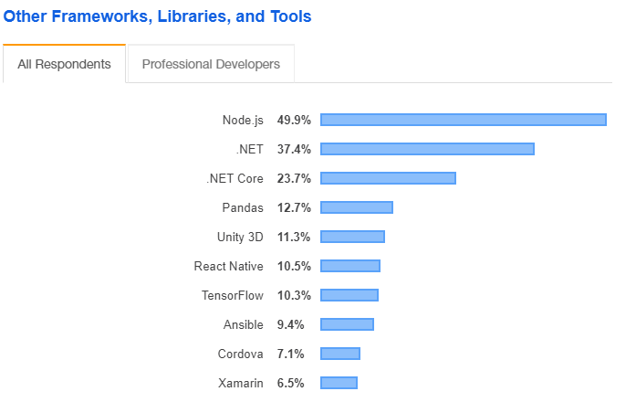
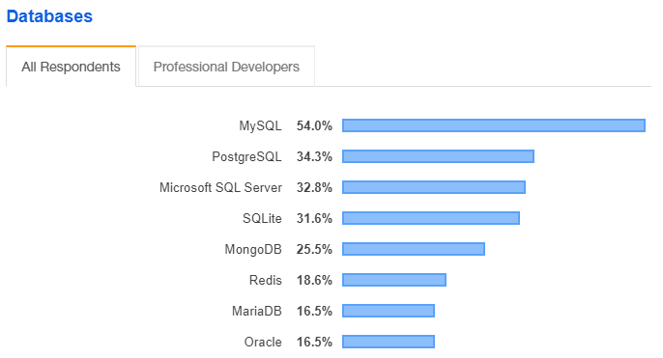
Research
Source: https://insights.stackoverflow.com/survey/2019

Slide 4




Technologies
We have to think about what sort of connections will be going on within this software.
After planning out some communication between devices it became obvious that there were going to be a large amount of connections between clients and server. Following is an evaluation of the technologies looked at.

Slide 5

We chose not to use PHP because
Poor documentation
Synchronous operation: unlike JS

Slide 6

We chose to use NodeJS because
- Has NPM which is better for modularisation.
Using it JavaScript means it will be easier for full stack development using one language on the backend and front end, making less effort compared to using multiple languages.

Slide 7

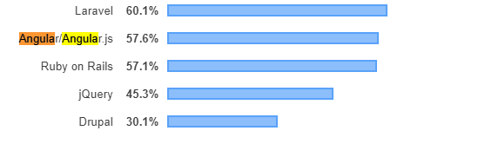
We chose not to use AngularJS because
Creating the web app as a single page application was not necessary for this project
Less familiarity, AngularJS has a bit of a learning curve as it works quite differently to other JavaScript frameworks and libraries which could make it hard for everyone to work together on the project.

Slide 8
We chose to use jQuery because
- provides many tools that simplify code and speed up development
jQuery makes it easy to bind data to Dom elements
Relatively lightweight
Syntax is easy to understand and similar to vanilla JavaScript

Slide 9

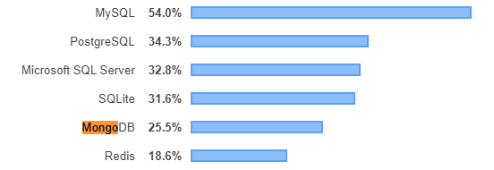
We chose not to use MongoDB because
- It gives us less control of what data is being saved.
- Flexibility isn’t necessary.

Slide 10
We chose to use MySQL because
- We already know all the data we want to save, requiring less maintenance.
- It gives us more control over the structure.

Slide 11
Demo

