Slide 1
__ _ __ _ _ __ ___ ___ _ __ ___ __ _ _ __ __ _ __ _ ___ _ __
/ _` |/ _` | '_ ` _ \ / _ \ / '_ ` _ \ / _` | '_ \ / _` |/ _` |/ _ \ '__|
| (_| | (_| | | | | | | __/ | | | | | | (_| | | | | (_| | (_| | __/ |
\__, |\__,_|_| |_| |_|\___| |_| |_| |_|\__,_|_| |_|\__,_|\__, |\___|_|
__/ | __/ |
|___/ |___/
a tool by
Sabrina Rasch
Roman Schwob

Slide 2
_
| |
__ _ ___ __ _| |
/ _` |/ _ \ / _` | |
| (_| | (_) | (_| | |
\__, |\___/ \__,_|_|
__/ |
|___/
Organise social games
Find good fit for game event
Make suggestions for next purchase
Rate experience of playing your games
→ Let’s take a tour!

Slide 3
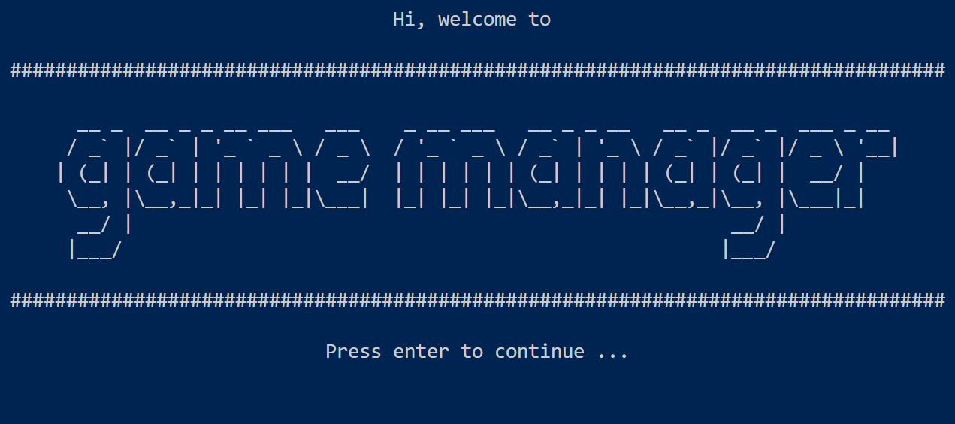

Slide 4
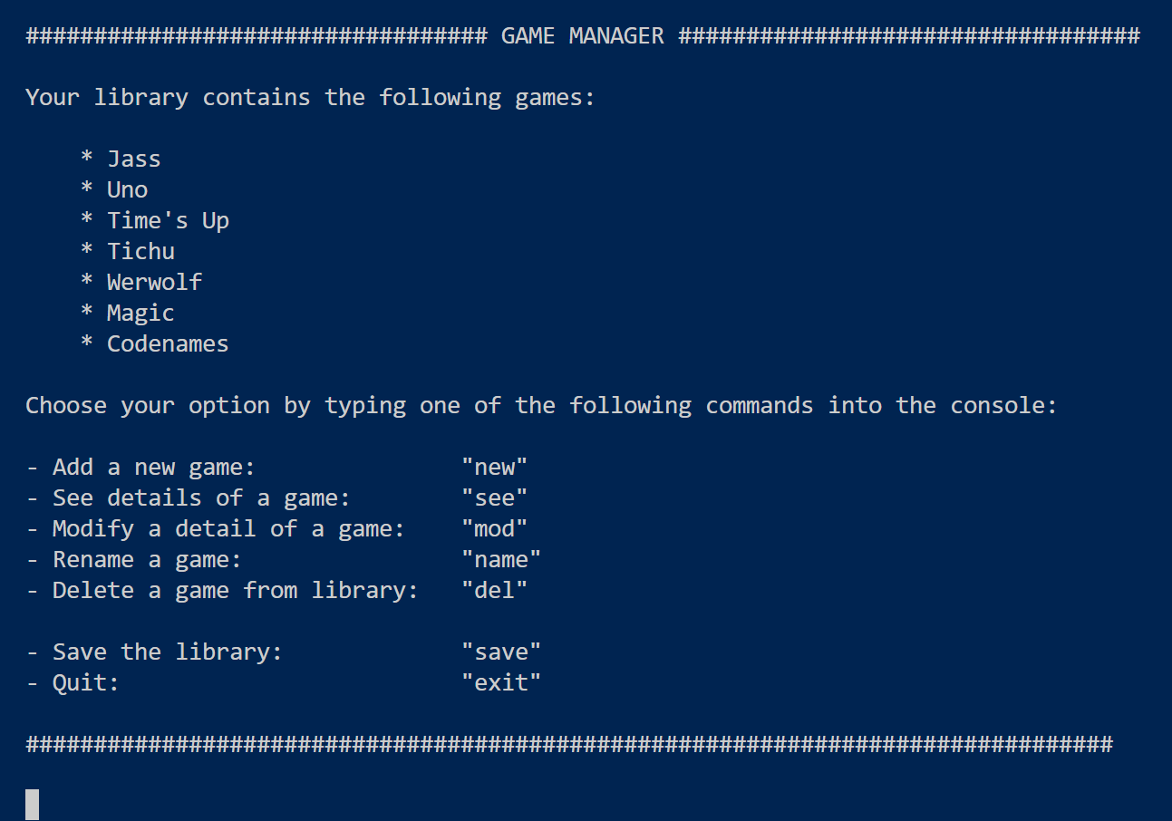

Command screen

Slide 5
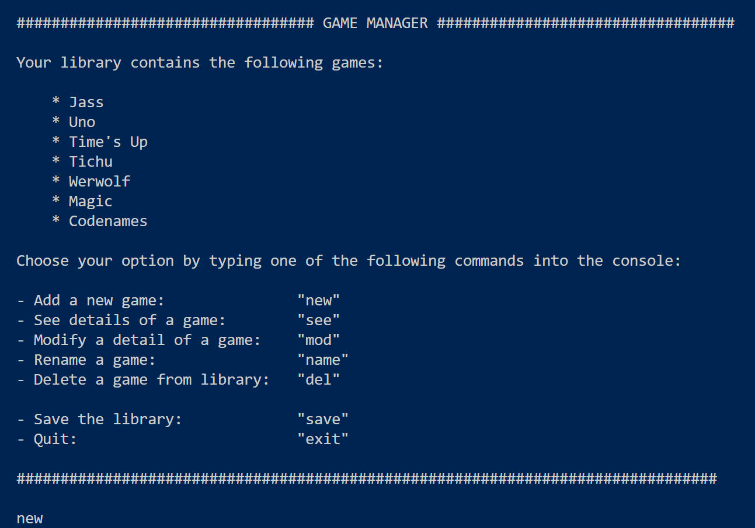

Slide 6
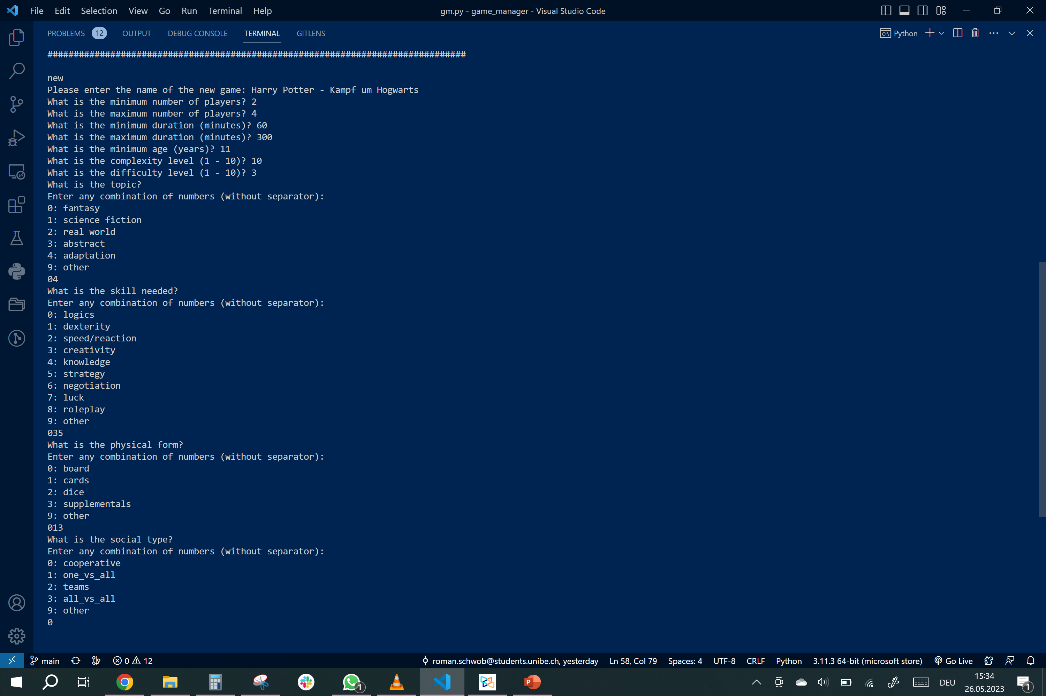
numeric
choice

Slide 7
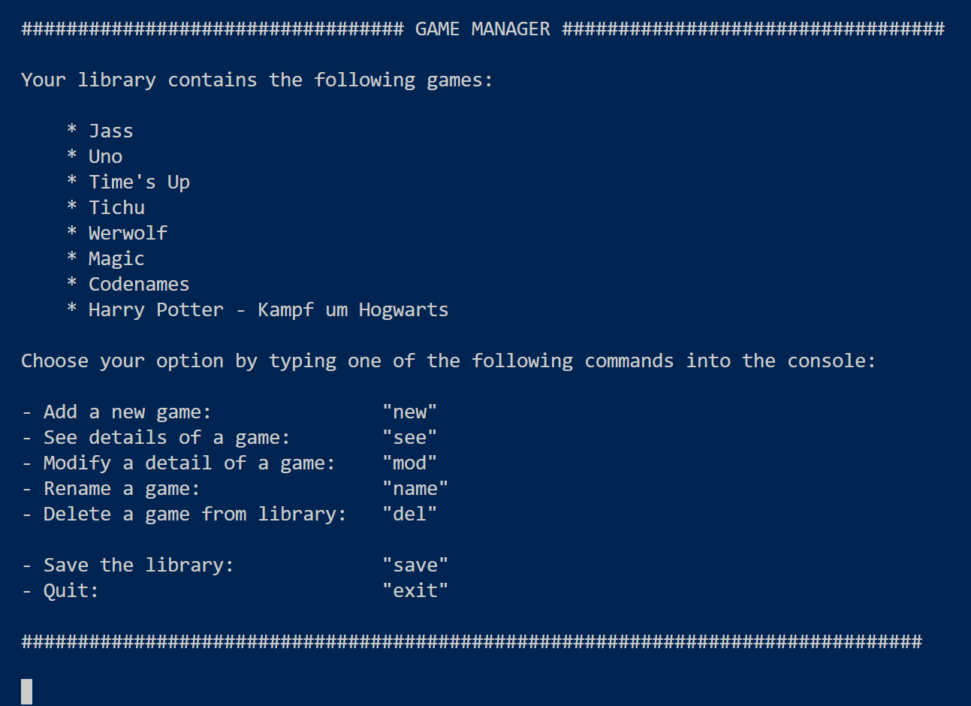

Slide 8
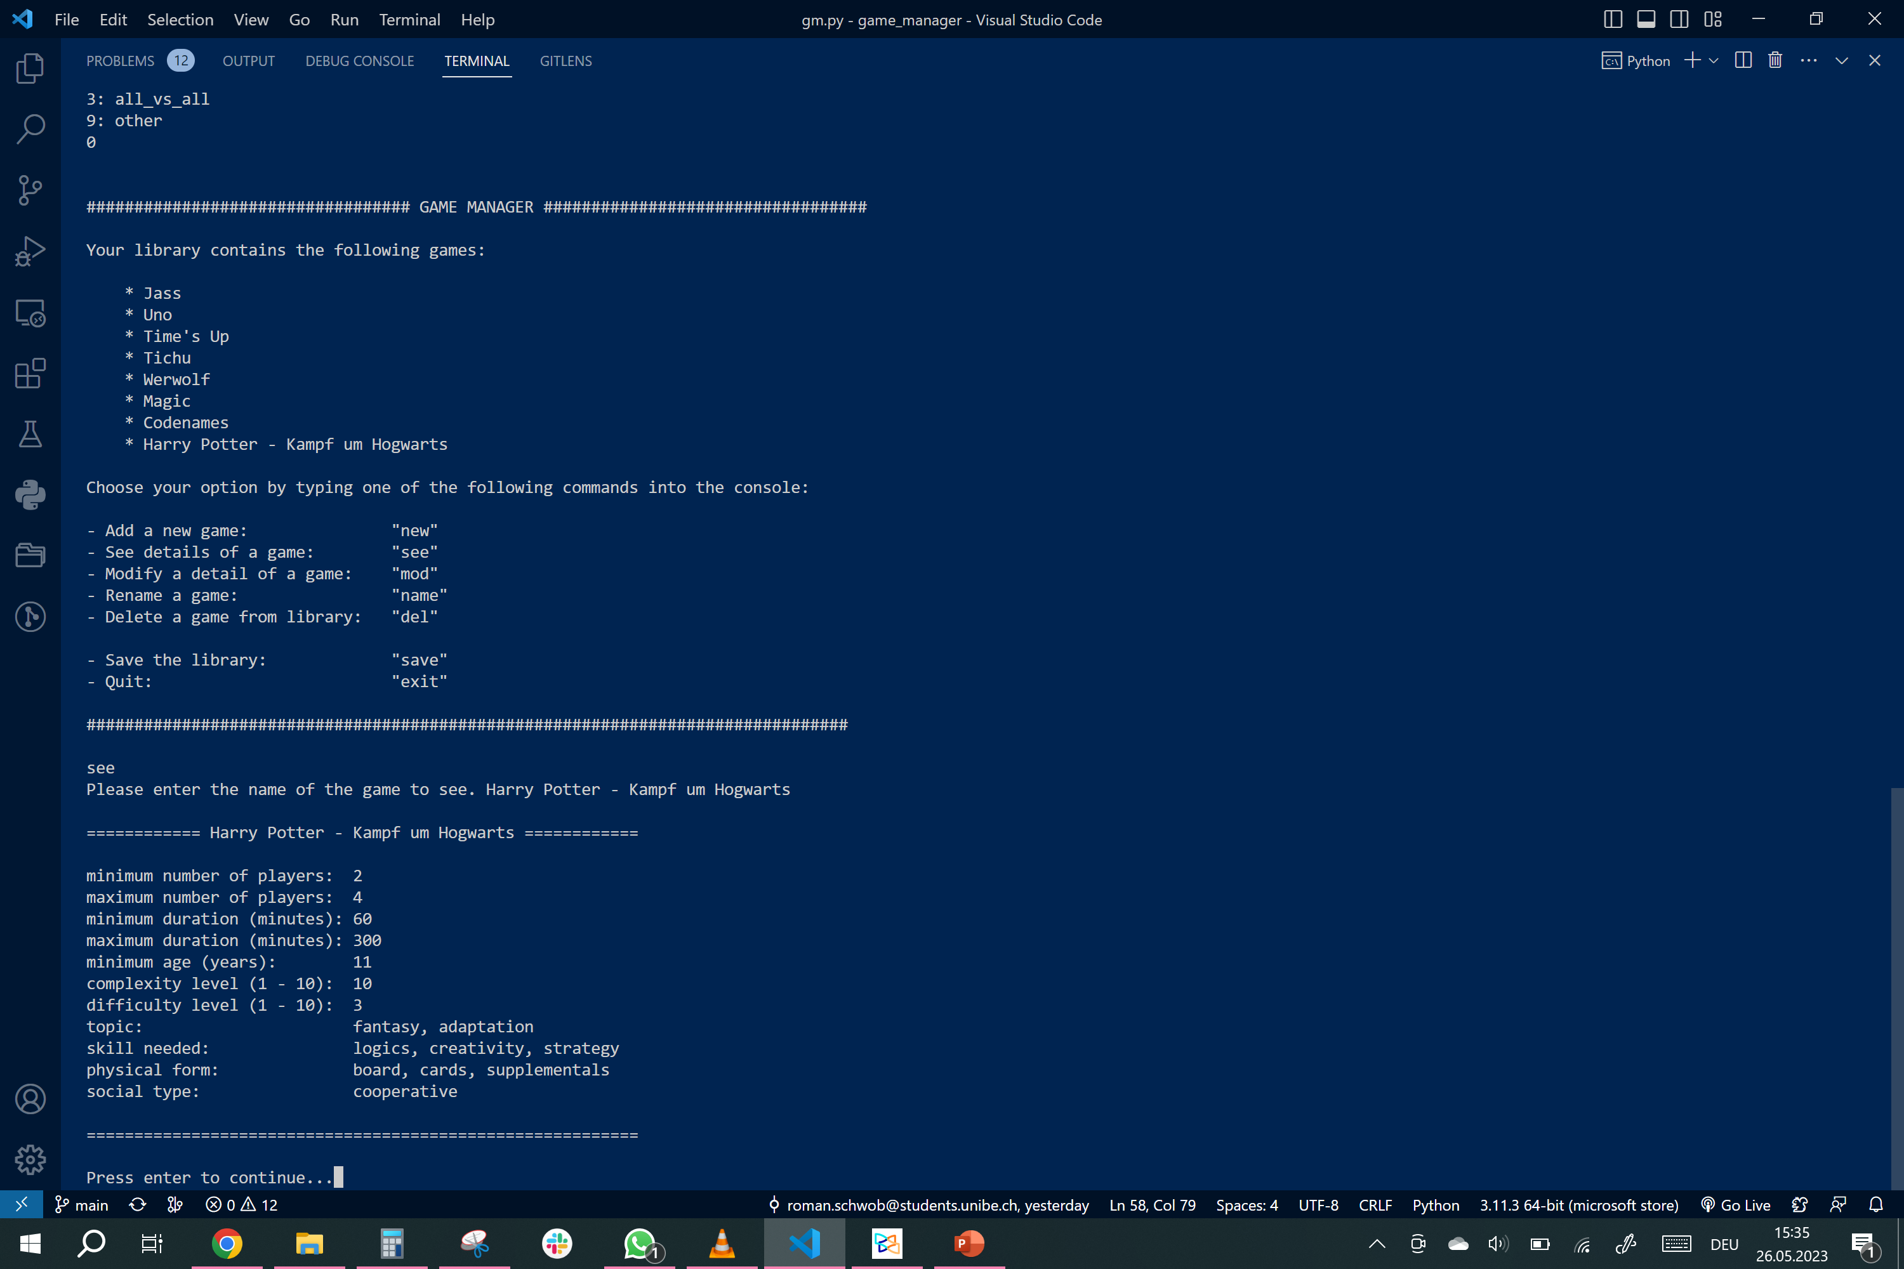

Slide 11
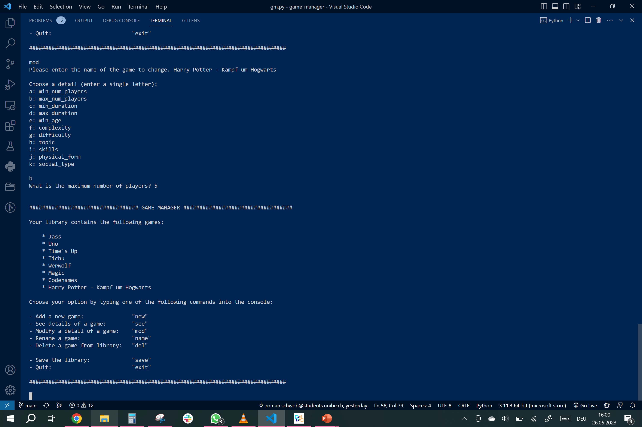

Slide 15
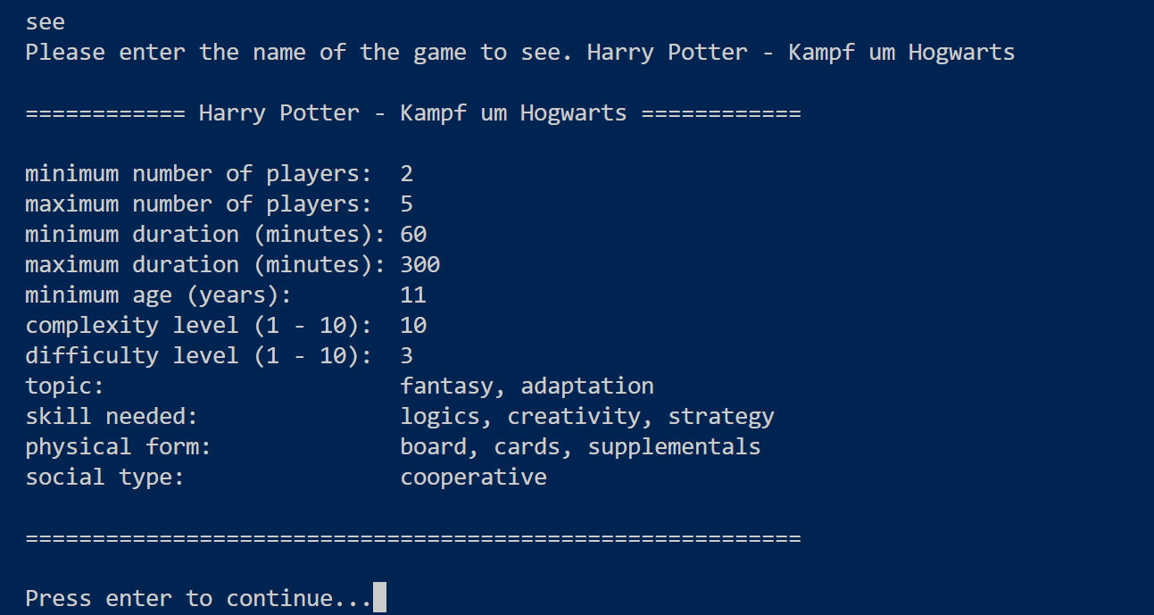

Slide 17
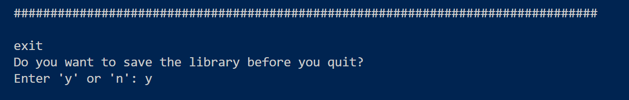

Slide 18
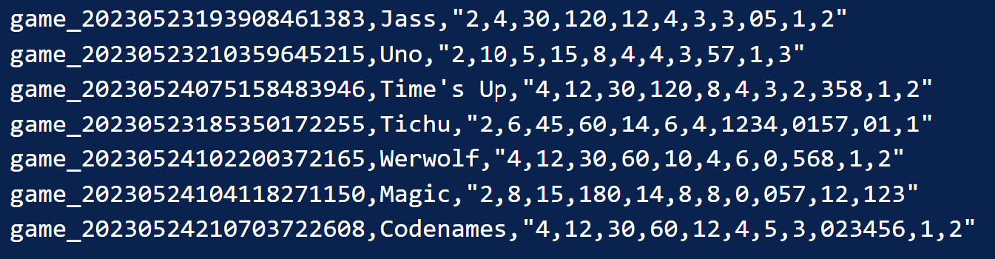
Saving grace - library.gm:
csv: id name details “code string”

Slide 19
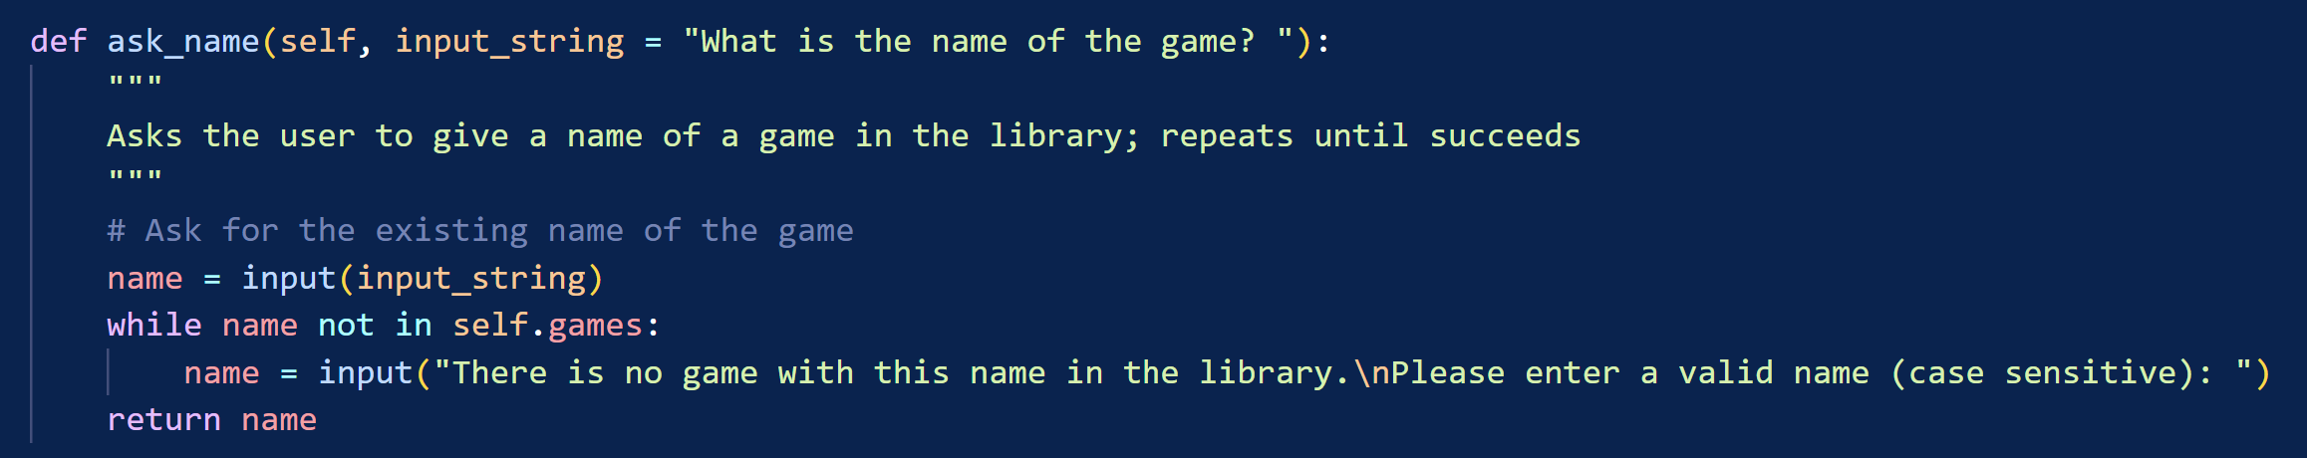
_ _ _ _
| | | (_) | |
_ _ _ __ _____ ___ __ ___ ___| |_ ___ __| |_ _ __ _ __ _ _| |_
| | | | '_ \ / _ \ \/ / '_ \ / _ \/ __| __/ _ \/ _` | | '_ \| '_ \| | | | __|
| |_| | | | | __/> <| |_) | __/ (__| || __/ (_| | | | | | |_) | |_| | |_
\__,_|_| |_|\___/_/\_\ .__/ \___|\___|\__\___|\__,_|_|_| |_| .__/ \__,_|\__|
| | | |
|_| |_|
Check every input; if it is NOT correct, repeat question until correct input is entered:
Idea for improvement: let user exit this loop

Slide 20
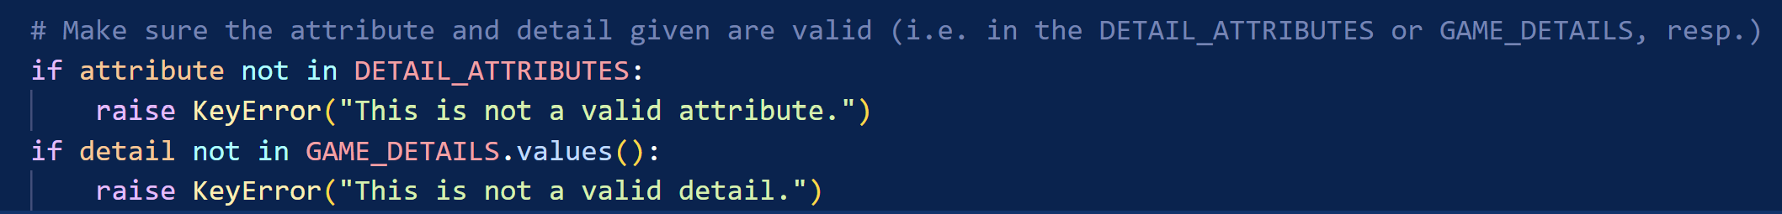
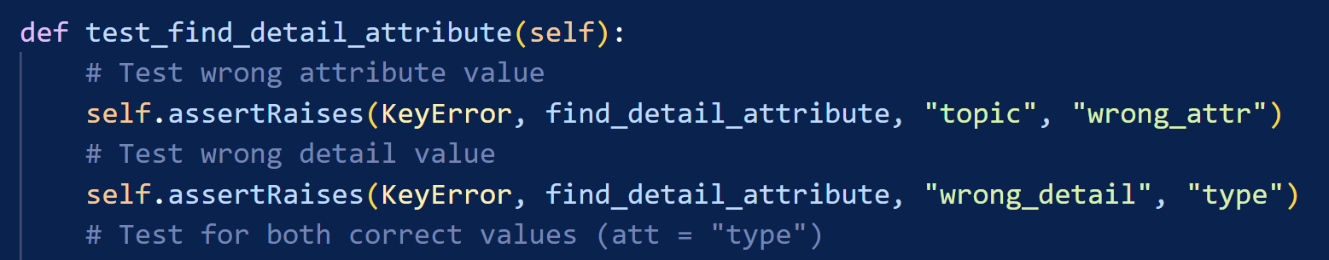
_ _ _ _
(_) | | | | |
_ _ _ __ _| |_| |_ ___ ___| |_
| | | | '_ \| | __| __/ _ \/ __| __|
| |_| | | | | | |_| || __/\__ \ |_
\__,_|_| |_|_|\__|\__\___||___/\__|
find_detail_attribute(detail, attribute): Finds an attribute to a given detail in the DETAIL_DF and returns it.

Slide 21
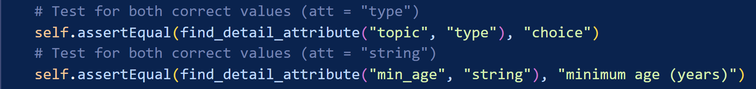
_ _ _ _
(_) | | | | |
_ _ _ __ _| |_| |_ ___ ___| |_
| | | | '_ \| | __| __/ _ \/ __| __|
| |_| | | | | | |_| || __/\__ \ |_
\__,_|_| |_|_|\__|\__\___||___/\__|
find_detail_attribute(detail, attribute): Finds an attribute to a given detail in the DETAIL_DF and returns it.

Slide 22
_
(_)
_ ___ ___ _ _ ___
| / __/ __| | | |/ _ \
| \__ \__ \ |_| | __/
|_|___/___/\__,_|\___|
Initial situation
What are the physical parts (board, cards, dice, supplementals, other)?
→ Input only one of the options by typing right word
Issue
Be able to choose multiple options
Maybe give a selection with options

Slide 23
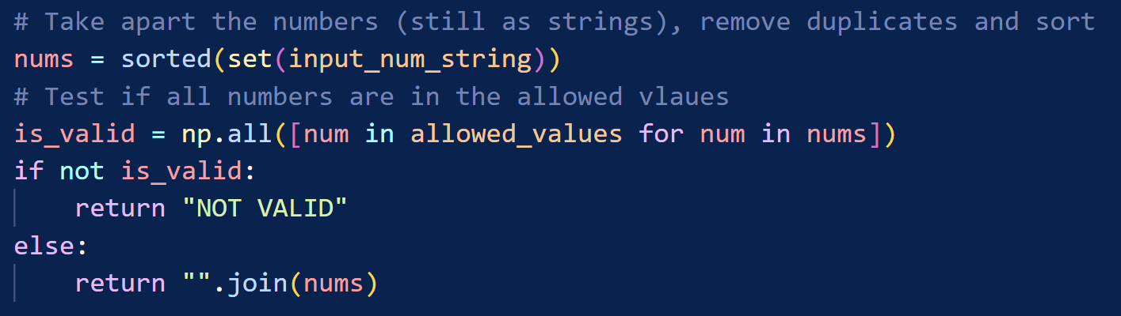
_ _ _
| | | | (_)
___ ___ | |_ _| |_ _ ___ _ __
/ __|/ _ \| | | | | __| |/ _ \| '_ \
\__ \ (_) | | |_| | |_| | (_) | | | |
|___/\___/|_|\__,_|\__|_|\___/|_| |_|
→

Slide 24
###################################################################################
_ _
| | (_)
__ _ _ _ ___ ___| |_ _ ___ _ __ ___
/ _` | | | |/ _ \/ __| __| |/ _ \| '_ \/ __|
| (_| | |_| | __/\__ \ |_| | (_) | | | \__ \
\__, |\__,_|\___||___/\__|_|\___/|_| |_|___/
| |
|_|
###################################################################################

Slide 25
###################################################################################
_ _ _
| | | | | |
| |_| |__ __ _ _ __ | | ___ _ ___ _ _
| __| '_ \ / _` | '_ \| |/ / | | |/ _ \| | | |
| |_| | | | (_| | | | | <| |_| | (_) | |_| |
\__|_| |_|\__,_|_| |_|_|\_\\__, |\___/ \__,_|
__/ |
|___/
###################################################################################

Slide 26
###################################################################################
_ _
(_) |
_____ ___| |_
/ _ \ \/ / | __|
| __/> <| | |_
\___/_/\_\_|\__|
###################################################################################

Slide 27
Ideas/Outlook
Search/filter games
History and rating
Visualize library (breakdown of games by properties and ratings)

Slide 28
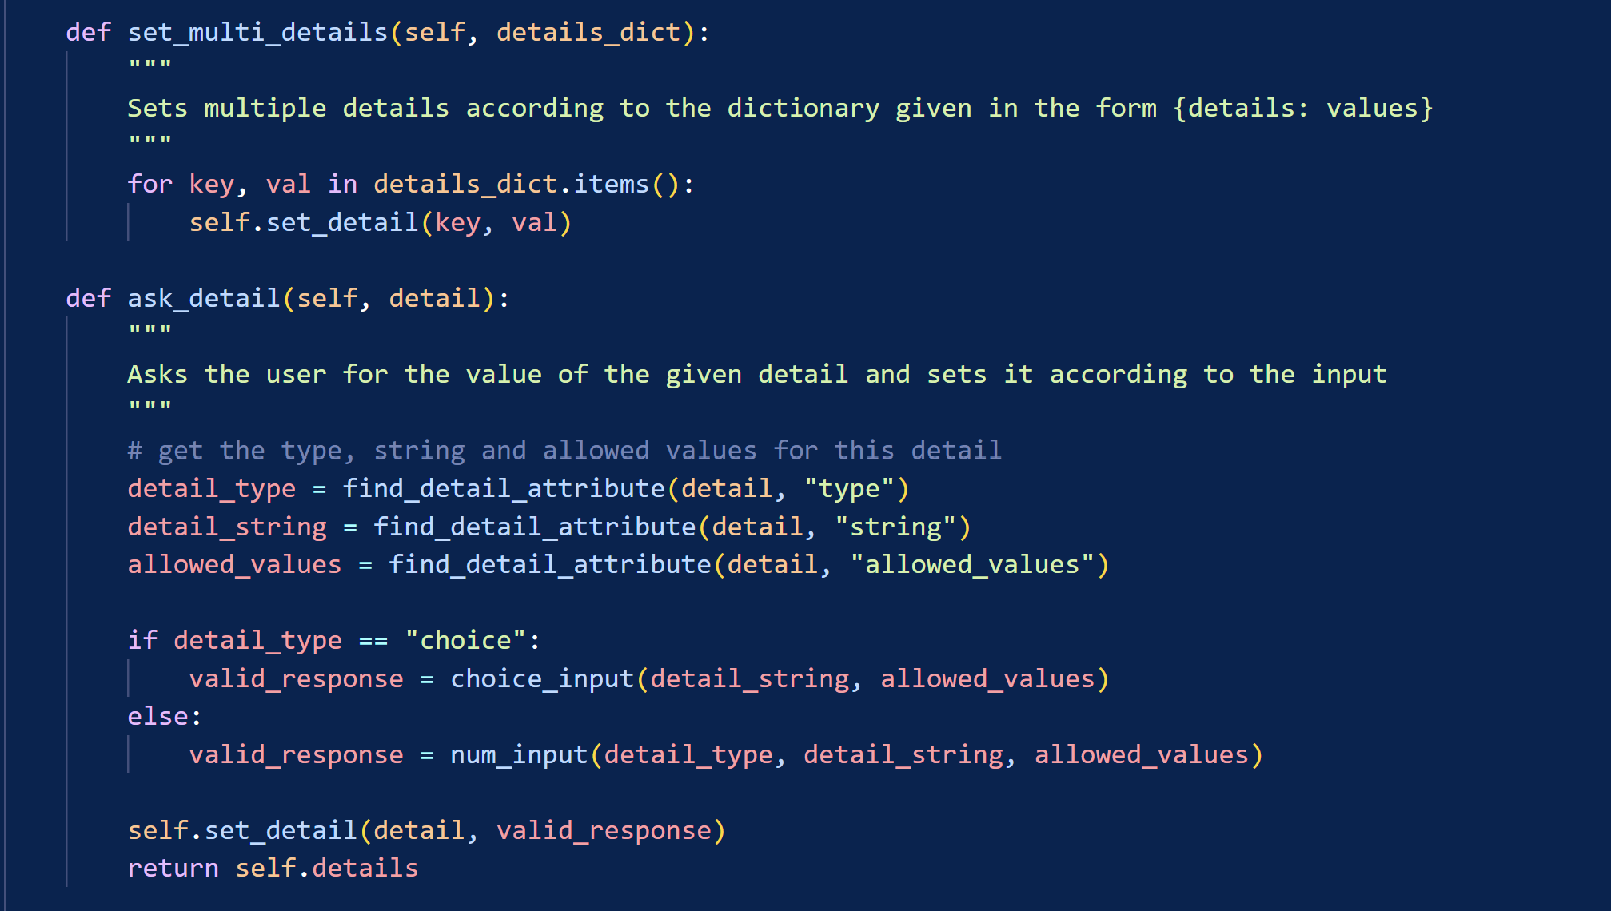
__ _ __ _ _ __ ___ ___ _ __ ___ __ _ _ __ __ _ __ _ ___ _ __
/ _` |/ _` | '_ ` _ \ / _ \ / '_ ` _ \ / _` | '_ \ / _` |/ _` |/ _ \ '__|
| (_| | (_| | | | | | | __/ | | | | | | (_| | | | | (_| | (_| | __/ |
\__, |\__,_|_| |_| |_|\___| |_| |_| |_|\__,_|_| |_|\__,_|\__, |\___|_|
__/ | __/ |
|___/ |___/
a tool by
Sabrina Rasch
Roman Schwob

