Slide 1

Recovering Loop Structure from First-Order Functional Progams
Advai Podduturi, Dr. John Reppy
^{University of Chicago}
1500 Sullivan Rd., Aurora, IL 60506

Slide 2

Research Background
Knowledge Map
Opportunity on the Map
Research Undertaken / Methodology
Data / Analysis
Discussion / Conclusions
References
Acknowledgements
Background | Knowl. Map | Opp. | Research | Data/Anal | Disc./ Concl. | Wrap up
‹#› of 16 | IMSAloquium 2018
Notes:
This is the outline of the talk. Use key words in the bullet points rather than long phrases or sentences.

Slide 3
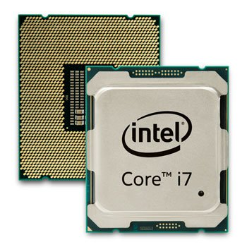
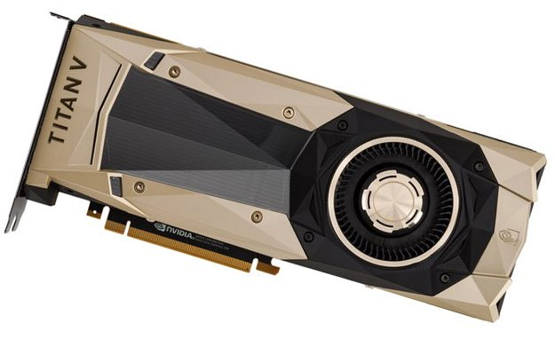
CPU vs. GPU
CPU
GPU
Parallel Programming
CUDA, OpenCL
SIMT Architecture
Harder to program
Imperative Programming
Python, Java, C++
Multi-core Architecture
Lower peak performance
Background | Knowl. Map | Opp. | Research | Data/Anal | Disc./ Concl. | Wrap up
‹#› of 16 | IMSAloquium 2018

Slide 4


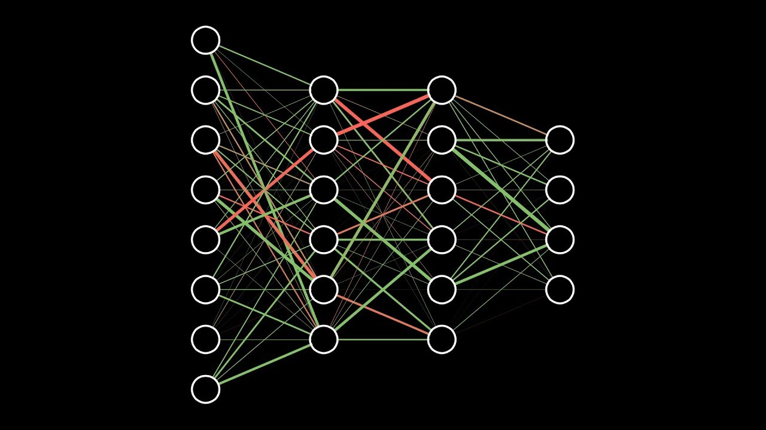


Applications and Advantages of GPUs
Background | Knowl. Map | Opp. | Research | Data/Anal | Disc./ Concl. | Wrap up
‹#› of 16 | IMSAloquium 2018
Notes:
DO NOT put large blocks of text on your slides. If you do, the audience will be reading it rather than listening to you.

Slide 5
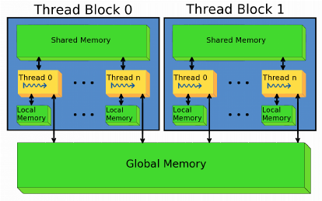
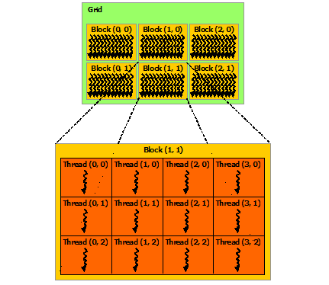
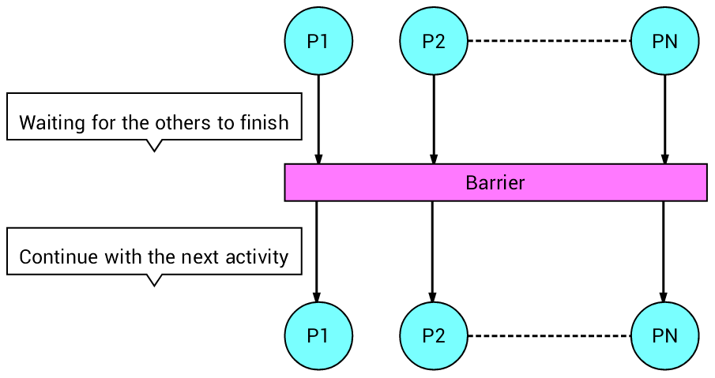
Challenges of GPU Programming
Explicit Memory Hierarchy
Thread Hierarchy
Barrier/Thread Synchronization
Background | Knowl. Map | Opp. | Research | Data/Anal | Disc./ Concl. | Wrap up
‹#› of 16 | IMSAloquium 2018
Notes:
DO NOT put large blocks of text on your slides. If you do, the audience will be reading it rather than listening to you.

Slide 6
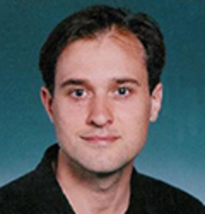

NESL
Parallel
First-order
Functional
Nested Data Parallelism
Platform Independent
Background | Knowl. Map | Opp. | Research | Data/Anal | Disc./ Concl. | Wrap up
‹#› of 16 | IMSAloquium 2018

Slide 7
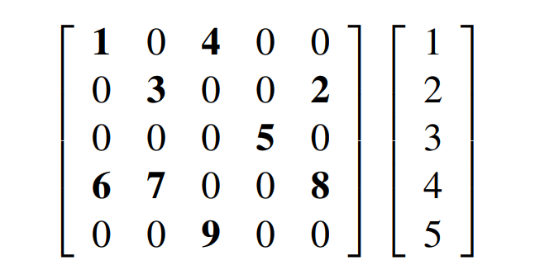
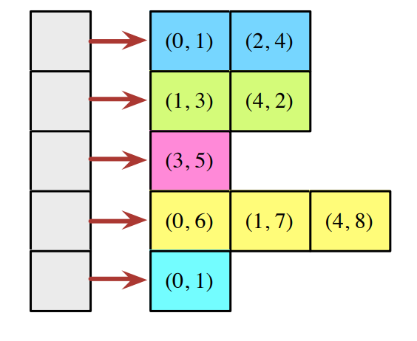
Example: Sparse Matrix Times Vector
function sparse_matrix_mult(A,x) =
{sum({v * x[i] : (i,v) in row})
: row in A};
% An example matrix and vector %
A = [[(0, 2.0), (1, -1.0)],
[(0, -1.0), (1, 2.0), (2, -1.0)],
[(1, -1.0), (2, 2.0), (3, -1.0)],
[(2, -1.0), (3, 2.0)]];
x = [1.0, 0.0, -1.0, 0.0];
% Try it out %
sparse_matrix_mult(A,x);
Background | Knowl. Map | Opp. | Research | Data/Anal | Disc./ Concl. | Wrap up
‹#› of 16 | IMSAloquium 2018

Slide 8
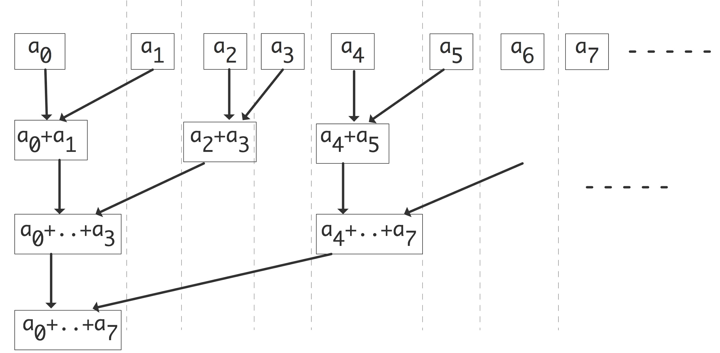
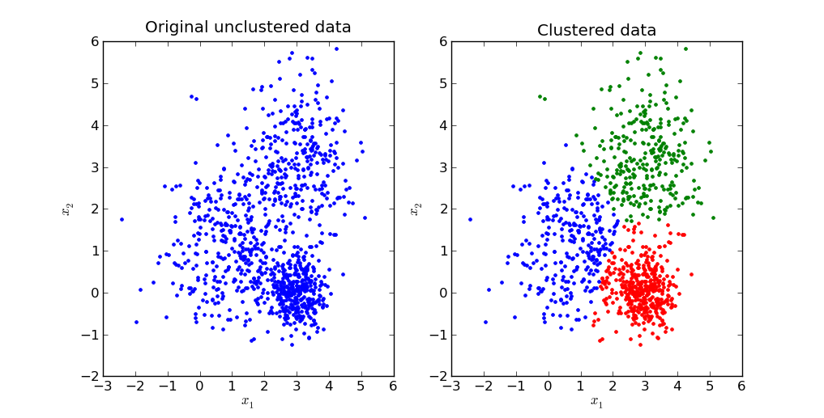
K-Means Clustering Algorithm
Involves heavy vector-based operations
Copious test data sets available
Background | Knowl. Map | Opp. | Research | Data/Anal | Disc./ Concl. | Wrap up
‹#› of 16 | IMSAloquium 2018

Slide 9
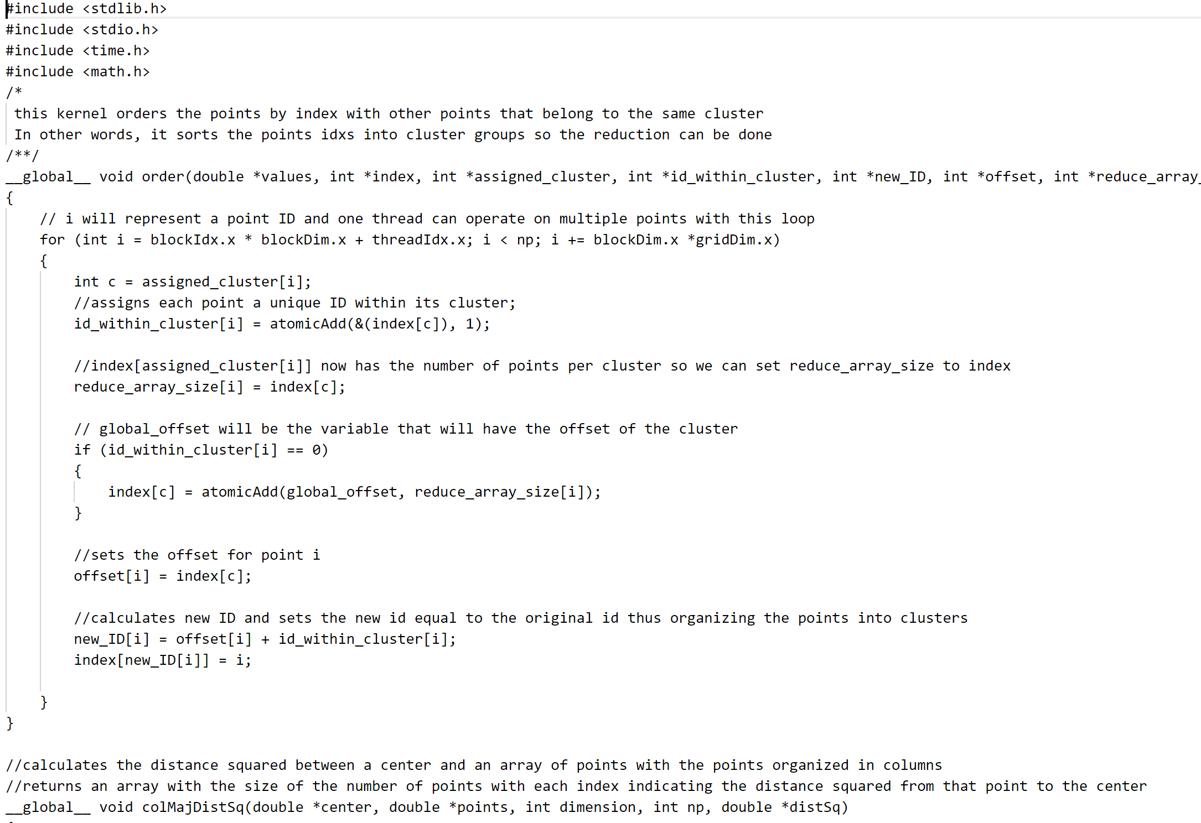
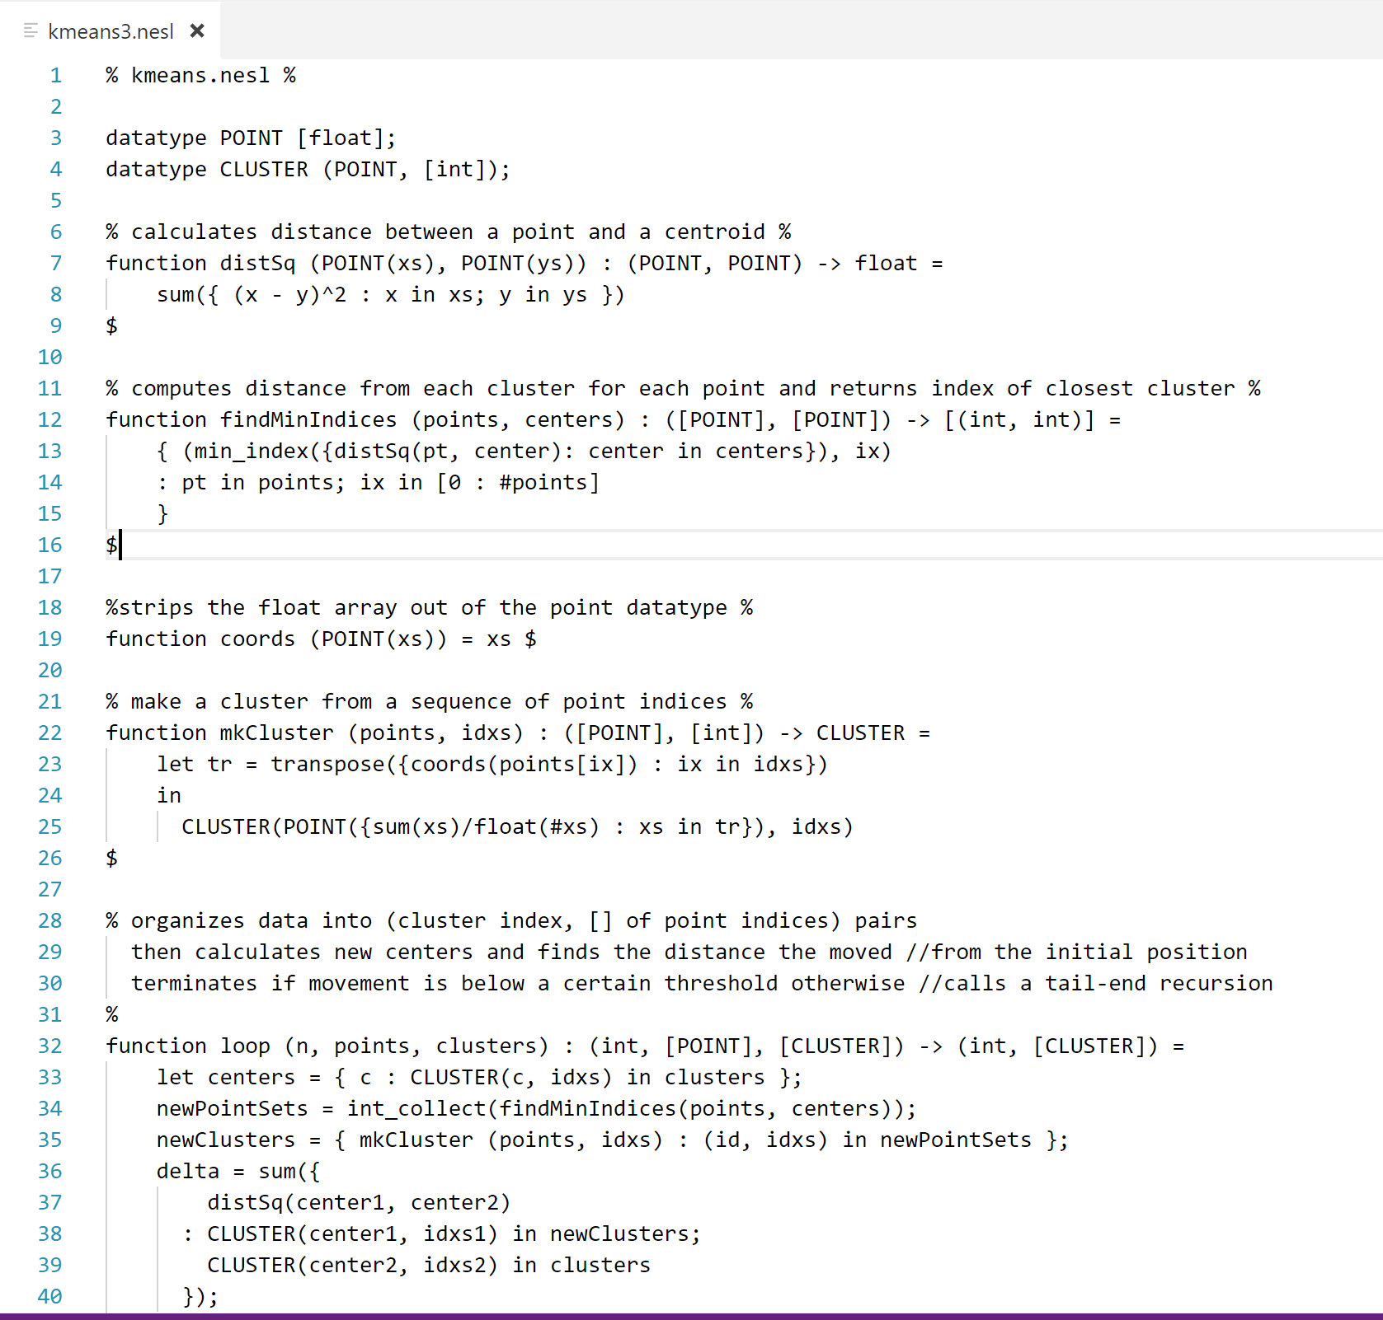
Implementation
CUDA
NESL
Background | Knowl. Map | Opp. | Research | Data/Anal | Disc./ Concl. | Wrap up
‹#› of 16 | IMSAloquium 2018

Slide 10
Knowledge Map
Parallel
Programming
CuNESL
(NESSIE)
GPU
SIMD
NESL
GPGPU
Programming
CUDA
Functional
Programming
NDP
NVIDIA
Tesla K40
First-order
Background | Knowl. Map | Opp. | Research | Data/Anal | Disc./ Concl. | Wrap up
‹#› of 16 | IMSAloquium 2018

Slide 11
Parallel
Programming
CuNESL
(NESSIE)
GPU
SIMD
NESL
GPGPU
Programming
CUDA
Loop Structure
Functional
Programming
NDP
NVIDIA
Tesla K40
First-order
Background | Knowl. Map | Opp. | Research | Data/Anal | Disc./ Concl. | Wrap up
‹#› of 16 | IMSAloquium 2018

Slide 12
CuNESL
Loop Structure
How can we improve the compilation from NESL code to CUDA code?
Why does this matter?
Execute parallel programs more efficiently
Background | Knowl. Map | Opp. | Research | Data/Anal | Disc./ Concl. | Wrap up
‹#› of 16 | IMSAloquium 2018

Slide 13
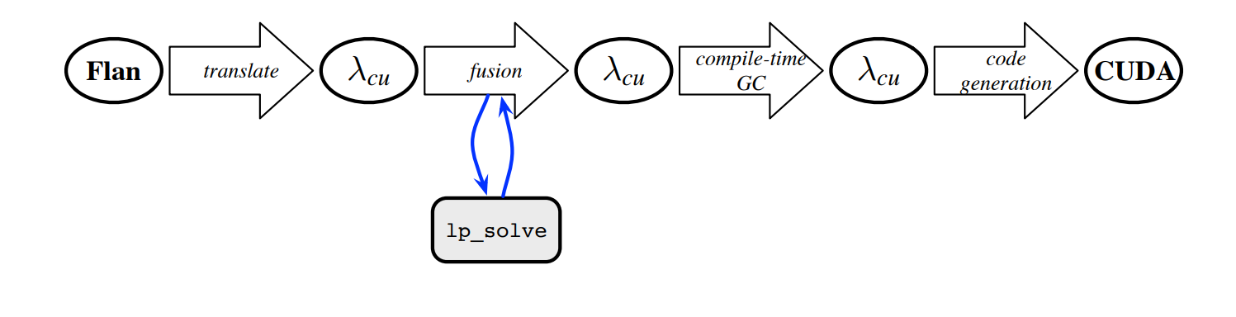
Nessie Backend
Loop Structure Recovery
Background | Knowl. Map | Opp. | Research | Data/Anal | Disc./ Concl. | Wrap up
‹#› of 16 | IMSAloquium 2018

Slide 14
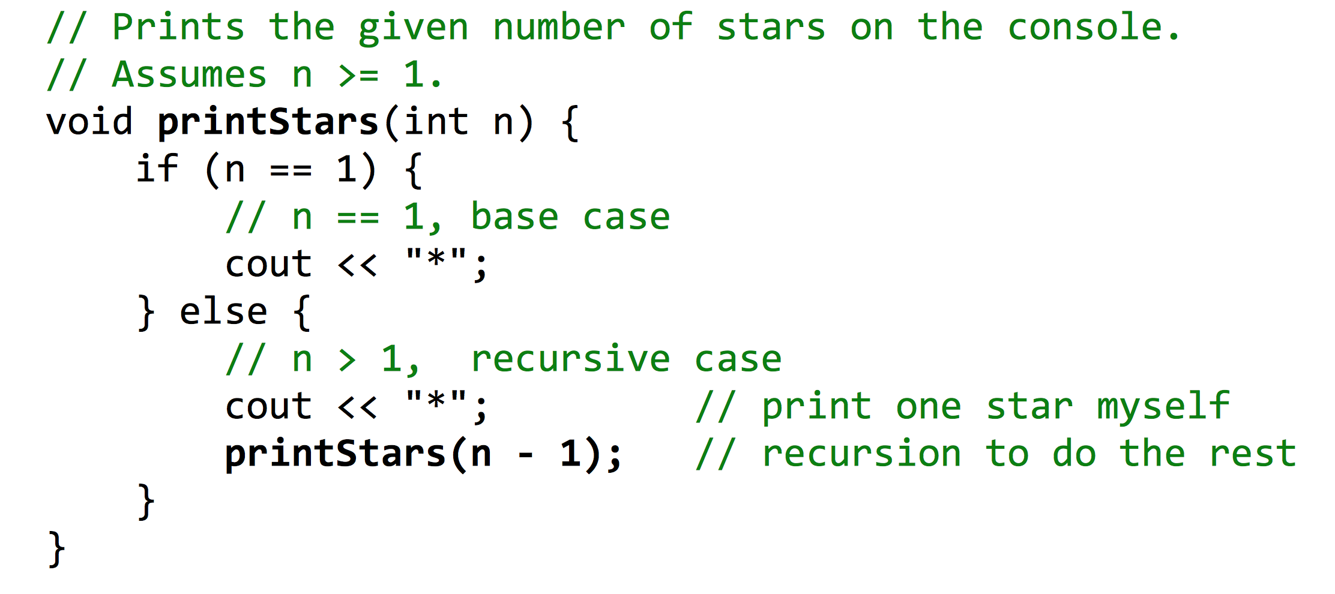
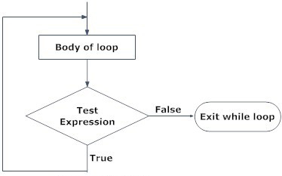
Tail-End Recursion vs. Loops
Background | Knowl. Map | Opp. | Research | Data/Anal | Disc./ Concl. | Wrap up
‹#› of 16 | IMSAloquium 2018

Slide 15
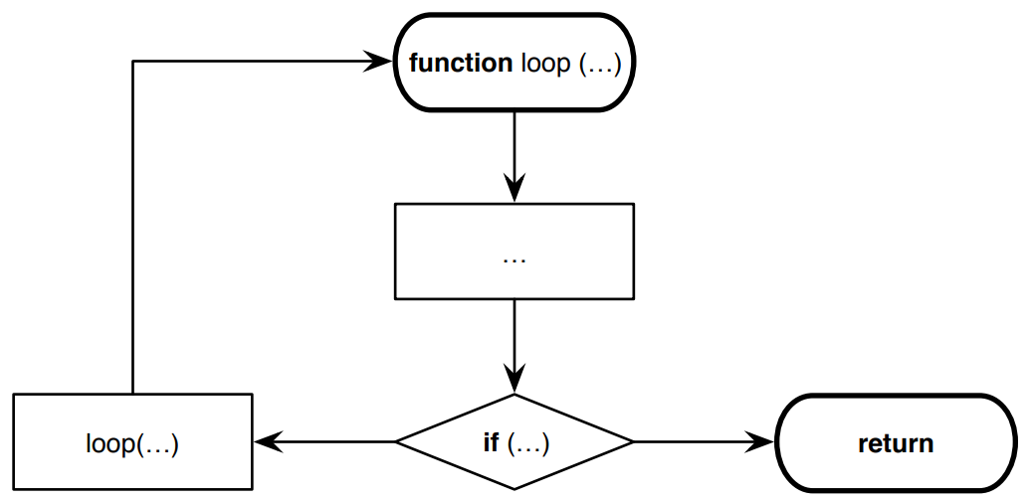
K-means Clustering Flow Chart
function loop (n, points, clusters) : (int, [POINT], [CLUSTER]) -> (int, [CLUSTER]) =
let centers = { c : CLUSTER(c, idxs) in clusters };
newPointSets = int_collect(findMinIndices(points, centers));
newClusters = { mkCluster (points, idxs) : (id, idxs) in newPointSets };
delta = sum({
distSq(center1, center2)
: CLUSTER(center1, idxs1) in newClusters;
CLUSTER(center2, idxs2) in clusters
});
in
if (delta < 0.001)
then (n, newClusters)
else loop(n+1, points, newClusters)
Background | Knowl. Map | Opp. | Research | Data/Anal | Disc./ Concl. | Wrap up
‹#› of 16 | IMSAloquium 2018

Slide 16
Results
Still developing loop recovery algorithm
We expect the new compilation to be more efficient than existing CuNESL compilations
Still to be completed:
Complete CUDA K-means implementation
Benchmark handwritten CUDA implementation
Benchmark current CuNESL compilation
Develop Loop Recovery algorithm
Compare/contrast the change
Background | Knowl. Map | Opp. | Research | Data/Anal | Disc./ Concl. | Wrap up
‹#› of 16 | IMSAloquium 2018

Slide 17
Discussion
This project will allow for more efficient programs to be made
GPU programming will become easier as NESL has a higher level of abstraction
Many more optimizations yet to be made in CuNESL compiler
Background | Knowl. Map | Opp. | Research | Data/Anal | Disc./ Concl. | Wrap up
‹#› of 16 | IMSAloquium 2018

Slide 18
References
Blelloch, G (1993, February). Class notes: Programming parallel algorithms. Technical Report CMU-CS-93-115, School of Computer Science, Carnegie Mellon University.
Blelloch, G. NESL: A nested data-parallel language (version 2.6). Technical Report CMU-CS-93-129, School of Computer Science, Carnegie Mellon University, April 1993.
Blelloch, G. (1996, March). Programming Parallel Algorithms. Communications of the ACM. 39(3). Retrieved from https://www.cs.cmu.edu/~scandal/cacm.html.
Blelloch, G. "Scans as primitive parallel operations," in IEEE Transactions on Computers, vol. 38, no. 11, pp. 1526-1538, Nov 1989. doi: 10.1109/12.42122
Blelloch, G. NESL: A Nested Data-Parallel Language. School of Computer Science, Carnegie Mellon University. 3.1, Retrieved from http://www.cs.cmu.edu/~scandal/html-papers/nesl-user-manual/user.html
Dhanasekaran, B. A New Method for GPU based Irregular Reductions and Its Application to K-Means Clustering. Advanced Micro Devices. Retrieved from http://www.ece.neu.edu/groups/nucar/GPGPU4/files/dhanasekaran.pdf.
Reppy, J. & Sandler, N. (2015). Nessie: A NESL to CUDA Compiler. Compilers for Parallel Computing Workshop.
Retrieved from http://people.cs.uchicago.edu/~jhr/papers/2015/cpc-nessie.pdf.
Background | Knowl. Map | Opp. | Research | Data/Anal | Disc./ Concl. | Wrap up
‹#› of 16 | IMSAloquium 2018
Notes:
References should be in alphabetical order (by author’s last name) and include all bibliographic details. This list will not include everything you read for your project – only the most important sources mentioned in the presentation.

Slide 19
Acknowledgements
Thank you to my Dr. John Reppy, my teacher(s) who helped me, the SIR department, etc.
Background | Knowl. Map | Opp. | Research | Data/Anal | Disc./ Concl. | Wrap up
‹#› of 16 | IMSAloquium 2018

