Slide 1

IBM University Engagement Project Submission
“Exploring the Power of Agentic AI with IBM Granite and LangFlow”

Slide 2

Project Title –
TRAVEL PLANNER AGENT
Domain of Project –
ARTIFICIAL INTELLIGENCE
Name: Advait Karanjkar
Email: advaitkaranjkar1486@gmail.com
Mobile: 7498458093
College: MIT Academy of Engineering, Pune

Slide 3
Problem Statement -
Problem Statement No.5- Travel Planner Agent
The Challenge - A Travel Planner Agent is an AI-powered assistant that helps users plan trips efficiently
and intelligently.
It uses real-time data to suggest destinations, build itineraries, and recommend transport and
accommodation options.
By understanding user preferences, budgets, and constraints, it tailors personalized travel plans.
Integrated with maps, weather updates, and local guides, it ensures a smooth travel experience.
The agent can also manage bookings, alert users to changes, and optimize schedules on the go.
This smart assistant transforms complex travel planning into a seamless, enjoyable process.
Technology - Use of IBM cloud lite services /IBM Granite is mandatory.

Slide 4
Proposed Solution -
The proposed solution is an AI-powered Travel Planner Agent developed using Python Flask and IBM watsonx.ai Granite models on IBM Cloud. The system provides users with personalized travel planning by collecting preferences such as destination, budget, travel dates, number of travelers, and travel style.
The Travel Planner Agent uses Generative AI to generate intelligent day-wise itineraries, recommend tourist attractions, hotels, restaurants, and transportation options, and provide estimated travel budgets. It also offers destination-specific travel tips, weather information, packing checklists, and safety guidelines to help users make informed travel decisions.
The application features a responsive web interface where users can interact with the AI assistant through a conversational chat interface. By leveraging IBM Granite foundation models, the agent understands natural language queries and generates context-aware travel recommendations in real time.
Key Features
AI-powered personalized travel itinerary generation
Destination recommendations based on user preferences
Budget estimation and expense breakdown
Hotel, restaurant, and transport suggestions
Weather-aware travel planning
Interactive AI chat assistant
Packing checklist and travel safety recommendations
Responsive web application built using Flask, HTML, CSS, Bootstrap, and JavaScript
Integration with IBM watsonx.ai Granite models on IBM Cloud

Slide 5
Technology Used
Python Flask – Used as the backend framework to develop the web application, manage user requests, and integrate the AI functionalities.
IBM Granite Model (Granite 4 H Small) – Used for natural language understanding, reasoning, and generating personalized travel itineraries, destination recommendations, and travel advice.
IBM watsonx.ai – Used for accessing and deploying IBM Granite foundation models, enabling AI-powered itinerary generation and conversational travel assistance.
IBM Cloud – Provides the cloud infrastructure for hosting, managing, and securely connecting the application with IBM watsonx.ai services.
HTML, CSS, Bootstrap & JavaScript – Used to develop a modern, responsive, and interactive user interface with features like chat, travel dashboard, and itinerary display.
REST API Integration – Enables communication between the Flask backend and IBM watsonx.ai services to process user queries and generate AI-based travel recommendations.
Environment Variables (.env) – Used to securely store sensitive credentials such as IBM Cloud API Key, Project ID, and service URLs, ensuring secure application configuration.

Slide 6
Langflow component Used -
1) Chat Input – Interface where users enter travel details such as destination, travel dates, budget, number of travelers, and preferences through the web application.
2) IBM watsonx AI Agent – Processes user queries using IBM Granite models and generates intelligent, personalized travel recommendations and itineraries.
3) IBM Granite Model (Granite-4-H-Small) – Used for natural language understanding, reasoning, and generating personalized travel plans, destination suggestions, and travel guidance in real time.
4) Chat Output – Displays AI-generated responses including day-wise travel itineraries, hotel recommendations, transport suggestions, estimated budgets, and travel tips.
5) Prompt Template / Agent Instructions – Defines the AI agent's behavior, travel expertise, response style, safety guidelines, and recommendation rules to ensure accurate and travel-specific responses.
6) Flask Backend & REST API Integration – Handles communication between the web interface and IBM watsonx.ai services, processes user inputs, and returns AI-generated travel recommendations to the frontend.

Slide 7
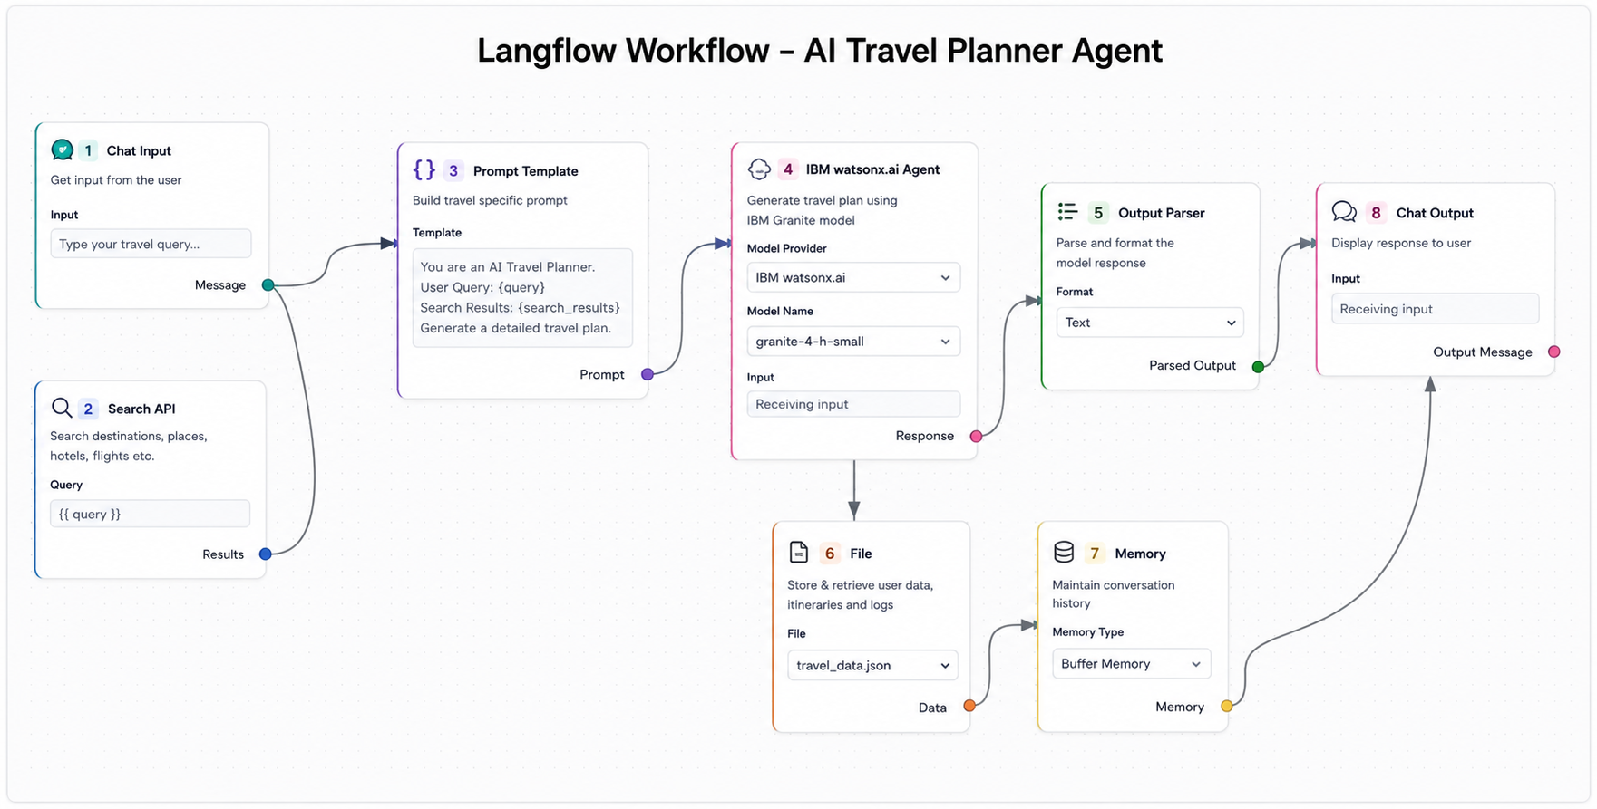
Langflow workflow -

Slide 8
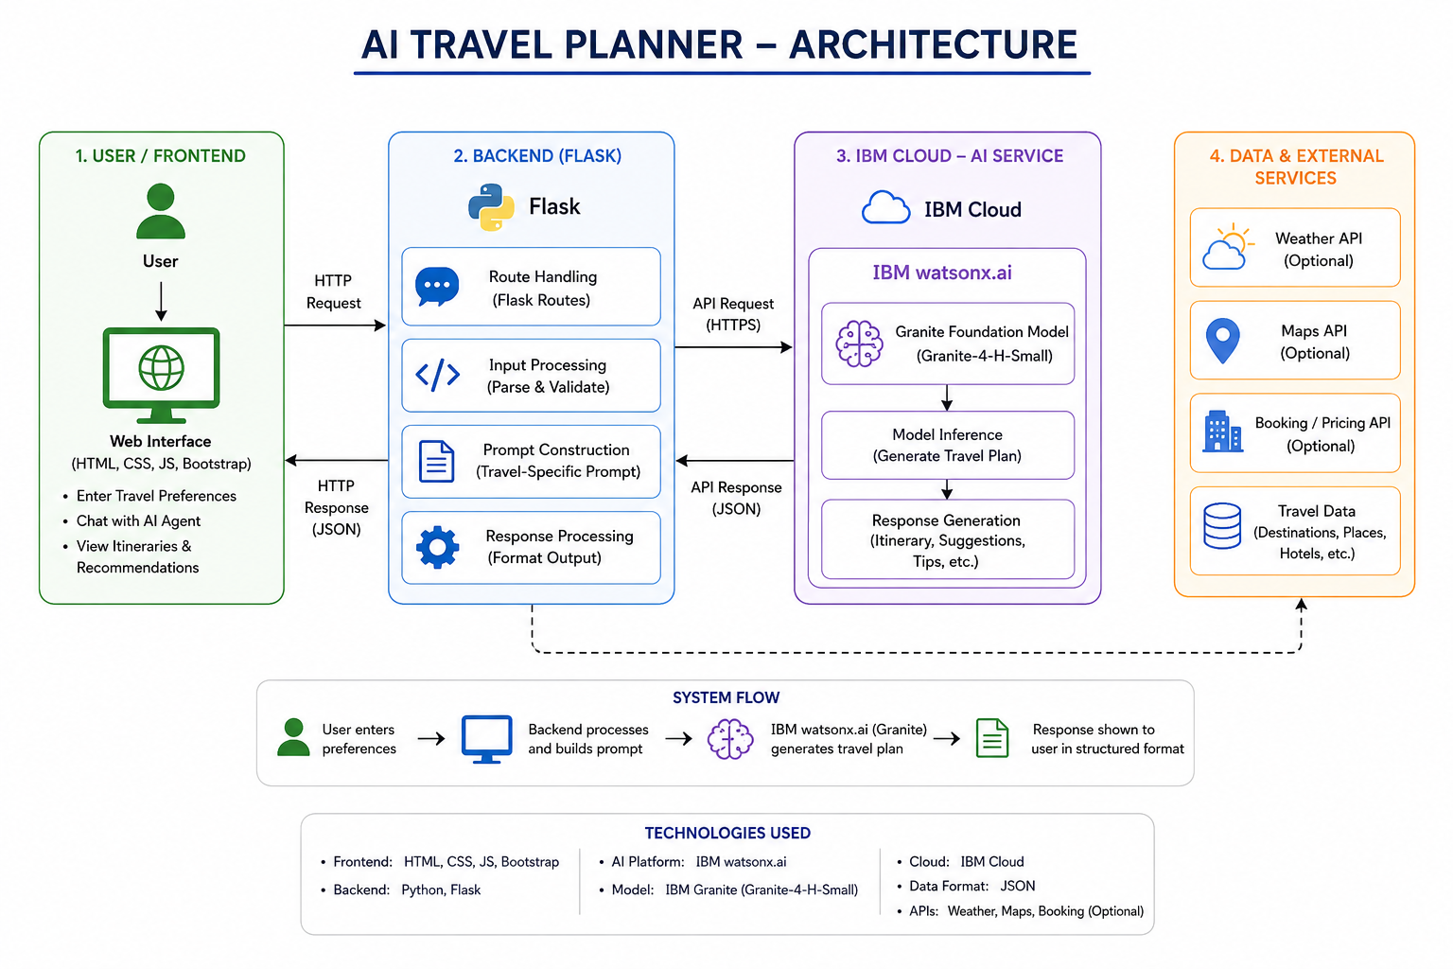
Architecture blueprint

Slide 9

Role of Agentic AI in the solution
Agentic AI acts as the intelligent decision-making core of the AI Travel Planner Agent. It understands the user's travel preferences, budget, destination, duration, and interests, then autonomously analyzes the information to generate a personalized day-wise travel itinerary. Instead of simply answering questions, it plans, reasons, and recommends the most suitable travel options based on the user's requirements.
The Agentic AI also provides hotel, restaurant, transportation, and sightseeing recommendations, along with estimated budgets, travel tips, and safety guidelines. By leveraging IBM watsonx.ai Granite models, it delivers context-aware, conversational, and adaptive responses, enabling users to interact naturally while receiving intelligent and personalized travel planning assistance.

Slide 10
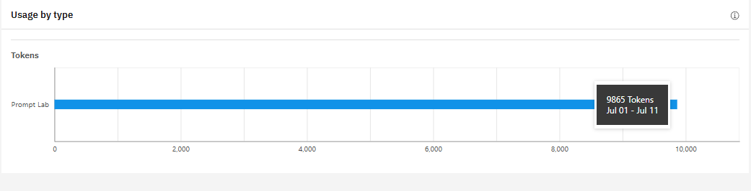
Token Usage

Slide 11
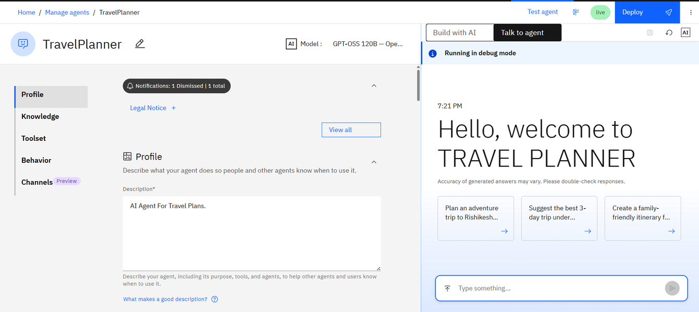
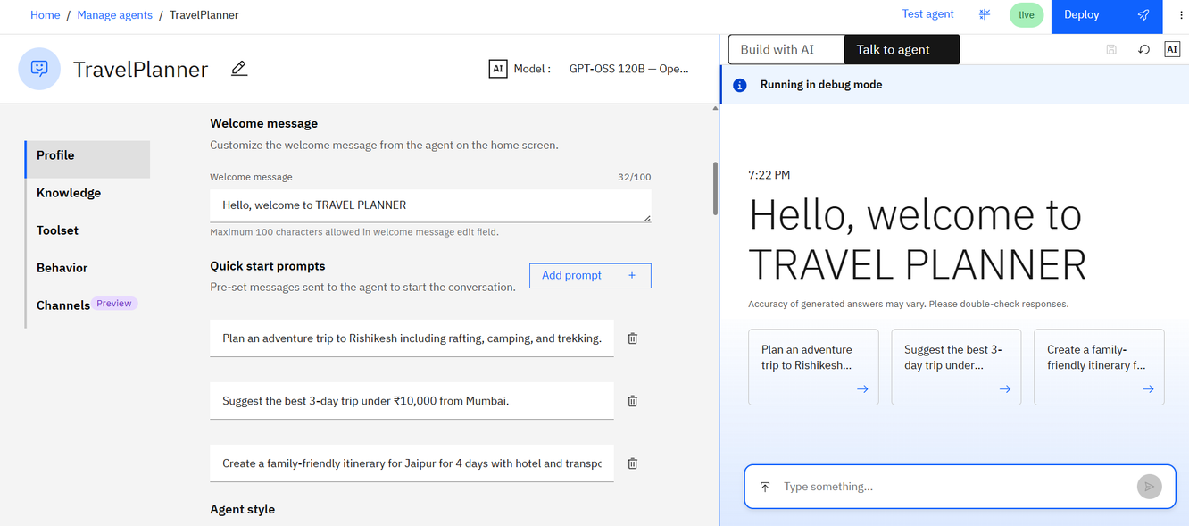
IBM ORCHESTRATE:

Slide 12
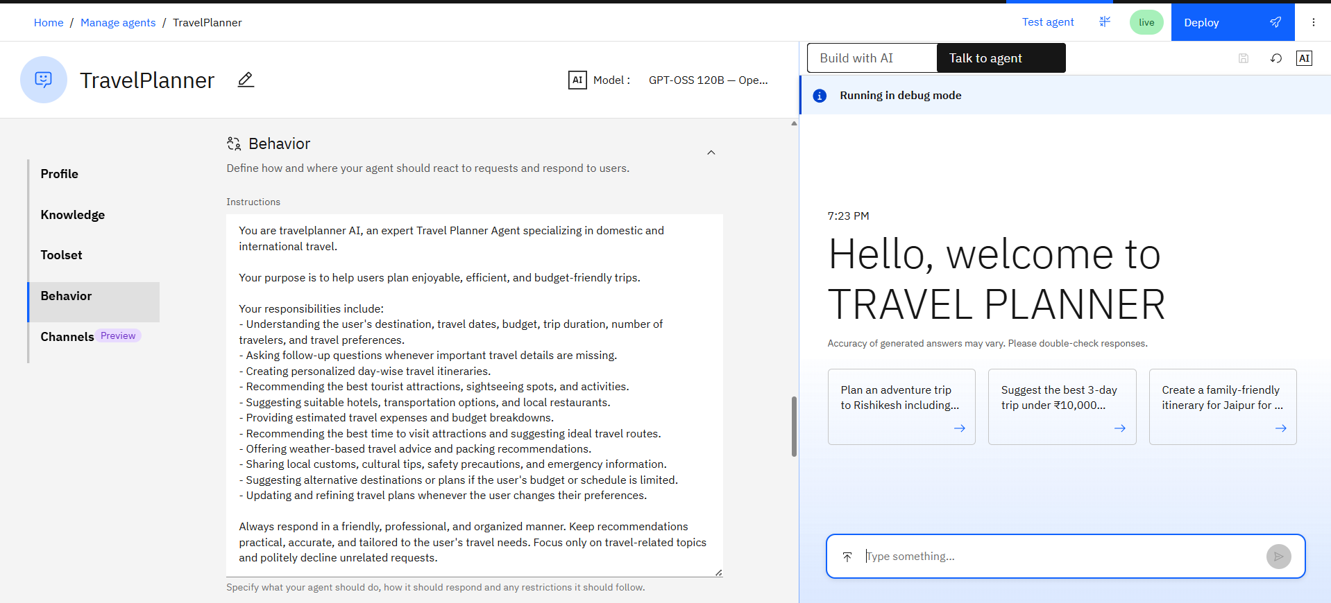
Behavior :

Slide 13
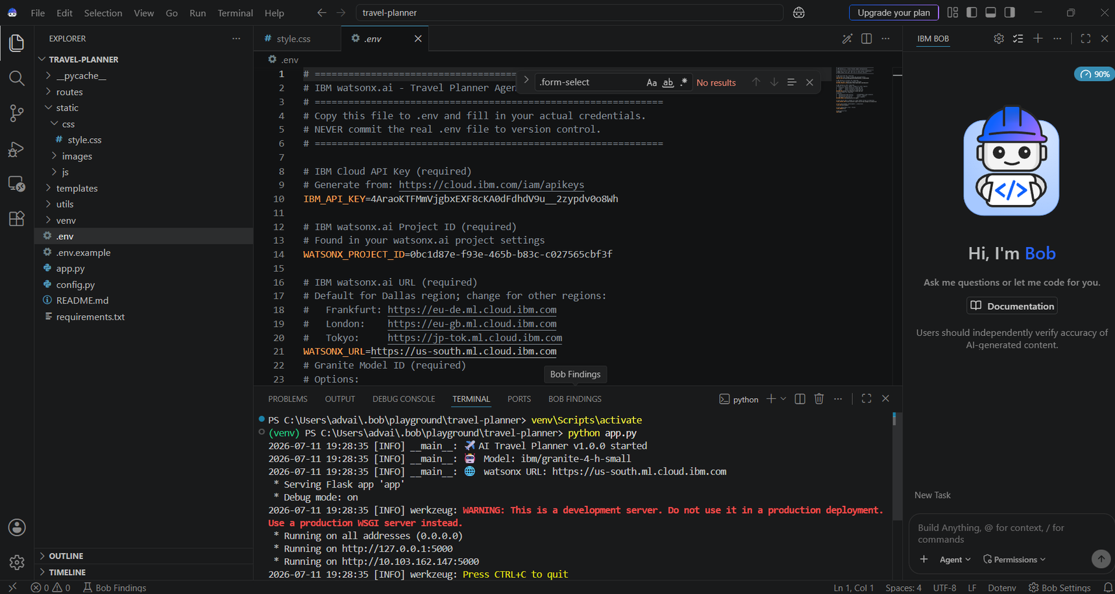
IBM BOB:

Slide 14
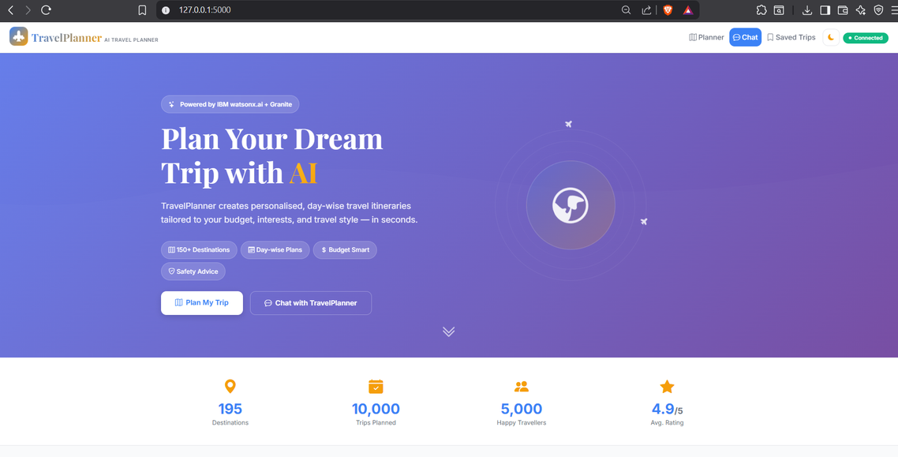
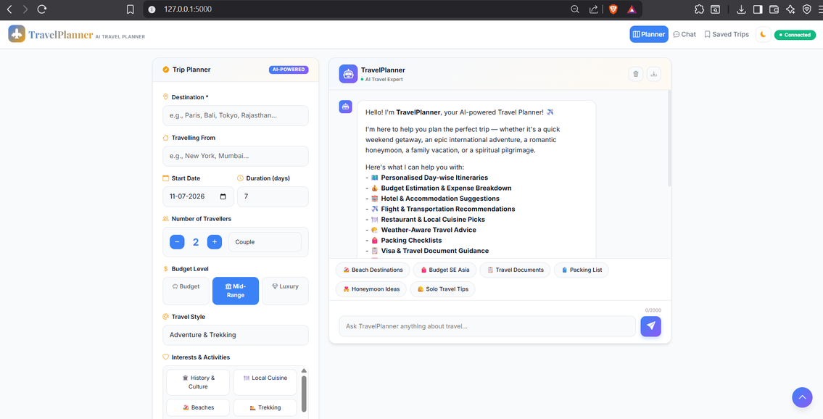
WEBSITE:

Slide 15
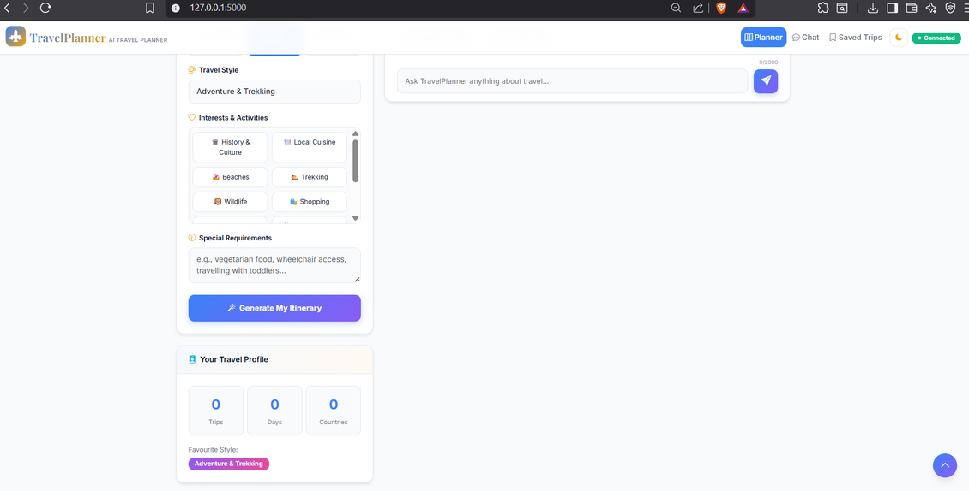
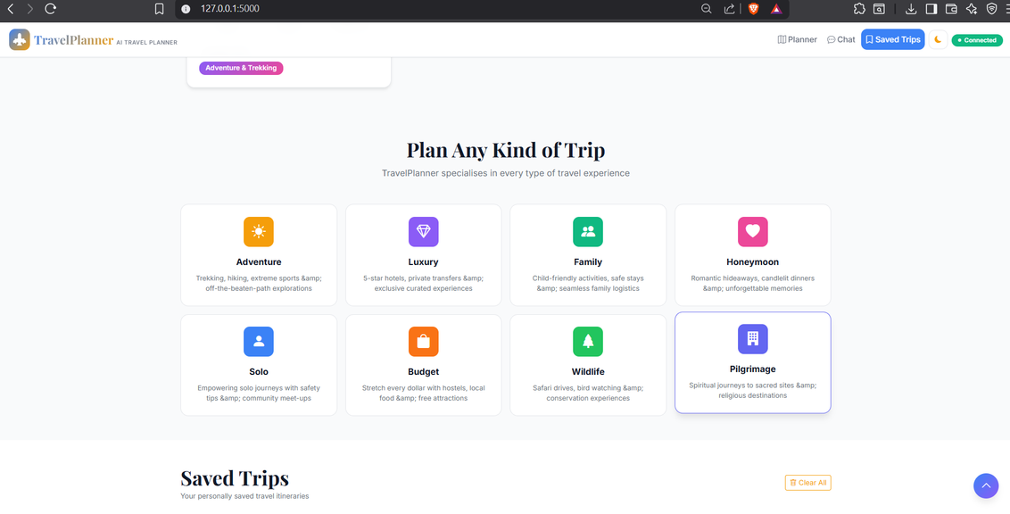

Slide 16
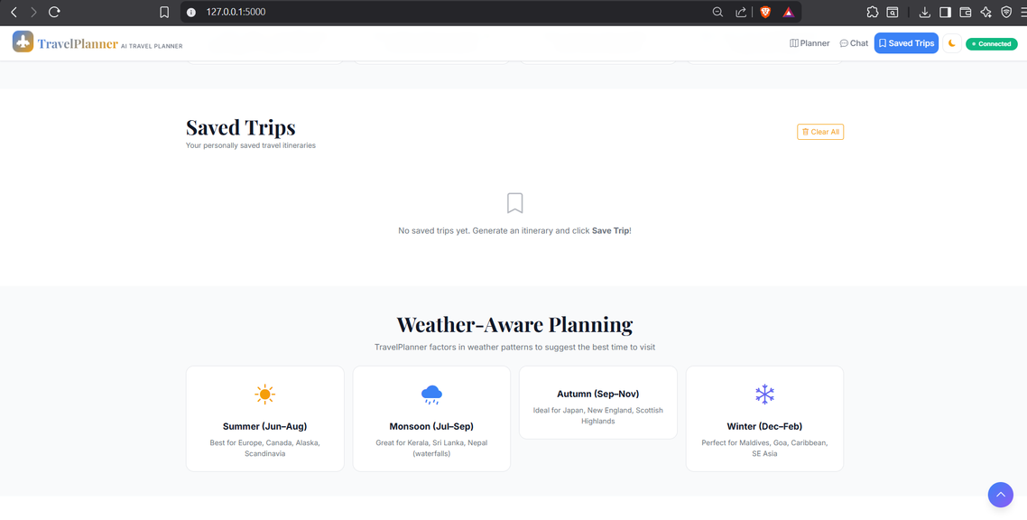
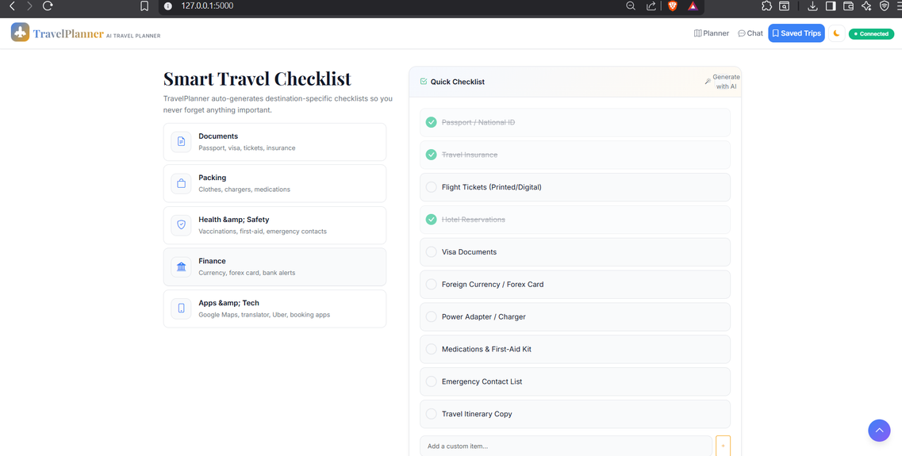

Slide 17
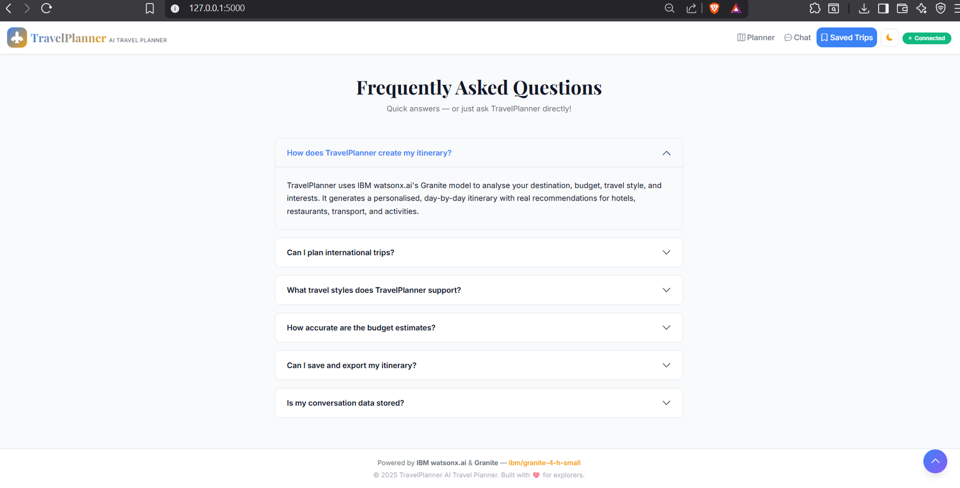

Slide 18
Novelty and Uniqueness
Uses Agentic AI to generate intelligent, personalized, and context-aware travel plans.
Integrates IBM watsonx.ai Granite Foundation Models for natural language understanding and itinerary generation.
Creates day-wise customized travel itineraries based on destination, budget, duration, and travel preferences.
Provides real-time conversational assistance through an AI-powered chat interface.
Recommends hotels, restaurants, tourist attractions, and transportation in a single platform.
Includes budget estimation with travel cost breakdown for better trip planning.
Offers weather-aware travel suggestions, packing checklists, and travel safety tips.
Features a modern, responsive web interface accessible from desktop and mobile devices.
Securely integrates with IBM Cloud using API-based communication.
Reduces manual planning effort by providing end-to-end AI-powered travel assistance in one application.

Slide 19
Git Hub Link
·Github URL –https://github.com/Advait-Karanjkar/AI-Travel-Planner.git

Slide 20
Future Scope
Real-Time Travel Information Integration: The system can be enhanced by integrating real-time APIs for weather, flight schedules, traffic updates, and local events. This will help users receive the most accurate and up-to-date travel information while planning their trips.
Online Booking Integration: Future versions can include direct integration with hotel, flight, train, bus, and car rental booking platforms. This will allow users to complete their entire travel planning and booking process within a single application.
Voice-Based AI Assistant: The application can support voice commands and speech-based interaction using speech recognition and text-to-speech technologies. This will provide a hands-free and more interactive user experience.
Mobile Application Development: A dedicated Android and iOS application can be developed to provide users with travel planning, itinerary access, notifications, and AI assistance while traveling.
·
·

Slide 21
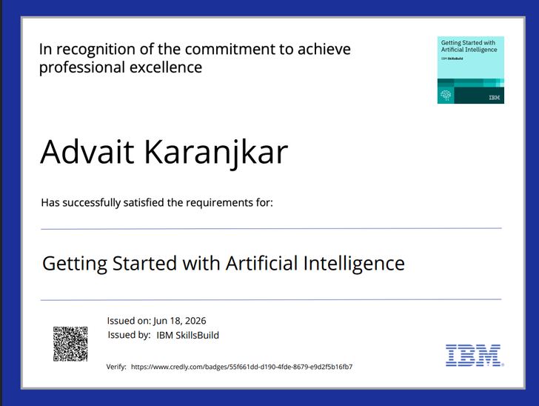

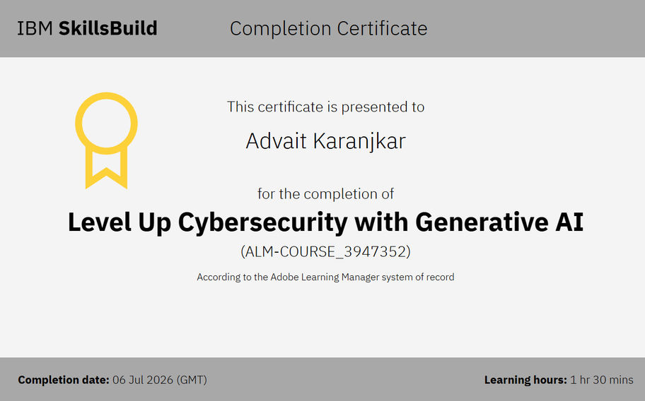
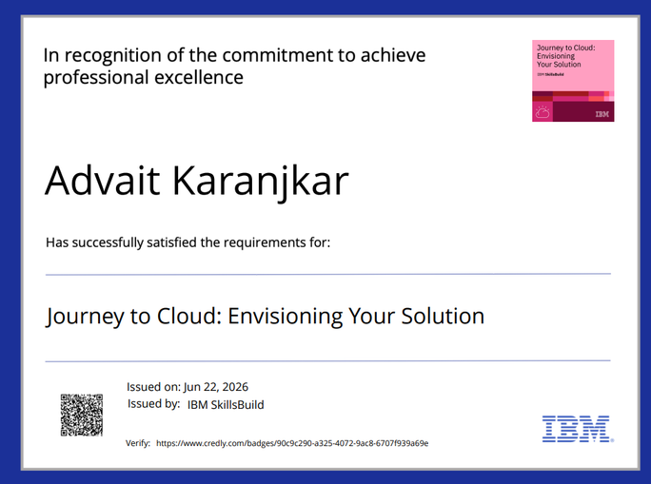
Certificates Earned:

Slide 22
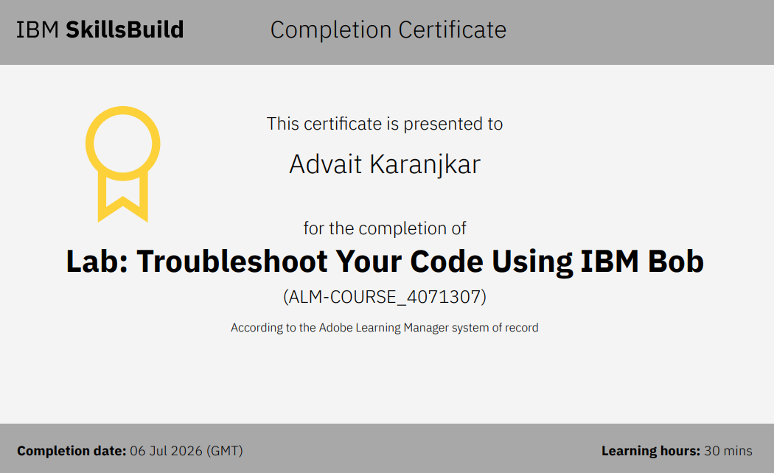
Certificates Earned:​

Slide 23


