Slide 1
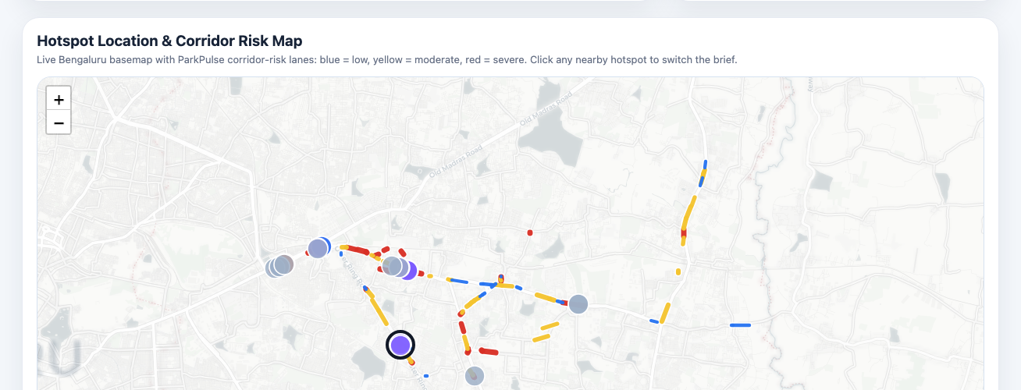
Flipkart
F
×
P
ParkPulse
ParkPulse Bengaluru
Illegal Parking Impact Intelligence
Which illegal parking should Bengaluru solve first?
Impact-weighted
Exposure-adjusted
Resource-constrained
A deployment decision system for control rooms, station inspectors and field officers - not a generic traffic dashboard.
298,450
151
55
10,306
violation records analysed
active calendar days
police stations covered
hotspot cells ranked
Flipkart GRiD Round 2 | Theme 1 | AI-driven parking intelligence for illegal-parking hotspots and traffic-flow impact

Slide 2
Flipkart
F
×
P
ParkPulse
02 / 18
PROBLEM
Bengaluru does not have an illegal-parking data problem. It has a prioritization problem.
All violations are not equal: a blocked running lane near a junction is operationally different from a low-impact challan.
Illegal parking
Capacity loss
Queue spillback
Resource trade-off
Kerb or running-lane space occupied
Fewer usable lanes during the pressure window
Junction, market, metro or corridor movement degrades
Patrol and tow units must be rationed by payoff
What a raw heatmap misses
What ParkPulse adds
Decision output
• Recording bias
• Officer/device visibility
• Vehicle footprint
• Tow/patrol capacity
• Exposure adjustment
• Obstruction severity
• Repeat/chronic pressure
• Resource-constrained dispatch
• Which zone
• Which time window
• Which action
• Why this priority
Source: ParkPulse pipeline outputs from the provided Theme-1 enforcement dataset
Proxy metrics are labelled; nothing is presented as measured live traffic

Slide 3
Flipkart
F
×
P
ParkPulse
03 / 18
WORKFLOW SHIFT
From complaint-led patrolling to impact-weighted enforcement operations
ParkPulse changes the operating model from 'where were violations recorded?' to 'where should the next enforcement unit go?'
Current enforcement workflow
ParkPulse workflow
Complaint or patrol driven
Daily command-center priority queue
Raw visibility bias
Exposure-adjusted hotspot ranking
No congestion-impact ranking
Obstruction, spillback and recovery proxies
No officer-hour ROI
Patrol/tow simulator and resource-hour payoff
Limited feedback loop
Closure/action fields become model feedback when integrated
Before: patrol harder. After: dispatch smarter, explain decisions, and learn after every shift.
Source: ParkPulse pipeline outputs from the provided Theme-1 enforcement dataset
Proxy metrics are labelled; nothing is presented as measured live traffic

Slide 4
Flipkart
F
×
P
ParkPulse
04 / 18
USERS
Three police workflows, one shared operating system
The product is designed around command, station planning and field execution - not around charts.
CONTROL ROOM
STATION
FIELD
Commander
Inspector
Officer / Tow Unit
Job
Allocate first-wave patrol/tow units
Job
Plan local enforcement beats
Job
Clear the obstruction quickly
Pain
Too many hotspots to inspect manually
Pain
City heatmaps do not become local action
Pain
Needs exact location, reason and action
Feature
City priority queue + risk map
Feature
Station-wise plan + time windows
Feature
Mobile/printable field brief
Metric
Top-K high-impact capture
Metric
SLA compliance + repeat reduction
Metric
Closure time + recovery proxy
Source: ParkPulse pipeline outputs from the provided Theme-1 enforcement dataset
Proxy metrics are labelled; nothing is presented as measured live traffic

Slide 5
Flipkart
F
×
P
ParkPulse
05 / 18
DAY-IN-THE-LIFE
A morning shift journey from control room to field clearance
A good civic-tech product must fit the shift ritual, not ask officers to become analysts.
07:30
07:35
07:40
08:00-12:00
End shift
1
2
3
4
5
Command Center opens
Top-20 zones ranked
Station plans issued
Field execution
Feedback captured
City KPIs and corridor map
Obstruction-risk priority queue
Local time-window action plans
Tow/patrol/fixed-window enforcement
Closure/action data improves future runs
Feedback loop: action / closure data improves tomorrow's priority queue
The same workflow is useful today with batch records, and becomes measured after closure/action feeds arrive.
Source: ParkPulse pipeline outputs from the provided Theme-1 enforcement dataset
Proxy metrics are labelled; nothing is presented as measured live traffic

Slide 6
Flipkart
F
×
P
ParkPulse
06 / 18
DATA CONTRACT
What we observe, what we model, what is a proxy, and what is absent
Trust comes from labelling every claim: direct observation, modelled signal, transparent proxy or unavailable feed.
Observed directly
Modelled
Transparent proxy
Not available
• Location
• Timestamp
• Police station
• Vehicle class
• Violation text
• Validation status
• Recurrence risk
• Hotspot persistence
• Exposure-adjusted ranking
• Patrol-coverage gap
• Obstruction-risk score
• Queue-spillback risk
• Equivalent lane recovery minutes
• Traffic-flow impact estimate
• Measured speed
• Queue length
• Closure timestamp
• Before-after enforcement outcome
Therefore: ParkPulse claims decision-support and impact-weighted prioritization today, not exact km/h improvement.
Source: ParkPulse pipeline outputs from the provided Theme-1 enforcement dataset
Proxy metrics are labelled; nothing is presented as measured live traffic

Slide 7
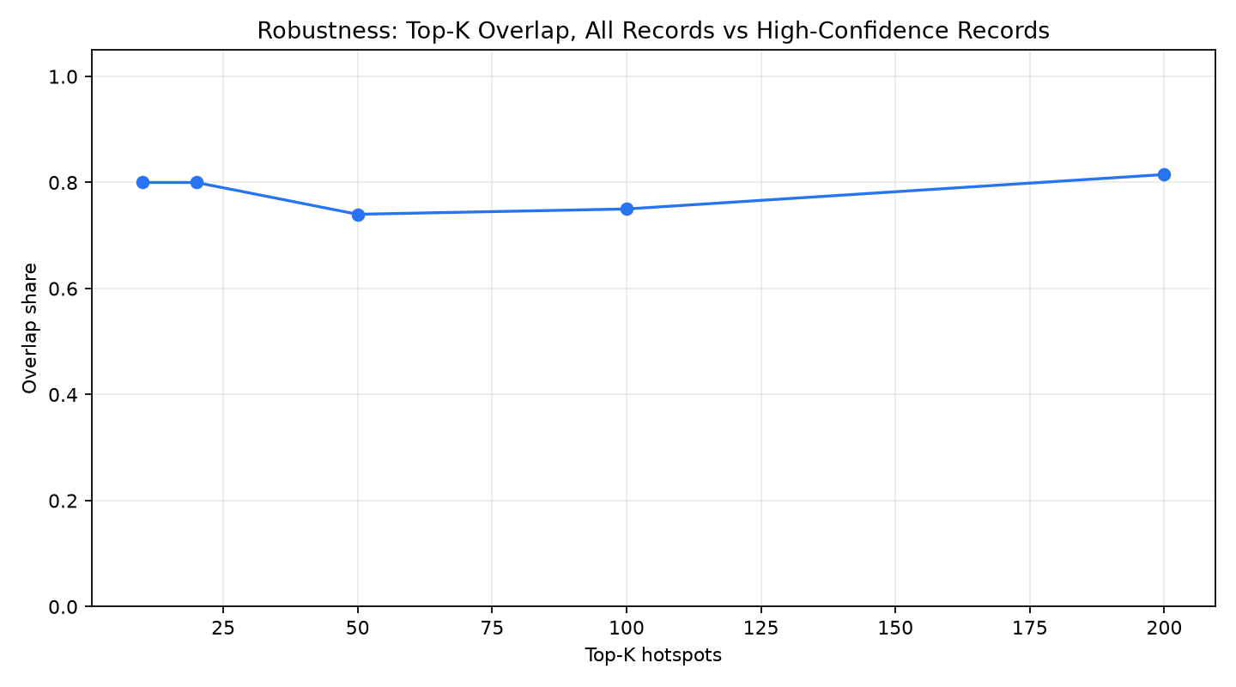
Flipkart
F
×
P
ParkPulse
07 / 18
BIAS STRESS TEST
ParkPulse is not fooled by where enforcement is already visible
High counts may mean true pressure, but they may also mean more officers, devices and validation coverage.
0.85
58%
80.0%
367
raw count vs recording exposure
records with validation timestamp
robust top-20 overlap
18-22 records: coverage risk
Recording exposure bias
Exposure-adjusted ranking
Validation gaps
Confidence bands
Sparse evening records
Coverage-risk warning
All vs high-confidence
Robustness check
367 evening records is a coverage warning, not proof that evening risk is absent.
Source: ParkPulse pipeline outputs from the provided Theme-1 enforcement dataset
Proxy metrics are labelled; nothing is presented as measured live traffic

Slide 8
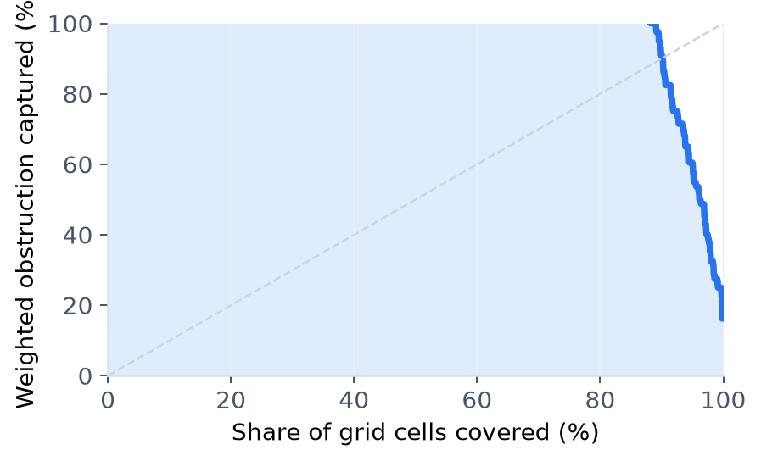
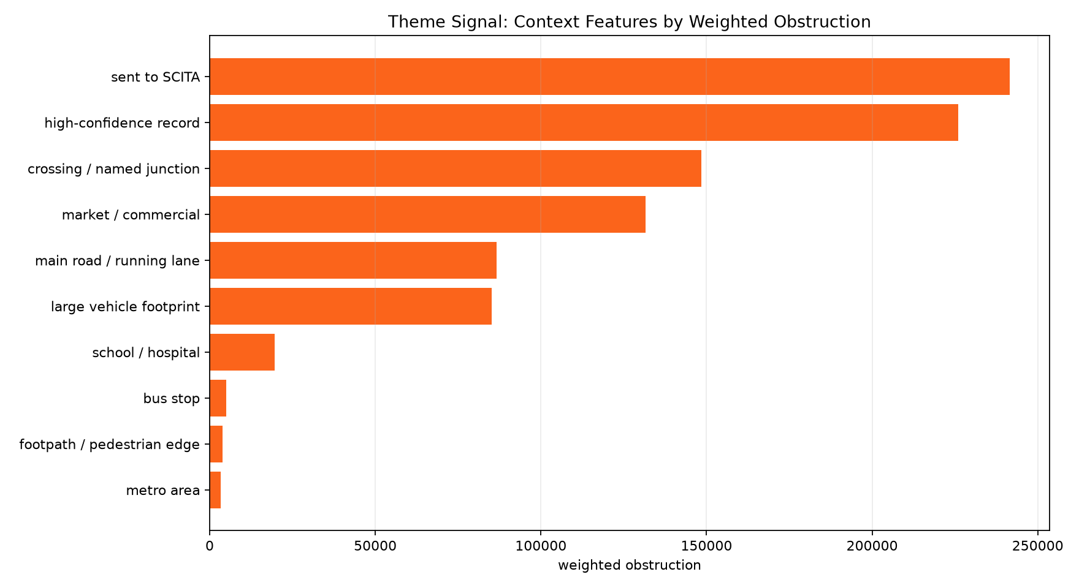
Flipkart
F
×
P
ParkPulse
08 / 18
EDA
Why this is a targeted-enforcement problem, not generic clustering
Obstruction pressure is concentrated, repeat vehicles matter, and road-space context changes enforcement priority.
Concentrated
Repeating
Chronic
Top 5 percent of cells hold about 65.5 percent of weighted obstruction.
34.2 percent of known-vehicle records repeat at least twice.
18.3 percent of known records are 3+ occurrence vehicles.
This is why enforcement should be targeted, not evenly spread.
Source: ParkPulse pipeline outputs from the provided Theme-1 enforcement dataset
Proxy metrics are labelled; nothing is presented as measured live traffic

Slide 9
Flipkart
F
×
P
ParkPulse
09 / 18
PRODUCT ARCHITECTURE
ParkPulse is a five-layer operating system for enforcement
The architecture converts raw enforcement records into ranked actions, not just visualizations.
Layer 1
Layer 2
Layer 3
Layer 4
Layer 5
Data clean-room
Hotspot engine
Scoring + model
Action engine
Command product
Input
Input
Input
Input
Input
Violation records
Lat/lon + time
History + context
Risk + resources
Plans + maps
Output
Output
Output
Output
Output
Normalised fields
250m cells + corridors
Recurrence + obstruction risk
Tow/patrol/engineering plans
Briefs, simulator, queue
Source: ParkPulse pipeline outputs from the provided Theme-1 enforcement dataset
Proxy metrics are labelled; nothing is presented as measured live traffic

Slide 10
Flipkart
F
×
P
ParkPulse
10 / 18
DATA SCIENCE CORE
We optimize for top-K operational capture, not generic accuracy
The modelling question is: which few zones should receive scarce enforcement capacity first?
Spatial unit
Temporal unit
Features
250m grid / hotspot cell
Date x enforcement time-window
Lagged counts, rolling means, exposure, validation, vehicle obstruction, road context
Target
Validation
Metrics
Next-day / next-window recurrence and pressure
Time-safe split; no random future leakage
Capture@K, NDCG@K, Precision@K
Features
Target
Top-K ranking
Enforcement queue
Why top-K? Police need the best first 10-20 actions before the shift starts, not a perfect city-wide regression score.
Source: ParkPulse pipeline outputs from the provided Theme-1 enforcement dataset
Proxy metrics are labelled; nothing is presented as measured live traffic

Slide 11
Flipkart
F
×
P
ParkPulse
11 / 18
WHY RAW DENSITY IS NOT ENOUGH
A heatmap finds where violations were recorded; ParkPulse finds where enforcement should go next
Prediction and action are different jobs: recurrence is only the first filter.
High count + high exposure
Medium count + heavy vehicles + junction
Emerging hotspot + low past exposure
May already be heavily patrolled; do not blindly over-allocate.
Can block running lanes and spill queues despite fewer records.
Hidden risk can be missed by raw historic density.
Correct with exposure adjustment
Raise obstruction priority
Flag patrol gap
ParkPulse first predicts recurrence, then adds obstruction severity, confidence, action type and officer-hour ROI.
Source: ParkPulse pipeline outputs from the provided Theme-1 enforcement dataset
Proxy metrics are labelled; nothing is presented as measured live traffic

Slide 12
Flipkart
F
×
P
ParkPulse
12 / 18
SCORING LOGIC
Prediction, explanation and dispatch are deliberately separate jobs
A single magic score is fragile; ParkPulse separates recurrence, obstruction explanation and resource-constrained dispatch.
1. Recurrence model
2. Obstruction index
3. Dispatch priority
Predicts where pressure returns using lagged counts, rolling windows, exposure and validation features.
Explains severity using persistence, time pressure, junction context, vehicle footprint and repeat pressure.
Sequences field action using recovery potential, confidence, patrol gap and resource requirement.
Predict recurrence
Explain obstruction
Dispatch resources
All traffic-flow impact values are modelled proxies until speed, queue and closure feeds are connected.
Source: ParkPulse pipeline outputs from the provided Theme-1 enforcement dataset
Proxy metrics are labelled; nothing is presented as measured live traffic

Slide 13
Flipkart
F
×
P
ParkPulse
13 / 18
VALIDATION + DIFFERENTIATION
Why ParkPulse beats a heatmap
Raw density tells us where violations return. ParkPulse tells us where limited enforcement creates the highest operational payoff.
15.2%
15.2%
80.0%
+40.0%
Proxy
Capture@20: top-20 zones vs next-day high-pressure cells
raw-density Capture@20: recurrence baseline
top-20 overlap: all vs high-confidence records
recovery-proxy uplift under same resources
not live delay
Decision question
Raw heatmap
Density forecast
ParkPulse
What it ranks
Recorded counts
Where pressure returns
Where enforcement should go next
Bias handling
Can reflect patrol/device bias
Partly learns history
Exposure + confidence aware
Traffic-flow impact
None
None
Obstruction and spillback proxies
Action output
No tow/patrol guidance
No dispatch guidance
Tow, patrol, fixed-window or engineering
Field usability
Map only
Prediction list
Brief: location, reason, SLA, resource
Prediction layer finds where pressure returns. Action layer decides what to do with scarce patrol and tow capacity.
Source: ParkPulse pipeline outputs from the provided Theme-1 enforcement dataset
Proxy metrics are labelled; nothing is presented as measured live traffic

Slide 14
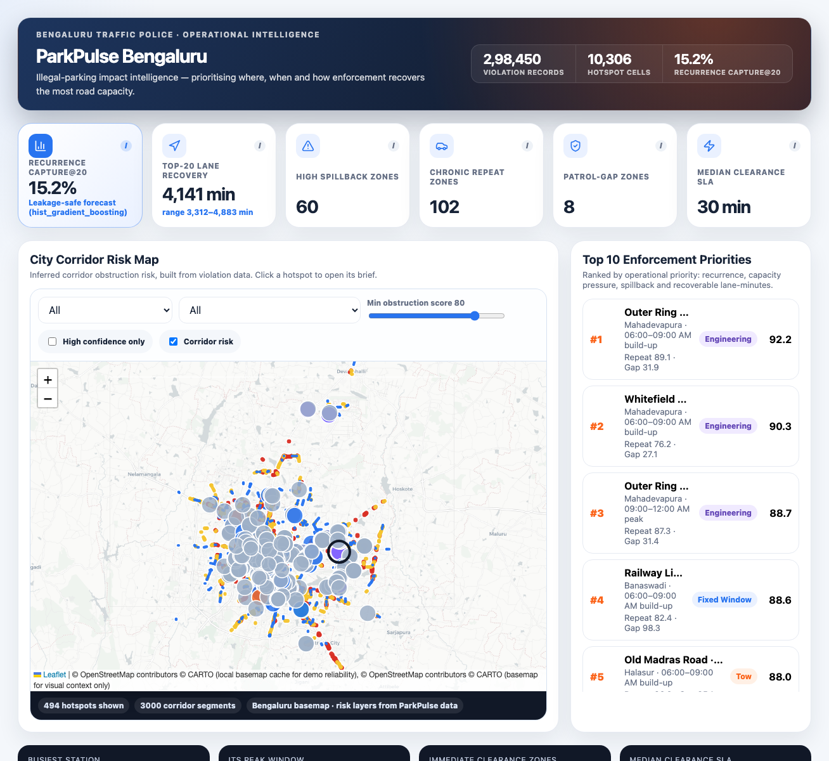
Flipkart
F
×
P
ParkPulse
14 / 18
PRODUCT WALKTHROUGH
Command Center: one city map, six decision numbers, one priority queue
The control room sees what to act on first, not a generic traffic dashboard.
KPI cards
Six decision numbers for the shift.
Risk map
Basemap + inferred corridor-risk lanes.
Priority queue
Top actions ordered by payoff.
Proxy labels
Impact estimates are clearly marked.
Built as a working product, not a mock chart.
Live screenshot from the ParkPulse React prototype
Proxy metrics are labelled; nothing is presented as measured live traffic

Slide 15
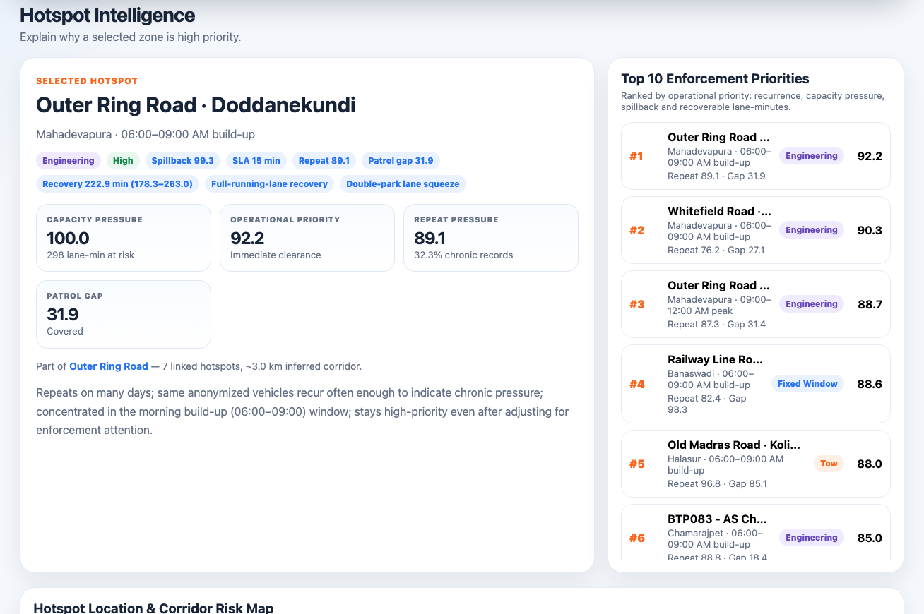
Flipkart
F
×
P
ParkPulse
15 / 18
PRODUCT WALKTHROUGH
Station inspector and field officer: from hotspot explanation to action brief
A hotspot card answers: where, when, why, what action, confidence, deadline and required resource.
Field Brief
Location
Outer Ring Road, Marathahalli
Best window
00-06 night / early morning
Action
Pre-position tow + patrol unit
Reason
Main-road illegal parking likely blocking running lane
Confidence
High confidence; validation-aware
SLA
Immediate clearance: within 30 minutes
Resource
1 tow vehicle + 1 patrol unit
This is the bridge from data science to police action.
Live screenshot from Hotspot Intelligence after basemap/corridor fix
Proxy metrics are labelled; nothing is presented as measured live traffic

Slide 16
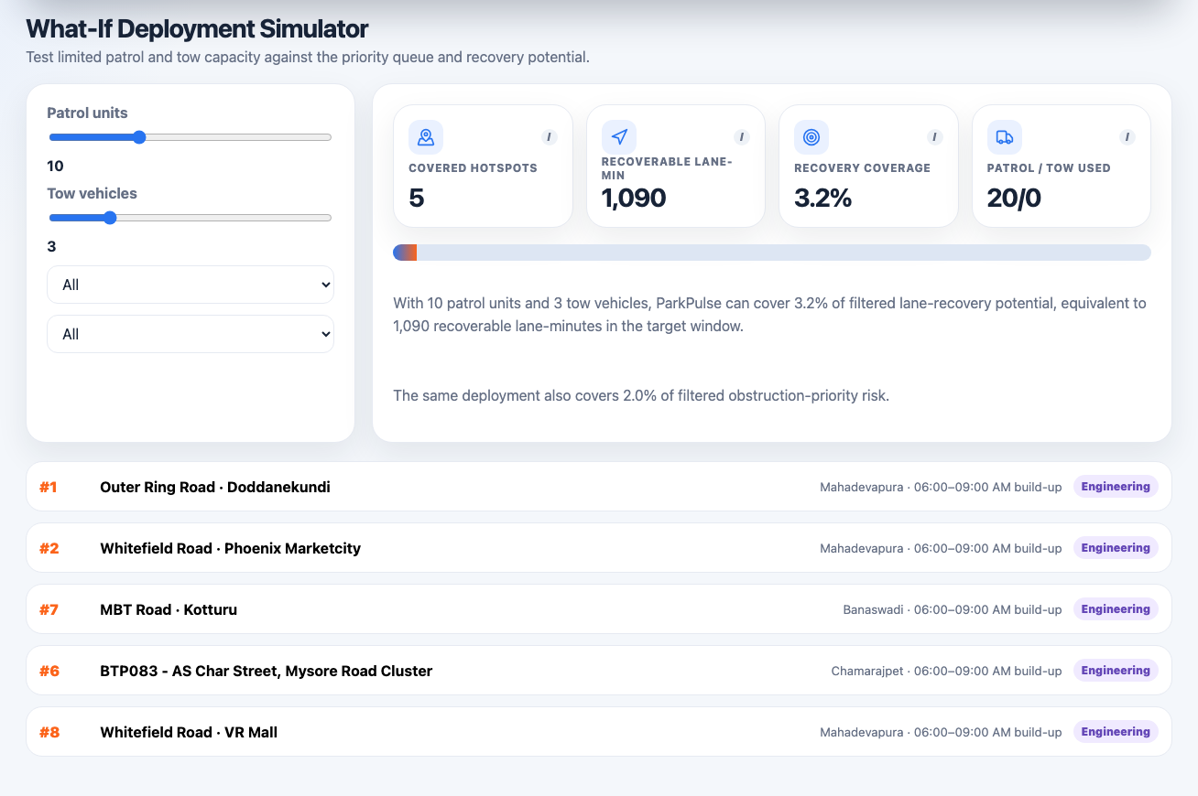
Flipkart
F
×
P
ParkPulse
16 / 18
DEPLOYMENT SIMULATOR
Limited patrol and tow resources become a measurable allocation plan
The simulator turns enforcement strategy into resource-constrained dispatch decisions before a shift begins.
Resource inputs
Patrol units + tow vehicles + station + time window
Selected zones
The highest payoff hotspots under the same resource budget
Covered / uncovered risk
Covered obstruction proxy, uncovered risk and resource-hour ROI
845 min
+40.0%
standard-shift lane-recovery proxy
vs raw-density dispatch; same budget
Proxy planning back-test; not measured live traffic delay
Live screenshot from the ParkPulse deployment simulator
Proxy metrics are labelled; nothing is presented as measured live traffic

Slide 17
Flipkart
F
×
P
ParkPulse
17 / 18
ROLLOUT ROADMAP
Useful tomorrow morning, stronger as richer feeds arrive
The MVP is day-one deployable from violation records; production integrations convert proxies into measured outcomes.
Day 1
30 days
90 days
Next feeds
Batch dashboard
Feedback loop
Measured impact
Full command stack
• Decision support
• Hotspot ranking
• Station-wise plans
• Outcome learning
• Closure/tow timestamps
• SLA compliance
• Measured traffic impact
• Speed + queue feeds
• Before-after review
• Road graph/lane width
• Signal health
• Patrol roster + events
Success metric
Examples
Operational adoption
Top-K capture, SLA compliance, repeat-offender reduction, officer-hour ROI, closure-time reduction
Source: ParkPulse pipeline outputs from the provided Theme-1 enforcement dataset
Proxy metrics are labelled; nothing is presented as measured live traffic

Slide 18
Flipkart
F
×
P
ParkPulse
Defensible today. Measurable tomorrow.
ParkPulse narrows the field, explains the reason, dispatches the right resource, and learns after every shift.
Claim with confidence now
Use as transparent proxy
Measure after integration
- Recurring hotspots
- Obstruction risk
- Speed improvement
- Repeat/chronic pressure
- Spillback risk
- Queue reduction
- Exposure-adjusted priority
- Lane-recovery minutes
- Closure impact
- Station-wise plans
- Traffic-flow impact estimate
- Manpower response effectiveness
ParkPulse is not a heatmap. It is a decision system for deciding which illegal parking Bengaluru should solve first.

