Slide 1
SonarEye
Finding what doesn't belong on the seafloor
• Ghost nets and marine debris keep catching life long after they're abandoned — but on side-scan sonar they blend into natural clutter (rock, reef, sand ripples).
• Sonar survey review is still largely manual: an analyst scrubs hours of imagery frame by frame.
• The hard problem: telling a real anomalous object from high-contrast natural texture, at scale, without missing things.

Slide 2
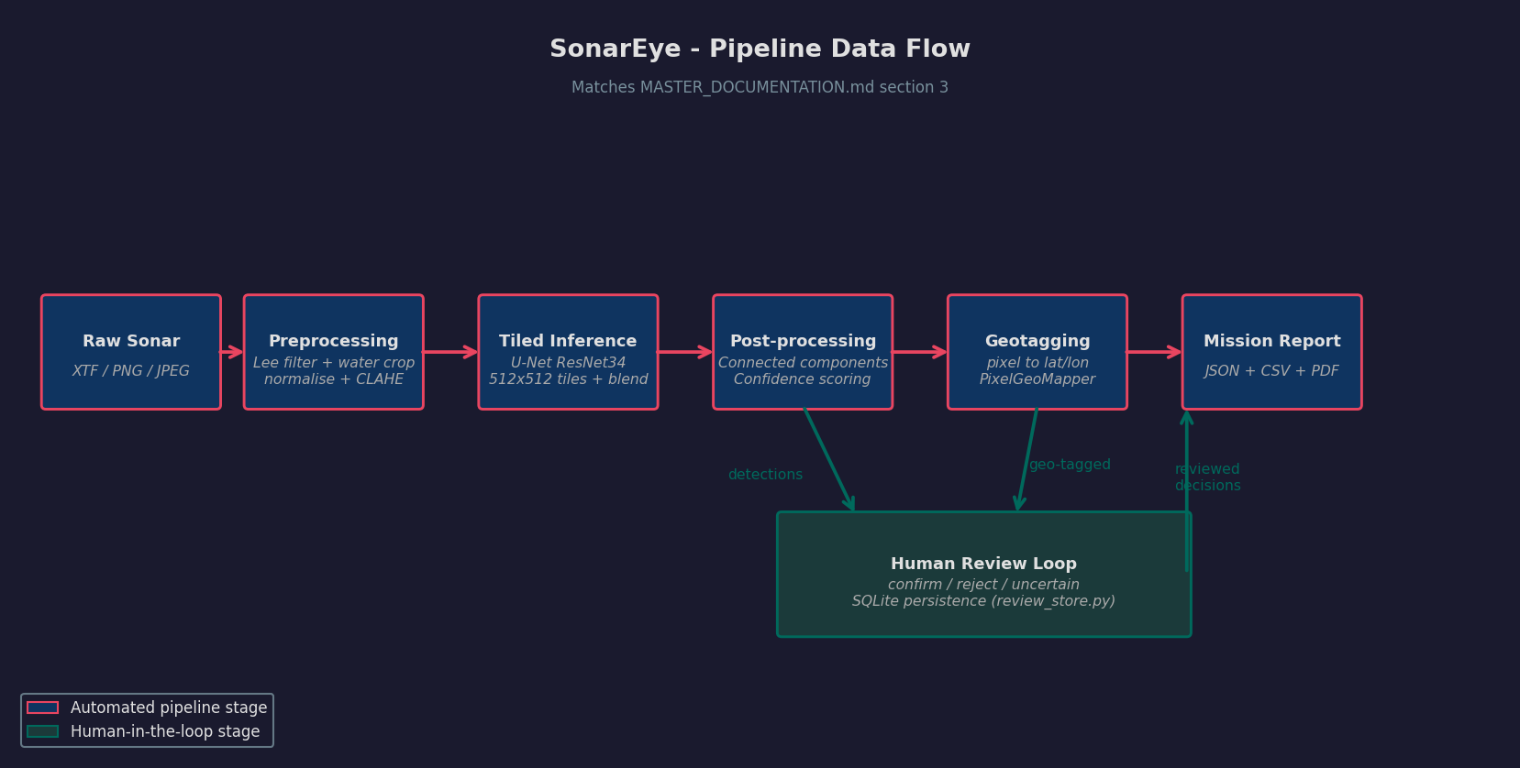
What we built and proved
• End-to-end pipeline: raw sonar → preprocessing → tiled U-Net segmentation → post-processing → geotagging → mission report, with a human review loop.
• Validated on real shipwreck side-scan sonar (AI4Shipwrecks: 286 images, 28 sites; site-based split, zero site overlap between train and test).
• Headline: Test IoU 0.4268 / Dice 0.5983 on 13 held-out sites.
• In-distribution validation reaches IoU 0.713 / Dice 0.833 — the gap is reported, not hidden.

Slide 3
How it works, end to end
Preprocessing (Lee filter + water crop + CLAHE) · U-Net ResNet34, 512×512 tiles @50% overlap · connected-components + sonar-heuristic confidence · pixel→lat/lon geotagging · JSON/CSV/PDF report · SQLite-persisted human review loop

Slide 4
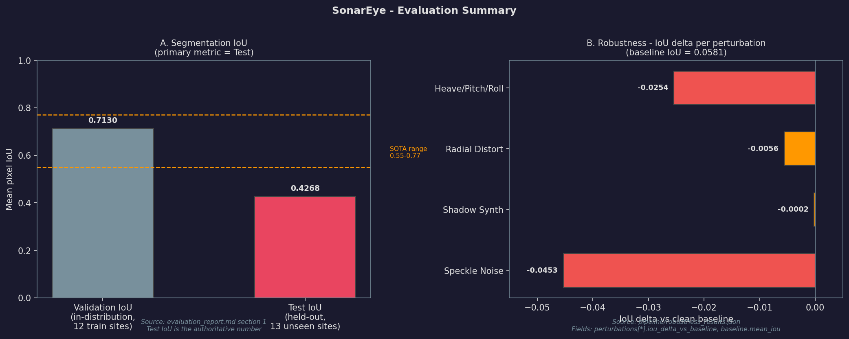
Evidence: evaluation & robustness
• The single convergent finding: the model fires on high-contrast structured texture, not exclusively on shipwreck shape.
• The perturbations that degrade it most (speckle −0.0453, heave/pitch/roll −0.0254) are the ones that alter texture; four independent stress tests point the same way. Baseline IoU 0.0581.

Slide 5
Evidence: deployment & performance
Metric | Measured value | Scope
GPU forward pass | 0.37 s | pure model, warm
Full pipeline (GPU) | 686 ms | preprocess + infer + post, warm
Full pipeline (CPU) | 4.29 s | warm
Cold start | ~7,120 ms | incl. ~5.9 s one-time imports
ONNX FP32 export | 97.7 MB · max diff 2.57e-05 | PASS
ONNX INT8 export | 24.6 MB · diff 0.6497 | WARN — not used
• Runs today as a Streamlit app.
• No "real-time" or "edge-ready" claim — those require measurement on target hardware, which we have not done.

Slide 6
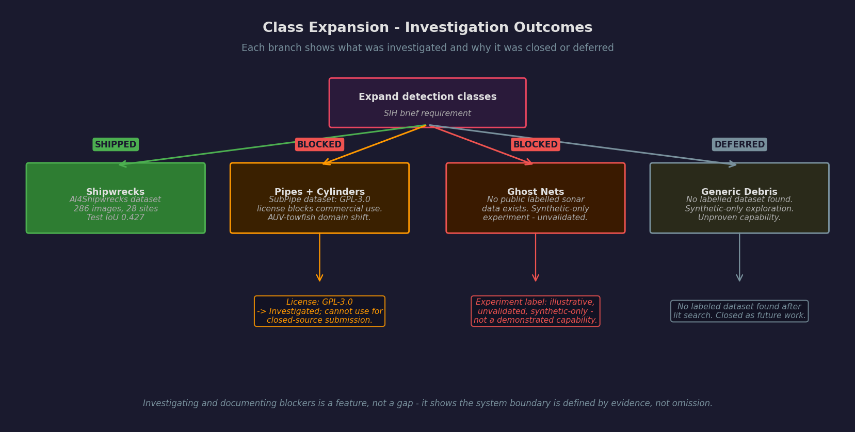
The taxonomy gap: investigated, not hidden
Shipwrecks SHIPPED (test IoU 0.427) · Pipes+cylinders BLOCKED (SubPipe GPL-3.0 + domain shift) · Ghost nets BLOCKED (no public labeled sonar data) · Generic debris DEFERRED. The system boundary is defined by evidence, not omission.

Slide 7
The pipeline doesn't know what it's looking at
• The segmentation model outputs "anomalous object vs seafloor" — it is not hardcoded to "shipwreck."
• Adding a second class is a data problem, not an architecture rewrite: the review workflow already stores a generic category field (shipwreck, rock, shadow_artifact, biological, unknown).
• Shipwrecks were simply the class that had real, licensed, labeled data to prove the architecture on. The design generalizes; the evidence is class-specific by necessity.

Slide 8
Synthetic net exploration — a texture probe
• Exploratory probe on synthetic net-like texture: 26/30 (86.7%) patches triggered a detection (72 detections total, seed 7).
• Consistent with the Slide 4 finding — the model fires on unfamiliar high-contrast texture, not on net shape.
Label: “illustrative, unvalidated, synthetic-only exploration — not a demonstrated capability.” This is NOT ghost-net detection and is not presented as one.

Slide 9
AI assists, a human verifies
• Mission flow: landing → survey → analysis → review-in-sequence → map → summary → report.
• Each detection is reviewed in sequence: confirm / reject / uncertain, with optional category and note; decisions persist across restarts (SQLite).
• The report distinguishes AI-flagged / unreviewed from human-confirmed — the tool never presents an unreviewed detection as a verified finding.

Slide 10
What real deployment would need next
• Labeled ghost-net sonar data — the one missing ingredient. Plausible route: partner with a conservation / ghost-gear-retrieval organization to co-label real survey imagery, the way AI4Shipwrecks itself was built.
• Embedded-hardware benchmarking before any "edge" or "real-time" claim can be made.
• Validation on Indian-waters sonar to confirm generalization beyond freshwater Great Lakes data.

Slide 11
What's real today, and what's next
• Real and tested today: end-to-end pipeline validated on real held-out shipwreck sonar (Test IoU 0.4268), with measured latency, a human review loop, and geotagged reports.
• Honestly bounded: we documented every class we couldn't ship and why; the net work is an unvalidated texture probe, not a capability.
• Next: labeled ghost-net data + hardware benchmarking + regional validation turn a proven architecture into a deployable tool.

