Slide 1
IWP Review Audio and Video embedding in HTML
Advait Deochakke
20BCE1143

Slide 2
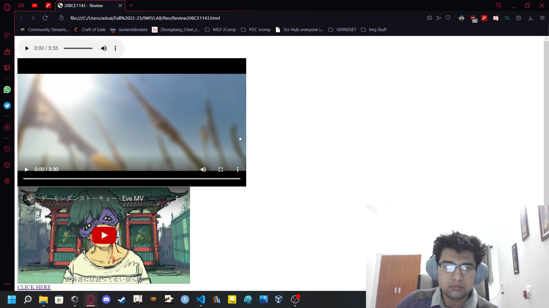
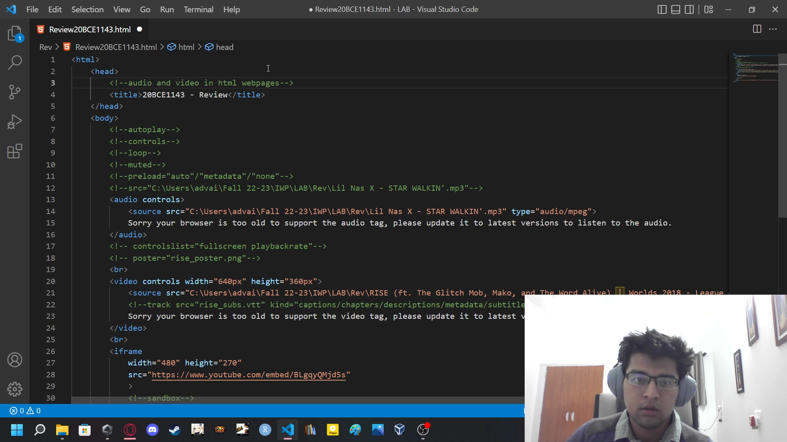
Backend Code display
We use code and webpage concurrently, changing and showcasing what each change does.

Slide 3



Look of basic elements
Audio
Video
Embedded links (Eg. Youtube)

Slide 4
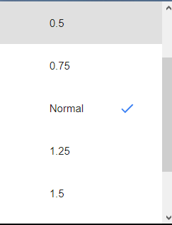




Default controls available
Using attribute <controls>
For Audio -
Play/Pause
Volume Control
Playback Speed
Position scrubber
For Video -
Same as above, plus fullscreen

Slide 5
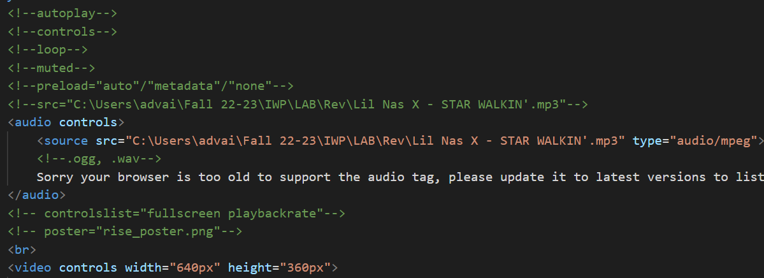
Usable generic tags

Slide 6
Explanations
Autoplay – Enables or disables autoplay on page load, forced off on most browsers due to privacy/non-user friendly attitude
Controls – Enables the availability of controls on the multimedia element. Can be modified with <controlslist>
Loop – enables auto-looping of the multimedia
Muted – makes the multimedia element muted by default
Preload – Auto/Metadata/None ► decides whether the data for the multimedia loading completely, only has the metadat, or none
(explained more in video)

Slide 7
Explanations – contd.
Src – the source can be either added within the multimedia tag, or inside the tags using the <source> tag
Type – (Please check video description for correction) programmer-set identification of “type” of multimedia, so that if the browser is unable to play it, it can indicate directly without errors. Does NOT affect actual playing capability
Controlslist – List of controls which are enabled with the <controls> attribute
Poster – a thumbnail for a video multimedia element
Tracks – A .srt or .vtt file for video subtitles

Slide 8
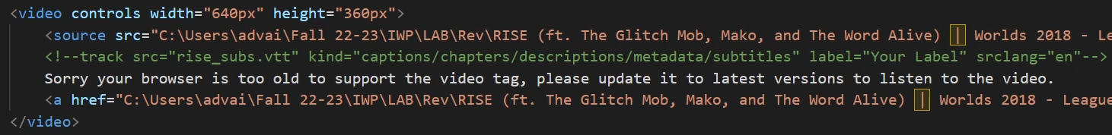
What to do if browser is too old?
<audio> and <video> tags enable programmers to add an apology text if the browser does not support or allow the embedding of audio/video elements.
If the source is unable to load, “Sorry your ... video.” loads, and the corresponding link gets added in.

Slide 9
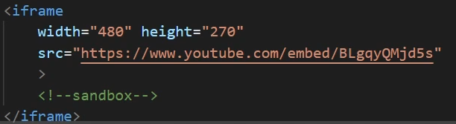
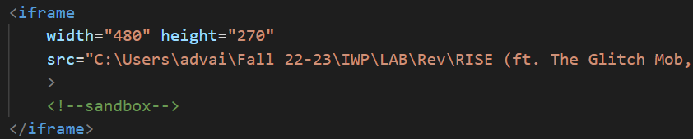
iframe
An iframe can display a
webpage within a webpage
Using designated embed-able
pages makes the page look better (Eg. YT embeds)
But can also embed anything else, eg videos

Slide 10
<sandbox>
Iframes are by nature not exceptionally secure
<sandbox> applies extra restrictions to the content in the frame.
Can prevent scripting based attacks.
Like most things, does not work on IE 9 or earlier
<sandbox> is obsolete if the user opens the source in a new origin.

Slide 11
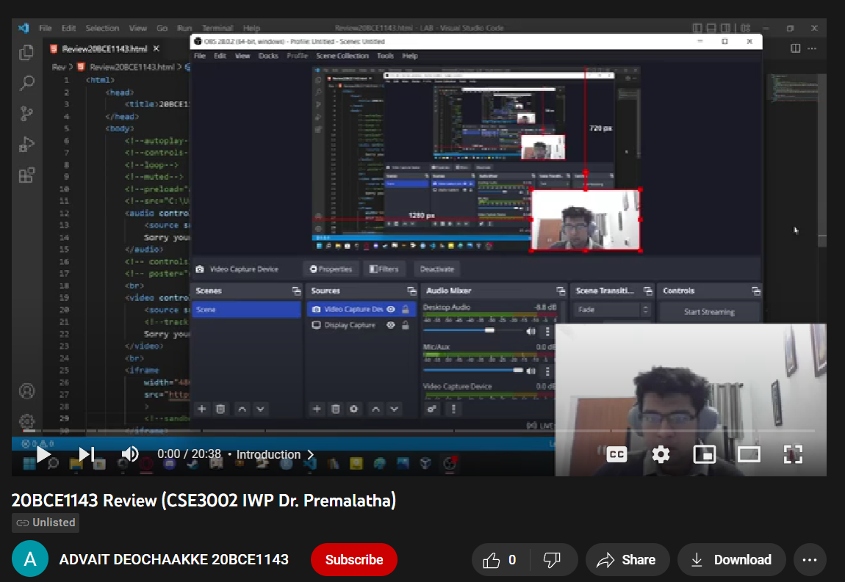
Video Link
Good explanations in the video -
https://youtu.be/2tt2O6t5sOM
Like, Share, Subscribe and
make sure to ring the bell icon!

