Slide 1
Analysis of vaccination rate and its effect on spread of Coronavirus
CSE3505 – Foundation of Data Analytics - F1
Advait Deochakke 20BCE1143 Aryan Shah 20BCE1490

Slide 2
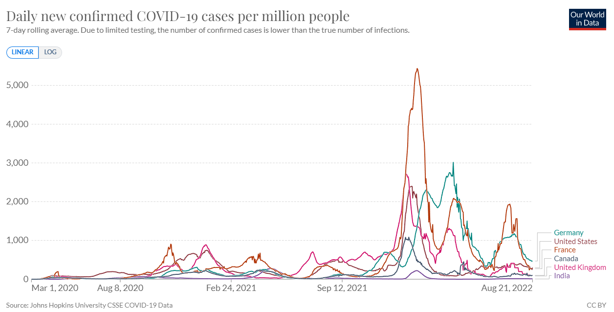
Background -
Covid-19 gripped the world in early 2020 and extensive research was conducted. Vaccinations were soon prepared, like the Moderna or Pfizer vaccine. Many people jumped at the chance to get these vaccines, and millions of people were vaccinated every day.
Vaccine mandates, Mask mandates, and social distancing, combined with a prolonged period of social distancing and understanding from people has largely decreased infection rates.
Moreover, the pandemic has created a massive wealth of data due to the global-scale cooperation, creating opportunities for exercising various data analytics concepts.

Slide 3
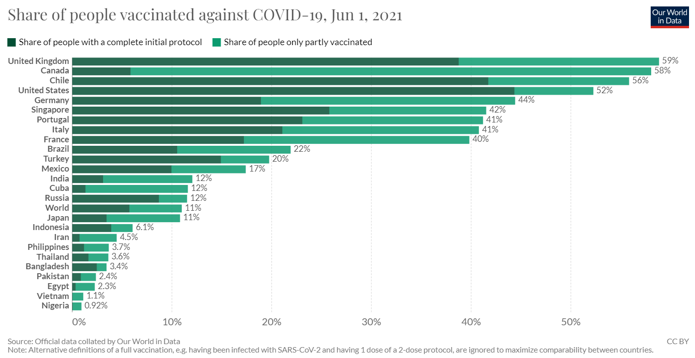
Problem Statement
Whether there is a connection between vaccination rates and infection rates
What is the extent of said connection, if it exists
Can we predict the decrease in infection rates as vaccination rates decrease?

Slide 4
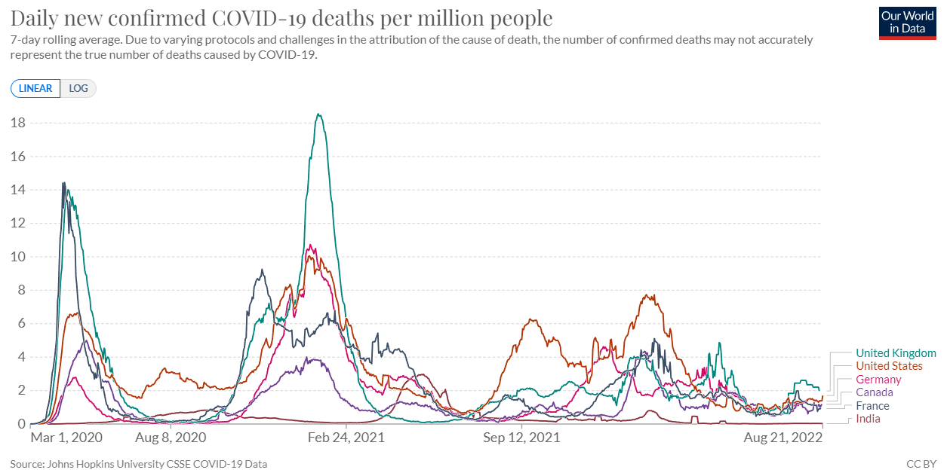
Problem Statement
Whether there is a notable relation between the two, to what extent they are interconnected, and how we can predict the rate of infection to change as time goes past and more people are vaccinated.
How does the spread of Coronavirus fare today?

Slide 5
Literature
https://onlinelibrary.wiley.com/doi/10.1002/jmv.27609 Correlation between vaccine coverage and the COVID-19 pandemic throughout the world: Based on real-world data Chao Huang,Lijun Yang,Jia Pan,Xiaomei Xu,Rong Peng - ‘mass COVID-19 vaccination policy would protect the health and wellbeing of all, especially when the rate of vaccination passes 60%’
https://doi.org/10.1016/j.msard.2022.104033 COVID-19 infection and vaccination against COVID-19 L. Pandit , A. Sudhir, C. Malli , A. D’Cunha - ‘vaccinations are safe and significantly mitigates the risk of severe infection’

Slide 6
Literature
https://doi.org/10.1016/j.meegid.2021.104834 Predictive analysis of COVID-19 eradication with vaccination in India, Brazil, and U.S.A Deepa Chaturvedi , U. Chakravarty ’we have predicted the possible timescales for the end of the epidemic for different values of vaccination rates’

Slide 7
Objective
Figuring out quantitatively whether the increasing rate of vaccinated individuals has had a definitive impact on the spread of novel coronavirus
If there is a notable relation between the two, to what extent they are interconnected
how we can predict the rate of infection to change as time goes past and more people are vaccinated

Slide 8
Dataset
https://ourworldindata.org/covid-vaccinations
Dataset maintained by John Hopkins Uni. and Oxford University.
Publicly and Grant funded online publication, maintained and developed ‘for the public good’, includes one of the world’s most complete data repositories, particularly for Coronavirus related data
Hannah Ritchie, Edouard Mathieu, Lucas Rodés-Guirao, Cameron Appel, Charlie Giattino, Esteban Ortiz-Ospina, Joe Hasell, Bobbie Macdonald, Diana Beltekian and Max Roser (2020) - "Coronavirus Pandemic (COVID-19)". Published online at OurWorldInData.org. Retrieved from: 'https://ourworldindata.org/coronavirus' [Online Resource]

Slide 9
Algorithms
In general, to be decided under the Model Planning Stage
Approach lies along the lines of co-relating vaccine rates by identifying weekly averages of increasing and cumulative vaccines (segregated by markers such as country, month, wave, etc – TBD) to the infection rate in that same category, and analyzing the processed data.

Slide 10
Novelty of Findings
Offers a new look on the statistic of disease and infection rate, looking not from the perspective of mask users or social distancing norms followers, but foraying into vaccinations
Going past the immunity provided by vaccination and employing the considerations that ‘higher vaccination rates may indicate higher awareness and respectability of regulations’, and co-relating them with spreading rate of the virus

Slide 11
Expected Conclusion
We may confirm the existence of a relation between vaccination rates in a particular demographic, and their relation of the spread of COVID-19 in the same demographic.
We may find to what degree this relationship is, and hope to investigate into whether this is causation type of relationship between the former and the latter, or a co-relation type.

Slide 12
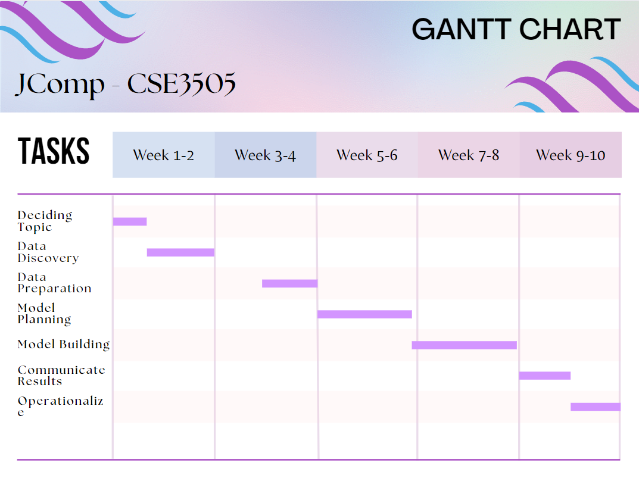
Timeline

Slide 13
Thank You -Advait Deochakke -Aryan Shah (References are inline)

