Slide 1
Udyam Digital
Get a small business online in one sitting — discover, buy, verify and track on a phone, in its own language.
Track A · Accel Business · YTL Hackathon 2026
Notes:
Udyam Digital turns Accel Business's slow, visit-led SMB sale into a self-serve journey: an AI advisor in Hindi, Marathi or English, one clear price, five-minute KYC on the phone and a live order tracker — with partners handling the high-value 20%.

Slide 2
Only 7 in 100 interested small businesses ever get connected — and most drops are our process, not their choice
7.4%
17.6 days
of 5,000 leads activate
from lead to live
3×
₹15,053
status chases per customer
to acquire one SMB
54% of drops are process failures
no visit scheduled, unreachable, quote too slow or complex, paperwork, install delays — all removed by a self-serve journey
Notes:
Source: smb_leads.csv. 5,000 leads became 368 activations. Leads with a GSTIN activate at 9.6% vs 2.0% without. Every one of the 273 drops between quote accepted and KYC complete was paperwork-related.

Slide 3
Start where digital pays: professional offices and micro shops online, partners on the high-value end
Segment (share of leads) | Today: activation · median bill · CAC · churn | Our play | Starter bundle (from the rules engine) | Price · contract
1 · Professional offices (25%) clinics, CA firms, coaching | 11.1% · ₹6,575 · ₹10,694 · 13.8% | Digital-first, wave 1 | Fibre 300 + 2 business lines + email ×6 + 1 TB backup; add failover | ₹3,774/mo (12 m) ₹3,346 on 36 m
2 · Micro retail (54%) kirana, pharmacy, salon | 4.1% · ₹2,470 · ₹20,007 · 22.7% | Digital-only, zero-touch; CAC must fall ~8× | Fibre 100 (or AirFiber) + 2 lines + billing & UPI tablet; WhatsApp once GST is active | ₹2,546/mo (12 m) +₹2,500 setup
3 · Multi-site (15%) chains of 3–12 outlets | 11% · ₹28,080 · ₹15,614 · 10.8% | Digital quote, partner closes | Per outlet: Fibre 300 + failover + SD-WAN + billing + 2 CCTV | ₹39,267/mo for 6 outlets (24 m, SD-WAN)
4 · Manufacturers (5%) auto-parts, textile units | 12.8% · ₹15,910 · ₹15,324 · 8.1% | Field-led; digital KYC + tracker | Leased line 20 + 2 lines + 6 CCTV + 4 machine sensors | ₹13,588/mo (24 m)
Why this order: professional offices activate at 11% with low churn and buy cloud add-ons; micro shops are half the leads but cost ₹20k to win via visits against a ₹2.5k bill — only a near-zero-touch journey makes them profitable. Prices are the catalogue's midpoint on 12 months, falling to the floor on 36.

Slide 4
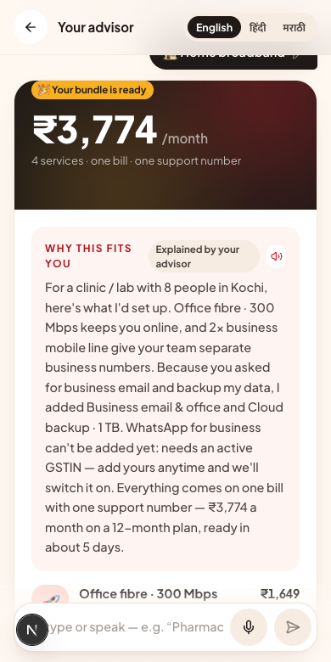
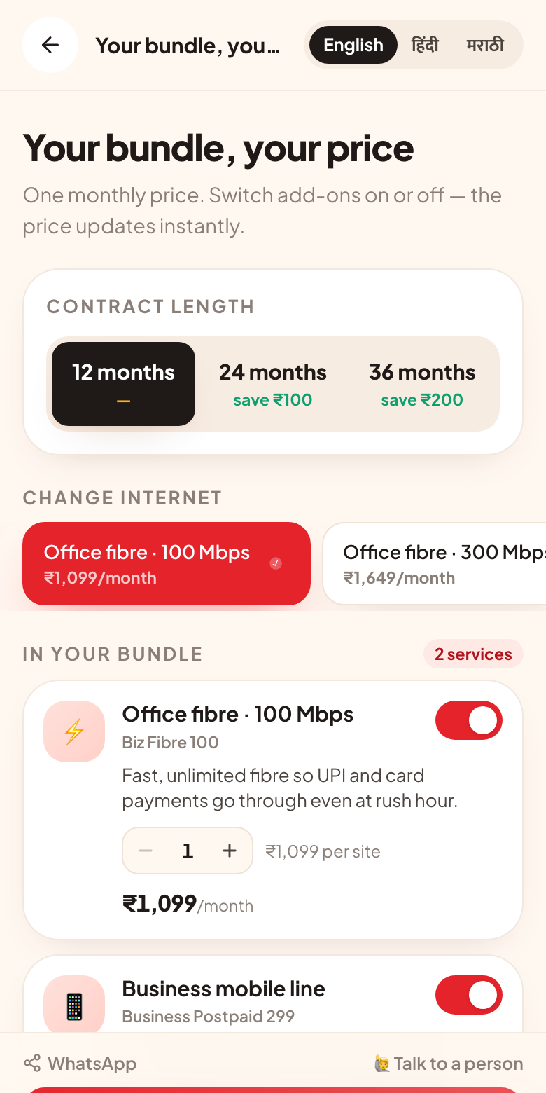
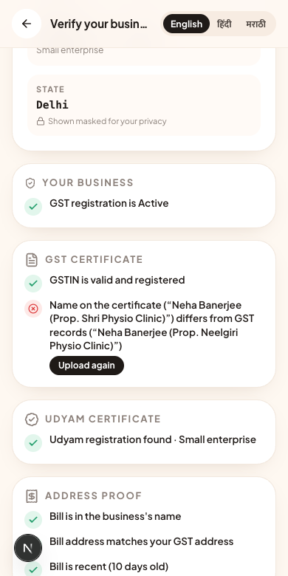
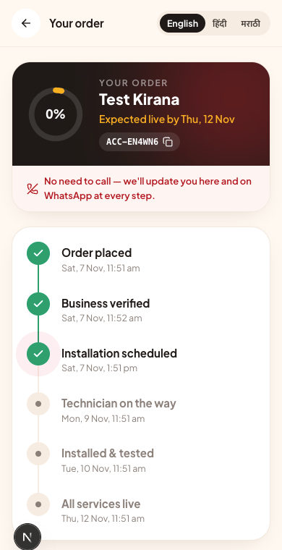
One journey on the owner's phone: four screens, no visit
1 · Advisor
2 · Quote
3 · Smart KYC
4 · Tracker
Tap, type or speak in English, हिंदी or मराठी; bundle builds live
One monthly price; toggle add-ons, switch speed, pick contract
Read on the phone, checked against GST & Udyam records
Live stages and install slot — no follow-up calls
Notes:
Also built: a WhatsApp-style chat front end on the same advisor (webhook contract ready for the WhatsApp Cloud API), voice input/read-aloud, and a partner console with a propensity-ranked call list.

Slide 5
Needs discovery without a salesperson: rules decide, AI explains
1
2
3
4
5
Owner speaks
Understand
Decide
Price
Explain
Taps 6 chips or says “dental clinic in Kochi, 8 people, no GST” — EN / हिं / मरा, voice or text
On-device parser in 3 languages; NVIDIA NIM / Sarvam fill gaps when keys are set
Rules engine over the 25-product catalogue: city tier, staff, sites, active GSTIN, dependencies
One monthly price + setup + GST; contract slider; add-ons owners can toggle
Plain-language “why this fits you”, streamed; what's not included and why
0
<100 ms
3.5 s
ineligible products recommended across 15 judge-style scenarios + 400 random profiles (unit-tested)
for the bundle to update after a tap — no network round-trip; AI text streams in
hard timeout on every AI call, then a template answer — the screen never hangs

Slide 6
KYC in five minutes, with privacy built in: documents never leave the phone
Consent per purpose
Blur check
Auto-straighten
On-device OCR
Checksum + registry
Verdict + one-tap fix
Applicant | Planted problem | What the owner sees
K01 | GSTIN cancelled; Udyam no. missing | GST services blocked; non-GST bundle offered
K02 | Photo tilted 7° | Straightened, matched by name → verified
K04 | GST certificate blurry | “Retake in good light”
K05 | No Udyam certificate | Found in Udyam records — no upload
K06 | GSTIN fails check digit | Flagged; suggests the registered GSTIN
K07 | Name differs from GST records | Flagged as a possibly edited certificate
K10 | OCR misread I↔J | Auto-corrected via registry → verified
K11 | Electricity bill 257 days old | “Upload a bill from the last 90 days”
DPDP Act 2023 by design
Consent: per-purpose toggles, versioned, withdrawable
Minimisation: server receives fields, never images
Purpose: KYC data used only to activate; no marketing by default
IDs masked in UI, logs, partner console
Retention: chats 30 d, unconverted leads 90 d, auto-deleted
K03, K08, K09, K12 pass clean · all 12 run as automated tests

Slide 7
People where they add value: the journey hands partners warm, scored leads
Self-serve (80% of volume)
Micro shops and offices buy online; partners earn the same commission on digital orders from their pin code.
Hand-off in one tap
“Talk to a person” from advisor, quote, KYC or chat lands in the partner console with bundle, language and stage.
Call list ranked by propensity (AUC 0.712)
Logistic model on lead-time features; next best action per drop reason (e.g. “no fibre → offer AirFiber”).
Partners own the hard 20%
Field visits cost ~6× a referral or inbound lead.
Multi-site, leased lines, site surveys and installs — routed to someone who speaks the owner's language.

Slide 8
Same spend, more customers: +55% to +130% activations a quarter
₹9,718 → ₹6,548
CAC with today's ₹5.5M quarterly spend (from ₹15,053), before cutting any visits
+₹1.7–4.0 Cr
new ARR per quarterly cohort (202–478 extra activations × ₹6,900 median bundle)
17.6 → ~5 days
to live: fibre in 5 days, AirFiber in 2; KYC no longer waits on visits
1 bill, 1 number
for the owner instead of 4–5 vendors; a kirana's whole setup is ₹2,546/month
Model: funnel stage rates from smb_leads.csv; only drops our screens remove are recovered (unreachable leads excluded).

Slide 9
Five numbers we would run the business on
Metric | Today | 90-day pilot | Year 1 | Lever
Lead → activation | 7.4% | 11% | 15% | Self-serve + recovered process drops
Days from lead to live | 17.6 | 7 | 5 | Instant quote & KYC; AirFiber when no fibre
Status chases per customer | 3 | 0.5 | 0.2 | Tracker; 5 chases today ⇒ 28% churn
Blended CAC | ₹15,053 | ₹10,000 | ₹6,000 | Digital first; micro ≤ ₹3,000
6-month churn | 15.2% | 12% | 10% | Faster, quieter onboarding; right-sized bundles
Guardrails: KYC first-pass rate ≥ 80% · NPS ≥ 8 · zero ineligible activations · AI fallback rate tracked per language.

Slide 10
Rollout in three steps, with the risks we have already designed for
Weeks 0–6
Days 1–90
Quarter 2–4
Connect
Pilot
Scale
GSTN/Udyam via a GSP, DigiLocker, Aadhaar e-sign, UPI AutoPay, OSS provisioning events
Pune + Nagpur (Marathi/Hindi), professional offices + micro, 2 channel partners, weekly metric review
10 cities; Tamil, Telugu, Kannada, Gujarati, Bengali; WhatsApp Cloud API; multi-site with partners
Risk | Mitigation already in the design
AI gives a wrong answer | AI never picks products or prices; the rules engine does, and the server re-checks every order
Forged or mismatched documents | Check digit, registry status and name/address match; mismatches go to manual review
Channel conflict with partners | Pin-code commission on digital orders; partners get scored hand-offs
Fibre not feasible at the site | AirFiber fallback offered automatically (41 drops last quarter)
Low digital comfort | Voice, three languages, WhatsApp-style chat, a person one tap away

