Slide 1
Simulating a Muon detector
By Advait Dhingra

Slide 2
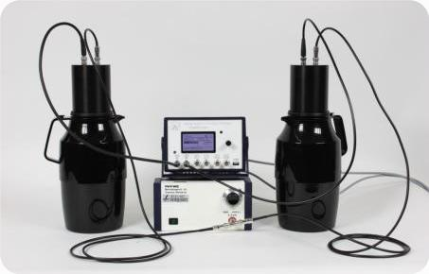
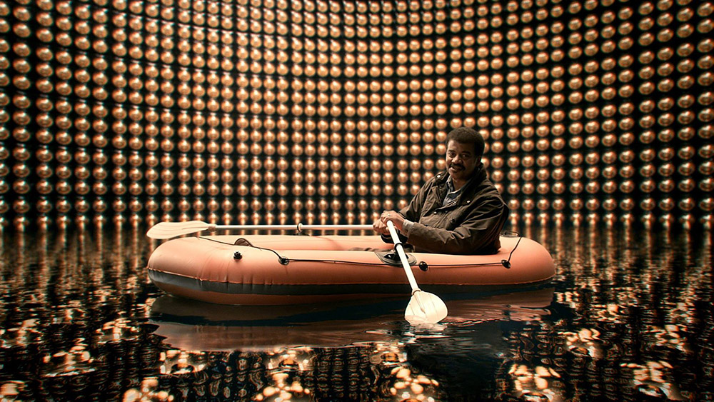
Introduction
Simulation of a Kamiokande-style detector.
Scaled down to the size of a tea kettle, → Kamiokanne (ger. Kamio-can).
Using Root, a C++ framework by CERN

Slide 3
Why?
Check if the algorithms/logic work/s.
Support observations.
Make predictions in software before doing the experiment.
Good coding exercise.

Slide 4
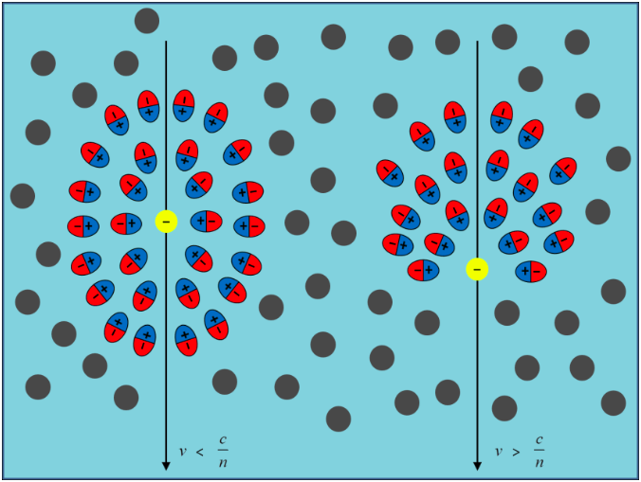
How does the detector work?
Muons fly through the detector at different angles.
Flashes of light are emitted→ Cherenkov effect
Photomultiplier detects flashes

Slide 5
Benifits?
Easy to set up
Simple concept → Good for schools
Inexpensive
Quite accurate and easy to log

Slide 6
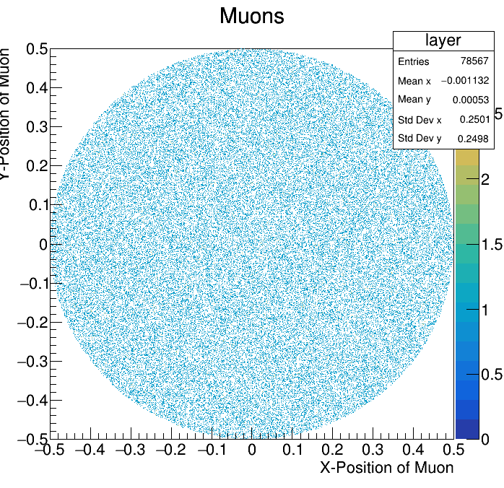
The simulation
Step 1: Generate random points in the cylindrical detector
→ Declare the radius and height of the cylinder as variables.
→ Generate a random x, y coordinate and if it’s within the cylinder, a z component.
→ Plot all the points in a 2d Histogram
and colorize it.

Slide 7
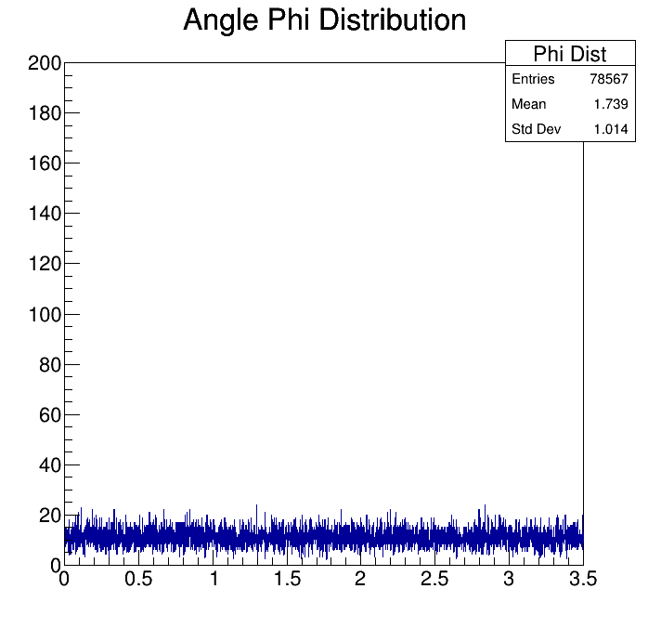
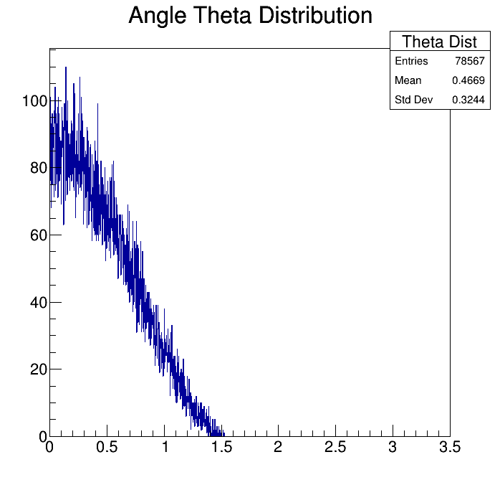
The Simulation
Step 2: Generate a Phi and Theta Angle.
→Declare a TF1 “cos(x)²” and get a random point on that graph. (Theta)
Generate a random number between 0 and 2pi (Phi).
Plot both on a Histogram to get the distribution

Slide 8
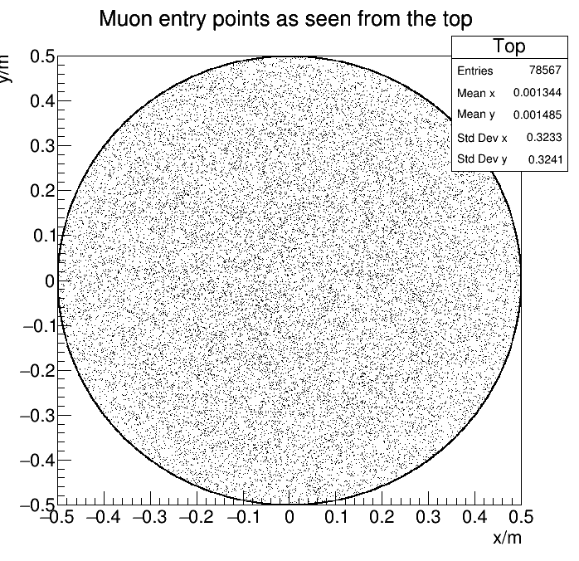
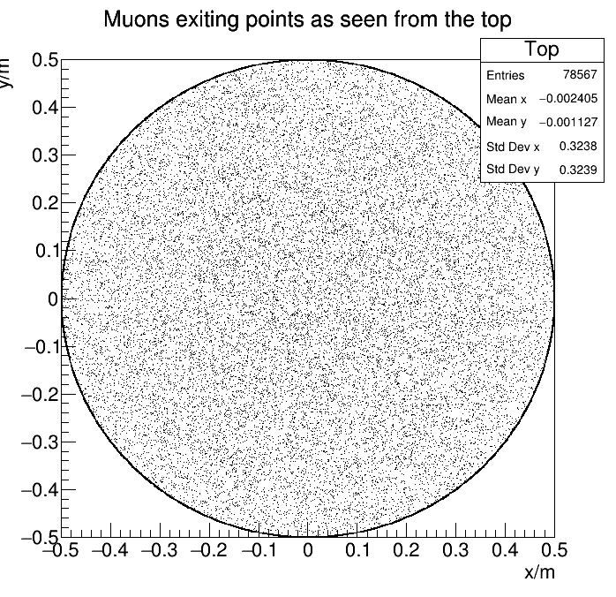
The Simulation
Step 3: Calculate the entry and exit points:
→Calculate the lambda value (p = p_0 + lambda * m) for when
→ Z = 0; z = -detectorHeight (declared in the first step)
→ x²+y² = detectorRadius² (declared in the first step)
Use Spherical coordinates to convert the two generated angles into the transformation vector
Plot the points from different perspectives
Here you can clearly see all the entry and exit points in the top and bottom layer, and a ring for all the entry and exit points from the side

Slide 9
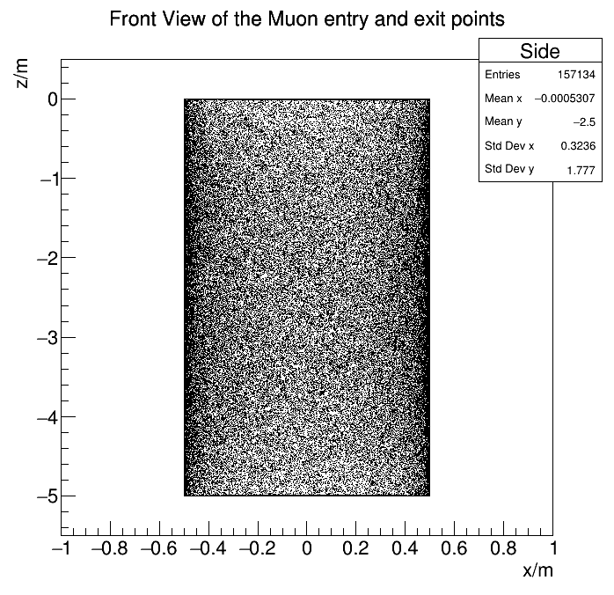
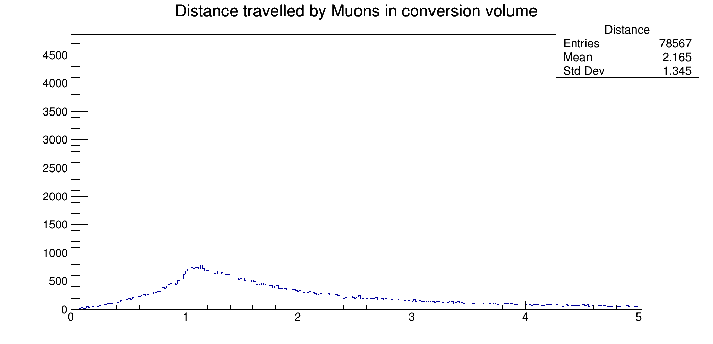
The Simulation
Here you can see all the entry and exit points as seen from the front. The solid lines at the top and bottom represent the Muons entering from the Top and exiting from the bottom
Shading on the side → Geometrical effect
Calculate the distance traveled by the particle, disregarding energy

Slide 10
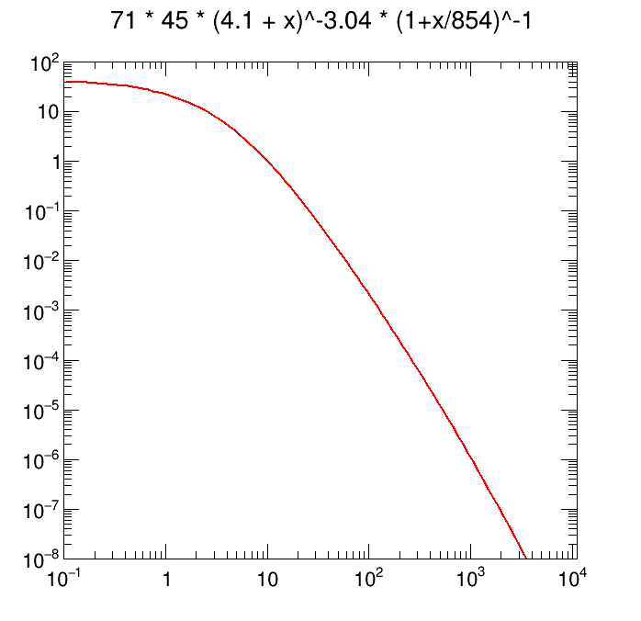
The Simulation
Step 4: (currently in progress) Assign an energy to each Moun and calculate on the basis of that if the Muon will be stopped (i.e. detected) or not. (Taking special relativity into account).
Energy dist.

Slide 11
Thank you for your attention
Any questions, comments, constructive criticism?

