Slide 1

Exam Cheating Detection System
Presented by: Sarwadeep Dhaval, Ritesh Gurav, Advait Dongre
This presentation outlines an AI-driven solution for detecting and preventing exam malpractice, ensuring academic integrity.

Slide 2
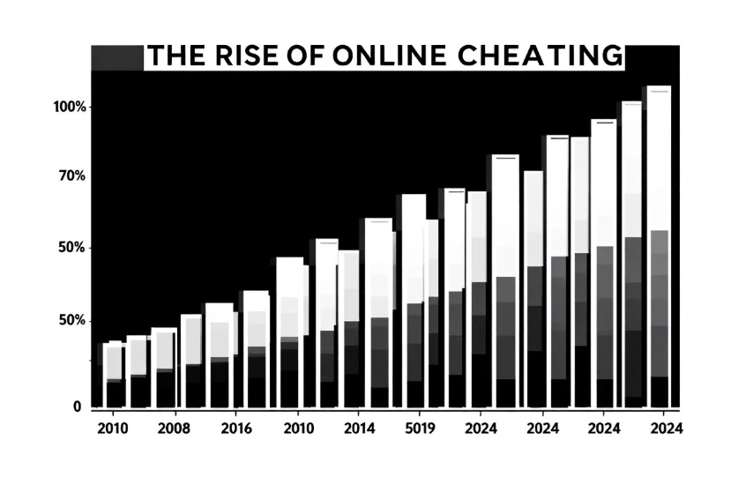
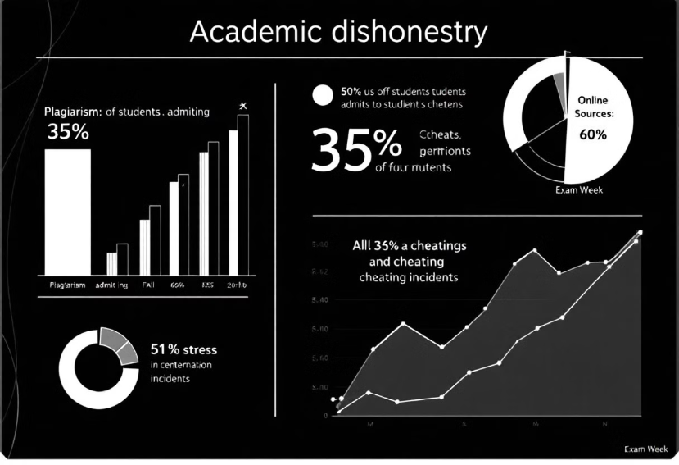
The Problem: Exam Malpractice
Academic dishonesty is prevalent, impacting exam integrity. Studies show 60-70% of students admit to cheating.
Traditional proctoring faces limitations in cost, scalability, and effectiveness. AI-based proctoring can reduce proctoring costs by up to 80%.
Cheating prevalence: affects online exams
Traditional proctoring: costly and limited

Slide 3
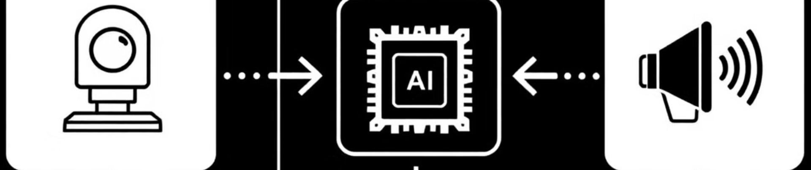



AI-Based Proctoring: A Modern Solution
Benefits
System Overview
AI Components
AI proctoring offers real-time monitoring, objectivity, and scalability. Cheating incidents can decrease by up to 50%.
The system uses a webcam, AI algorithms, and an alert system. AI processing occurs in real-time with less than 200ms latency.
Components include object detection, facial analysis, and behavior analysis. Scalable and consistent, using innovative technologies.

Slide 4



Technology Deep Dive: YOLOv12
Phone detection
Detecting prohibited items like phones.
Mask detection
Detecting prohibited masks.
YOLOv12 detects phones, notes, and masks with 92% mAP. It offers speed and accuracy advantages compared to previous versions.

Slide 5
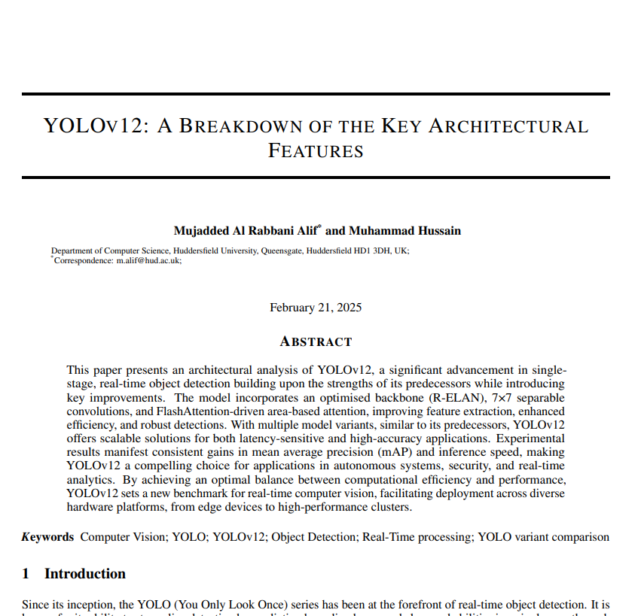
Yolo V12 Research
Paper
Using FlashAttention to minimize memory access overhead.
Removing positional encoding for a cleaner and faster model.
Adjusting the MLP ratio (from the typical 4 to 1.2 or 2) to better balance computation between attention and feed-forward layers.
Link: https://arxiv.org/pdf/2502.14740

Slide 6






Technology Deep Dive: Dlib
Robustness
Works with subtle head movements
Facial landmark detection
Locates key facial features
Accuracy
High accuracy pupil detection rate
Dlib enables accurate pupil detection even with subtle head movements. It achieves 98% accuracy under normal lighting conditions.

Slide 7
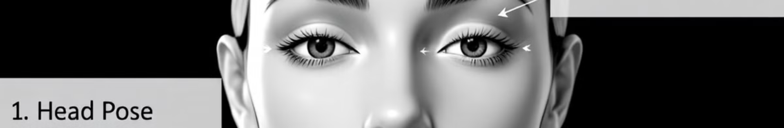
Fine-Tuned Predictor for Head Pose and Eye Blink Detection
Head Pose
Thresholds
Detects gaze direction.
Triggers alerts.
1
2
3
Eye Blink
Tracks blink frequency.
Shape Predictor tracks head posture and eye blink frequency. Head rotation exceeding 30 degrees or a blink rate less than 8 per minute triggers an alert.

Slide 8
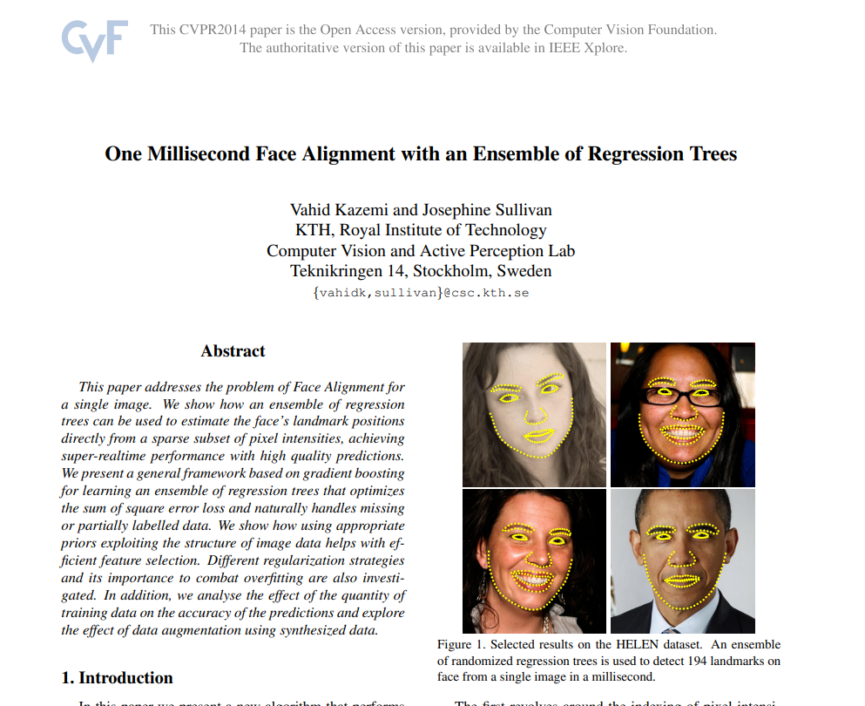
Fine tuned Shape Predictor Research paper
The main Techniques/algorithms used from the research paper are:
Ensemble of Regression Trees – Predicts landmark offsets using multiple regression trees.
Cascaded Regression – Iteratively refines landmarks to improve accuracy.
Pixel Intensity Features – Uses pixel differences for robust feature extraction
Link: https://www.cv-foundation.org/openaccess/content_cvpr_2014/papers/Kazemi_One_Millisecond_Face_2014_CVPR_paper.pdf

Slide 9



Challenges and Limitations
Lighting conditions
Privacy concerns
Computation
Data collection ethics require anonymization, encryption, and user consent.
Balancing accuracy and computational cost
Accuracy drops in low light by 10-15%

Slide 10
Future Improvements and Conclusion
Voice detection
Enhanced Analysis
Identify unauthorized communication.
Detect suspicious patterns beyond individual actions.
Explore voice detection libraries like Google Speech-to-Text API.
Need 1000 hours of exam recordings for training.
The system combats academic dishonesty with continuous improvements on the horizon. Key areas are voice detection, enhanced behavior analysis, and LMS integration.

