Slide 1

Advanced Computer Architecture
Prof. Moinuddin Qureshi
Thanks to Prof. Kim, Prof. Loh, Prof. Pruvulovic for earlier versions of the lecture notes!

Slide 2
Memory Hierarchy
Memory: Just an “ocean of bits”
IDEAL Memory: Zero cost, zero latency, infinite capacity
Trade-off between: latency and capacity (big is slow)
Trade-off between cost: fast is typically expensive
Solution: Build a hierarchy (frequent: fast, else: slow, cheap)

Slide 3
Memory Hierarchy
CAPACITY
SPEED and COST
Registers
On-Chip
SRAM
Off-Chip
SRAM
DRAM
Flash/Disk

Slide 4
Locality and Caches
Data Locality
Temporal: if data item needed now, it is likely to be needed again in near future
Spatial: if data item needed now, nearby data likely to be needed in near future
Exploiting Locality: Caches
Keep recently used data in fast memory close to the processor
Also bring nearby data there

Slide 5
Memory Latency is Long
60-100ns not uncommon
Quick back-of-the-envelope calculation:
2GHz CPU
→ 0.5ns / cycle
100ns memory → 200 cycle memory latency!
Solution: Caches

Slide 6
Cache Basics
Fast (but small) memory close to processor
When data referenced
If in cache, use cache instead of memory
If not in cache, bring into cache (actually, bring entire block of data, too)
Maybe have to kick something else out to do it!
Important decisions
Placement: where in the cache can a block go?
Identification: how do we find a block in cache?
Replacement: what to kick out to make room in cache?
Write policy: What do we do about stores?
Key: Optimize the
average memory
access latency

Slide 7
Review questions
Memory addresses A, A+1, A+2, A+3, A+4
Spatial locality or temporal locality?:
Spatial locality
Memory addresses A, B,C, A,B,C,A,B,C
Spatial locality or temporal locality?
Temporal locality

Slide 8
Cache Basics: A Layman View
Consider a library in law dept.: many books, each 100 pages.
Pages identified with [BOOKNAME][PAGENUM]
eg. MYBOOK64, OLDBOOK75, FINES88
We have a shelf that can store 2600 pages or 26 Books
How to organize this shelf?

Slide 9
Cache Basics: A Layman View
Perhaps we want to keep books instead of individual pages ➔ -Less book-keeping overhead
-Likely we read many pages from same book
26 Books. Need to check quickly if book in my shelf
How about partitioning the shelf? Hashing based on first char
What is the problem? Can’t hold two books starting with “A”
How about below: 13 bins (each with two places ➔ flexibility)
A | B | C | D | E | F | G | H | I | J | K | L | M | N | O | P | Q | R | S | T | U | V | W | X | Y | Z
A or B
Y or Z

Slide 10
Cache Basics
Cache consists of block-sized lines
Line size typically power of two
Typically 16 to 256 bytes in size
Example
Suppose block size is 256 bytes
Lowest eight bits determine offset within block
Read data at address A=0xFADEDACE
The block address is 0xFADEDA,
Byte in block is 0xCE
MSB
LSB
Block size

Slide 11
Cache Placement
Placement
Which memory blocks are allowed into which cache lines
Placement Policies
Direct mapped (block can go to only one line)
Fully Associative (block can go to any line)
Set-associative (block can go to one of N lines)
E.g., if N=4, the cache is 4-way set associative
Other two policies are extremes of this (E.g., if N=1 we get a direct-mapped cache)

Slide 12
Cache Identification
When address referenced, need to
Find whether its data is in the cache
If it is, find where in the cache
This is called a cache lookup
Each cache line must have
A valid bit (1 if line has data, 0 if line empty)
We also say the cache line is valid or invalid
A tag to identify which block is in the line (if line is valid)

Slide 13
Index
Pop quiz: Why is index typically the least significant bits (LSBs) and not MSBs
dex
TAG
Index
Block offset
TAG
TAG
=
=
Logic
YES
Data
HIT
YES

Slide 14
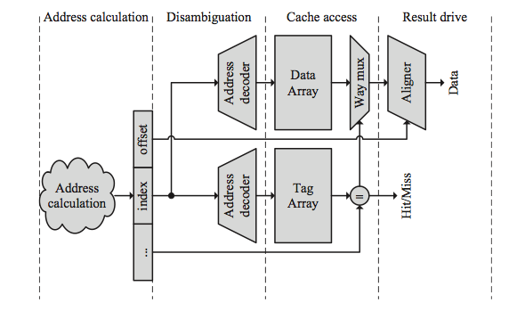
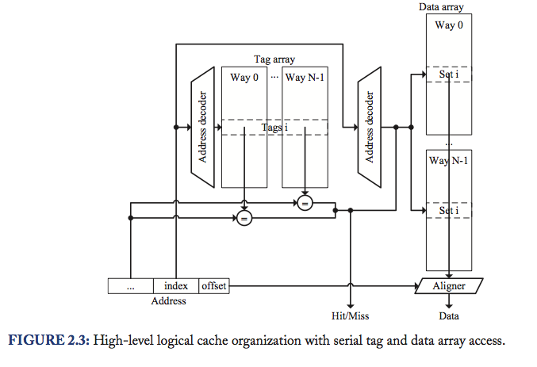
Parallel/Serial TAG and Data Array Access
Synthesis lecture series: microarchitecture

Slide 15
Cache Replacement
Need a free line to insert new block
Which block should we kick out?
Several strategies
Random (randomly selected line)
FIFO (line that has been in cache the longest)
LRU (least recently used line)
LRU Approximations (Pseudo LRU)

Slide 16
Implementing LRU
Have “time-stamp” with each line ➔ Expensive
Maintain a LRU “stack”
Ordered list with MRU line on top, LRU line on bottom
On a hit, remove the line from list and put on top of stack
For eviction, select line from bottom
Stack Algorithm still needs Log2(Assoc) bits per line
LRU approximations: Clock (1-bit LRU), NMRU, Tree etc.

Slide 17
Review questions-II
Here is a series of address references given as word address: 1,4,8,5,20,17,19,56,9,11,4,4,3,5,6,9,17. Assuming a direct-mapped cache with 16 one-word blocks that is initially empty, label each reference in the list as a hit or miss and show the final contents of the cache.
1%16 =1
4%16 = 4
8%16 =8
5%16 =5
20%16 = 4
17%16 = 1
19%16 =3
56%16 = 8
9%16 =9
11%16 =11
4%16 = 4
4% 16 = Hit
3 % 16 = 3
5%16 = 5 Hit
6%16 = 6
9%16 = 9 Hit
17%16 =1 Hit
0
1 | 1 17
2
3 | 19 3
4 | 4 20 4
5 | 5
6 | 6
7
8 | 8 56
9 | 9
10
11 | 11 43
12
13
14
15

Slide 18
Write Policy
Do we allocate cache lines on a write?
Write-allocate
A write miss brings block into cache
No-write-allocate
A write miss leaves cache as it was
Pros and cons?
Depends on temporal locality
Do we update memory on writes?
Write-through
Memory immediately updated on each write
Write-back
Memory updated when line replaced

Slide 19
Write Through/Write Back
PROC
CACHE
MEM
Write-through
PROC
CACHE
MEM
Write-back
replacement

Slide 20
Write-Back Caches
Need a Dirty bit for each line (stored in the Tag!)
A dirty line has more recent data than memory
Line starts as clean (not dirty)
Line becomes dirty on first write to it
Memory not updated yet, cache has the only up-to-date copy of data for a dirty line
Replacing a dirty line
Must write data back to memory (write-back)

Slide 21
Tag Storage
Any information related to cache other than data is stored in the tag storage.
Not only tag bits, information for replacement, dirty bits (if we need), valid bit
(in the future, cache coherence state information)

Slide 22
TAG
MSB
LSB
Data
address
TAG
Index
Offset
Offset: Byte offset in block
Index: Which set in the cache is the block located
Tag: need to match address tag in cache
Set: Group of blocks corresponding to same index

Slide 23
Cache Performance
Miss rate
Fraction of memory accesses that miss in cache
Hit rate = 1 – miss rate
Average memory access time
AMAT = hit time + miss rate * miss penalty
Memory stall cycles
CPUtime = CycleTime x (Cycles_{Exec} + Cycles_{MemoryStall})
Cycles_{MemoryStall} = CacheMisses x (MissLatency_{Total} – MissLatency_{Overlapped})

Slide 24
Improving Cache Performance
AMAT = hit time + miss rate * miss penalty
Reduce miss penalty
Reduce miss rate
Reduce hit time
Cycles_{MemoryStall} = CacheMisses x (MissLatency_{Total} – MissLatency_{Overlapped})
Increase overlapped miss latency
Increase memory level parallelism

Slide 25
Improving Cache Performance (2)
Memory latency = 100 cycles
16KB cache, 3 cycle latency, 85% hit rate
What’s the baseline AMAT?
= 3+100*0.15 = 18
What’s the best way to reduce latency?
Smaller 8KB cache: 1 cycle latency, 75% hit rate
= 1+ 100*0.25 = 26
Larger 32KB cache: 4 cycle latency, 90% hit rate
= 4 + 100*0.1 = 14

Slide 26
Reducing Cache Miss Penalty (1)
Multilevel caches
Very Fast, small Level 1 (L1) cache
Fast, not so small Level 2 (L2) cache
May also have slower, large L3 cache, etc.
Why does this help?
Miss in L1 cache can hit in L2 cache, etc.
AMAT = HitTime_{L1}+MissRate_{L1}MissPenalty_{L1}
MissPenalty_{L1}= HitTime_{L2}+MissRate_{L2}MissPenalty_{L2}
MissPenalty_{L2}= HitTime_{L3}+MissRate_{L3}MissPenalty_{L3}

Slide 27
Multi-Level Caches
Memory latency = 100 cycles
16KB L1 cache, 3 cycle latency, 85% hit rate
Use two levels of caching
Smaller 8KB cache: 1 cycle latency, 75% hit rate
Larger 128KB cache: 6 cycle latency, 60% hit rate
Exclusion Property
If block is in L1 cache, it is never in L2 cache
Saves some L2 space
Inclusion Property
If block A is in L1 cache, it must also be in L2 cache

Slide 28
Reducing Cache Miss Penalty (2)
Early Restart & Critical Word First
Block transfer takes time (bus too narrow)
Give data to loads before entire block arrive
Early restart
When needed word arrives, let processor use it
Then continue block transfer to fill cache line
Critical Word First
Transfer loaded word first, then the rest of block (with wrap-around to get the entire block)
Use with early restart to let processor go ASAP

Slide 29
Reducing Cache Miss Penalty (3)
Increase Load Miss Priority
Loads can have dependent instructions
If a load misses and a store needs to go to memory, let the load miss go first
Need a write buffer to remember stores
Merging Write Buffer
If multiple write misses to the same block, combine them in the write buffer
Use block-write instead of a many small writes

Slide 30
Kinds of Cache Misses
The “3 Cs”
Compulsory: have to have these
Miss the first time each block is accessed
Capacity: due to limited cache capacity
Would not have them if cache size was infinite
Conflict: due to limited associativity
Would not have them if cache was fully associative

Slide 31
Loop Interchange
For loops over multi-dimensional arrays
Example: matrices (2-dim arrays)
Change order of iteration to match layout
Gets better spatial locality
Layout in C: last index changes first
for(j=0;j<10000;j++) for(i=0;i<40000;i++) c[i][j]=a[i][j]+b[i][j];
for(i=0;i<40000;i++) for(j=0;j<10000;j++) c[i][j]=a[i][j]+b[i][j];
a[i][j] and a[i+1][j] are 10000 elements apart
a[i][j] and a[i][j+1] are next to each other

Slide 32
Review
Improving cache performance
Cache block sizes?
Cache write polices?
Multi-level caches
Inclusion/exclusion property
Write buffers

Slide 33
Question
#define MAX_LAST_NAME_SIZE 16
typedef struct _TAGPHONE_BOOK_ENTRY {
char LastName[MAX_LAST_NAME_SIZE];
char FirstNAME[16]; char email[16]; char phone[10]; char cell[10]; char addr1[16];
char addr2[16]; char city[16]; char state[2]; char zip[5];
_TAGPHONE_BOOK_ENTRY *pNext;
} Phone BOOK
PhoneBook *FindName(char Last[], PhoneBook *pHead) {
While (pHead != NULL) {
if (stricmp (Last, pHead->LastName) == 0)
Return pHead;
pHead = pHead->pNext;
}
return NULL;
}
What are the problems and how to improve the cache locality?

Slide 34
Solutions
Last Name
Last Name
Pointer
Among 127 B, only 20B are used.
Cache block size is 64B
(1) Rearrange the data structure (Put LastName & Pointers nearby)
(2) Put all LastName together and then put the rest of them somewhere
127B
Pointer
Last Name
Last Name
Last Name

Slide 35
Hiding Miss Latency
Idea: overlap miss latency with useful work
Also called “latency hiding”
Non-blocking (Lockup-free) caches
A blocking cache services one access at a time
While miss serviced, other accesses blocked (wait)
Non-blocking caches remove this limitation
While miss serviced, can process other requests
Prefetching
Predict what will be needed and get it ahead of time

Slide 36
Non-Blocking (Lockup-Free) Caches
Hit Under Miss
Allow cache hits while one miss in progress
But another miss has to wait
Miss Under Miss, Hit Under Multiple Misses
Allow hits and misses when other misses in progress
Memory system must allow multiple pending requests
MSHR (Miss Information/Status Holding Register): Stores unresolved miss information for each miss that will be handled concurrently.

Slide 37
MSHR (Miss Status Holding Register)
Track address, data, and status for multiple outstanding cache misses
Provide correct memory ordering, other information (e.g, cache coherence)
Valid flag,
Write bits
# of entries: # of outstanding memory requests

Slide 38
Example
Inst1: LD Block A (cache miss)
Inst2: LD Block B (cache miss)
If Blocking Cache
Miss A
Miss B
If Non-Blocking Cache
Saved Cycles
Miss A
Miss B

