Slide 1
ECE4100/ECE6100/CS4290/CS6290
Thanks to Prof. Kim, Prof. Loh & Prof. Prvulovic

Slide 2
Problem
P1
P2
P3
P1
LD MEM[A1]
LD MEM[A1]
ST MEM[A1] 20
$
$
10 ? 20
$
A1: 20
Main Memory
A1: 10
A1: 10
A2: 20
A3: 39
A4: 17

Slide 3
Cache Coherence Problem
Shared memory easy with no caches
P1 writes, P2 can read
Only one copy of data exists (in memory)
Caches store their own copies of the data
Those copies can easily get inconsistent
Classic example: adding to a sum
P1 loads allSum, adds its mySum, stores new allSum
P1’s cache now has dirty data, but memory not updated
P2 loads allSum from memory, adds its mySum, stores allSum
P2’s cache also has dirty data
Eventually P1 and P2’s cached data will go to memory
Regardless of write-back order, the final value ends up wrong

Slide 4
Cache Coherence Definition
A memory system is coherent if
A read R from address X on processor P1 returns the value written by the most recent write W to X on P1 if no other processor has written to X between W and R.
If P1 writes to X and P2 reads X after a sufficient time, and there are no other writes to X in between, P2’s read returns the value written by P1’s write.
Writes to the same location are serialized: two writes to location X are seen in the same order by all processors.

Slide 5
Cache Coherence Definition
Property 1. preserves program order
It says that in the absence of sharing, each processor behaves as a uniprocessor would
Property 2. says that any write to an address must eventually be seen by all processors
If P1 writes to X and P2 keeps reading X, P2 must eventually see the new value
Property 3. preserves causality
Suppose X starts at 0. Processor P1 increments X and processor P2 waits until X is 1 and then increments it to 2. Processor P3 must eventually see that X becomes 2.
If different processors could see writes in different order, P2 can see P1’s write and do its own write, while P3 first sees the write by P2 and then the write by P1. Now we have two processors that will forever disagree about the value of A.

Slide 6
SNOOPING
P1
P2
P3
P1
LD MEM[A1]
$
$
$
A1: 20
A1: 20
Main Memory
A1: 10
A2: 20
A3: 39
A4: 17

Slide 7
SNOOPING
P1
P2
P3
P1
ST MEM[A2]
$
$
$
A2: 50
A2: 40
A1: 20
A2: 60
A1: 20
A2: 30
Main Memory
A1: 20
A2: 20
A3: 39
A4: 17

Slide 8
Snooping
Typically used for bus-based (SMP) multiprocessors
Serialization on the bus used to maintain coherence property 3
Two flavors
Write-update (write broadcast)
A write to shared data is broadcast to update all copies
All subsequent reads will return the new written value (property 2)
All see the writes in the order of broadcasts One bus == one order seen by all (property 3)
Write-invalidate
Write to shared data forces invalidation of all other cached copies
Subsequent reads miss and fetch new value (property 2)
Writes ordered by invalidations on the bus (property 3)

Slide 9
Update vs. Invalidate
A burst of writes by a processor to one addr
Update: each sends an update
Invalidate: possibly only the first invalidation is sent
Writes to different words of a block
Update: update sent for each word
Invalidate: possibly only the first invalidation is sent
Producer-consumer communication latency
Update: producer sends an update, consumer reads new value from its cache
Invalidate: producer invalidates consumer’s copy, consumer’s read misses and has to request the block
Which is better depends on application
But write-invalidate is simpler and implemented in most MP-capable processors today

Slide 10
MSI Snoopy Protocol
State of block B in cache C can be
Invalid: B is not cached in C
To read or write, must make a request on the bus
Modified: B is dirty in C
has the block, no other cache has the block, and C must update memory when it displaces B
Can read or write B without going to the bus
Shared: B is clean in C
C has the block, other caches have the block, and C need not update memory when it displaces B
Can read B without going to bus
To write, must send an upgrade request to the bus

Slide 11
MSI Example
P1
P2
P3
P1
ST MEM[A1] 30
ST MEM[A1] 20
LD MEM[A1]
$
$
$
A1: 20
I
A1: 20
A1: 20
M
Hit
A1:30
S
S
M
Cache Miss
Cache Miss
Main Memory
A1: 10
A1: 10
A2: 20
A3: 39
A4: 17

Slide 12
MSI
I
S
M
Fill out CPU read, CPU write
BUS read, BUS write

Slide 13
MSI
Bus read/write
cpu read
I
S
cpu read
Bus write
Bus read
Bus write
cpu write
cpu write
M
Bus read
cpu read/write

Slide 14
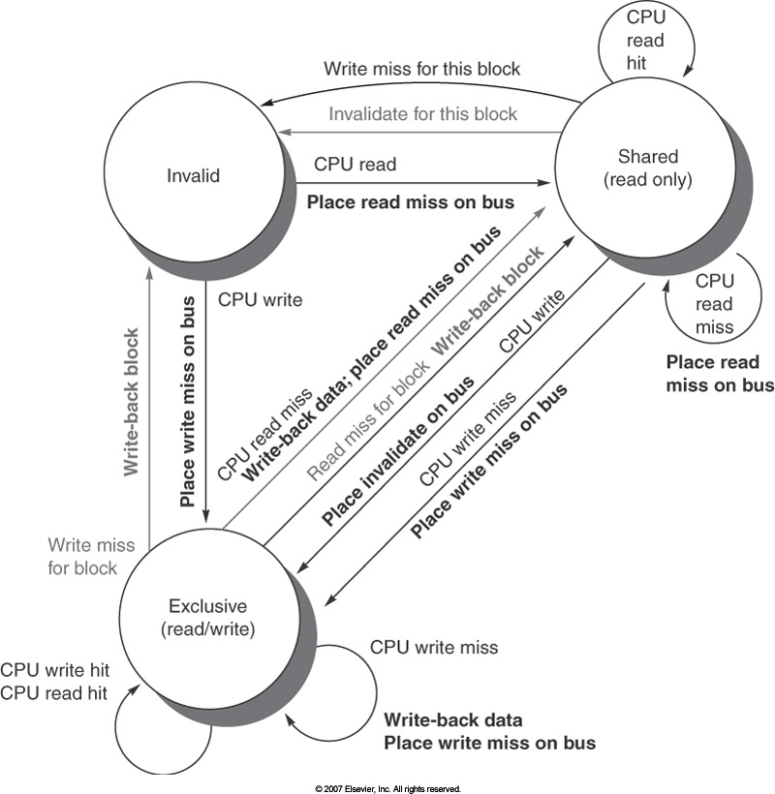
MSI Snoopy Protocol
My RD/WR:
My action
Also called “modified”
Someone else

Slide 15
Review Question
MSI protocol : cache block size is 4B
P1 LDB mem[A]
P2 STB mem[A]
P3 LDB mem[A]
P1 STB mem[A]
P2 STB mem[A]
P3 LDB mem[A]
P1 | P2 | P3
S | X | X
I | M | X
I | S | S
M | I | I
I | M | I
I | S | S

Slide 16
Cache to Cache Transfers
Problem
P1 has block B in M state
P2 wants to read B, puts a RdReq on bus
If P1 does nothing, memory will supply the data to P2
What does P1 do?
Solution 1: abort/retry
P1 cancels P2’s request, issues a write back
P2 later retries RdReq and gets data from memory
Too slow (two memory latencies to move data from P1 to P2)
Solution 2: intervention
P1 indicates it will supply the data (“intervention” bus signal)
Memory sees that, does not supply the data, and waits for P1’s data
P1 starts sending the data on the bus, memory is updated
P2 snoops the transfer during the write-back and gets the block

Slide 17
Cache-To-Cache Transfers
Intervention works if some cache has data in M state
Nobody else has the correct data, clear who supplies the data
What if a cache has requested data in S state
There might be others who have it, who should supply the data?
Solution 1: let memory supply the data
Solution 2: whoever wins arbitration supplies the data
Solution 3: A separate state similar to S that indicates there are maybe others who have the block in S state, but if anybody asks for the data we should supply it

Slide 18
Illinois’ Protocol (MESI)
Bus read/write
cpu read
I
S
cpu read, shared
Bus write
Bus write
Bus read
Bus read
Bus write
cpu write
cpu read, exclusive
cpu write
(write through)
Bus read
M
E
cpu read/write
cpu write
(write back)
cpu read

Slide 19
MESI Protocol (Alternative Version)
Bus read/write
cpu read
I
S
cpu read, shared
Bus write
Bus write
Bus read
Bus read
Bus write
cpu write
cpu read, exclusive
Bus read
M
E
cpu write
cpu read/write
cpu write
(write back)
cpu read

Slide 20
MESI Protocol
New state: exclusive
data is clean
but I have the only copy (except memory)
Benefit: bandwidth reduction
No broadcasting from E→ M because I have copy

Slide 21
MESI Question
MESI protocol : cache block size is 4B
P1 LDB mem[A]
P1 STB mem[A]
P3 LDB mem[A]
P1 STB mem[A]
P2 STB mem[A]
P2 STB mem[A]
P3 LDB mem[A]
P1 | P2 | P3
E | X | X
M | X | X
S | X | S
M | X | I
I | M | I
I | M | I
I | S | S

Slide 22
MOESI
M: Modified (dirty, unique)
I have the only copy, and it’s dirty (memory is stale)
O: Owned (dirty, shared)
I have the most up-to-date copy, others may have copies, too, but I am responsible for sourcing data
E: Exclusive (clean, unique)
I have the only copy (clean)
S: Shared (clean, shared)
Everyone has a clean copy (incl. memory)
I: Invalid

Slide 23
Directory-Based Coherence
Typically in distributed shared memory
For every local memory block, local directory has an entry
Directory entry indicates
Who has cached copies of the block
In what state do they have the block

Slide 24
Basic Directory Scheme
Each entry has
One dirty bit (1 if there is a dirty cached copy)
A presence vector (1 bit for each node) Tells which nodes may have cached copies
All misses sent to block’s home
Directory performs needed coherence actions
Eventually, directory responds with data

Slide 25
Distributed MSI Example
CPU₀
cache
CPU₁
cache
CPU₂
cache
CPU₃
cache
Add 0-0x1000
Add 0x1000-0x2000
Add 0x2000-0x3000
Add 0x3000-0x4000
Dist.Memory₀
Dist.Memory₁
Dist.Memory₂
Dist.Memory₃
Interconnection Network

Slide 26
Read Miss
Processor P_{k} has a read miss on block B, sends request to home node of the block
Directory controller
Finds entry for B, checks D bit
If D=0
Read memory and send data back, set P[k]
If D=1
Request block from processor whose P bit is 1
When block arrives, update memory, clear D bit, send block to P_{k} and set P[k]

Slide 27
Directory Operation
Network controller connected to each bus
A proxy for remote caches and memories
Requests for remote addresses forwarded to home, responses from home placed on the bus
Requests from home placed on the bus, cache responses sent back to home node
Each cache still has its own coherence state
Directory is there just to avoid broadcasts and order accesses to each location
Simplest scheme: If access A1 to block B still not fully processed by directory when A2 arrives, A2 waits in a queue until A1 is done

Slide 28
Shared Memory Performance
Another “C” for cache misses
Still have Compulsory, Capacity, Conflict
Now have Coherence, too
We had it in our cache and it was invalidated
Two sources for coherence misses
True sharing
Different processors access the same data
False sharing
Different processors access different data, but they happen to be in the same block

Slide 29
False Sharing
X and Y are in the same cache block, P1 and P2 are read/write X & Y
time | P1 | P2 | Cache hit,miss ? /Coherence state (P1, P2) [M,S,I]
1 | Read X |  | Miss (S, X)
2 |  | Read X | Miss (S,S)
3 | Write X |  | Hit (M, I)
4 |  | Read X | Miss (S, S)
True Sharing
time | P1 | P2 | Cache hit,miss ? (P1,P2)
1 | Read X |  | Miss (S,X)
2 |  | Read Y | Miss (S,S)
3 | Write X |  | Hit (M, I)
4 |  | Read Y | Miss (S,S)
False Sharing

