Slide 1

ECE 4100/ECE6100 CS4290/6290 Advanced Computer Architecture LOGISTICS & INTRODUCTION
Moinuddin K. Qureshi
ECE, Georgia Tech

Slide 2
Agenda
Syllabus, Course Logistics, Info
Requirements
Introduction
Assignment 1 already posted

Slide 3
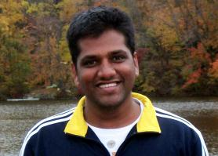
Who am I?
Instructor: Prof. Moinuddin Qureshi
moin@ece.gatech.edu
Office: Klauss 2312
Office Hours:
W:2-3pm (or by appointment)
http://www.ece.gatech.edu/~moin
PhD from UT-Austin, worked at IBM Watson, Intel
Research interests:
Computer Architecture
Memory and storage systems
Emerging Memory Technology
Fault Tolerance
Hardware security

Slide 4
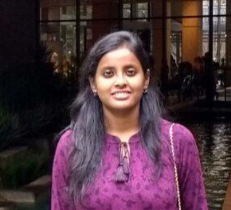
The TAs
????
Poulami Das
poulami@utexas.edu
Time: TBD
(Next to KACB 2332)
The TAs will hold (optional) recitation section (Time/Venue information next week)

Slide 5
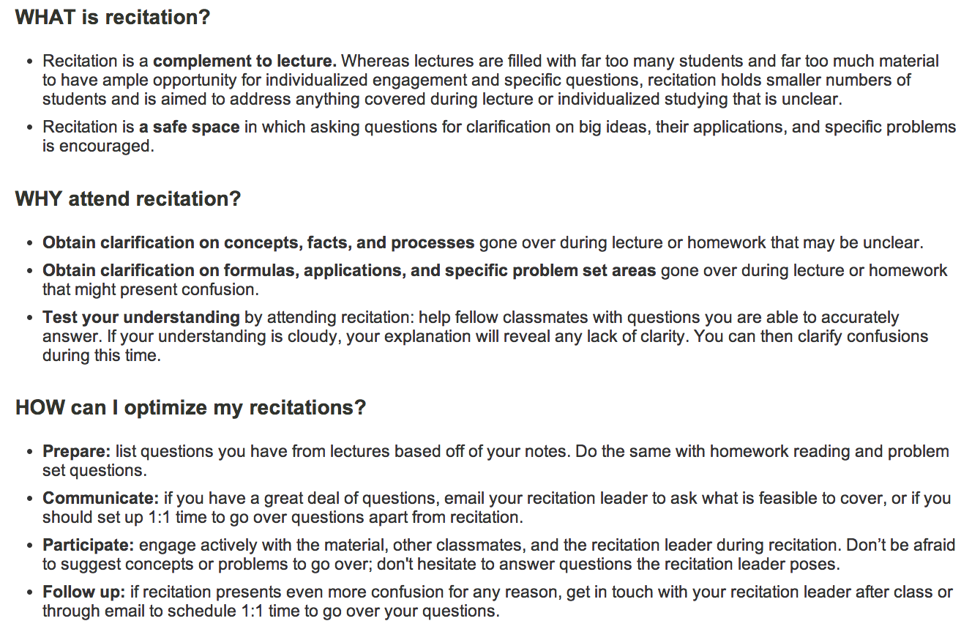
What is a Recitation Section Anyway?
Source:http://web.mit.edu/uaap/learning/lectures/recitations.html

Slide 6
Where to Find Latest Info
T-Square: (check at least once a week)
Upload assignments here
Lecture notes (we won’t be following a text book)
Piazza:
Encouraged for common questions
Try to answer the posted question, if you can
Otherwise TAs will respond (in some time)
Email:
Me or TA if you have any question that are not suited for public forum such as Piazza (E.g why did I get only 20 pts?)

Slide 7
Course about Computer Architecture
Problem
Algorithm
ISA
ISA: Interface between s/w & h/w
u-architecture
Circuits
Electrons

Slide 8
Course Goals
Goal 1: To familiarize computer architecture students and those interested in computer system design with both fundamental design tradeoffs and some of the recent research issues/trends
Goal 2: To provide the necessary background and experience to do design and research in computer system design
Strong emphasis on
Quantitative Evaluations and Trade-offs
Hands on programming assignments

Slide 9
What Do I Expect From You?
Required background: basic architecture (ECE 3056 or equivalent), basic programming (C/C++)
Learn the material, understand it and analyze it
Do the work & work hard
Do the programming assignments
Ask questions, take notes, participate: If we are not discussing, then one way lecture will be boring (for both you and me)
We will have a “No Open Screens” policy in this class

Slide 10
“Electronic Etiquette Policy” for this Class
No open Laptops, Tablets, Phone etc. in lectures.
Why? Several studies [Princeton and U California] show Open Laptops are a hindrance to classroom learning: test scores of students with open
Laptop substantially lower than the students with closed screens
http://www.newyorker.com/tech/elements/the-case-for-banning-laptops-in-the-classroom (6/6/2014)
The open screens affects:
You (hard to be a part of the discussion if your attention is on your screen)
Your fellow students (who may get distracted by your videos of cute kittens)
Professor (more motivated if students are paying attention)
If your screens/texting causes distraction for other students in class, I may have to ask you to leave and return after taking care of what you need to.

Slide 11
Course Grading
Item | Percentage
Lab1 | 5%
Lab2 | 10%
Lab3 | 10%
Lab4 | 10%
Assignment | 2%
HW1 | 1%
HW2 | 1%
Participation | 1%
SubTotal | 40%
Midterm1 | 20%
Midterm2 | 20%
Final Exam | 20%
Total | 100%
Overall score | Grade
90%+ | A
80%+ | B
70%+ | C

Slide 12

Warning!!
This course requires heavy programming
Don’t take too many program/project heavy courses together!
It is 3-credit course but you feel a 4-5 credit course
The most ECE-like course in CS, the most CS-like course in ECE

Slide 13
Zero Tolerance Policy for Cheating
ALL lab assignments are individual
You can discuss ideas with other students
You CANNOT see (or show) other students code
We will use MOSS to detect cases of substantial overlap
http://theory.stanford.edu/~aiken/moss/
Zero on assignment + One grade drop + Report to dean (academic warning in file)
22 students caught in Fall 2012, 22 in Spring 2014, 2 in Fall 2014

Slide 14
Assignments
Assignment 1 already posted
Based on your background knowledge of pipelining
Test you on ability to work with architecture simulators
This is a touchstone for your prerequisite
Due this Friday at 3pm (so that you can drop the course if you find that you do not have the right background)
Get started early (you may not have the set up to do the work on the reference machine: ecelinsrv7.ece.gatech.edu)

Slide 15
Course Schedule (tentative)
 | Tue | Thu | Notes (Due Dates)
Week 1 (21 Aug-) |  |  | LAB1 Due
Week 2 (28 Aug-)
Week 3 (4 Sep-)
Week 4 (11 Sep-)
Week 5 (18 Sep-) |  |  | LAB2 Due
Week 6 (25 Sep-) |  | Midterm1 | SubmitOnlyHW1( Due Tue)
Week 7 (2 Oct-)
Week 8 (9 Oct-) | FallBreak
Week 9 (16 Oct-) |  |  | Lab3 Due (Tue)
Week 10 (23 Oct-) | GUEST | GUEST | MICRO 2018 -- Japan
Week 11 (30 Oct-)
Week 12 (6 Nov-) |  |  | Lab4 Due (Tue)
Week 13 (13 Nov-) |  | Midterm 2 | SubmitOnlyHW2 Due (Tue)
Week 14 (20 Nov-) |  | ThanksGiving
Week 15 (27 Nov-) |  |  | Assignment Due (Tue)
Week 16 (4 Dec-) | Last Class
Final Exam (Sec B) | 6 Dec (2:40pm-)
Final Exam (Sec A/Q) | 11 Dec (2:40pm-)

Slide 16
Difference between 4**0 & 6**0
The Lecture material remains the same
The Lab assignments (Lab2-Lab4) for the undergrad section (4**0) will have reduced requirements.
Extra credit for doing the 6**0 version of the assignments
The midterm will be the same for both 4**0 and 6**0

Slide 17
If you took ECE3056 with me (F14/S17)
You may find that almost half the lecture material is similar
We need to ensure all students have the same level of background
We will build new (advanced) ideas on top of basic background knowledge … so stay patient ☺
The lab assignments are less detail oriented and more at high level

Slide 18
Question
A byte-addressable computer has a 256B data cache. The cache block size is 16 Bytes. When a given program is executed, the processor reads data from the following sequence of hex addresses:
0x0500, 0x0600, 0x0504, 0x604, 0x0508, 0x0608
a. Hit Rate for Direct mapped Cache?
b. Hit Rate for 2-way set associative cache?

Slide 19
Question
Arrange the following structures, in terms of typical storage capacity, starting from lowest to highest:
Register File, I cache, Main Memory, Page Table,
Last level cache, Hard disk, Program counter

Slide 20
Question
a. Alice likes to bike on a hilly terrain. The route she takes has three parts: Uphill of 20 miles, Flat plains of 20 miles, and Downhill of 20 miles. Her speed uphill is 10 miles an hour, on plains it is 20 miles an hour, and downhill it is 30 miles an hour. What is the average speed of Alice along this route?
b. Bob likes to bike in the gym. He bikes for one hour each at three different speeds: 10 miles per hour, 20 miles per hour, and 30 miles per hour. What is the average speed of Bob during this training exercise?

