Slide 1
ECE4100/ECE6100/CS420/CS6290
HW1 Solution

Slide 2
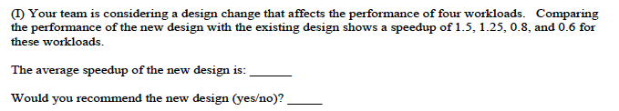
Q1 A
Geomean(1.5, 1.25, 0.8, 0.6) = 0.974
NO

Slide 3

Q1 B
Page size 8KB, means 13 bits for byte in page
There are 2^17 pages, each needing 2^3 bytes of PTE = 2^20=1 MB

Slide 4
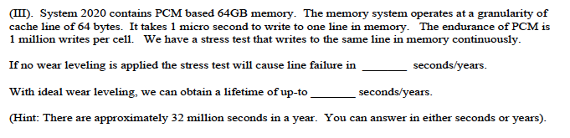
Q1 C
1 million writes per line * 1 micro second per write = 1 second
There are 2^30 lines, each lasting 1 second.
Total lifetime 2^30 seconds or (2^25).(2^5) seconds = 32 years

Slide 5

Q1 D
Each RAT entry (1 valid bit + 8 bit )=9 bits RAT size = 16 * 9 bits = 18 bytes (16 bytes accepted) Physical register file size = 256 registers * 8B = 2048B

Slide 6
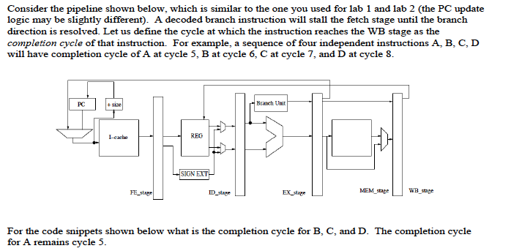
Q2

Slide 7
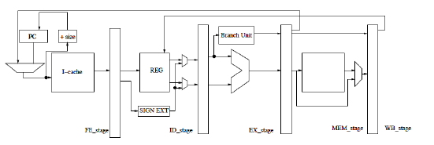
Q2-I
Cyc | FE | ID | EX | M | WB
1 | A
2 | B | A
3 | C | B | A
4 | C | B | * | A
5 | C | B | * | * | A
6 | D | C | B | * | *
7 | D | C | * | B
8 | D | C | * | * | B
9 |  | D | C
10 |  | D | * | C
11 |  | D | * | * | C
12 |  |  | D | * | *
13 |  |  |  | D | *
14 |  |  |  |  | D
A. ADD R3, R2, R1 5
B. ADD R4, R3, R2
C. ADD R5, R4, R3
D. ADD R6, R5, R4
We assumed read/write in same cycle
To register file is okay
If not the answers: 9, 13, 17 (graded okay)

Slide 8
Q2-II
Cyc | FE | ID | EX | M | WB
1 | A
2 | B | A
3 |  | B | A
4 |  |  | B | A
5 | C | * | * | B | A
6 | D | C | * | * | B
7 |  | D | C
8 |  | D | * | C
9 |  | D | * | * | C
10 |  |  | D
11 |  |  |  | D
12 |  |  |  |  | D
13
14
A. ADD R3, R2, R1 5
B. BR (Taken to C)
C. ADD R5, R4, R3
D. ADD R6, R5, R4
In cycle 5
We assumed read/write in same cycle
To register file is okay
If not the answers: 6, 9, 13 (graded okay)

Slide 9
Q2-III
Cyc | FE | ID | EX | M | WB
1 | A
2 | B | A
3 |  | B | A
4 |  | B | * | A
5 |  | B | * | * | A
6 |  |  | B | * | *
7 | C | * | * | B | *
8 | D | C | * | * | B
9 |  | D | C
10 |  | D | * | C
11 |  | D | * | * | C
12 |  |  | D | * | *
13 |  |  |  | D
14 |  |  |  |  | D
A. ADD R3, R2, R1 5
B. BNEZ R3 (Taken to C)
C. ADD R5, R4, R3
D. ADD R6, R5, R4
In cycle 7
We assumed read/write in same cycle
To register file is okay
If not the answers: 9, 12, 16 (graded okay)

Slide 10
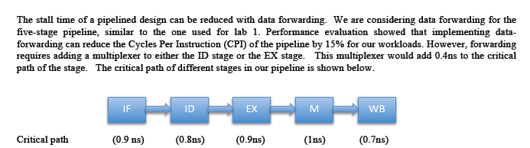
Q3: Forwarding and Balanced Pipeline

Slide 11
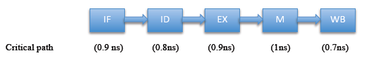

Q3-I
The M stage will determine frequency, 1ns so 1GHz

Slide 12
Q3-II
ID stage critical path now: 0.8+0.4=1.2ns
Frequency now, 1/1.2ns = 833MHz
NewTime = 0.85 (New CPI) * 1/0.833 (New Freq) = 1.02
Speedup = OldTime/NewTime = 1/1.02 = 0.98

Slide 13
Q3-III
EX stage critical path now: 0.9+0.4=1.3ns
Frequency now, 1/1.3ns = 770 MHz
NewTime = 0.85 (New CPI) * 1/0.77 (New Freq) = 1.105
Speedup = OldTime/NewTime = 1/1.105 = 0.90

Slide 14

Q3-IV
C. Both A and B cause slowdown

Slide 15
Q3-IV
Yes, recommendation changes to A (implement in ID stage)
Critical path of ID now is 1ns ➔ No change in frequency
NewTime = 0.85 Speedup = 1/0.85 = 1.17x

Slide 16
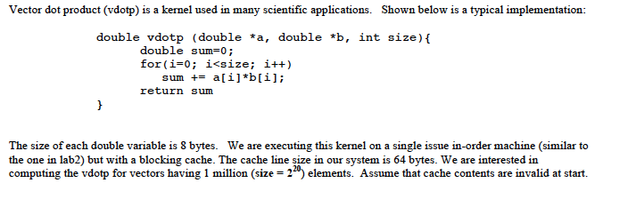
Q4-I
2^20 elements ➔ 2^17 cache lines (element 8B, cache line 64B)
Cache misses 2^17 each for A and B = 2^18

Slide 17

Q4-II
There are four lines in the row buffer
Rowbuf sequence Miss, Hit, Hit Hit, Miss, Hit, Hit, Hit
Average latency (100+50+50+50)/4 = 62.5 cycles

Slide 18
Q4-III
25% probability of bank collision: Each access takes 100 cycles
75% probability of no bank collision: Average latency of 62.5 cycles
So, average now = (0.25*100)+(0.75*62.5)= 71.8 cycles

Slide 19
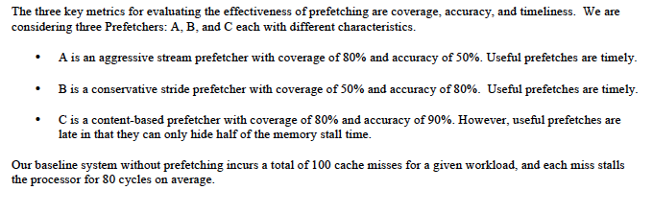
Q5

Slide 20
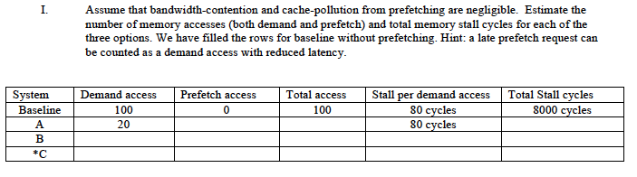
Q5-A
A has a coverage of 80%, that means it eliminates 80% of the misses
However, accuracy is 50%, that means it sent 160 accesses to avoid 80 misses
Prefetch accesses do not stall the processor, only demand access do
Total access: 180 Total stall cycles: 20*80=1600 cycles

Slide 21
Q5-B
B has a coverage of 50%, that means it eliminates 50% of the misses
However, accuracy is 80%, that means it sent 50*(1/0.8)=63 prefetch request
Demand access: 50, Prefetch access: 63,
Total access: 113 (50+63)
Total stall cycles: 50*80=4000 cycles

Slide 22
Q5-C
C sent out 80 good prefetches (coverage of 80%)
To do this, it actually had to send out 80*(1/0.9)= 88 prefetches
There are 20 demand accesses (full latency) + 80 demand accesses (half latency)
Demand access: 20 + 80* (half latency ones)
Prefetch access: 88, Total access: 20+88=108 (don’t double count late prefetches)
Total stall cycles: (20*80 cycles)+(80*40 cycles)=4800 cycles

Slide 23

Q5-II
Under our assumptions, A provides the best performance
Stall cycles for A=1600, B= 4000, C=4800
We specified that the system has enough bandwidth such that the bandwidth contention from prefetching is negligible. For some systems this is true, for others it is not. If system is bandwidth constrained then a highly accurate Prefetcher is desirable.

Slide 24
Q1 A
We have three workloads (X, Y, and Z) each containing the same number of instructions. The IPC for X is 1, for Y is 0.5, and for Z is 2. A new design option can change the IPC of X to 2, Y to 0.25, and Z to 4, while maintaining the same frequency as before.
What is the average IPC before the design change? HMEAN(1,0.5,2) = 0.857
What is the average IPC after the design change? HMEAN(2,0.25,4) = 0.63
Would you recommend this design change (yes/no)? NO

Slide 25

Q1 B
Page size 4KB, means 12 bits for byte in page
There are 2^28 pages, each needing 2^2 bytes of PTE = 2^30=1 GB
To reduce size: Make Multi-Level Page Tables (or increase Page Size)

Slide 26
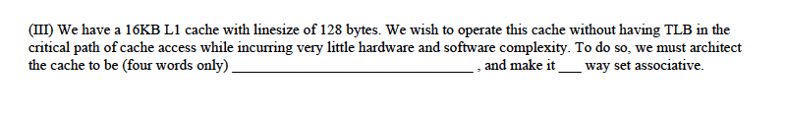
Q1 C
Virtually Indexed Physically Tagged and Four Way

Slide 27
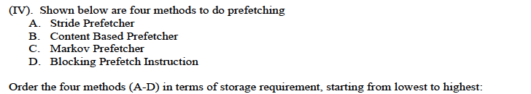
Q1 D
C needs most storage
D does not require storage (lowest)
B requires current virtual address
A requires past line address and stride (two fields)
So, DBAC (DABC is okay too)

Slide 28
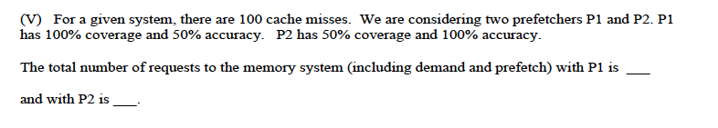
Q1 E
P1: Sends 2x requests, so to hide 100 misses, it will send 200
P2: 50 prefetch requests + 50 demand requests: so 100

Slide 29
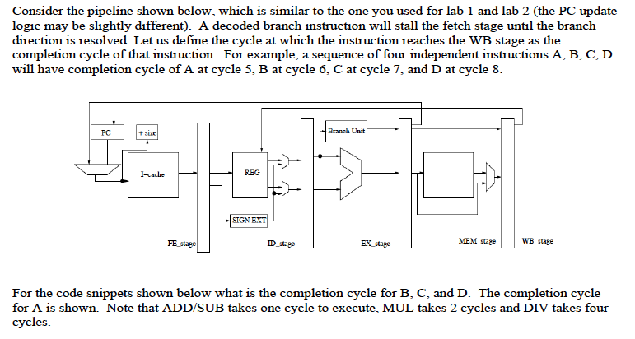
Q2

Slide 30
Q2-I
Cyc | FE | ID | EX | M | WB
1 | A
2 | B | A
3 | C | B | A
4 | C | B | * | A
5 | C | B | * | * | A
6 | C | B (R3) | * | * | *
7 | D | C | B(E1) | * | *
8 | D | C | B(E2) | * | *
9 | D | C | * | B | *
10 | D | C | * | * | B
11 |  | C(R4) |  | * | *
12 |  | D | C(E1) | * | *
13 |  | D | C(E2) | * | *
14 |  |  | C(E3) | * | *
15 |  |  | C(E4)
16 |  |  | * | C
17 |  |  | * | * | C
18 |  | D(R5) |  | * | *
19 |  |  | D |  | *
20 |  |  |  | D
A. ADD R3, R2, R1 5
B. MUL R4, R3, R2 10
C. DIV R5, R4, R3 17
D. SUB R6, R5, R4 21
We assumed read/write in same cycle
To register file is not allowed
If yes the answers: 9, 15, 18 (graded okay)

Slide 31
Q2-II
 | FE | ID | EX | M | WB
1 | A
2 | B | A
3 |  | B | A
4 |  |  | B | A
5 | C | * | * | B | A
6 | D | C | * | * | B
7 |  | D | C
8 |  | D | * | C
9 |  | D | * | * | C
10 |  | D(R5)
11 |  |  | D
12 |  |  |  | D(E1)
13 |  |  |  | D(E2)
14 |  |  |  |  | D
A. SUB R3, R2, R1 5
B. BR (Taken to C)
C. ADD R5, R4, R3
D. MUL R6, R5, R4
In cycle 5
We assumed read/write in same cycle
To register file is not allowed
If yes the answers: 9, 9, 13 (graded okay)

Slide 32
Q2-III
Cyc | FE | ID | EX | M | WB
1 | A
2 | B | A
3 | ? | B | A
4 | ? | B | * | A
5 | ? | B | * | * | A
6 | ? | B (R3) | * | * | *
7 | ? | * | B | * | *
8 | C | * | * | B | *
9 | D | C | * | * | B
10 |  | D | C(E1) | *
11 |  | D | C(E2) | * | *
12 |  | D | C(E3) | * | *
13 |  | D | C(E4) | * | *
14 |  | D |  | C | *
15 |  | D |  | * | C
16 |  | D(R5) | * | *
17 |  |  | D(E1) | *
18 |  |  | D(E2 | * | *
19 |  |  | D(E3) |  | *
20 |  |  | D(E4)
A. SUB R3, R2, R1 5
B. BNEZ R3 (Taken to C)9
C. DIV R5, R4, R3 15
D. DIV R6, R5, R4 22
In cycle 8
We assumed read/write in not done in same
Cycle.
If yes the answers: 8, 14, 20 (graded okay)

Slide 33
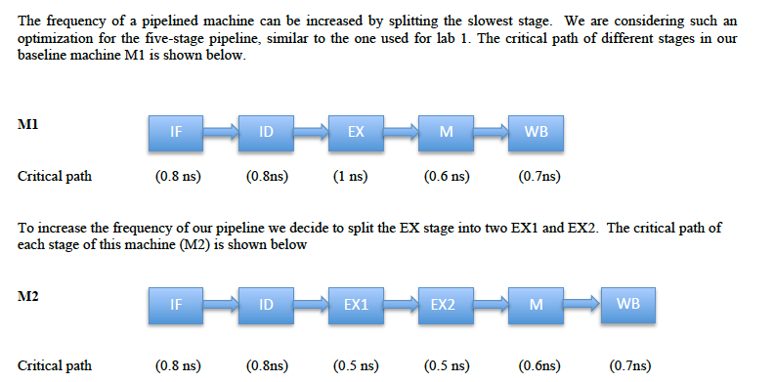
Q3: Balanced Pipeline

Slide 34
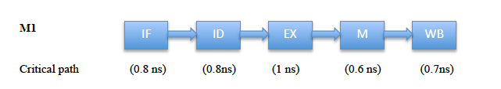
Q3-I
The EX stage will determine frequency, 1ns so 1GHz

Slide 35
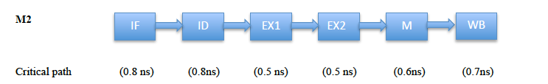
Q3-II
IF/ID stage have critical path: 0.8ns, so 1.25GHz

Slide 36

Q3-III to V
EX stage critical path now: 0.9+0.4=1.3ns
Speedup = 1.25GHz/1GHz = 1.25x
Control (and Data) dependencies take longer to resolve
BIPS1 = IPC1*Freq1 = 0.8*1 = 0.8
BIPS2 = IPC2 *Freq2 = 2/3 * 5/4 = 10/12
Speedup = BIPS2/BIPS1 = 100/96 = 1.04

Slide 37
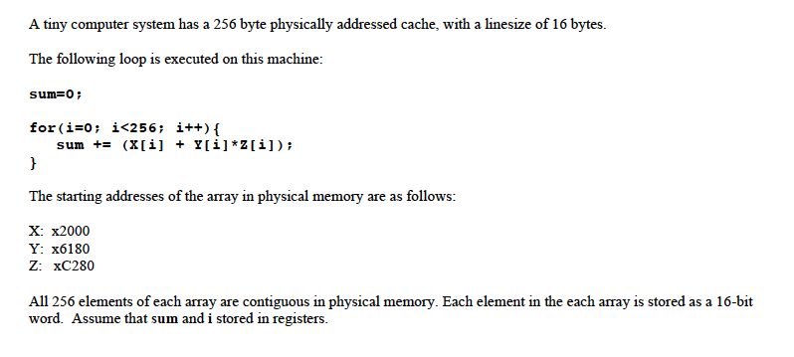
Q4
2^20 elements ➔ 2^17 cache lines (element 8B, cache line 64B)

Slide 38
Q4-I
Convert the starting address to binary
X: 0010 0000 0000 0000
Y: 0110 0001 1000 0000
Z: 1100 0010 1000 0000
The last four bits are for byte in block, the next four are for cache index
(cache has 16 blocks, and is direct mapped)
Y an Z conflict in the cache, so they will always miss
X will have a miss followed by seven hits (cache block has eight words)
So hit rate is 7/8+0/8+0/8 = 7/24

Slide 39
Q4-II
Convert the starting address to binary
X: 0010 0000 0000 0000
Y: 0110 0001 1000 0000
Z: 1100 0010 1000 0000
The last four bits are for byte in block, the next THREE are for cache index
(cache has 16 blocks, two way means the cache has 8 sets)
X,Y, and Z all conflict. Hit rate is 0

Slide 40
Q4-III and IV
Make it four way set associative so that X Y and Z can co exist (three elements
In four ways)
The hit rate for X, Y, and Z will be 7/8 (Miss followed by seven hits)
So, overall hit rate will be 7/8

Slide 41
Exam 3-- Q1 A
(A) You are considering a micro-architectural change that will yield different speedups for four different benchmarks. The speedup for the four benchmarks is as follows: 1.1x, 1.2x, 1.3x, 0.5x.
i. What is the average speedup? ______
GEOMEAN(1.1,1.2,1.3,0.5)=0.9624
ii. Would you implement the technique (yes/no)? no

Slide 42
Q1B
(B) The Haswell processor from Intel has an L1 data cache that is 32KB. Intel processors use a cache linesize of 64 bytes, and can support a pagesize of 4KB. The design can access the L1 cache without having the TLB access in the critical path while incurring very little hardware and software complexity. To do so, the L1 cache must have been designed as a “VIRTUALLY Indexed PHYSICALLY Tagged” cache, and it must be architected as at least a _8_way set-associative structure.

Slide 43
Q1C
The accuracy of branch predictors can be increased by a hybrid approach, which combines multiple predictors. We have a base predictor B that has an accuracy of 80%. We have a choice of combining it with either predictor X or predictor Y.
Predictor X has an accuracy of 60%, however half of the time when B is incorrect X is correct.
Predictor Y has an accuracy of 80%, however quarter of the time when B is incorrect Y is correct.
Which predictor (if any) should be combined with predictor B? _X__
What is the branch prediction accuracy of this combination (assuming perfect meta predictor)? _90%___

Slide 44
Q1D
(D) The advantage of Loop unrolling is (in six words or less):
Better scheduling and fewer instructions
And, the disadvantage is (in six words or less): Code Bloat

Slide 45
Q1E
We want to implement register renaming for a machine that has 32 architectural registers, each 8 byte wide. We are considering 512 physical registers. The total size of the Register Alias Table (RAT) for this machine will be __40____ bytes. The size of the physical register file will be __4096___ bytes.

Slide 46
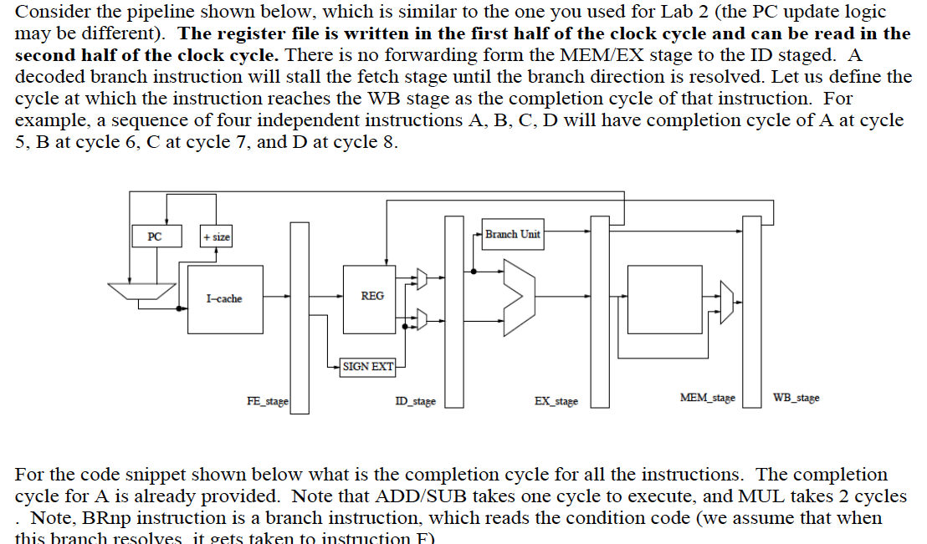

Slide 47
Cycle Num | FETCH | DECODE | EXECUTE | MEMORY | WBACK
1 | A
2 | B | A
3 | C | B | A
4 | C | B |  | A
5 | C | B(OK) |  |  | A
6 | D | C | B(MUL1)
7 | D | C | B(MUL2)
8 | D | C |  | B
9 | D | C(OK) |  |  | B
10 | D | D | C
11 | E | D |  | C
12 | E | D (OK) |  |  | C
13 | E |  | D
14 | F |  |  | D(Fetch F)
15 |  | F |  |  | D
16 |  |  | F
17 |  |  |  | F
18 |  |  |  |  | F

Slide 48
Q3
What is the clock frequency at which M1 can operate?
1/2.5ns = 400MHz
B) What is the clock frequency at which M2 can operate?
1/3ns = 333MHz
C) Which design would you recommend? M1 (faster)
D) Speedup of this machine wrt baseline? 400MHz/100MHz=4x

Slide 49
Q4
A. AMAT for design X? = 1+0.1*100=11 cycles B. AMAT for design Y? = 10+0.02*100=12 cycles C. AMAT for design Z?
Assume 100 accesses, out of which 90 will hit in L1, 2 will miss L2, and the remaining 8 will miss in L1 and hit in L2.
For 100 accesses we need (90*1) + (8*11) + (2*111) = 400 cycles
So, average is 400 /100=4 cycles
D. Which design would for you recommend? = Z (lowest AMAT)

Slide 50
Q5
Assume 100 iterations of this loop.
Predication will need 100*(110 instructions/per loop)=11000
There will be 20 mispredictions, each costing 100 inst. So,
Bpred will need (100*100) + (20*100, mispred) = 12000
So, predication is better
B. Same as above, but now there are only 5 mispredictions
So, the number of instructions with prediction remains 11000
With Bpred, it will be (100*100)+(5*100, mispred) =10500
So, branch prediction is better

Slide 51
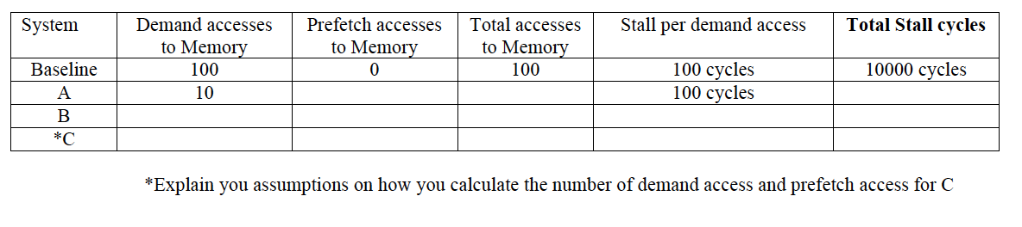
Q6
225
235
10*100=1000
60
44
104
100
60*100=6000
20 full+ 80 half
80
100
100 for full, 50 for half
6000
Which design would you recommend? A, as it has the lowest stall time

