Slide 1
ECE4100/ECE6100/CS420/CS6290
Thanks to Prof. Kim for slides

Slide 2
What to do with branches?
-Eliminate branches
Predication (more on later)
Delayed branch slot
SPARC, MIPS
Dual-path execution (more on later)
Or predict? ☺

Slide 3
Control Dependencies
Branches are very frequent
Approx. 20% of all instructions
Can not wait until we know where it goes
Long pipelines
Branch outcome is known after B cycles
No scheduling past the branch until outcome known
Superscalars (e.g., 4-way)
Branch every cycle or so!
One cycle of work, then bubbles for ~B cycles?

Slide 4
Surviving Branches: Prediction
Predict Branches
And predict them well!
Fetch, decode, etc. on the predicted path
Option 1: No execution until branch is resolved
Option 2: Execute anyway (speculation)
Recover from mispredictions
Restart fetch from correct path

Slide 5
Branch Prediction
Need to know two things
Whether the branch is taken or not (direction)
The target address if it is taken (target)
Direct jumps, Function calls: unconditional branches
Direction known (always taken), target easy to compute
Conditional Branches (typically PC-relative)
Direction difficult to predict, target easy to compute
Indirect jumps, function returns
Direction known (always taken), target difficult

Slide 6
Branch Prediction: Direction
Needed for conditional branches
Most branches are of this type
Many, many kinds of predictors for this
Static: fixed rule, or compiler annotation (e.g. br.bwh (branch whether hint. IA-64))
Dynamic: hardware prediction
Dynamic prediction usually history-based
Example: predict direction is the same as the last time this branch was executed

Slide 7
Static Prediction
Always predict NT
easy to implement
30-40% accuracy … not so good
Always predict T
60-70% accuracy
BTFNT
loops usually have a few iterations, so this is like always predicting that the loop is taken
don’t know target until decode

Slide 8
One-Bit Branch Predictor: Last-time predictor
Branch history table of 2^K entries, 1 bit per entry
K bits of branch instruction address
Index
Use this entry to predict this branch:
0: predict not taken
1: predict taken
When branch direction resolved, go back into the table and update entry: 0 if not taken, 1 if taken

Slide 9
One-Bit Branch Predictor (cont’d)
0xDC08: for(i=0; i < 100000; i++)
{
0xDC44: if( ( i % 100) == 0 )
CountHundred( );
0xDC50: if( (i & 1) == 1)
CountOddNums( );
}
T
N
T

Slide 10
The Bit Is Not Enough!
Example: short loop (8 iterations)
Taken 7 times, then not taken once
Not-taken mispredicted (was taken previously)
Act: TTTTTTTNTTTTTTNTTTTTTTNT…
Pred: XTTTTTTTNTTTTTTNTTTTTTTN
Corr: Xooooo MMooooooMMooooooMM
Misprediction rate: 2/8 = 25%
Execute the same loop again
First always mispredicted (previous outcome was not taken)
Then 6 predicted correctly
Then last one mispredicted again
Each fluke/anomaly in a stable pattern results in two mispredicts per loop

Slide 11
Examples
DC08: TTTTTTTTTTT ... TTTTTTTTTTNTTTTTTTTT …
100,000 iterations
NT
How often is branch outcome != previous outcome?
2 / 100,000
TN
99.998%
Prediction
Rate
DC44: TTTTT ... TNTTTTT … TNTTTTT …
2 / 100
98.0%
DC50: TNTNTNTNTNTNTNTNTNTNTNTNTNTNT …
2 / 2
0.0%

Slide 12
Two Bits are Better Than One
Predict NT
Predict T
Transistion on T outcome
2
3
Transistion on NT outcome
0
1
0
1
FSM for Last-time
Prediction
FSM for 2bC
(2-bit Counter)

Slide 13
Example
1bC:
Initial Training/Warm-up
0
1
1
1
1
…
1
1
0
1
1
…
T
T
T
T
T
T
N
T
T
T
✗
✓
✓
✓
✓
✓
✗
✗
✓
✓
2bC:
0
1
2
3
3
…
3
3
2
3
3
…
T
T
T
T
T
T
N
T
T
T
✗
✗
✓
✓
✓
✓
✗
✓
✓
✓
2
3
Only 1 Mispredict per N branches now!
DC08: 99.999% DC44: 99.0%
0
1

Slide 14
Importance of Branches
98% → 99%
Who cares?
Actually, it’s 2% misprediction rate → 1%
That’s a halving of the number of mispredictions
So what?
If a pipeline can fetch 5 instructions at a cycle and the branch resolution time is 20 cycles
To Fetch 500 instructions
100 accuracy : 100 cycles
98 accuracy:
100 (correctly fetch) + 20 (misprediction)*10 = 300 cycles
99 accuracy
100 (correctly fetch) + 20 misprediction *5 = 200 cycles

Slide 15
Two-level Branch Predictor
Pattern History Table
00 …. 00
1 1 ….. 1 0
00 …. 01
2
3
previous one
00 …. 10
BHR
(branch history register)
0
1
index
11 …. 11
Yeh&patt’92

Slide 16
BHR (Branch History Register)
Initialization value (0 or 1)
Old history
New history
0 0 0 0 0 0
1 : branch is taken
0: branch is not-taken
History length
New BHR = old BHR<<1 | (br_dir)
Example
BHR: 00000
Br1 : taken → BHR 00001
Br 2: not-taken → BHR 00010
Br 3: taken → BHR 00101

Slide 17
Why does Global Predictor Work?
PHT
Branches are correlated
Branch X: if (cond1)
….
Branch Y: if (cond 2)
….
Branch Z : if (cond 1 and cond 2)
BHR
…….1 0
…….1 1
Branch X | Branch Y | Branch Z
1 | 0 | 0
1 | 1 | 1
0 | 1 | 0
0 | 0 | 0
…….01
…….00

Slide 18
Gshare Branch Predictor
2bc
1 1 ….. 1 0
2bc
BHR
2bc
index
XOR
0x809000
PC
2bc
McFarling’93
Predictor size: 2^(history length)*2bit

Slide 19
Exercise
There are three static branches, br1, br2, br3. dynamic branch trace is T,N,T,T,T,T,N,N,T (br1,br2, br3 is repeated three times). 3 bit BHR (start from 000).
PC addresses of the branches are 1,2,3 respectively.

Slide 20
Agree Predictor
Most branches are biased
Interference in PHT entries
Constructive (T+T, or N+N)
Destructive (T+N, or N+T)
Agree predictor ➔ Check if branches agree with Bias direction (most entries will agree)
Reduces destructive interference in PHT

Slide 21
Global vs. Local Branch History
Local Behavior
What is the predicted direction of Branch A given the outcomes of previous instances of Branch A?
Global Behavior
What is the predicted direction of Branch Z given the outcomes of all* previous branches A, B, …, X and Y?
* number of previous branches tracked limited by the history length

Slide 22
Tournament Predictors (Hybrid predictor)
No predictor is clearly the best
Different branches exhibit different behaviors
Some “constant”, some global, some local
Idea: Let’s have a predictor to predict which predictor will predict better ☺

Slide 23
Tournament Hybrid Predictors
Pred₀
Pred₁
Meta-
Predictor
table of 2-/3-bit counters
Pred₀ | Pred₁ | Meta Update
✗ | ✗ | ---
✗ | ✓ | Inc
✓ | ✗ | Dec
✓ | ✓ | ---
Final Prediction
If meta-counter MSB = 0,
use pred₀ else use pred₁

Slide 24
Common Combinations
Global history + Local history
“easy” branches + global history
2bC and gshare
short history + long history
Many types of behaviors, many combinations

Slide 25
Perceptron Predictor
Use machine learning to train a branch predictor
Outcome is not always taken or not-taken
Train weight factors
Requires much smaller storage
Negative: complex calculation (solution: pipelining), linearly inseperable (solution: piece-wise linear predictor)

Slide 26
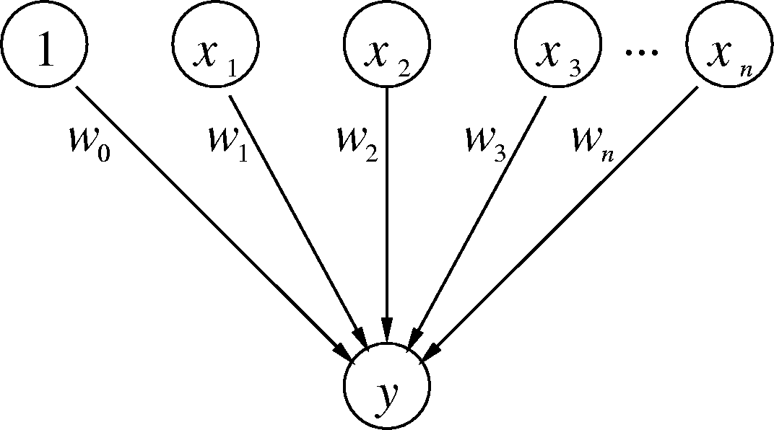
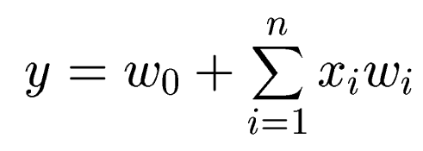
Branch-Predicting Perceptron
Inputs (x’s) are from branch history and are -1 or +1
n + 1 small integer weights (w’s) learned by on-line training
Output (y) is dot product of x’s and w’s; predict taken if y ≥ 0
Training finds correlations between history and outcome
from D. Jimenez’s slides

Slide 27
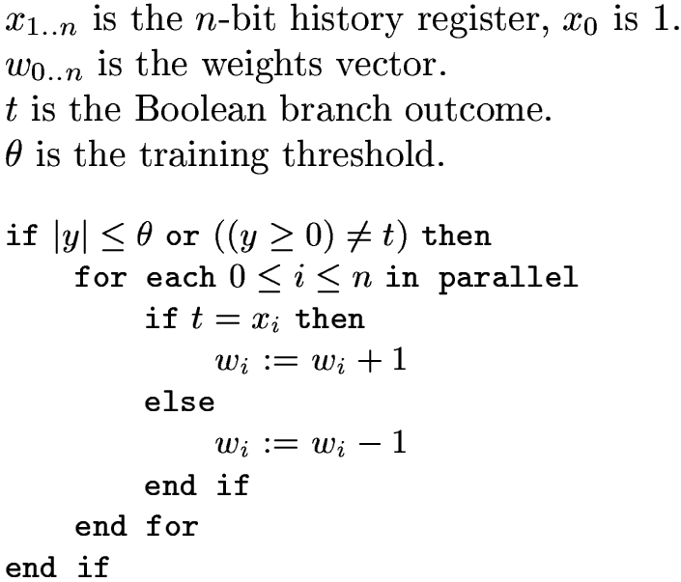
Training Algorithm
from D. Jimenez’s slides

Slide 28
What Do The Weights Mean?
The bias weight, w₀:
Proportional to the probability that the branch is taken
Doesn’t take into account other branches; just like a Smith predictor
The correlating weights, w₁ through w_{n}:
w_{i} is proportional to the probability that the predicted branch agrees with the i^{th} branch in the history
The dot product of the w’s and x’s
w_{i} × x_{i} is proportional to the probability that the predicted branch is taken based on the correlation between this branch and the i^{th} branch
Sum takes into account all estimated probabilities
What’s θ?
Keeps from overtraining; adapt quickly to changing behavior
from D. Jimenez’s slides

Slide 29
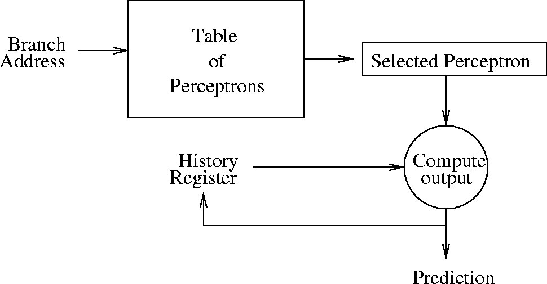
Organization of the Perceptron Predictor
Keeps a table of m perceptron weights vectors
Table is indexed by branch address modulo m
[Jiménez & Lin, HPCA 2001]
from D. Jimenez’s slides

Slide 30
Seznec’s Predictors: OGEHL
The basis (inspired by earlier work on multiple tables and combining)
TO
T1
T2
?
L(0)
L(1)
T3
L(2)
T4
L(3)
L(4)

Slide 31
GEometric History Length predictor
The set of history lengths forms a geometric series
Capture correlation
on very long histories
{0, 2, 4, 8, 16, 32, 64, 128}
most of the storage
for short history !!
What is important: L(i)-L(i-1) is drastically increasing

Slide 32
TAGE: Geometric history length + partial tags + optimized update policy
pc
pc
h[0:L1]
pc
h[0:L2]
pc
h[0:L3]
hash
hash
hash
hash
hash
hash
ctr
tag
ctr
tag
ctr
tag
u
u
u
=?
=?
=?
1
1
1
1
1
1
1
Tagless base
predictor
1
1
prediction

Slide 33
TAGE
Considered the state-of-the-art in branch prediction
Winner of Championship Branch Prediction (2006, 2011, 2014)
Some variant of TAGE likely to be in modern processors
For more detailed working, check out these papers:
A. Seznec, Pierre Michaud “A Case for (partially) tagged Geometric History Length Branch Prediction”, JILP 2006
A. Seznec, “A 256Kbits L-TAGE Predictor” in CBP-2, 2006

Slide 34
Target Address Prediction
Branch Target Buffer
IF stage: need to know fetch addr every cycle
Need target address one cycle after fetching a branch
For some branches (e.g., indirect) target known only after EX stage, which is way too late
Even easily-computed branch targets need to wait until instruction decoded and direction predicted in ID stage (still at least one cycle too late)
So, we have a fast predictor for the target that only needs the address of the branch instruction

Slide 35
Branch Target Buffer
BTB indexed by instruction address (or fetch address)
We don’t even know if it is a branch!
If address matches a BTB entry, it is predicted to be a branch
BTB entry tells whether it is taken (direction) and where it goes if taken
BTB takes only the instruction address, so while we fetch one instruction in the IF stage we are predicting where to fetch the next one from
Direction prediction can be factored out into separate table

Slide 36
Branch Target Buffer

Slide 37
Prediction at Fetch Stage with BTB
Direction predictor (2-bit counters, etc.)
taken?
PC + inst size
Next Fetch
Address
Program
Counter
hit?
Address of the
current branch
target address
Cache of Target Addresses (BTB: Branch Target Buffer)

Slide 38

Function Calls
main()
{
foo();
printf(“still hungry\n”);
….
foo();
printf(“full\n”);
}
foo(){
…..
return
}
BTB
??

Slide 39
Return Address Stack (RAS)
Function returns are frequent, yet
Address is difficult to compute (have to wait until EX stage done to know it)
Address difficult to predict with BTB (function can be called from multiple places)

Slide 40
Function Calls
foo(){
…..
return
}
main()
{
foo();
printf(“still hungry\n”);
….
foo();
printf(“full\n”);
}
0x800
0x804
0x900
0x904

Slide 41
Return Address Stack (RAS)
But return address is actually easy to predict
It is the address after the last call instruction that we haven’t returned from yet
Hence the Return Address Stack

Slide 42
Function Calls
foo(){
…..
return
}
main()
{
foo();
printf(“still hungry\n”);
….
foo();
printf(“full\n”);
}
0x800
0x804
0x900
0x904
0x804
0x904

Slide 43
Return Address Stack (RAS)
Call pushes return address into the RAS
When a return instruction decoded, pop the predicted return address from RAS
Accurate prediction even w/ small RAS

Slide 44
LOOP Branches
for (ii =0; ii < 10; ii++)
{
…
}
Loop branch is iterated 10 times all the time
Special treatment for loop branches

Slide 45
Options
Prepare to branch (HPL-PD)
Software gives hints to the hardware about what the branch target will be. It saves us the target prediction since it has already been written into one of the target registers.
Special Loop predictor (Intel’s Pentium M)
Detect a loop branch
Train the max iteration counter value

Slide 46
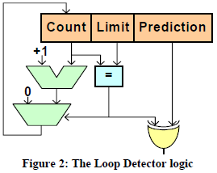
Pentium-M (cont’d)
Local component also has support for loops
accurately predict branches of the form (T^{k}N)*

Slide 47
Direct vs. Indirect Branch
A
A
R1 = MEM[R2]
branch R1
N
br.cond TARGET
T
?
TARG
A+1
α
β
δ
ρ
Conditional (Direct) Branch
Indirect Branch
Use the BTB
A special indirect branch predictor (Intel’s Core-2)

Slide 48
Indirect Branch Predictors
Tagged Target Cache (Chang‘97)
Target Cache
History Information
Target address
Branch Address
Hash Function

Slide 49
Avoiding Branch Prediction
Predicated Execution
Dual-path execution
When you see a low-confidence branch, start to fetch from only two paths
See another low-confidence branch?
Ignore and just keep only two paths
Multi-path execution
Whenever it sees a low-confidence branch, forks

Slide 50
Predication (Predicated Execution)
Idea: Compiler converts control dependency into a data dependency → branch is eliminated
Each instruction has a predicate bit set based on the predicate computation
Only instructions with TRUE predicates are committed (others turned into NOPs)
(normal branch code)
(predicated code)
A
T
N
A
if (cond) {
b = 0;
}
else {
b = 1;
}
C
B
B
C
D
D
A
p1 = (cond)
branch p1, TARGET
A
p1 = (cond)
(!p1) mov b, 1
(p1) mov b, 0
B
B
mov b, 1
jmp JOIN
C
C
TARGET:
mov b, 0
D
add x, b, 1
D
add x, b, 1

Slide 51
Predicated Execution (II)
Predicated execution can be high performance and energy-efficient
Predicated Execution
A
Fetch Decode Rename Schedule RegisterRead Execute
C
B
F
E
E
F
D
F
D
E
F
C
A
B
A
E
F
C
D
B
F
D
E
B
C
A
F
E
C
D
A
B
E
D
B
C
A
D
C
A
B
C
B
A
B
A
E
A
A
F
D
E
F
C
D
E
B
C
D
A
B
A
C
D
A
B
B
A
C
C
B
nop
Branch Prediction
D
Fetch Decode Rename Schedule RegisterRead Execute
F
E
D
B
A
E
Pipeline flush!!
F

Slide 52
Predicated Execution (III)
Advantages:
+ Eliminates mispredictions for hard-to-predict branches
+ No need for branch prediction for some branches
+ Good if misprediction cost > useless work due to predication
+ Enables code optimizations hindered by the control dependency
+ Can move instructions more freely within predicated code
Disadvantages:
-- Causes useless work for branches that are easy to predict
-- Reduces performance if misprediction cost < useless work
-- Adaptivity: Static predication is not adaptive to run-time branch behavior. Branch behavior changes based on input set, phase, control-flow path.
-- Additional hardware and ISA support
-- Cannot eliminate all hard to predict branches
-- Loop branches?

Slide 53
Conditional Move Operations
Very limited form of predicated execution
CMOV R1 ← R2
R1 = (ConditionCode == true) ? R2 : R1
Employed in most modern ISAs (x86, Alpha)

Slide 54
Dual-path Execution
Dual-path
A
Low-confidence
path 1
path 2
C
B
C
B
D
D
D
E
Low-confidence
E
E
F
G
F
F

Slide 55
Multi-path Execution
Multi-path
A
Low-confidence
path 1
path 2
C
B
C
B
D
D
D
E
Low-confidence
E
E
path 3
path 4
F
G
F
G
F
G
H
I
H
I
H
I

Slide 56
High-Bandwidth Fetch: Collapsing Buffer
Fetch from two cache blocks, rotate, collapse past taken branches
Thomas M. Conte, Kishore N. Menezes, Patrick M. Mills and Burzin A. Patel. Optimization of Instruction Fetch Mechanisms for High Issue Rates. International Symposium on Computer Architecture, June 1995.

Slide 57
High-Bandwidth Fetch: Trace Cache
Fold out taken branches by tracing instructions as they commit into a fill buffer
Eric Rotenberg, S. Bennett, and James E. Smith. Trace Cache: A Low Latency Approach to High Bandwidth Instruction Fetching. MICRO, December 1996.

Slide 58
Intel Pentium 4 Trace Cache
No first-level instruction cache: trace cache only
Trace cache BTB identifies next trace
Miss leads to fetch from level two cache
Trace cache instructions are decoded (uops)
Cache capacity 12k uops
Overwhelmed for database applications
Serial decoder becomes performance bottleneck

