Slide 1
ECE4100/ECE6100/CS4290/CS6290
Thanks to Prof. Kim, Prof. Loh & Prof. Prvulovic

Slide 2
Amdahl’s Law
If we help only a limited portion of the execution time, then the portion we do not help starts to dominate
Serial
Parallel (P)
Serial
P/2
Serial
P/4
Max Speedup =
1
(S+P/N)
Serial
P/8
Serial
P/infinity

Slide 3
Multiprocessing
Flynn’s Taxonomy of Parallel Machines
How many Instruction streams?
How many Data streams?
SISD: Single I Stream, Single D Stream
A uniprocessor
SIMD: Single I, Multiple D Streams
Each “processor” works on its own data
But all execute the same instrs in lockstep
E.g. a vector processor or MMX, CUDA

Slide 4
Flynn’s Taxonomy
MISD: Multiple I, Single D Stream
Not used much
Stream processors are closest to MISD
MIMD: Multiple I, Multiple D Streams
Each processor executes its own instructions and operates on its own data
This is your typical off-the-shelf multiprocessor (made using a bunch of “normal” processors)
Includes multi-core processors

Slide 5
Flynn’s Classical Taxonomy
SISD Single Instruction, Singe Data | SIMD Single Instruction, Multiple Data
MISD Multiple Instruction, Single Data | MIMD Multiple Instruction, Multiple Data
Notes:
In the SIMD model there are two types of architectures:
1. Shared-memory model; and
2. Direct-connection networks

Slide 6
Multiprocessors
Why do we need multiprocessors?
Uniprocessor speed keeps improving
But there are things that need even more speed
Wait for a few years for Moore’s law to catch up?
Or use multiple processors and do it now?
Multiprocessor software problem
Most code is sequential (for uniprocessors)
MUCH easier to write and debug
Correct parallel code very, very difficult to write
Efficient and correct is even harder
Debugging even more difficult (Heisenbugs)
ILP limits
reached?

Slide 7
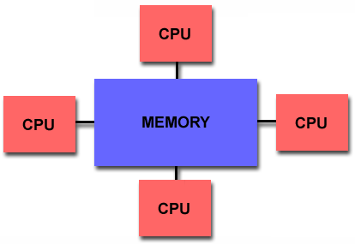
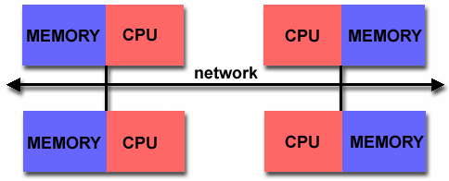
MIMD Multiprocessors
Centralized Shared Memory
Distributed Memory

Slide 8
Centralized-Memory Machines
Also “Symmetric Multiprocessors” (SMP)
“Uniform Memory Access” (UMA)
All memory locations have similar latencies
Data sharing through memory reads/writes
P1 can write data to a physical address A, P2 can then read physical address A to get that data
Problem: Memory Contention
All processor share the one memory
Memory bandwidth becomes bottleneck
Used only for smaller machines
Most often 2,4, or 8 processors

Slide 9
Distributed-Memory Machines
Two kinds
Distributed Shared-Memory (DSM)
All processors can address all memory locations
Data sharing like in SMP
Also called NUMA (non-uniform memory access)
Latencies of different memory locations can differ (local access faster than remote access)
Message-Passing
A processor can directly address only local memory
To communicate with other processors, must explicitly send/receive messages
Also called multicomputers or clusters
Most accesses local, so less memory contention (can scale to well over 1000 processors)

Slide 10
Message-Passing Machines
A cluster of computers
Each with its own processor and memory
An interconnect to pass messages between them
Producer-Consumer Scenario:
P1 produces data D, uses a SEND to send it to P2
The network routes the message to P2
P2 then calls a RECEIVE to get the message
Two types of send primitives
Synchronous: P1 stops until P2 confirms receipt of message
Asynchronous: P1 sends its message and continues
Standard libraries for message passing: Most common is MPI – Message Passing Interface

Slide 11



Message Passing Example
1
10
20
5
6
8
Master
Slave
Slave
11
25
14
25
50

Slide 12
Message Passing: A Program
Calculating the sum of array elements
#define ASIZE 1024
#define NUMPROC 4
double myArray[ASIZE/NUMPROC];
double mySum=0;
for(int i=0;i<ASIZE/NUMPROC;i++)
mySum+=myArray[i];
if(myPID=0){
for(int p=1;p<NUMPROC;p++){
int pSum;
recv(p,pSum);
mySum+=pSum;
}
printf(“Sum: %lf\n”,mySum);
}else
send(0,mySum);
Must manually split the array
“Master” processor adds up partial sums and prints the result
“Slave” processors send their partial results to master

Slide 13
Message Passing Pros and Cons
Pros
Simpler and cheaper hardware
Explicit communication makes programmers aware of costly (communication) operations
Cons
Explicit communication is painful to program
Requires manual optimization
If you want a variable to be local and accessible via LD/ST, you must declare it as such
If other processes need to read or write this variable, you must explicitly code the needed sends and receives to do this

Slide 14
Communication Performance
Metrics for Communication Performance
Communication Bandwidth
Communication Latency
Sender overhead + transfer time + receiver overhead
Communication latency hiding
Characterizing Applications
Communication to Computation Ratio
Work done vs. bytes sent over network
Example: 146 bytes per 1000 instructions

Slide 15
Shared Memory Example
1
10
20
5
6
8
14
11
25
39
50

Slide 16
Shared Memory: A Program
Calculating the sum of array elements
#define ASIZE 1024
#define NUMPROC 4
shared double array[ASIZE];
shared double allSum=0;
shared mutex sumLock;
double mySum=0;
for(int i=myPID*ASIZE/NUMPROC;i<(myPID+1)*ASIZE/NUMPROC;i++)
mySum+=array[i];
lock(sumLock);
allSum+=mySum;
unlock(sumLock);
if(myPID=0)
printf(“Sum: %lf\n”,allSum);
Array is shared
Each processor sums up “its” part of the array
Each processor adds its partial sums to the final result
“Master” processor prints the result

Slide 17
Shared Memory Pros and Cons
Pros
Communication happens automatically
More natural way of programming
Easier to write correct programs and gradually optimize them
No need to manually distribute data (but can help if you do)
Cons
Needs more hardware support
Easy to write correct, but inefficient programs (remote accesses look the same as local ones)

Slide 18
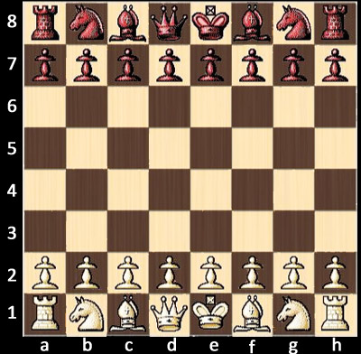
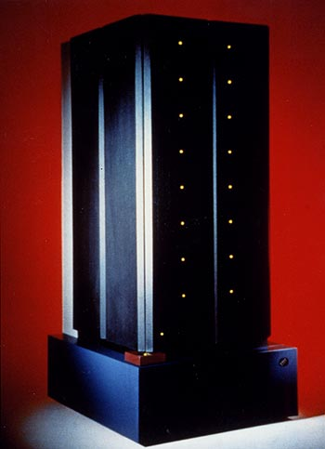

PopQuiz
Deep Blue vs. Kasparov (1997)
Small dataset, lots of parallelism
Shared memory or message passing?

Slide 19
Multi Processors

Slide 20
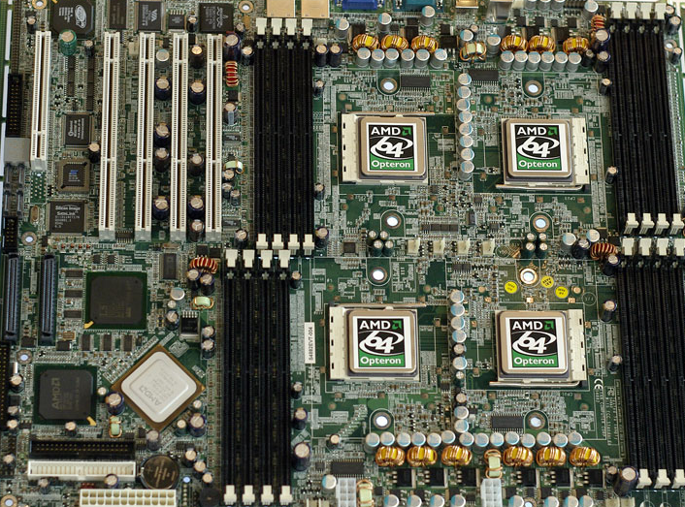
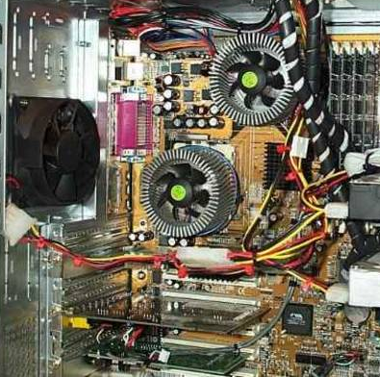
Implementing MP Machines
One approach: add sockets to your MOBO
minimal changes to existing CPUs
power delivery, heat removal and I/O not too bad since each chip has own set of pins and cooling
CPU₀
CPU₁
CPU₂
CPU₃
Pictures found from google images

Slide 21
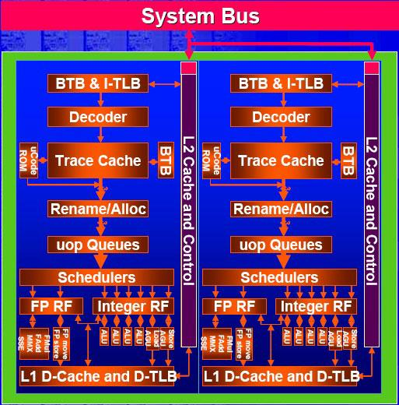
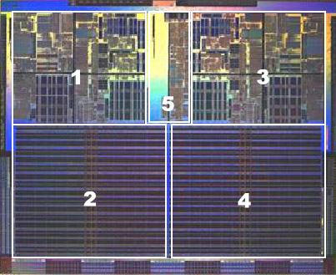
Chip-Multiprocessing
Simple SMP on the same chip
Intel “Smithfield” Block Diagram
AMD Dual-Core Athlon FX
Pictures found from google images

Slide 22
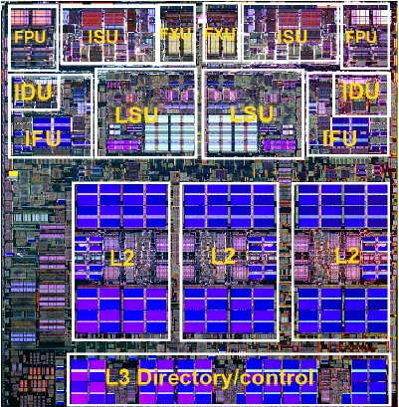
Shared Caches
Resources can be shared between CPUs
ex. IBM Power 5
CPU₀
CPU₁
L2 cache shared between
both CPUs (no need to
keep two copies coherent)
L3 cache is also shared (only tags
are on-chip; data are off-chip)

Slide 23
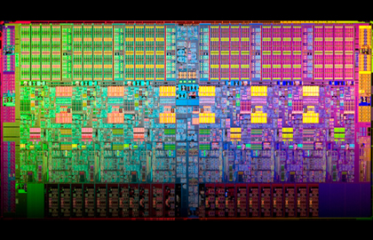
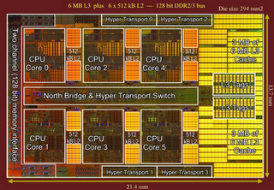
6-core world!

Slide 24
Benefits?
Cheaper than mobo-based SMP
all/most interface logic integrated on to main chip (fewer total chips, single CPU socket, single interface to main memory)
less power than mobo-based SMP as well (communication on-die is more power-efficient than chip-to-chip communication)
Performance
on-chip communication is faster
Efficiency
potentially better use of hardware resources than trying to make wider/more OOO single-threaded CPU

Slide 25
Performance vs. Power
2x CPUs not necessarily equal to 2x performance
2x CPUs → ½ power for each
maybe a little better than ½ if resources can be shared
Back-of-the-Envelope calculation:
3.8 GHz CPU at 100W
Dual-core: 50W per CPU
P ∝ V³: V_{orig}³/V_{CMP}³ = 100W/50W → V_{CMP} = 0.8 V_{orig}
f ∝ V: f_{CMP} = 3.0GHz
Benefit of SMP: Full power
budget per socket!

Slide 26
Performance vs. Power (2)
So what’s better?
One 3.8 GHz CPU?
Or a dual-core running at 3.0 GHz?
Depends on workloads
If you have one program to run, the 3.8GHz CPU will run it in 79% of the time
If you have two programs to run, then:
3.8GHz CPU: 79% for one, or 158% for both
Dual 3.0GHz CPU: 100% for both in parallel

Slide 27
Question
Dual Core: total power 200W frequency: 2GHz
With the same power budget if we have 4 cores, what should be the frequency of each core?
Assume that the power is equally distributed
P ∝ V³:
V_{dual}³/V_{quad}³ = 100W/50W → V_{quad} = 0.8 V_{dual}
f ∝ V: f_{quad} = 1.6GHz

