Slide 1

Multithreading, SMT, and SIMD
Thanks to Prof. Kim, and Prof. Mutlu

Slide 2
Multithreaded Processors
Single thread in superscalar execution: dependences cause most of stalls
Idea: when one thread stalled, other can go
Different granularities of multithreading
Coarse MT: can change thread every few cycles
Fine MT: can change thread every cycle
Simultaneous Multithreading (SMT)
Instrs from different threads even in the same cycle
AKA Hyperthreading

Slide 3
MT Architecture Performance
Why multi-threading can improve performance?
Processor is not utilized
Th 1
C
M
C
M
C
M
C
M
Th 2
C
M
C
M
C
M
C
M
Th 3
C
M
C
M
C
M
C
M
Th 4
C
M
C
M
C
M
C
M
Better utilization !
Th 5
C
M
C
M
C
M
C
M

Slide 4
Simple Performance Analysis
We will study more complex cases later
Q1) Average memory latency = 100 cycles. Average compute cycles per each memory instruction is 20 cycles. How many threads do we need to hide memory latency?
Q2) What if there is 5 cycles hardware context switch overhead, how many threads do we need?
100/20 = 5 more threads (6 total)
100/(20+5) = 4 more threads (5 total)

Slide 5
Simultaneous Multi-Threading
Uni-Processor: 4-6 wide, lucky if you get 1-2 IPC
poor utilization
SMP: 2-4 CPUs, but need independent tasks
else poor utilization as well
SMT: Idea is to use a single large uni-processor as a multi-processor

Slide 6
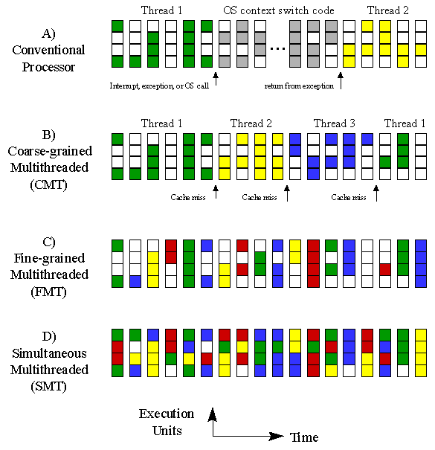
SMT (2)
Regular CPU
SMT (4 threads)
CMP
Approx 1x HW Cost
2x HW Cost

Slide 7
Overview of SMT Hardware Changes
For an N-way (N threads) SMT, we need:
Ability to fetch from N threads
N sets of architectural registers (including PCs)
N rename tables (RATs)
N virtual memory spaces
Front-end: branch predictor?: no, RAS? :yes
But we don’t need to replicate the entire OOO execution engine (schedulers, execution units, bypass networks, ROBs, etc.)

Slide 8
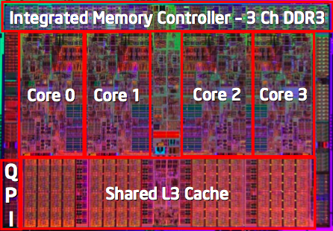
SMT+CMP
Intel’s Nehalemn
Each core is 2-way SMT
http://www.intel.com/technology/product/demos/turboboost/demo.htm?iid=tech_tb+demo

