Slide 1
Pipeline Basics
Moinuddin K Qureshi

Slide 2
How to Design a Fast Processor?
Get Data
Quickly
Perform Execution Quickly
Get Instructions
Quickly

Slide 3
Pipelining
Fundamental for faster processing
Key idea:
Instruction processing involves many steps. Eg. Fetch, Decode..
Don’t wait for processing of next instructions till all steps finish
Need: Latches to store intermediate state
Fetch
Decode
Execute
Memory
Write
back

Slide 4
Latches
Latch: holds value for the next cycle.
We assume edge latch.
The latch value is changed at the end of clock cycle.
1
010101
Combinational logic
Combinational logic
1
latch
Input set up & hold

Slide 5
Basic Five Stage Pipeline
Fetch
Dec
Exec
Mem
WB
Reg
File

Slide 6
Each Stage can take Multiple Cycles
Example: MIPS R4000
integer unit
ex
FP/int Multiply
IF
ID
m1
m2
m3
m4
m5
m6
m7
MEM
WB
FP adder
a1
a2
a3
a4
FP/int divider
Div (lat = 25, Init inv=25)

Slide 7
Pipelining: Dependencies
Two types of Dependencies: Control and Data
Control Dependency: Which instruction to fetch?
Data Dependency:
Read after write (RAW dependency) – TRUE dependency
Write after Read (WAR dependency) – Can be avoided
Write after Write (WAW dependency) – Can be avoided
How about “Read after Read” ??

Slide 8
Data Dependence Types
Flow dependence
r₃ ← r₁ op r₂ Read-after-Write
r₅ ← r₃ op r₄ (RAW)
Anti dependence
r₃ ← r₁ op r₂ Write-after-Read
r₁ ← r₄ op r₅ (WAR)
Output-dependence
r₃ ← r₁ op r₂ Write-after-Write
r₅ ← r₃ op r₄ (WAW)
r₃ ← r₆ op r₇

Slide 9
Interlocking
Detection of dependence between instructions in a pipelined processor to guarantee correct execution
Software based interlocking
vs.
Hardware based interlocking
Quiz: “MIPS” acronym?

Slide 10
Approaches to Dependence Detection
Scoreboarding
Each register in register file has a Valid bit associated with it
An instruction that is writing to the register resets the Valid bit
An instruction in Decode stage checks if all its source and destination registers are Valid
Yes: No need to stall… No dependence
No: Stall the instruction
Advantage:
Simple. 1 bit per register
Disadvantage:
Need to stall for all types of dependences, not only RAW dep

Slide 11
Approaches to Dependence Detection
Combinational dependence check logic
Special logic that checks if any instruction in later stages is supposed to write to any source register of the instruction that is being decoded
Yes: stall the instruction/pipeline
No: no need to stall… no RAW dependence
Advantage:
No need to stall on WAR and WAW dependences
Disadvantage:
Logic is more complex than a scoreboard
Logic becomes more complex as we make the pipeline deeper and wider (superscalar)

Slide 12
No Data Dependencies
Assume a program where all instructions (A-H) are independent
Cycle Num | FETCH | DECODE | EXECUTE | MEMORY | WBACK
1 | A
2 | B | A
3 | C | B | A
4 | D | C | B | A
5 | E | D | C | B | A
6 | F | E | D | C | B
7 | G | F | E | D | C
8 | H | G | F | E | D

Slide 13
Data Dependencies
Fetch
Dec
Exec
Mem
WB
A: ADD R2, R1, R0
B: ADD R3, R2, R0
C: ADD R7, R5, R4
Reg
File
Cycle Num | FETCH | DECODE | EXECUTE | MEMORY | WBACK
1 | A
2 | B | A
3 | C | B (R2?) | A
4 | C | B (R2?) |  | A
5 | C | B (R2?) |  |  | A(R2,end)
6 | C | B (R2)
7 |  | C | B
8 |  |  | C | B
9 |  |  |  | C | B

Slide 14
Forwarding (nominal)
Fetch
Dec
Exec
Mem
WB
A: ADD R2, R1, R0
B: ADD R3, R2, R0
C: ADD R7, R5, R4
MUX
Reg
File
Cycle Num | FETCH | DECODE | EXECUTE | MEMORY | WBACK
1 | A
2 | B | A
3 | C | B (R2?) | A
4 | C | B (R2?) |  | A
5 | C | B (R2) |  |  | A(R2OK)
6 |  |  | B
7 |  |  | C | B
8 |  |  |  | C | B
9 |  |  |  |  | C

Slide 15
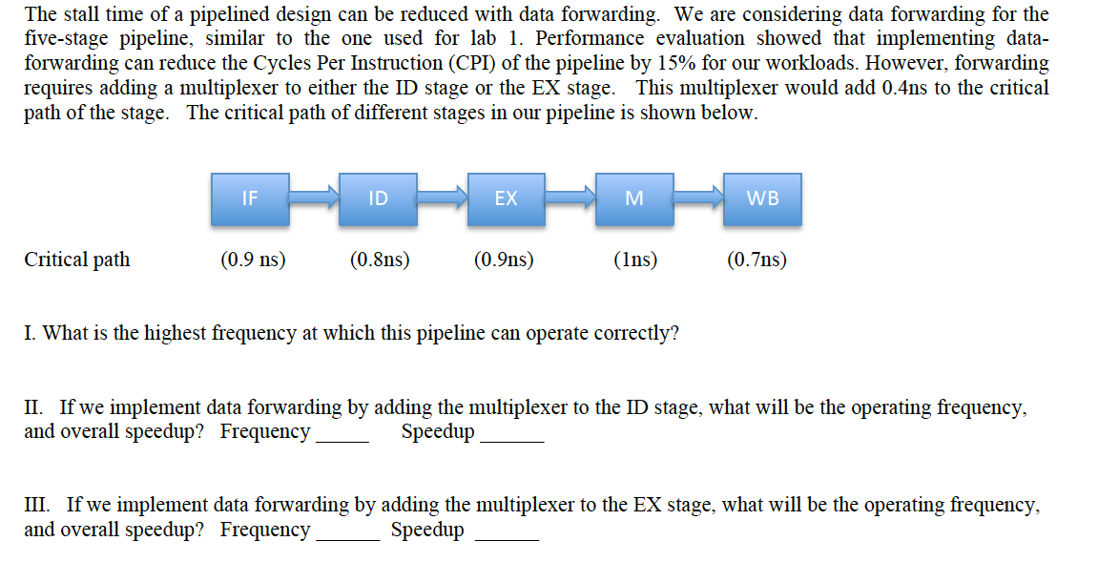
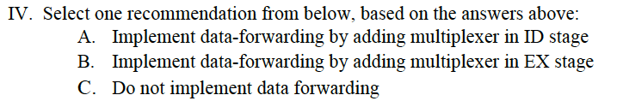
Quiz on Forwarding

Slide 16
Forwarding (all stages)
A: ADD R2, R1, R0
B: ADD R3, R2, R0
C: ADD R7, R5, R4
Fetch
Dec
Exec
Mem
WB
MUX
Reg
File

Slide 17
Forwarding (all stages)
A: ADD R2, R1, R0
B: ADD R3, R2, R0
C: ADD R7, R5, R4
Cycle Num | FETCH | DECODE | EXECUTE | MEMORY | WBACK
1 | A
2 | B | A
3 | C | B (R2) | A(Bypass)
4 |  | C | B | A
5 |  |  | C | B | A
6 |  |  |  | C | B
7 |  |  |  |  | C
8
9

Slide 18
Super-Scalar Pipelines
F1
D1
E1
M1
W1
2 in
2 out?
F2
D2
E2
M2
W2
Assume independent instructions A-N
Cycle Num | FETCH | DECODE | EXECUTE | MEMORY | WBACK
1 | A,B
2 | C,D | A,B
3 | E,F | C,D | A,B
4 | G,H | E,F | C,D | A,B
5 | I,J | G,H | E,F | C,D | A,B
6 | K,L | I,J | G,H | E,F | C,D
7 | M,N | K,L | I,J | G,H | E,F
How about the complexity of Dependency Check and Forwarding?

Slide 19
What about Control Dependency?
Fetch
Dec
Exec
Mem
WB
A: BR nzp, C
B: ADD R3,R3, #5
C: ADD R7, R5, R4
PC
Cycle Num | FETCH | DECODE | EXECUTE | MEMORY | WBACK
1 | A
2 | B (stall) | A
3 | B (stall) |  | A
4 | B (stall) |  |  | A (PC OK)
5 | C |  |  |  | A
6 |  | C
7 |  |  | C
8 |  |  |  | C
9 |  |  |  |  | C

Slide 20
Why is this an important bottleneck?
On average, 20% of the instructions are control flow (branches)
Lets assume a machine with CPI=1
For 20% of instructions, we have to add three cycles of bubbles.
What is the net CPI?
Let there be 100 instructions, so perfect cycles=100
20 instructions @ 3 extra cycles = 60 cycles additional
Total cycles = 100+60 = 160 ➔ Net CPI is now 1.6
Slowdown of 60% !
Modern pipelines are 15-20 deep, so 12-16 bubbles per branch!
What can we do to mitigate this problem?

Slide 21
Architecture Timing Simulation
Timing simulation
Simulate how many cycles to execute programs
In the previous example, how many cycles?
→ Finding out how many cycles? That’s the timing simulator

Slide 22
Trace driven vs. Execution driven
Trace driven: instructions are all executed
Easy to develop a simulator
Could be faster to simulate
Our lab assignment
Execution driven: simulator executes instructions during simulation time.
Development time is longer.
Can simulate wrong-path instructions, multi thread instruction behavior

