Slide 1
ECE4100/ECE6100/CS4290/CS6290
Thanks to Prof. Kim

Slide 2
Some Definitions
Work: Refers to movement (of objects/electrons)
In our case work refers to computation required to solve a given problem
Energy: Capacity to do work (unit: Joules)
Power: Work per unit time (unit: Joules per sec = Watts)
Power Density: power per unit area (Watts/cm^2)

Slide 3
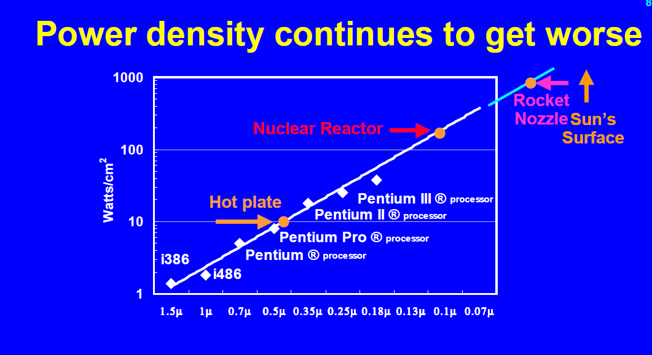
Why Power?
Fred Pollack, Intel, Micro-32 Keynote

Slide 4
Importance of Temperature Control
How to fry an egg on graphics processor (don’t try it):
http://www.youtube.com/watch?v=zrg8nJ0bsUk
No heat sink (for old processors, before kill switch was implemented):
http://www.youtube.com/watch?v=Xf0VuRG7MN4&feature=related

Slide 5
Power Dissipation in CMOS
V dd
V dd
V_{in}
V _{out}
0
Vcc
C_{L}
I _{leakage}
Static
Dynamic

Slide 6
Power Basics
Power vs. Energy
Dynamic power vs. Static power
Dynamic: “switching” power
Static: “leakage” power
Dynamic power dominates, but static power is increasingly important

Slide 7
Why do we care?
1) Increase the CPU cost
Thermal cost: keeping the devices below a given threshold
2) the cost of power delivery

Slide 8
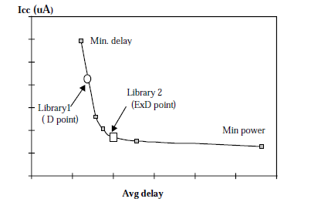
Power Reduction Techniques
Voltage scaling
Clock gating
Utilize circuit design techniques
Low power logic synthesis
Non-critical path→ low power circuit (slow but so what? )
Specific circuit technology
Reduce AF (domino circuit)
Low power
Slower
Dynamic Thermal Management for High-Performance Microprocessors,
Brooks and Martonosi (01)

Slide 9
DVS (Dynamic Voltage Scaling)
O/S controls the processor speed: find the minimum voltage required for the desired speed.
DVFS (Dynamic Voltage Frequency Scaling): Intel's CPU throttling technology, SpeedStep

Slide 10
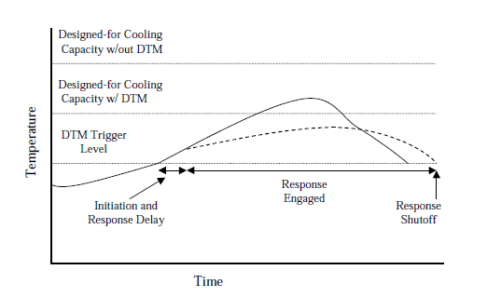
DTM (Dynamic Thermal Management)
DTM: software and hardware techniques at run-time to control a chip’s operating temperature
Thermal package is designed for normal operating conditions rather than worst case
Key goals:
To provide inexpensive hardware/software responses
Reduce power
Reduce impacts on performance as little as possible
Dynamic Thermal Management for High-Performance Microprocessors,
Brooks and Martonosi (01)

Slide 11
DTM
Trigger mechanisms
Temperature sensors, on-chip activity counters
DTM Response mechanisms
Clock frequency scaling
Voltage and frequency scaling
Decode throttling (PowerPC G3)
Speculation control
I-cache toggling (disabling instruction cache)
Migration computation
Dynamic Thermal Management for High-Performance Microprocessors,
Brooks and Martonosi (01), Temperature-Aware Microarchitecture:
Modeling and Implementation, skadron et al. ‘04

Slide 12
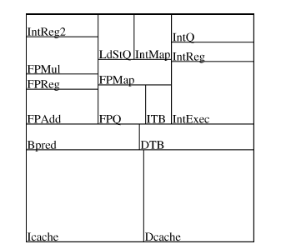
DTM: Migration Computation
Spare unit is located in cold area of chip
Primary unit reaches 81.6C, issue is stalled, instructions ready to write back is allowed.
All instructions use second register file.
When the primary register file reaches 81.5C the process is reversed
Temperature-Aware Microarchitecture: Modeling and Implementation, skadron et al. ‘04

Slide 13
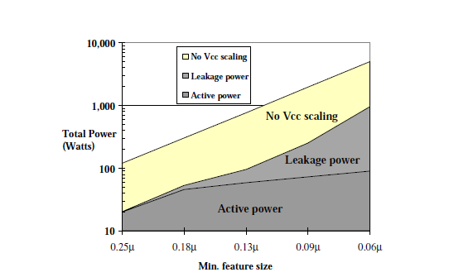
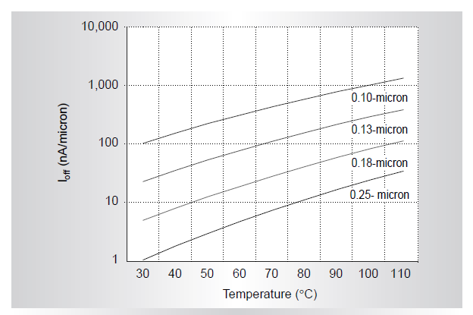
Leakage Power Trend
Technology scales, leakage power consumption is increased
Leakage power/current increases as temperature increases
DESIGN CHALLENGES OF TECHNOLOGY SCALING, Borkar’99

Slide 14
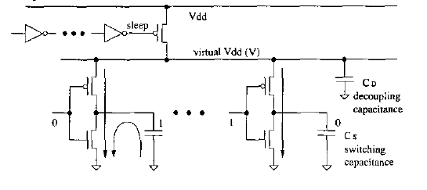
Power Gating
Power blocker
Virtual Vdd(V)
Sleep signal to turn off the supply voltage
Save both dynamic power and leakage power
Microarchitectural Techniques for Power Gating
of Execution Units, Hu et al.

Slide 15
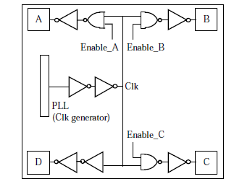
Clock Gating
Adds additional logic to a circuit to prune the clock tree
Reduce dynamic power consumption
Power up delay (timing problem)
Variations in current

Slide 16
Benefits of Power/Clock Gating
Clock Gating → reduce dynamic power consumption but not the static power consumption
Power gating → eliminate both dynamic and static power consumption

Slide 17
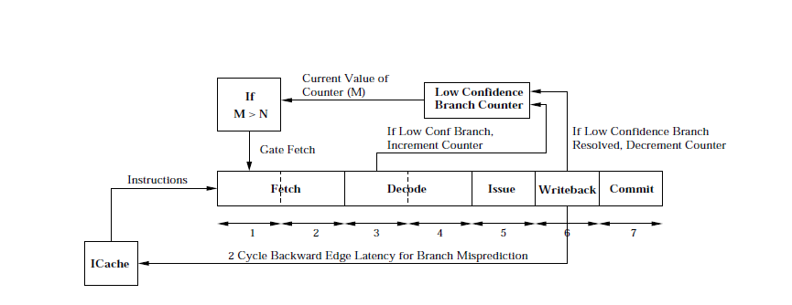
Pipeline Gating (Manne et al. ‘98)
Determine when a branch is more likely mispredicted and gate a pipeline
Use confidence estimator
Other metrics (number of instructions)

Slide 18
Metrics: What do they mean?
Power
Energy
EDP (Energy Delay Product)
EDDP (Energy Delay^2 Product) : more emphasis on performance
EPI (Energy per instructions)
Performance per Watt (Similar to EPI?)

Slide 19
Architecture Power Simulators
SimpleScalar ( Performance simulator)
Wattch : Dynamic Power Simulator
HotLeakage: Leakage current simulator
HotPower: thermal spot
McPat: Static & Dynamic Power

Slide 20
Essence of Power Model
Lets say we have three components: A, B, C.
We denote power with idle and power with 100% activity as X➔ Y
B
10W➔30W
A
10W➔20W
C
2W➔10W
%A | %B | %C | SUM W
0 | 0 | 0 | 10+10+2=22W
100 | 100 | 100 | 20+30+10=60W
50 | 50 | 50 | 15+20+6=41W
60 | 20 | 50 | 16+14+6=36W
Notes:
The next term, MaxPower is the allowable maximum power consumption per architectural unit.
In order to obtain these series of maxpower terms, we devise (-) special microbenchmarks that will maximize the accesses to specific architectural units.
These microbenchmarks are executed on the real machine and the power measurements are recorded.
Then, this equation is set up to solve the series of maxpower terms.
The left side that shows the series of recorded power values.
The middle term specifies the accessrates of the microbenchmarks.
Since we devise the benchmarks, we know the exact accessrates.
Then the right side shows the series of maxpower terms.
Since we know these two terms, we solve for the set of maxpower values that will close solve the equation.
Please note that maxpower values depend on the measured microbenchmark power, and they do not necessarily represent the physically possible power consumption.

