Slide 1

ECE 4100/ECE6100 CS4290/6290 Advanced Computer Architecture TA, Office hours & recitation
Moinuddin K. Qureshi
ECE, Georgia Tech

Slide 2
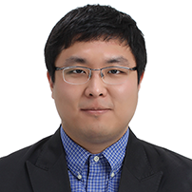
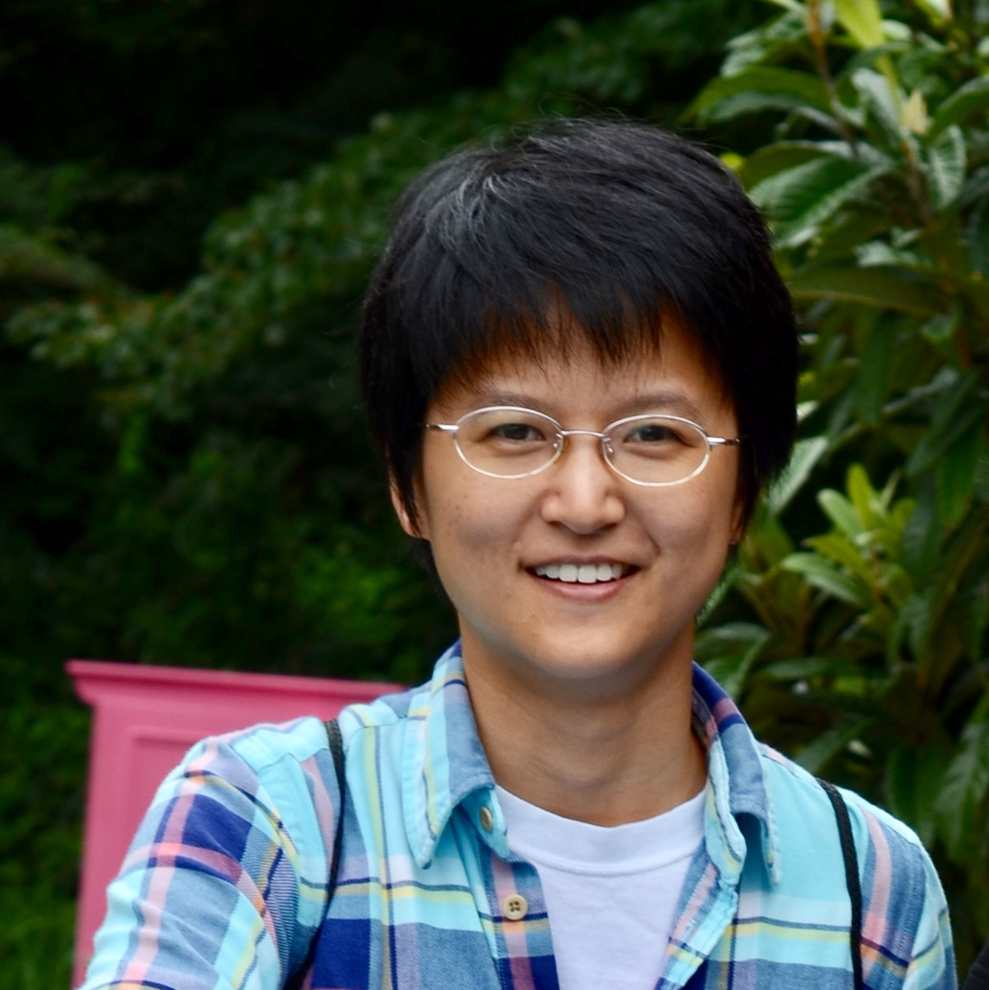
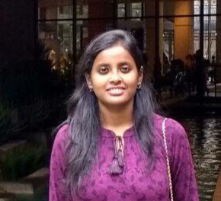

The TAs (approach TA from any section)
Section A/Q
Section B
Hyouk Jun Kwon
hyoukjun@gatech.edu
Yiming Kong
ymkong@gatech.edu
Poulami Das
poulami@gatech.edu
Danial Zuberi
dzuberi3@gatech.edu
Time: Mon 11:30-12:30
(Next to KACB 2324)
Time: Thu 12-1pm
(Next to KACB 2324)
Time: Tue 2-3pm
(Next to KACB 2324)
Time: Fri 12:30-1:30
(Next to KACB 2324)
Recitation: Mon 5-6pm
Recitation: Thu 11-12
Recitation: Tue 11-12
Recitation: Wed 5-6
* (Venue information for the optional recitation section will be provided in a few days)

Slide 3
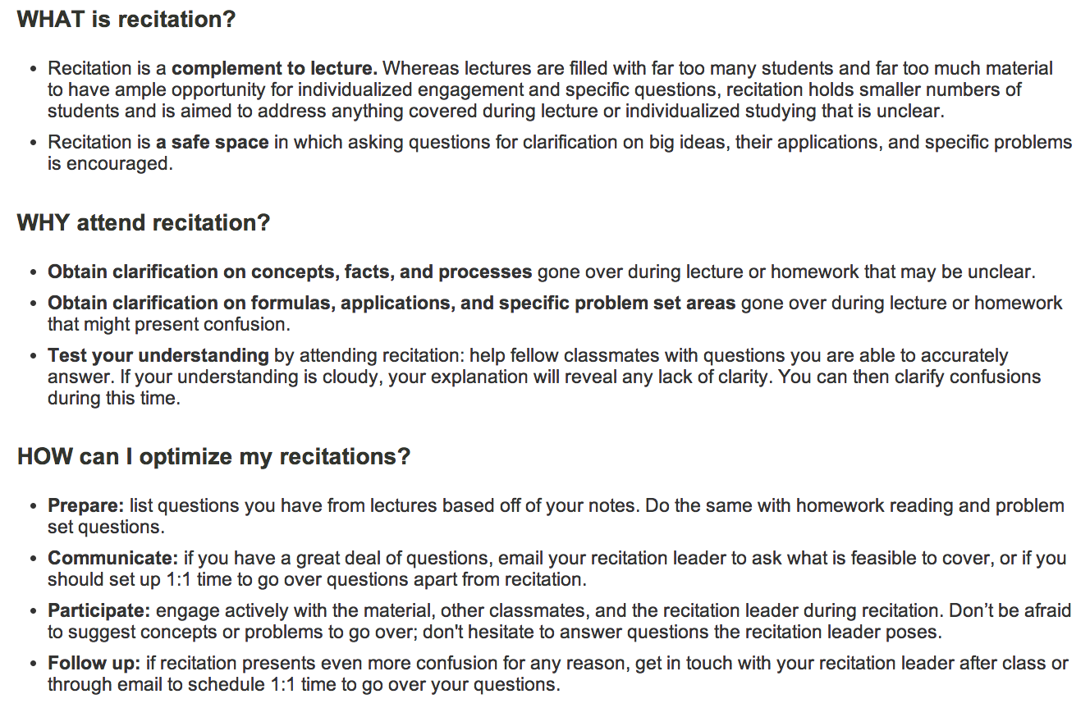
What is a Recitation Section Anyway?
Source:http://web.mit.edu/uaap/learning/lectures/recitations.html

