Slide 1
Vector and SIMD
Slides derived from Prof. Onur Mutlu (CMU)

Slide 2
SIMD Processing
Single instruction operates on multiple data elements
In time or in space
Multiple processing elements

Slide 3
Vector Processors
A vector is a one-dimensional array of numbers
Many scientific/commercial programs use vectors
for (i = 0; i<=49; i++)
C[i] = (A[i] + B[i]) / 2
A vector processor is one whose instructions operate on vectors rather than scalar (single data) values
Basic requirements
Need to load/store vectors → vector registers (contain vectors)
Need to operate on vectors of different lengths → vector length register (VLEN)
Elements of a vector might be stored apart from each other in memory → vector stride register (VSTR)
Stride: distance between two elements of a vector

Slide 4
Vector Processors (II)
A vector instruction performs an operation on each element in consecutive cycles
Vector functional units are pipelined
Each pipeline stage operates on a different data element
Vector instructions allow deeper pipelines
No intra-vector dependencies → no hardware interlocking within a vector
No control flow within a vector
Known stride allows prefetching of vectors into cache/memory

Slide 5
Vector Processor Advantages
+ No dependencies within a vector
Pipelining, parallelization work well
Can have very deep pipelines, no dependencies!
+ Each instruction generates a lot of work
Reduces instruction fetch bandwidth
+ Highly regular memory access pattern
Interleaving multiple banks for higher memory bandwidth
Prefetching
+ No need to explicitly code loops
Fewer branches in the instruction sequence

Slide 6
Vector Registers
Each vector data register holds N M-bit values
Vector control registers: VLEN, VSTR, VMASK
Vector Mask Register (VMASK)
Indicates which elements of vector to operate on
Set by vector test instructions
e.g., VMASK[i] = (V_{k}[i] == 0)
Maximum VLEN can be N
Maximum number of elements stored in a vector register
M-bit wide
M-bit wide
V0,0
V1,0
V0,1
V1,1
V0,N-1
V1,N-1

Slide 7
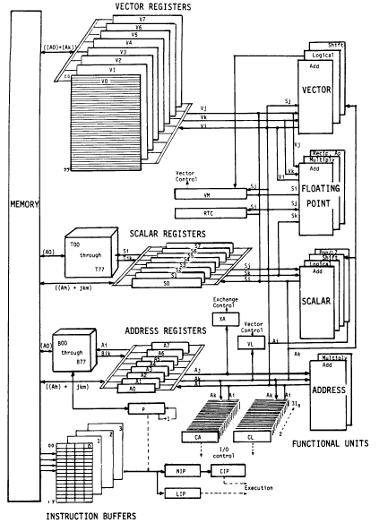
Vector Machine Organization (CRAY-1)
CRAY-1
Russell, “The CRAY-1 computer system,” CACM 1978.
Scalar and vector modes
8 64-element vector registers
64 bits per element
16 memory banks
8 64-bit scalar registers
8 24-bit address registers

Slide 8
SIMD Operations in Modern ISAs

Slide 9
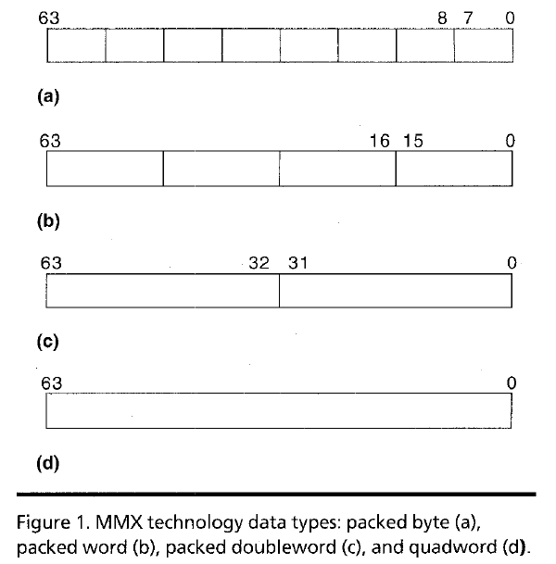
Intel Pentium MMX Operations
Idea: One instruction operates on multiple data elements simultaneously
Designed with multimedia (graphics) operations in mind
No VLEN register
Opcode determines data type:
8 8-bit bytes
4 16-bit words
2 32-bit doublewords
1 64-bit quadword
Stride always equal to 1.
Peleg and Weiser, “MMX Technology
Extension to the Intel Architecture,”
IEEE Micro, 1996.

Slide 10
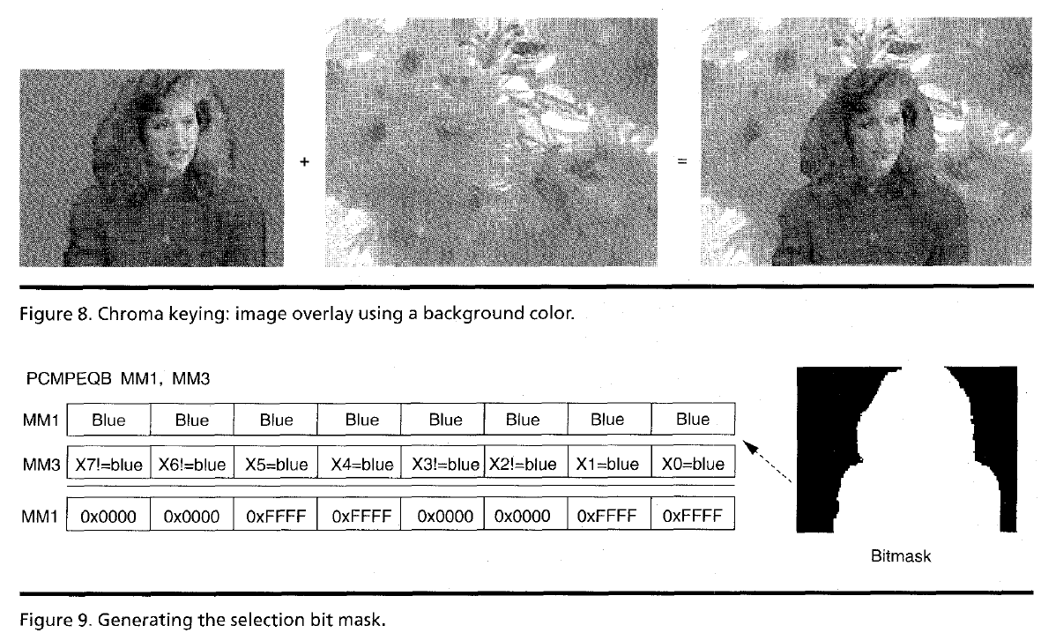
MMX Example: Image Overlaying (I)

